Slide 1


1. architecture
portfolio
documentation.pdf

Slide 2
1.1 index
archi
patterns
book
patterns old
clean
principles
clean silverlight
pulse os
clean code
code
complex
quality
definition
posa
errors
rest
errors js
results
tests
modeling
objectives
paradigms

Slide 3
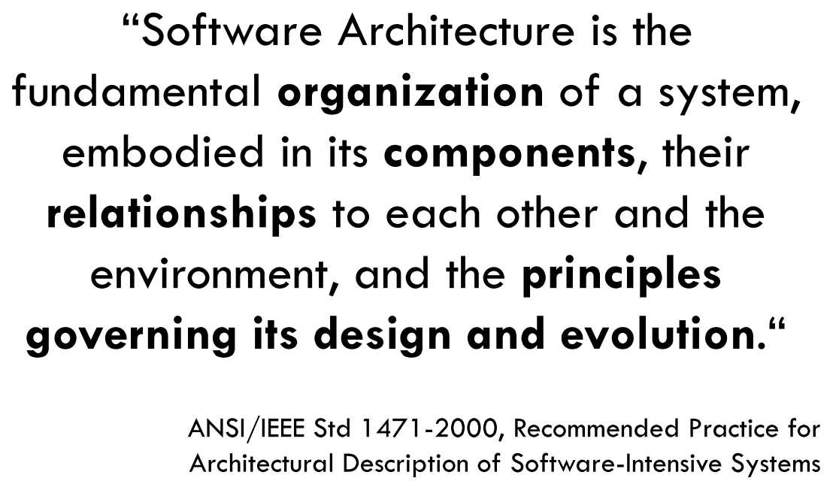
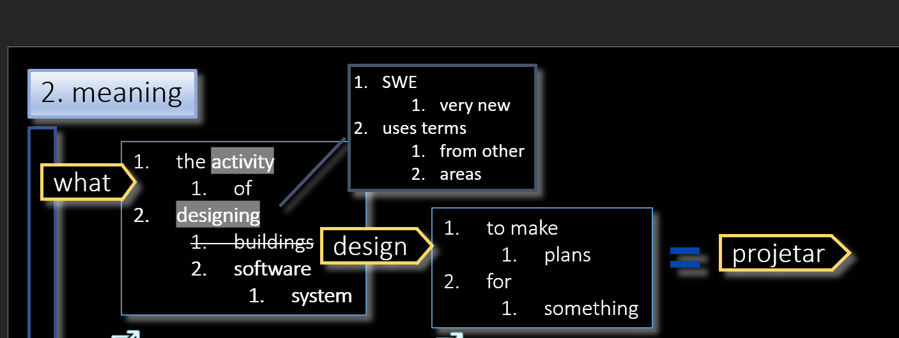
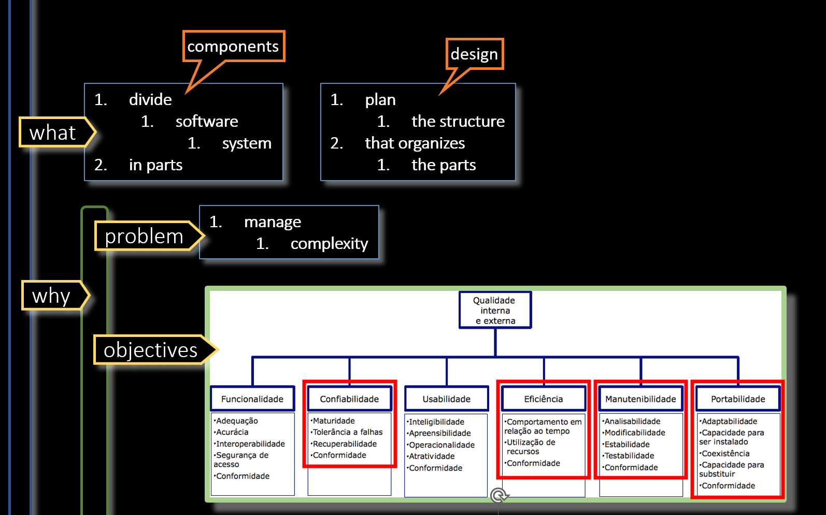
2. rational
what
definition
objectives
quality
how
modeling
using
principles

Slide 4
2.1 principles
what
the base
for this principles
are defined by
paradigms
procedural paradigm
the main one
is
modularity
the basic
approach
to modularity
is provided
by
modules
other paradigms
have other solutions
principles
scopes

Slide 5
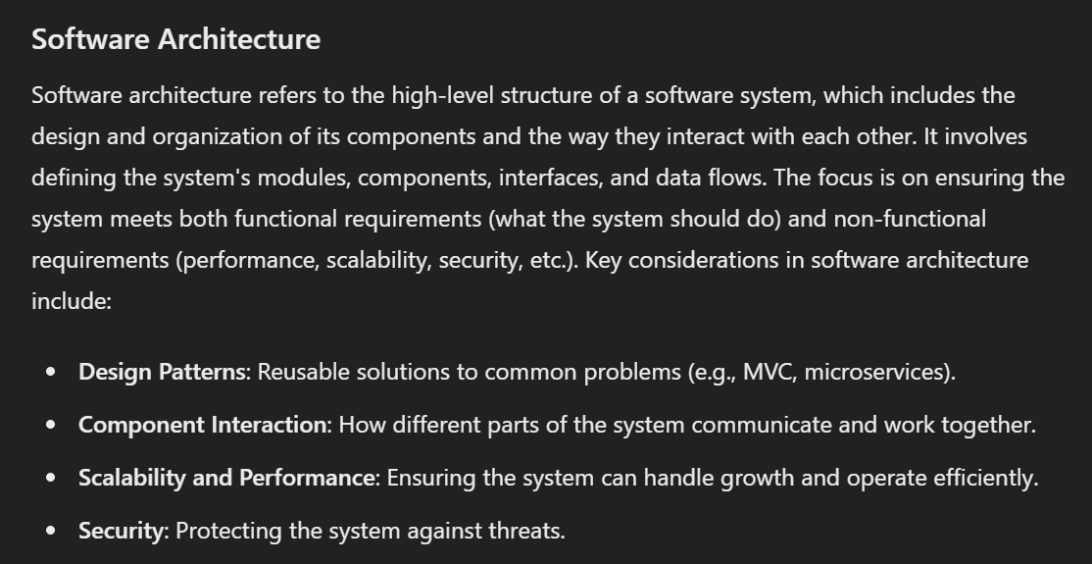
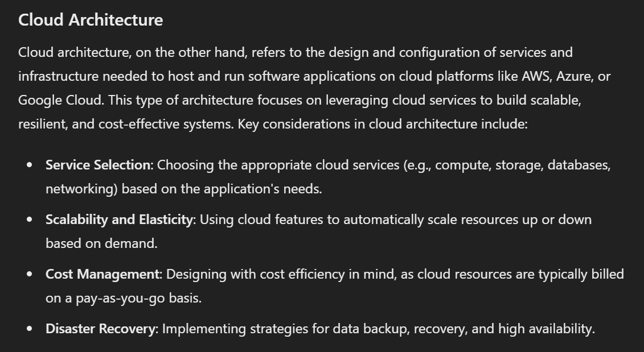
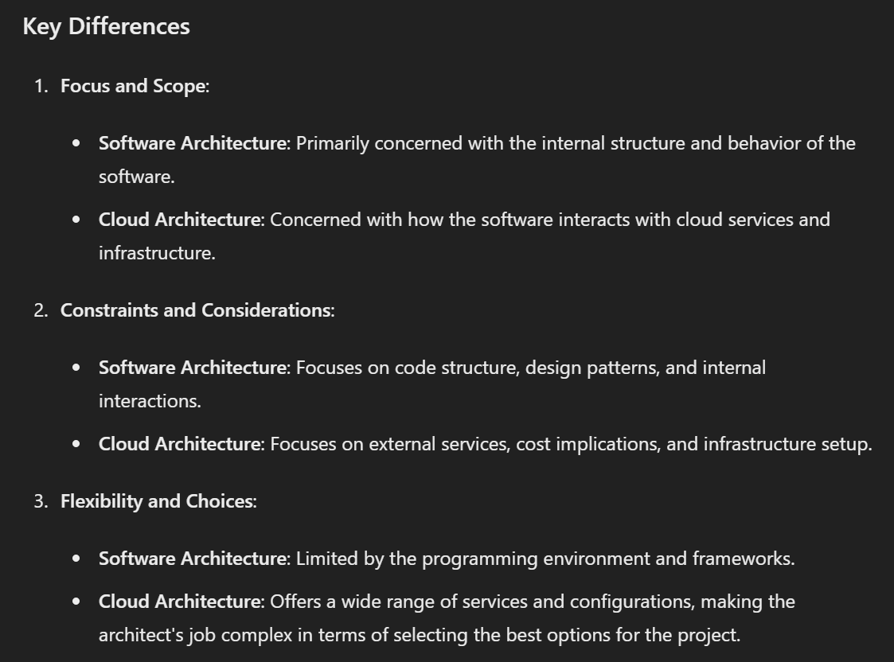

3. types
what
software-architect-vs-cloud-architect/
Solutions Architect vs Software Architect

Slide 6

3.1 software
categories
software systems
includes
rules
and
guidelines
for
organizing
the relationships
between them.
architectural
expresses a fundamental structural organization schema
for
software systems
provides
a set of
predefined subsystems
specifies
their
responsibilities
subsystems
design
provides a scheme for
refining the subsystems
or
components
of
a software system
refining
the relationships
between
them
describes
a commonly recurring structure
of
communicating components
that solves
a general design problem
within
a particular context
low-level
language specific
sources
idioms
is a low-level pattern
specific to a programming language
describes how to implement
particular aspects
of
components
or the relationships
between them
using
the features
of
the given language
patterns/posa/categories

Slide 7
4. taxonomy
architecture
cloud
Service Models
IaaS, PaaS, SaaS
Deployment Models
Public, Private, Hybrid, Multi-Cloud
Design Patterns
Microservices, Serverless, Event-Driven
software
paradigm
Object-Oriented Programming (OOP), Procedural Programming, Functional Programming, Logic Programming
categories
architectural patterns
Client-Server, Layered (n-tier), Microservices, Event-Driven, Service-Oriented Architecture (SOA), Pipe-and-Filter
design patterns
Creational Patterns (Singleton, Factory), Structural Patterns (Adapter, Composite), Behavioral Patterns (Observer, Strategy)
idioms
Language-specific practices (Pythonic, Ruby idioms), Best practices and coding conventions

Slide 8
4.1 design
architecture
design
Scope:
High-level structure of the system.
Focus:
Overall system organization,
components, their interactions,
and overarching principles.
Concerned with:
How different parts of the system fit together.
Non-functional requirements
(scalability, performance, security).
Major technological and structural decisions.
Examples:
architectural styles (Microservices, Layered),
architectural patterns (CQRS, Event Sourcing).
Scope:
Detailed structure within individual components or modules.
Focus:
Detailed implementation
and structure
of software components.
Concerned with:
Specific algorithms, data structures.
Class and object design.
Code-level practices and patterns.
Examples:
design principles (SOLID, DRY),
design patterns (Repository, Adapter, Singleton).

Slide 9
4.1.1 sources
"Clean Architecture: A Craftsman's Guide to Software Structure and Design"
by Robert C. Martin
Architecture represents the significant decisions that shape the system,
whereas
design is more about the individual components
and the details of how
those components are constructed
IEEE Standard 1471-2000 - Recommended Practice for Architectural Description of Software-Intensive Systems
Architectural descriptions focus on the high-level structure of the system,
whereas
detailed design focuses on
the implementation of the components
within the architectural structure
The Open Group Architecture Framework (TOGAF)

Slide 10
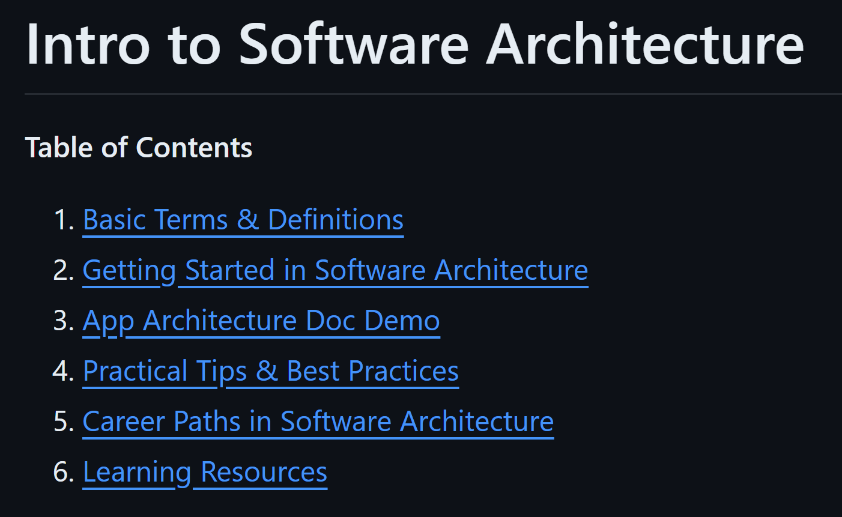
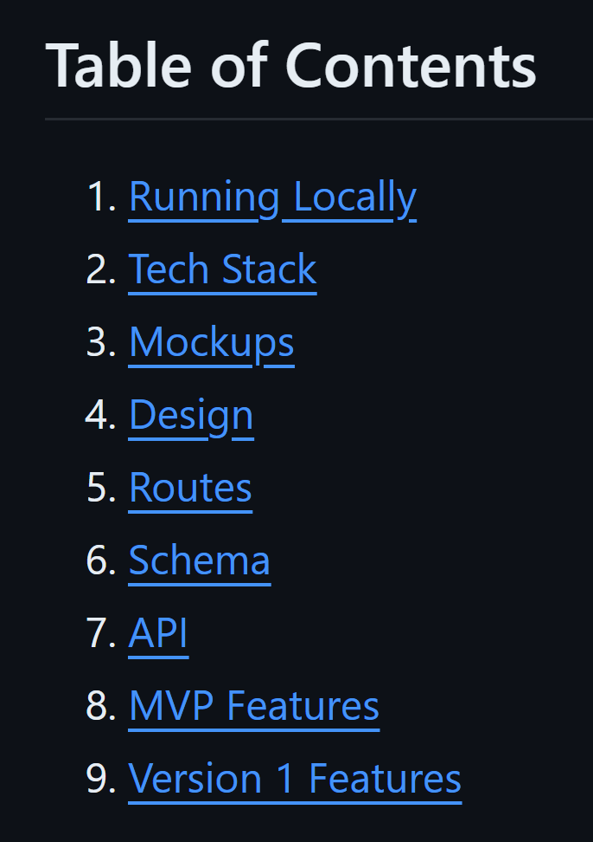
5. introduction
video: intro to software architecture
site: theory
example app

Slide 11
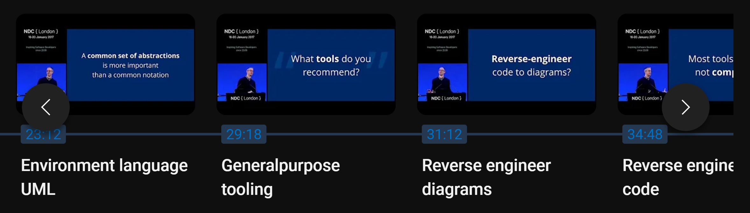
6. C4
video: explain the problems
need
detail
analysis
software architecture languages
Just_Enough_Software_Architecture__Fairbanks_2010-demo.pdf

Slide 12
7. wip
clean architecture
models
software-architecture-review
template for SAD
how-to-design-software-architecture
archi/wip
business logic
ddd-discussion-business-logic-validation
ddd-business-rules/
where-to-place-the-business-logic-in-ddd
***** Crafting Maintainable Python Applications with Domain-Driven Design and Clean Architecture
/against-railway-oriented-programming/
brilliant.org/levels/computer-science/

Slide 13
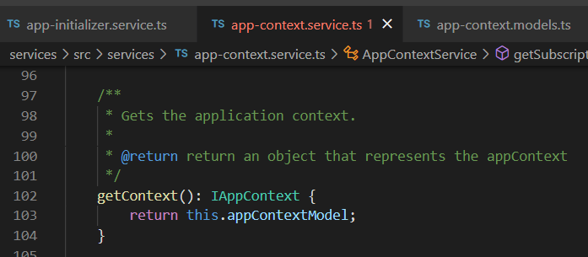


Z. template
new project
ExecuteAsync
square post-it
download
exe
download
exe
why
A slash
followed
by
two consecutive asterisks
D:\A1_research\C2_c0dice\B1_jmeter\A1_install
functionalities
introduction
build-exe
entity framework plus
zig help
⊂
4
every key-frame
defines the operation
success

