Slide 1

1. assistant
authentication

Slide 2
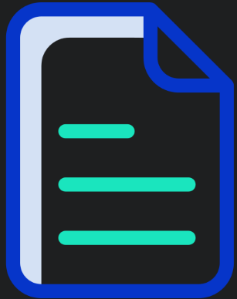
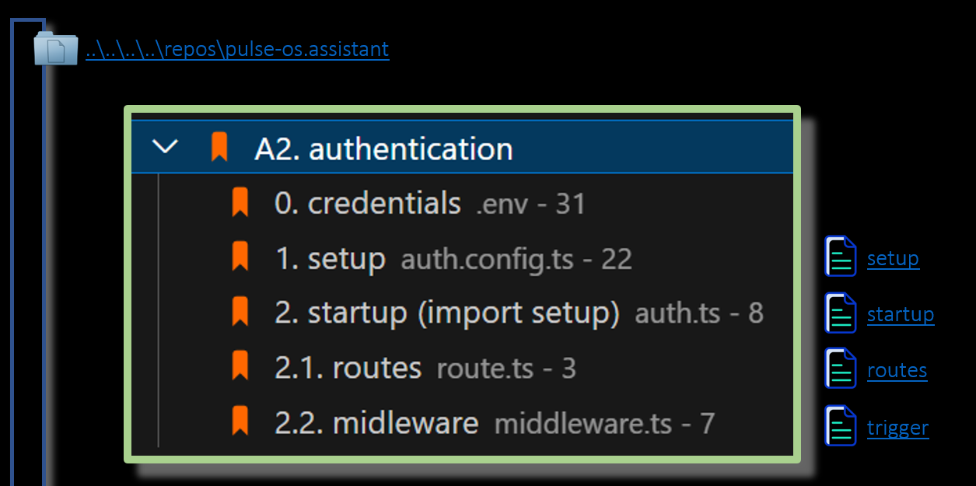
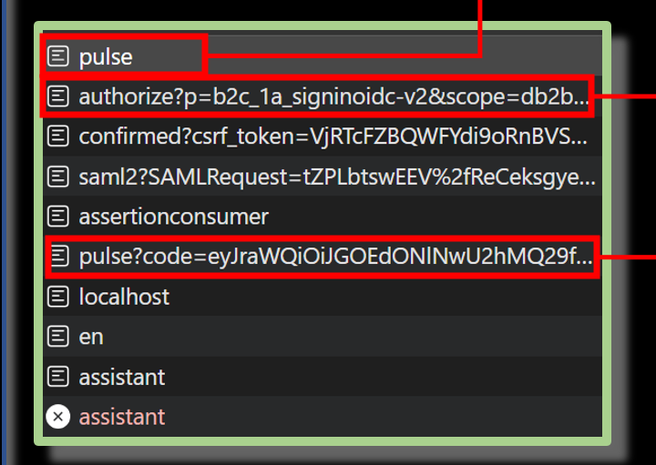
1.1 index
problem
code
endpoints
not conclusive
decided to use exchange token
experiment: try to get access token directly without exchange token
onboarding: pulse.assistant APP -> DEV/STG

Slide 3

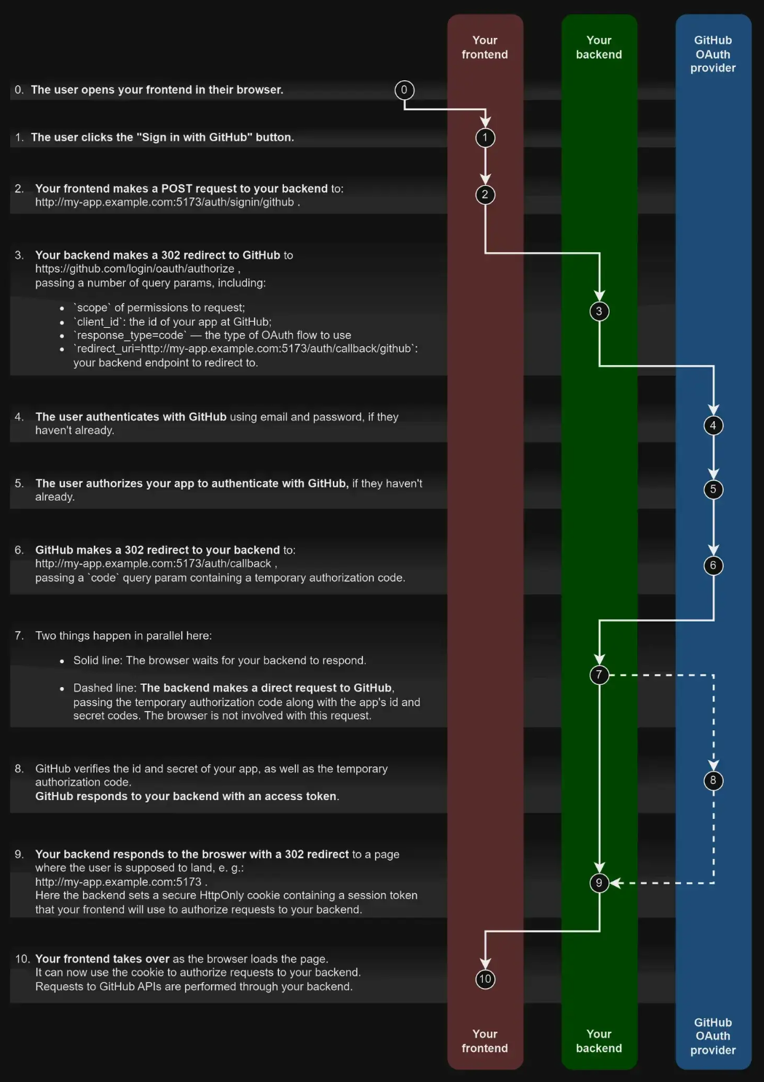
1.2 sources
authjs.dev/getting-started
authjs.dev/concepts/oauth
authjs.dev/getting-started/authentication/oauth
authjs.dev/guides/configuring-oauth-providers

Slide 4

2. problem
1
what
in assistant I need:
the access token
the refresh token
why
to connect to backend
to use in cegid business
approach
run assistant
debug
next-js/debug
understand auth code
code
understand library
try to get access token directly
not conclusive
decided to use exchange token
add exchange token
add refresh token

Slide 5
3. process
NPN
Install version 20
Setup JFROG token
Run script
ENV
Setup env for DEV
JFROG
Update env
Login in NPM in browser

Slide 6
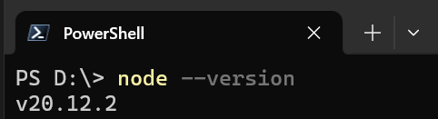
3.1 NPM
1
install version 20
we need
this version
to run the script
that setup NPM
process

Slide 7
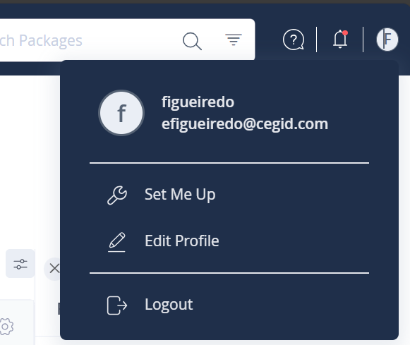
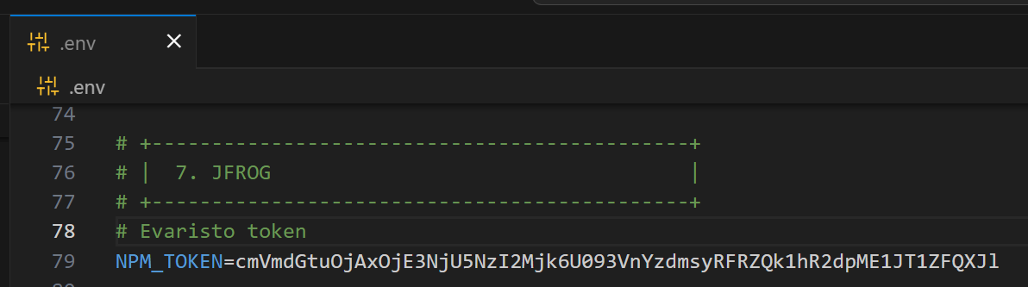
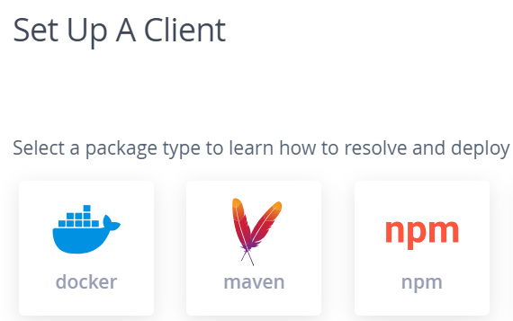
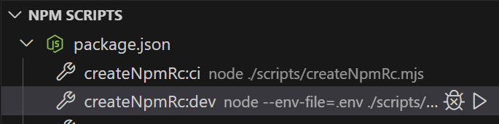
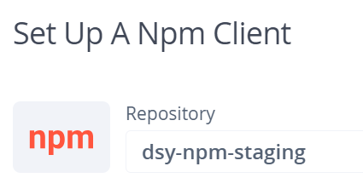
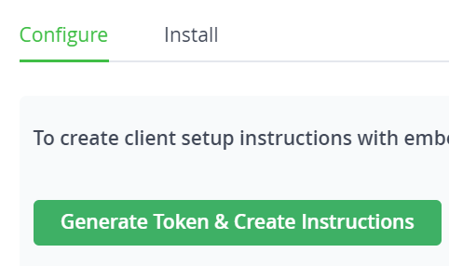
3.2 JFROG
2
setup libraries access
go to the site
JFROG
2.1
2.5
copy the token
to
the .env file
2.2
2.6
run this script
login to NPM
in browser
2.3
2.7
npm login --registry=https://cegid.jfrog.io/artifactory/api/npm/dsy-npm-staging/ --auth-type=web
2.4
cmVmdGtuOjAxOjE3NjU5NzI2Mjk6U093VnYzdmsyRFRZQk1hR2dpME1JT1ZFQXJl
process

Slide 8
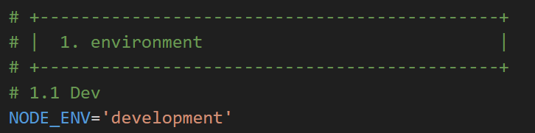
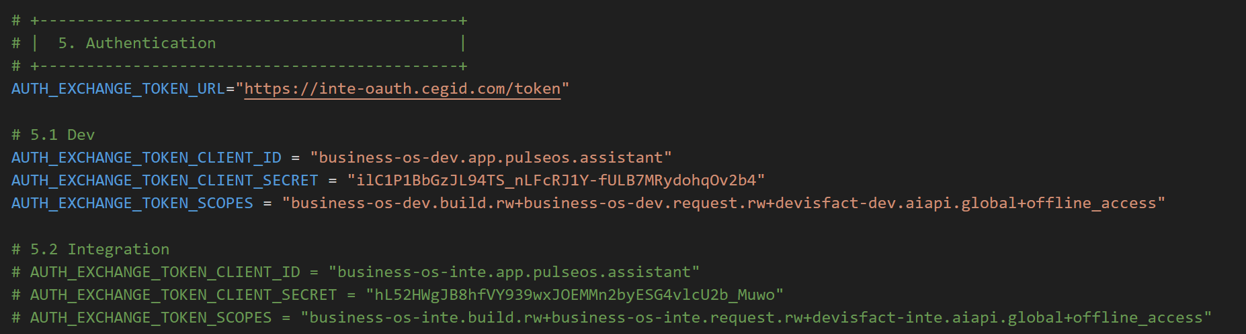
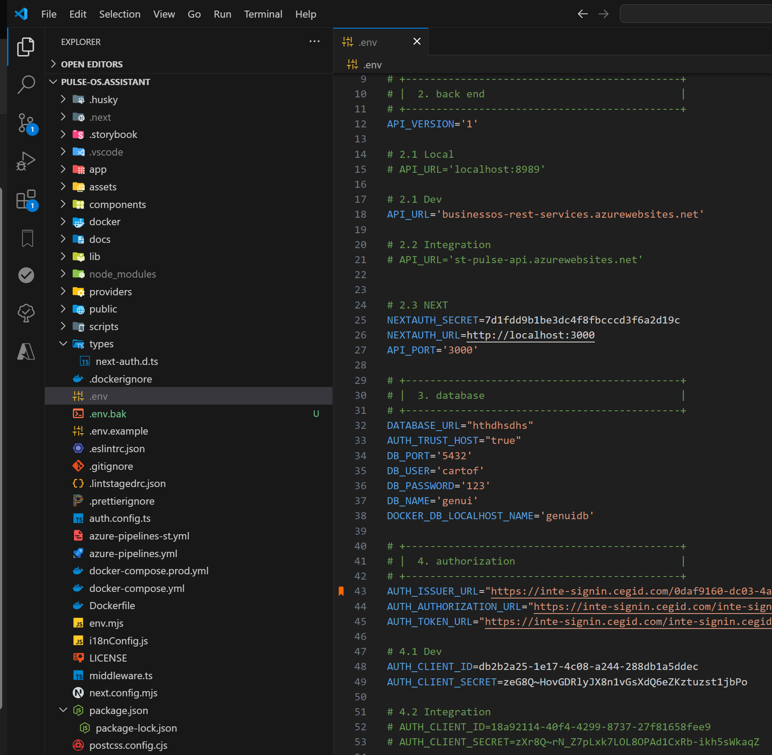
3.1 ENV
3
setup app for dev
process

Slide 9
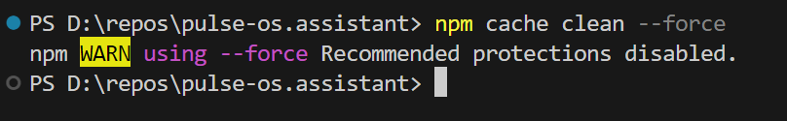
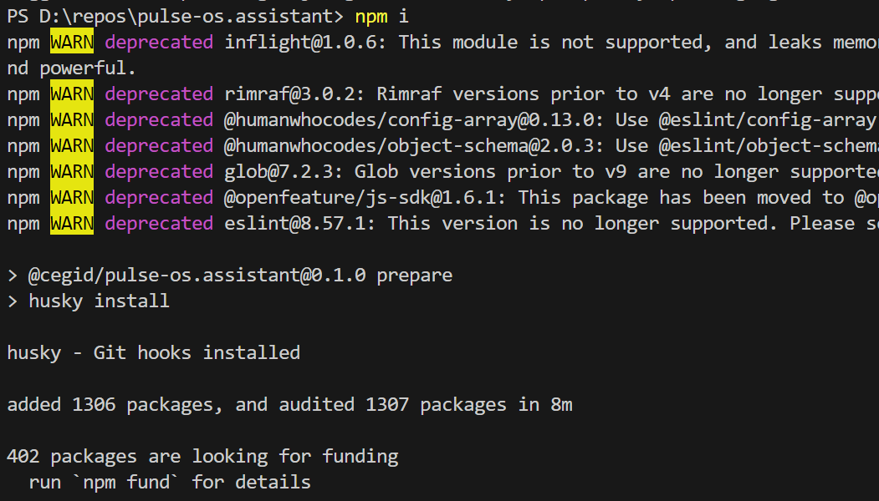
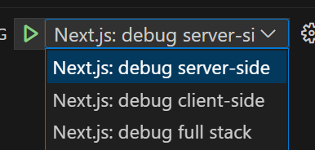
3.2 RUN
4
cache
npm cache clean --force
4.1
npm i
4.2
run in debug
not working

Slide 10
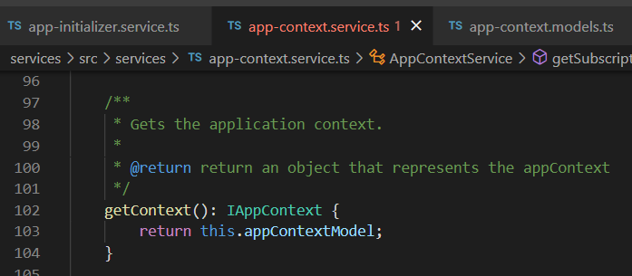



Z. template
new project
ExecuteAsync
square post-it
download
exe
download
exe
why
A slash
followed
by
two consecutive asterisks
D:\A1_research\C2_c0dice\B1_jmeter\A1_install
functionalities
introduction
build-exe
entity framework plus
zig help
⊂
⊂
4
every key-frame
defines the operation
deploy

