Slide 1

1. endpoints
authentication
assistant

Slide 2
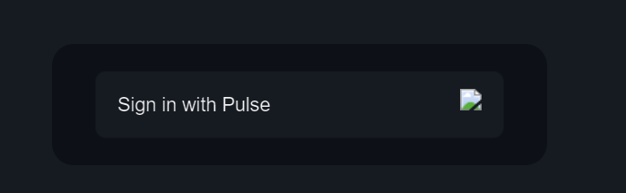
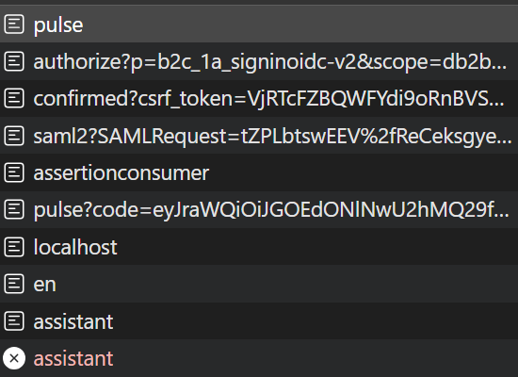
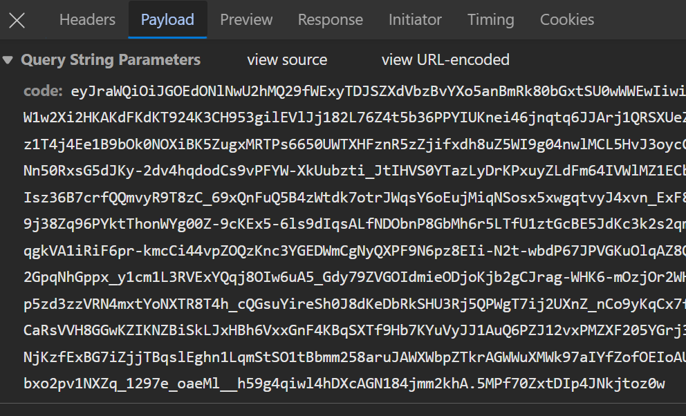
2. cegid
http://localhost:3000/api/auth/signin?callbackUrl=http%3A%2F%2Flocalhost%3A3000
https://inte-signin.cegid.com/inte-signin.cegid.com/oauth2/v2.0/authorize
p: b2c_1a_signinoidc-v2
scope: db2b2a25-1e17-4c08-a244-288db1a5ddec openid email profile
response_type: code
client_id: db2b2a25-1e17-4c08-a244-288db1a5ddec
redirect_uri: http://localhost:3000/api/auth/callback/pulse
code_challenge: 3aYlfIwR_Kiazpl_5IsQ3up6tkzW_prJsKmv3_9zdKw
code_challenge_method:S256
http://localhost:3000/api/auth/callback/pulse

Slide 3
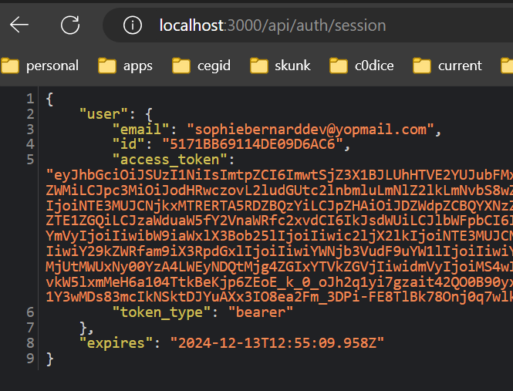
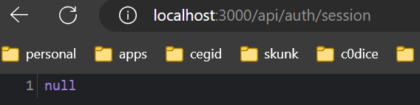
2.1 session
http://localhost:3000/api/auth/session
after clear site data

Slide 4
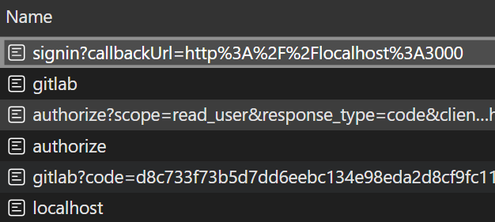
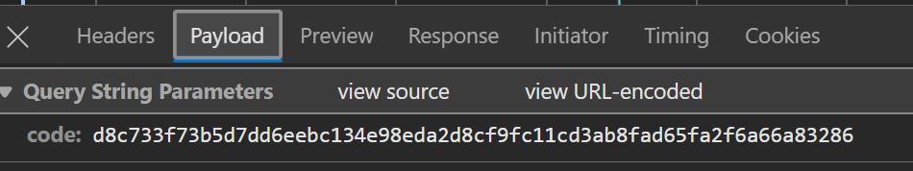
3. gitlab
http://localhost:3000/api/auth/signin?callbackUrl=http%3A%2F%2Flocalhost%3A3000
https://gitlab.com/oauth/authorize
scope: read_user
response_type: code
client_id: 6e2b489b135165b1e02a789efd048dbbaaf4d5a1a23296b49923dbb1ac690589
redirect_uri: http://localhost:3000/api/auth/callback/gitlab
code_challenge: 4DNzEr3f3ZpRsLzAAF5DnhlsCFBfwOOYGdcETAQ6Y78
code_challenge_method: S256
http://localhost:3000/api/auth/callback/gitlab

Slide 5
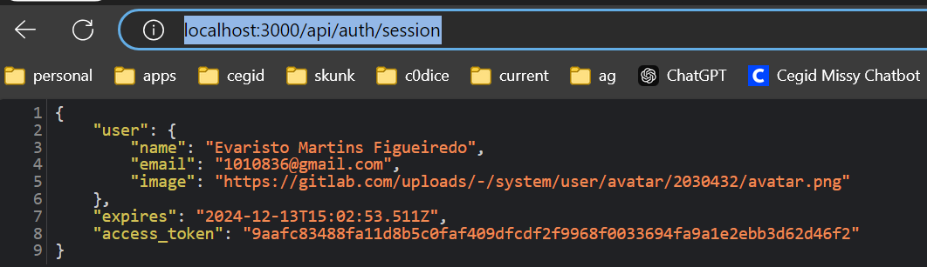
3.1 session
http://localhost:3000/api/auth/session
after clear site data

Slide 6
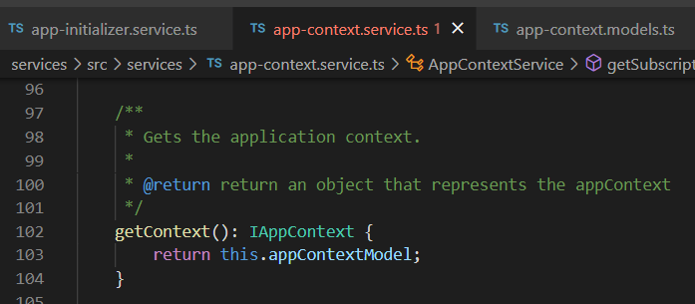






Z. template
new project
ExecuteAsync
square post-it
download
exe
download
exe
why
A slash
followed
by
two consecutive asterisks
D:\A1_research\C2_c0dice\B1_jmeter\A1_install
functionalities
introduction
build-exe
entity framework plus
zig help
⊂
⊂
4
every key-frame
defines the operation
deploy

