Slide 1

1. onboarding
authentication
assistant

Slide 2
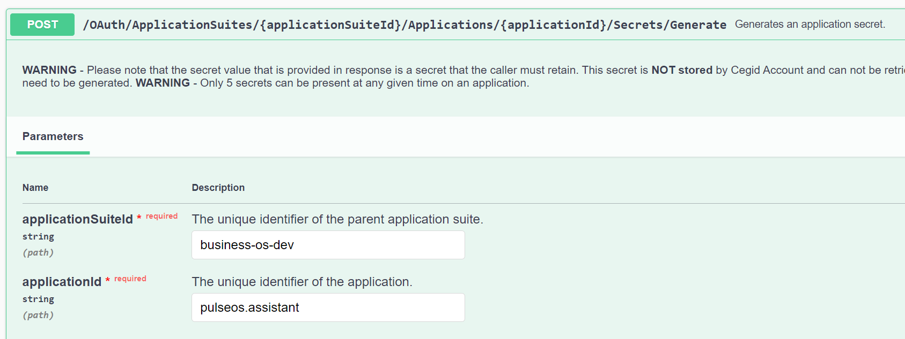

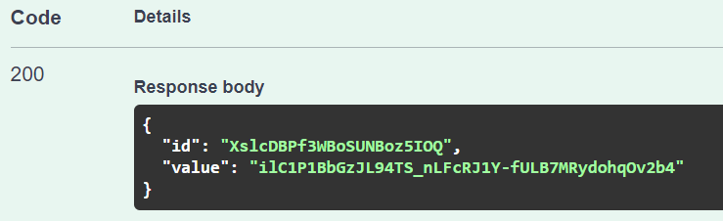
2. cegid DEV token app
cegid token service management
id
XslcDBPf3WBoSUNBoz5IOQ
client id
business-os-dev.app.pulseos.assistant
client secret
ilC1P1BbGzJL94TS_nLFcRJ1Y-fULB7MRydohqOv2b4

Slide 3
2.1 comparison
ASSISTANT DEV
BFF Studio
login
{
"clientId": "db2b2a25-1e17-4c08-a244-288db1a5ddec",
"applicationSuiteId": "business-os-dev",
"includeRoles": true,
"includeCegidLifeServices": false,
"useLightToken": false,
"label": "Pulse",
"redirectUris": [
"https://businessos-ui.azurewebsites.net/",
"http://localhost:5119/signin-oidc",
"https://businessos-ui.azurewebsites.net/api/auth/callback/pulse",
"https://businessos-ui.azurewebsites.net/api/auth/signin/pulse",
"https://businessos-ui.azurewebsites.net/api/auth/signin",
"http://localhost:3000/api/auth/callback/pulse",
"http://localhost:3000/api/auth/signin/pulse",
"http://localhost:3000/api/auth/signin",
"http://localhost:3000/"
],
"logoutEndpointUri": "https://www.webstore.cegid.com/logout"
}
login
{
"clientId": "15afd92e-a880-4b66-a3d4-1b672619ff91",
"applicationSuiteId": "business-os-dev",
"includeRoles": true,
"includeCegidLifeServices": false,
"useLightToken": false,
"label": "BFF-Studio",
"redirectUris": [
"http://localhost:5119/signin-oidc",
"http://localhost:5119",
"http://localhost:5001/signin-oidc",
"http://localhost:5001",
"http://localhost:8000/signin-oidc",
"http://localhost:8000"
],
"logoutEndpointUri": "https://www.webstore.cegid.com/logout"
}
token
{
"id": "bffStudio",
"applicationSuiteId": "business-os-dev",
"accessTokenValiditySeconds": 3600,
"allowClientCredentials": false,
"allowOfflineAccess": true,
"applicationType": "SignInTokenExchange",
"clientId": "business-os-dev.app.bffStudio",
"clientIdAlias": null,
"internalDescription": "BFF for Studio in Token Service",
"redirectUris": [],
"refreshTokenValiditySeconds": 3600,
"requireClientSecret": true,
"reusableRefreshToken": true,
"scopes": [
{
"scopeId": "business-os-dev.build.rw",
"granted": true
},
{
"scopeId": "business-os-dev.request.rw",
"granted": true
}
],
"signinApplicationClientId": "15afd92e-a880-4b66-a3d4-1b672619ff91"
}
token
{
"id": "pulseos.assistant",
"applicationSuiteId": "business-os-dev",
"accessTokenValiditySeconds": 3600,
"allowClientCredentials": false,
"allowOfflineAccess": true,
"applicationType": "SignInTokenExchange",
"clientId": "business-os-dev.app.pulseos.assistant",
"clientIdAlias": null,
"internalDescription": "Pulse OS assistant",
"redirectUris": [],
"refreshTokenValiditySeconds": 86400,
"requireClientSecret": true,
"reusableRefreshToken": true,
"scopes": [
{
"scopeId": "business-os-dev.build.rw",
"granted": true
},
{
"scopeId": "business-os-dev.request.rw",
"granted": true
}
],
"signinApplicationClientId": "db2b2a25-1e17-4c08-a244-288db1a5ddec"
}

Slide 4
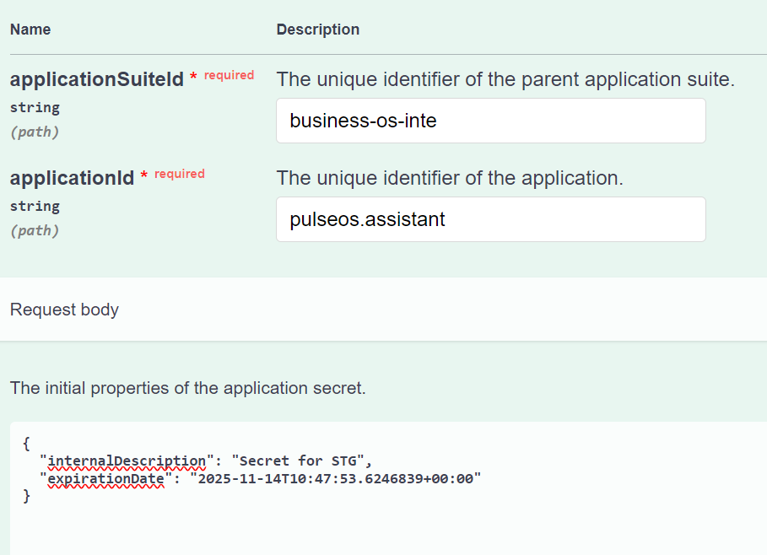
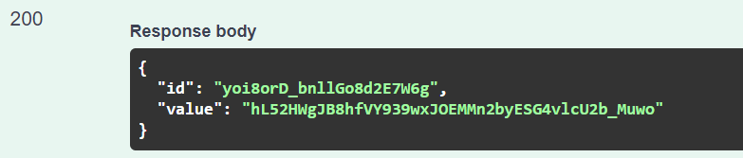
3. cegid STG token app
cegid token service management
id
yoi8orD_bnllGo8d2E7W6g
client id
business-os-inte.app.pulseos.assistant
client secret
hL52HWgJB8hfVY939wxJOEMMn2byESG4vlcU2b_Muwo

Slide 5
3.1 comparison
ASSISTANT INTE
ASSISTANT DEV
login
{
"clientId": "18a92114-40f4-4299-8737-27f81658fee9",
"applicationSuiteId": "business-os-inte",
"includeRoles": true,
"includeCegidLifeServices": false,
"useLightToken": false,
"label": "Pulse",
"redirectUris": [
"https://st-pulse.azurewebsites.net/api/auth/callback/pulse",
"https://st-pulse.azurewebsites.net/api/auth/signin/pulse",
"https://st-pulse.azurewebsites.net/api/auth/signin",
"https://st-pulse.azurewebsites.net/",
"http://localhost:3000/api/auth/signin/pulse",
"http://localhost:3000/api/auth/callback/pulse",
"http://localhost:3000/api/auth/signin",
"http://localhost:3000/"
],
"logoutEndpointUri": “https://www.webstore.cegid.com/logout”
}
login
{
"clientId": "db2b2a25-1e17-4c08-a244-288db1a5ddec",
"applicationSuiteId": "business-os-dev",
"includeRoles": true,
"includeCegidLifeServices": false,
"useLightToken": false,
"label": "Pulse",
"redirectUris": [
"https://businessos-ui.azurewebsites.net/api/auth/callback/pulse",
"https://businessos-ui.azurewebsites.net/api/auth/signin/pulse",
"https://businessos-ui.azurewebsites.net/api/auth/signin",
"https://businessos-ui.azurewebsites.net/",
"http://localhost:3000/api/auth/signin/pulse",
"http://localhost:3000/api/auth/callback/pulse",
"http://localhost:3000/api/auth/signin",
"http://localhost:3000/",
"http://localhost:5119/signin-oidc"
],
"logoutEndpointUri": "https://www.webstore.cegid.com/logout"
}
token
{
"id": "pulseos.assistant",
"applicationSuiteId": "business-os-inte",
"accessTokenValiditySeconds": 3600,
"allowClientCredentials": false,
"allowOfflineAccess": true,
"applicationType": "SignInTokenExchange",
"clientId": "business-os-inte.app.pulseos.assistant",
"clientIdAlias": null,
"internalDescription": "Pulse OS assistant",
"redirectUris": [],
"refreshTokenValiditySeconds": 86400,
"requireClientSecret": true,
"reusableRefreshToken": true,
"scopes": [
{
"scopeId": "business-os-inte.build.rw",
"granted": true
},
{
"scopeId": "business-os-inte.request.rw",
"granted": true
}
],
"signinApplicationClientId": "18a92114-40f4-4299-8737-27f81658fee9"
}
token
{
"id": "pulseos.assistant",
"applicationSuiteId": "business-os-dev",
"accessTokenValiditySeconds": 3600,
"allowClientCredentials": false,
"allowOfflineAccess": true,
"applicationType": "SignInTokenExchange",
"clientId": "business-os-dev.app.pulseos.assistant",
"clientIdAlias": null,
"internalDescription": "Pulse OS assistant",
"redirectUris": [],
"refreshTokenValiditySeconds": 86400,
"requireClientSecret": true,
"reusableRefreshToken": true,
"scopes": [
{
"scopeId": "business-os-dev.build.rw",
"granted": true
},
{
"scopeId": "business-os-dev.request.rw",
"granted": true
}
],
"signinApplicationClientId": "db2b2a25-1e17-4c08-a244-288db1a5ddec"
}

Slide 6
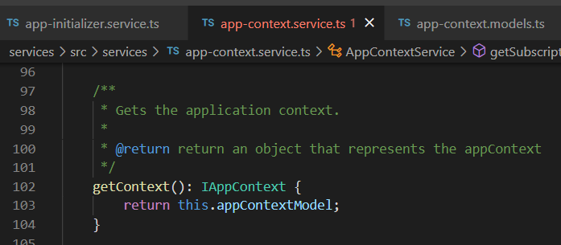





Z. template
new project
ExecuteAsync
square post-it
download
exe
download
exe
why
A slash
followed
by
two consecutive asterisks
D:\A1_research\C2_c0dice\B1_jmeter\A1_install
functionalities
introduction
build-exe
entity framework plus
zig help
⊂
⊂
4
every key-frame
defines the operation
deploy

