Slide 1

1. assistant integration with SG
authentication

Slide 2
2. diagrams
auth
WS
cookie to large
studio
SG
cookie
execution
first message
query parameter
cookie
ticket
header
cookie
assistant bd
pulse os
sessions
for
current user
cost
control
api sessions
(userID)
execution
(cegid api 1)
assistant
SG
assistant bff
(cegid api 1)
SG
https/WS
https/WS
external 1 (business)
management
(cegid api 1)
https
SEGID account
token para api
external 2 (UTC)

Slide 3
2.1 studio
what
how to send
authentication token
in
WS
when the SG was proxying
it was sending a cookie
in WS this cookie was triggering an error
so: remove the cookie
cookie to large
cookie
https
WS
pulse os
proxy (HTTPS/WS)
execution
studio
SG
management
cookie
first message
query parameter
cookie
ticket
header
so if we cannot send cookie
need another way to send authentication token
better way is to use standard WS header

Slide 4
2.2 assistant
https
WS
what
System VIEW
studio
(front end)
SG
proxy (HTTPS/WS)
studio API
scopes:
request.rw
management.rw
CEGID
business
iframe
https
https
WS 1
external systems
pulse os API
filter userID
assistant
(front end)
proxy (HTTPS/WS)
assistant API
execution
SG
WS 2
management
scopes:
request.rw
management.rw
assistant.rw
filter userID
cookie:
assistant.rw
scopes:
assistant.rw
cost control
feature flags
https
CEGID
account
PULSE
CORE
CEGID
CTU
CEGID
account
BFF:
cost control
requests management
using
user internally
Exchange token
scopes:
request.rw
management.rw

Slide 5
2.3.1 cegid account
what
how to integrate
assistant BFF
with
cegid account
https
pulse os API
https/ws
assistant API
filter userID
assistant
SG
proxy (HTTPS/WS)
execution
WS
management
cookie
https
filter userID
CEGID
account
1
2
3
scopes | api | application
build.rw request.rw assistant.rw | pulse os API | swagger | build.rw request.rw
 |  | studio | build.rw request.rw
 |  | CTU | general….
 |  | tests | build.rw request.rw
 |  | assistant | build.rw request.rw assistant.rw
scopes | api | application
build.rw request.rw | pulse os API | swagger | build.rw request.rw
 |  | studio | build.rw request.rw
 |  | CTU | general…
 |  | tests | build.rw request.rw
assistant.rw | assistant API | assistant client | build.rw request.rw assistant.rw
scopes | api | application
build.rw request.rw | backend | swagger | build.rw request.rw
 |  | studio | build.rw request.rw
 |  | CTU | build.rw request.rw
 |  | tests | build.rw request.rw
assistant.rw | assistant | assistant | assistant.rw
token coherence
semantically
incorrect
two API
inside
same application suite
only one API
two API
inside
same application suite
assistant
one scope
assistant
all scopes
assistant to pulse os
Clint Credentials
or
Dynamic Scope Request
assistant
all scopes
assistant to pulse os
same token

Slide 6
2.3.1.1 questions
1
assistant how to configure cegid account?
2
studio WS authentication in header?
UTC
3
assistant external services
Iframe with LEX cookie?
4
should I add introspection verification to my backend?
to ensure that the token was created by cegid account
the token verification uses the public key that comes with the token to verify the signature

Slide 7
2.2.1 cost management
direct implementation
this solution
was
abandoned
manage the cost directly in the BFF
need to create:
table
CRUD
name | value
user | efigueiredo@cegid.com
current_requests | 10
max_requests | 20
app_url | www.cegid.business.com
pulse-core
use existent API/client
from
pulse core
to manage
costs
this is
the correct
solution

Slide 8
4. local environment
only full
debug
out in
db 27017 : 27017
explorer DB 8081
execution 8989 : 8989
management 8888 : 8888
work ---------------
redis-stack 6379 : 6379
redis-stack UI 8001 : 8001
sg-studio 5119 : 5119
studio 8000 : 8000
execution
stop execution docker
run execution in vsCode: 8989

Slide 9
4.1 repos
business-os
pulse-os.core
pulse-os.assistant
disable forever
only to use for history
only our code (not assistant)
pipelines/docker-compose:
local:
docker
debug
k8s
only assistant code
pipelines/docker-compose:
local:
docker
debug
k8s

Slide 10
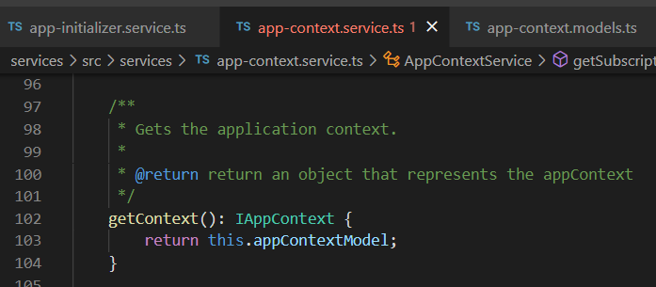






Z. template
new project
ExecuteAsync
square post-it
download
exe
download
exe
why
A slash
followed
by
two consecutive asterisks
D:\A1_research\C2_c0dice\B1_jmeter\A1_install
functionalities
introduction
build-exe
entity framework plus
zig help
⊂
⊂
4
every key-frame
defines the operation
deploy

