Slide 1

1. developers
authentication

Slide 2
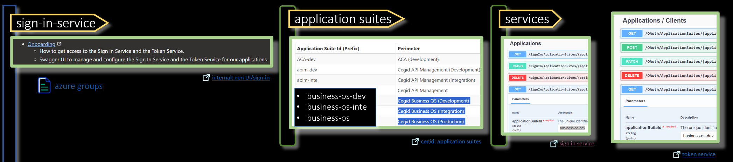
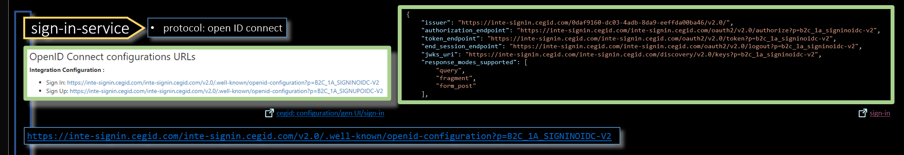
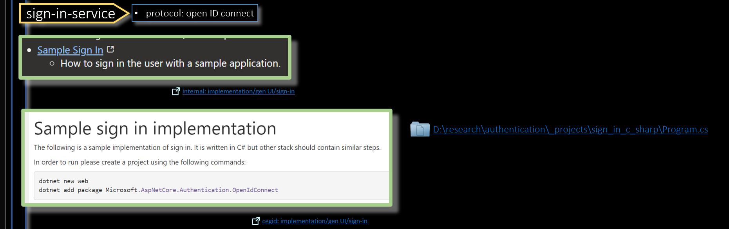
2. process
onboarding
well-known
code

Slide 3
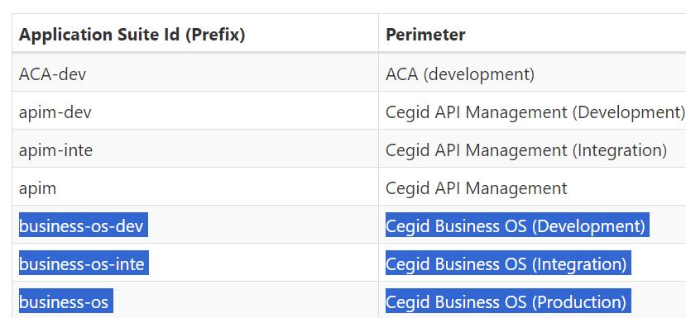
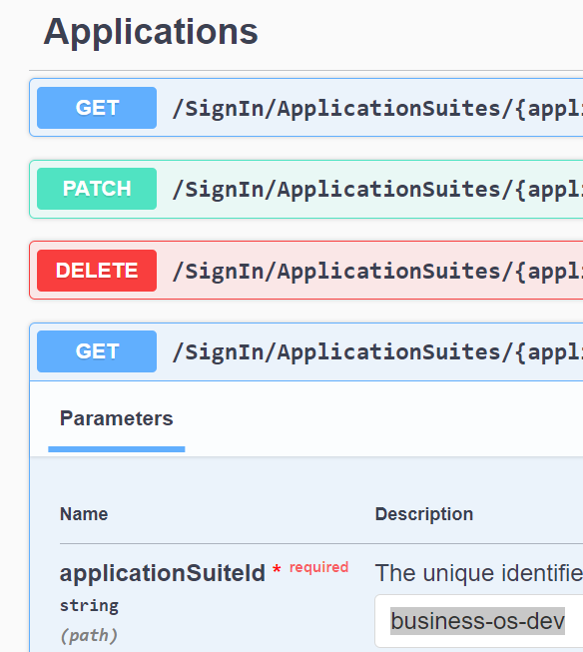


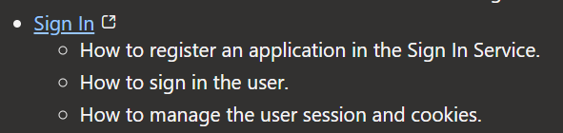
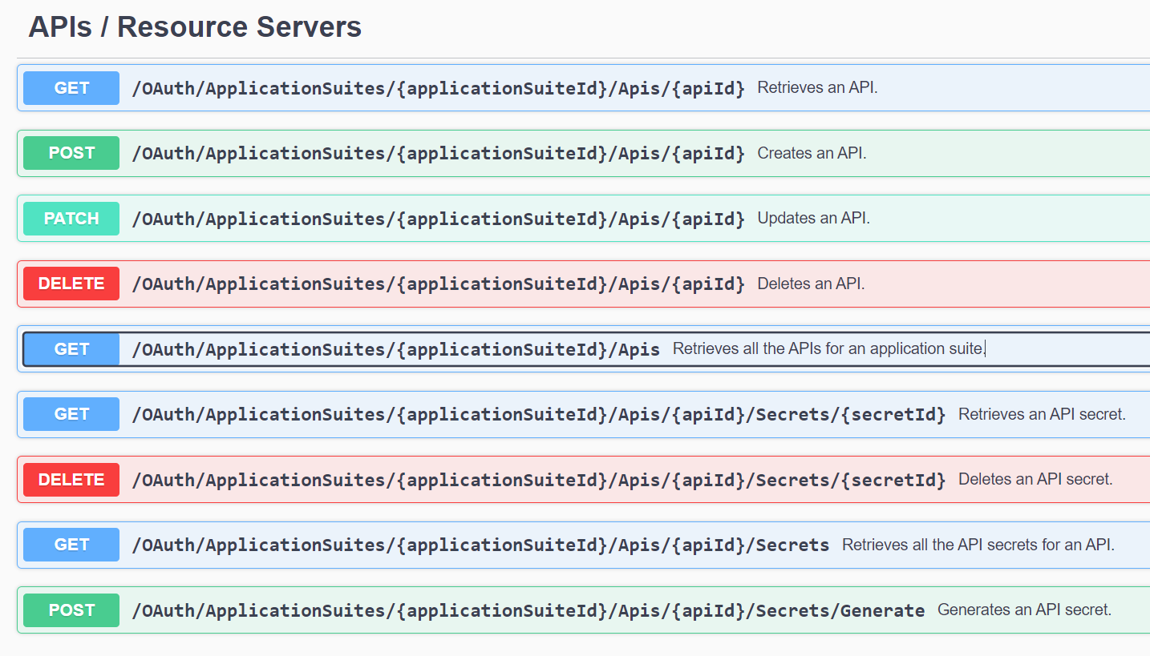
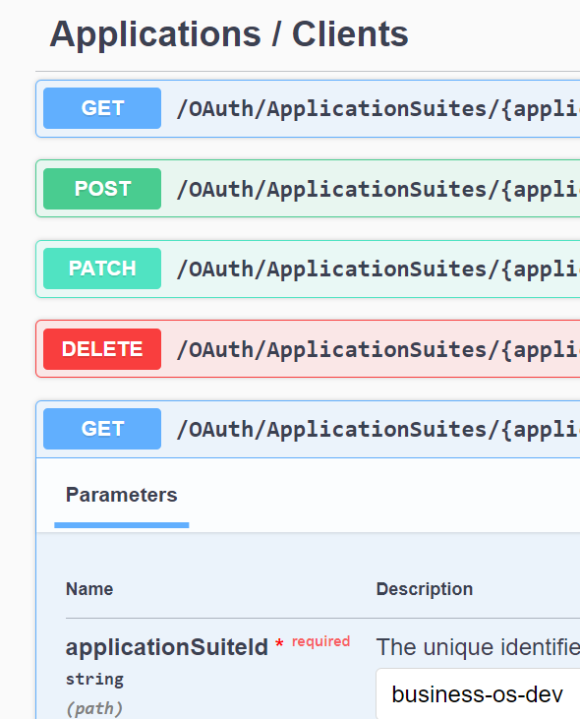
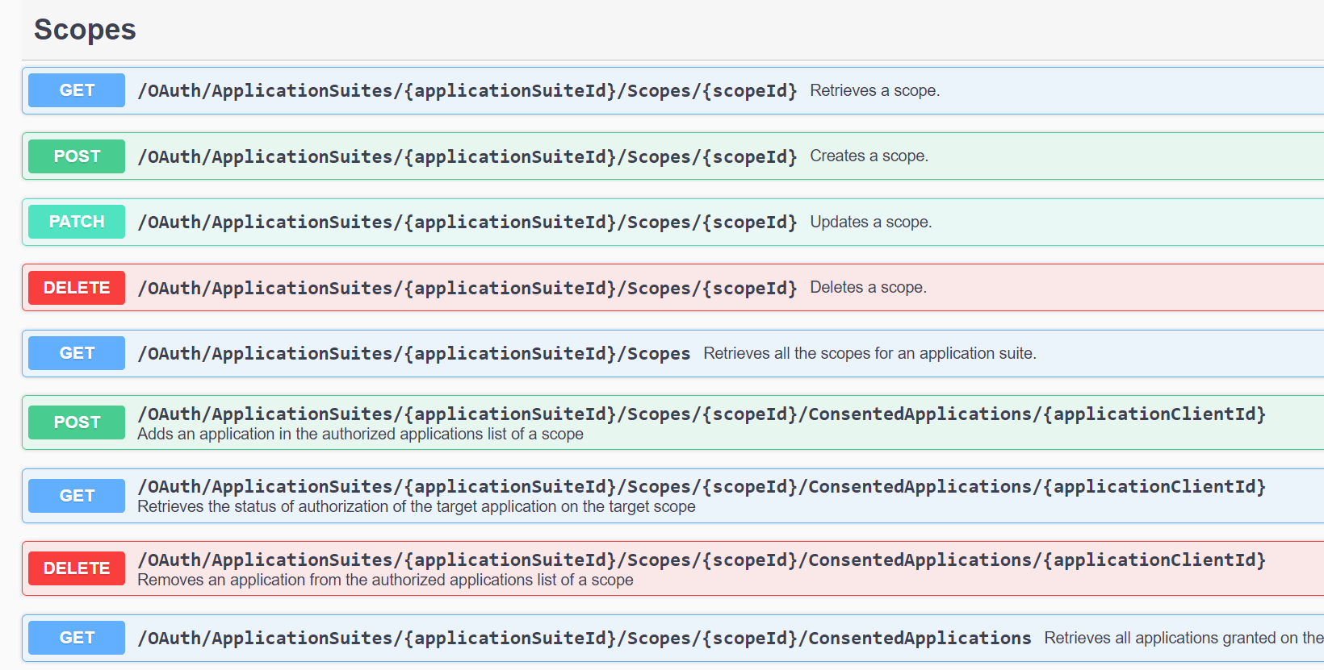

3. onboarding
sign-in-service
application suites
services
azure groups
internal: gen UI/sign-in
business-os-dev
business-os-inte
business-os
cegid: application suites
sign in service
internal: explanation/gen UI/sign-in
services
token-service
application suites
internal: swagger/token
token service
process/onboarding
process

Slide 4
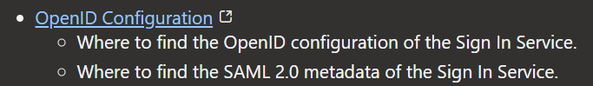
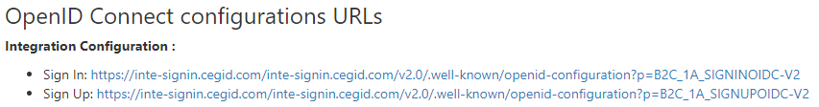
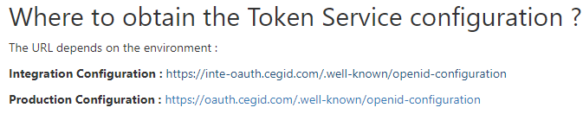
4. well known
sign-in-service
protocol: open ID connect
internal: configuration/gen UI/sign-in
{
"issuer": "https://inte-signin.cegid.com/0daf9160-dc03-4adb-8da9-eeffda00ba46/v2.0/",
"authorization_endpoint": "https://inte-signin.cegid.com/inte-signin.cegid.com/oauth2/v2.0/authorize?p=b2c_1a_signinoidc-v2",
"token_endpoint": "https://inte-signin.cegid.com/inte-signin.cegid.com/oauth2/v2.0/token?p=b2c_1a_signinoidc-v2",
"end_session_endpoint": "https://inte-signin.cegid.com/inte-signin.cegid.com/oauth2/v2.0/logout?p=b2c_1a_signinoidc-v2",
"jwks_uri": "https://inte-signin.cegid.com/inte-signin.cegid.com/discovery/v2.0/keys?p=b2c_1a_signinoidc-v2",
"response_modes_supported": [
"query",
"fragment",
"form_post"
],
cegid: configuration/gen UI/sign-in
https://inte-signin.cegid.com/inte-signin.cegid.com/v2.0/.well-known/openid-configuration?p=B2C_1A_SIGNINOIDC-V2
sign-in
token-service
OAuth 2
{
"issuer": "https://inte-oauth.cegid.com",
"jwks_uri": "https://inte-oauth.cegid.com/jwk",
"authorization_endpoint": "https://inte-oauth.cegid.com/authorize",
"token_endpoint": "https://inte-oauth.cegid.com/token",
"revocation_endpoint": "https://inte-oauth.cegid.com/revocation",
"introspection_endpoint": "https://inte-oauth.cegid.com/introspect",
"pushed_authorization_request_endpoint": "https://inte-oauth.cegid.com/connect/par",
"require_pushed_authorization_requests": false,
"scopes_supported": [
"iam.account.get",
cegid: configuration/swagger/token
token
https://inte-oauth.cegid.com/.well-known/openid-configuration
process/well known
process

Slide 5

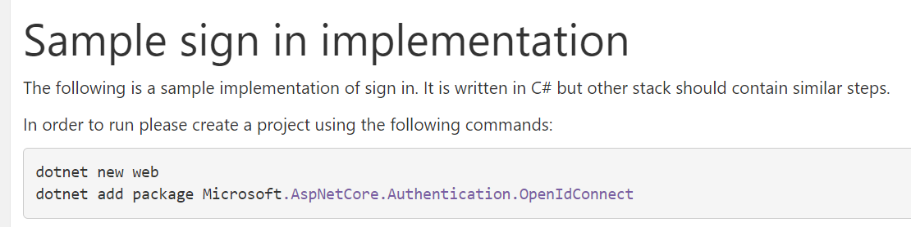
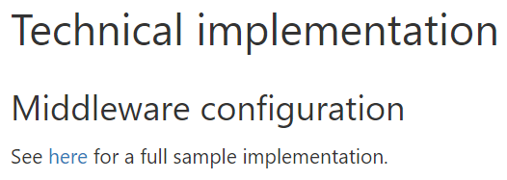

5. code
sign-in-service
protocol: open ID connect
internal: implementation/gen UI/sign-in
internal: explanation/gen UI/sign-in
cegid: implementation/gen UI/sign-in
cegid: explanation/gen UI/sign-in
D:\research\authentication\_projects\sign_in_c_sharp\Program.cs
process

Slide 6
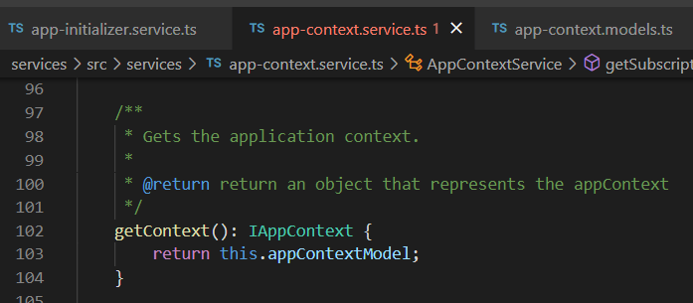



Z. template
new project
ExecuteAsync
square post-it
download
exe
download
exe
why
A slash
followed
by
two consecutive asterisks
D:\A1_research\C2_c0dice\B1_jmeter\A1_install
functionalities
introduction
build-exe
entity framework plus
zig help
⊂
4
every key-frame
defines the operation
deploy

