Slide 1
1. process/code

Slide 2
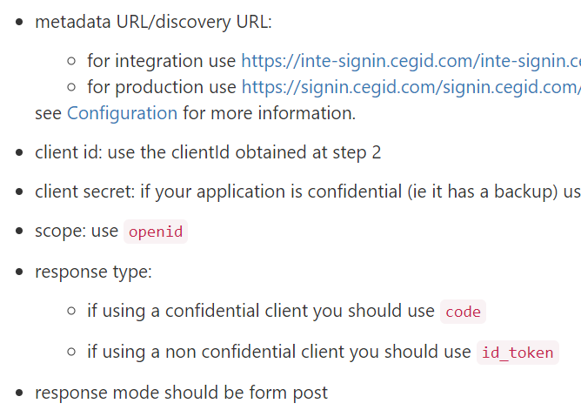

1. what
what
cegid: explanation/gen UI/sign-in
{
"includeRoles": false,
"includeCegidLifeServices": false,
"useLightToken": false,
"label": "evaristo cegid example",
"redirectUris": [
"http://localhost:5119"
],
"logoutEndpointUri": "https://localhost:5001/logout"
}
using
the C#
code example
app in CEGID account
client_id
59d9572b-d5d4-4d06-be26-7d86c0b79e1f

Slide 3
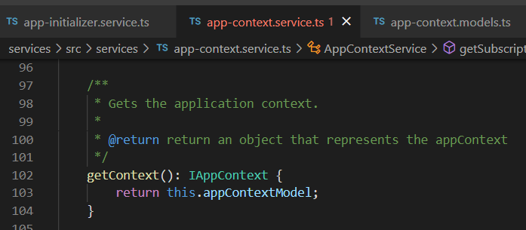






Z. template
new project
ExecuteAsync
square post-it
download
exe
why
A slash
followed
by
two consecutive asterisks
D:\A1_research\C2_c0dice\B1_jmeter\A1_install
functionalities
introduction
build-exe
entity framework plus
zig help
⊂
4
every key-frame
defines the operation
deploy

