Slide 1


1. implementation/onboarding
developers
documentation map/setup
authentication

Slide 2
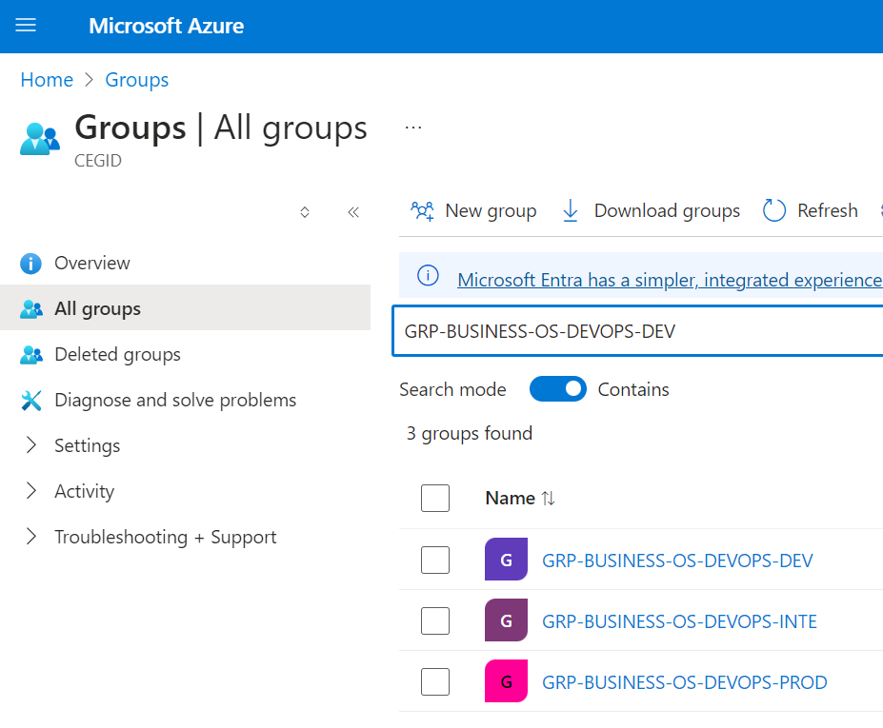
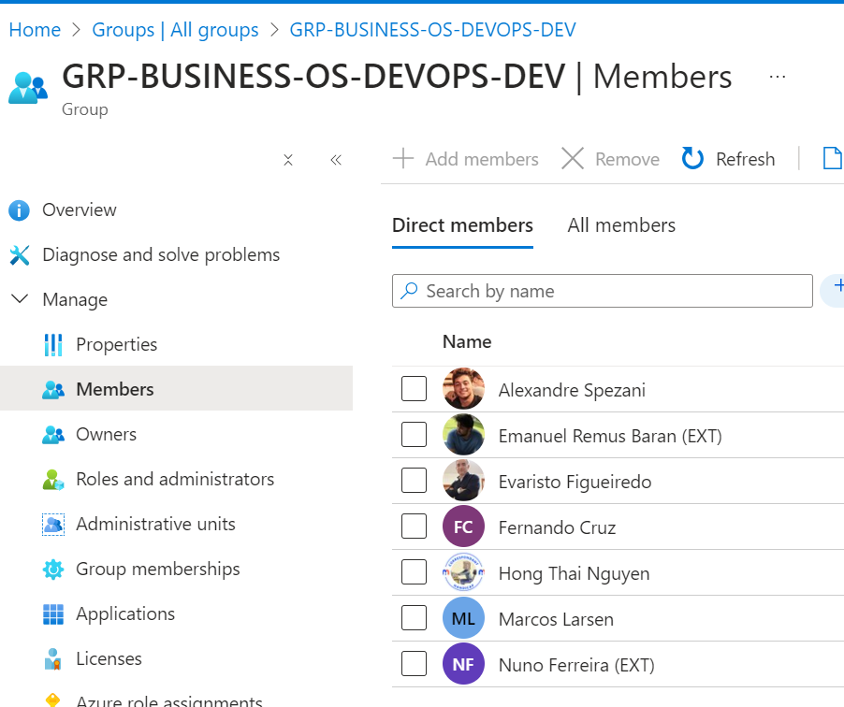

1. azure groups
what
Azure AD group
learn-about-groups: active directory

Slide 3
2. ==> gen UI/sign in

Slide 4
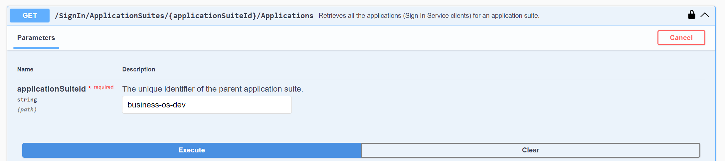
2.1 applications
919dfd55-eb25-4d0b-be97-00d1e219e865
db2b2a25-1e17-4c08-a244-288db1a5ddec
what
{
"clientId": "919dfd55-eb25-4d0b-be97-00d1e219e865",
"applicationSuiteId": "business-os-dev",
"includeRoles": true,
"includeCegidLifeServices": false,
"useLightToken": false,
"label": "LocalhostPulseOS",
"redirectUris": [
"http://localhost:8000",
"http://localhost:8000/signin-oidc"
],
"logoutEndpointUri": https://www.webstore.cegid.com/logout
},
{
"clientId": "db2b2a25-1e17-4c08-a244-288db1a5ddec",
"applicationSuiteId": "business-os-dev",
"includeRoles": true,
"includeCegidLifeServices": false,
"useLightToken": false,
"label": "Pulse",
"redirectUris": [
"https://businessos-ui.azurewebsites.net/api/auth/callback/pulse",
"https://businessos-ui.azurewebsites.net/api/auth/signin/pulse",
"https://businessos-ui.azurewebsites.net/api/auth/signin",
"https://businessos-ui.azurewebsites.nett/",
"http://localhost:3000/api/auth/callback/pulse",
"http://localhost:3000/api/auth/signin/pulse",
"http://localhost:3000/api/auth/signin",
"http://localhost:3000/"
],
"logoutEndpointUri": "https://www.webstore.cegid.com/logout"
}
studio
assistant
LocalhostPulseOS
Sign In Service Management
Pulse
business-os-dev

Slide 5
2.1.1 trash
{
"clientId": "3a5be6e9-6574-44a4-9948-859e7d4dea6f",
"applicationSuiteId": "business-os-dev",
"includeRoles": true,
"includeCegidLifeServices": false,
"useLightToken": false,
"label": "Localhost",
"redirectUris": [
"http://localhost:5119/signin-oidc",
"http://localhost:5119/redirect"
],
"logoutEndpointUri": "https://localhost:5119/local-logout"
},
{
"clientId": "98d11ac6-9c34-4748-be06-1545dc33553f",
"applicationSuiteId": "business-os-dev",
"includeRoles": true,
"includeCegidLifeServices": false,
"useLightToken": false,
"label": "Web Store",
"redirectUris": [
"https://www.webstore.cegid.com/store"
],
"logoutEndpointUri": "https://www.webstore.cegid.com/logout"
},

Slide 6
2.2 secrets
what
{
"secrets": [
{
"id": "a8910247-96cb-4259-8451-735995160182",
"applicationClientId": "db2b2a25-1e17-4c08-a244-288db1a5ddec",
"creationDate": "2024-07-22T03:06:13.410777Z",
"internalDescription": "Web store secret",
"expirationDate": "2025-07-16T17:00:35.0192321Z"
}
]
}
a8910247-96cb-4259-8451-735995160182
db2b2a25-1e17-4c08-a244-288db1a5ddec
assistant
the secrets
are not displayed
after first time
Pulse

Slide 7
3. ==> swagger/token

Slide 8
3.1 => scopes

Slide 9
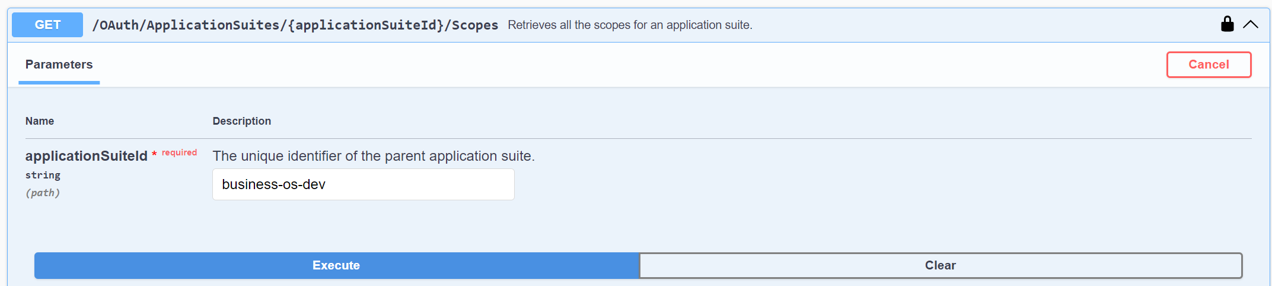
3.1.1 dev
what
{
"scopes": [
{
"id": "build.rw",
"applicationSuiteId": "business-os-dev",
"scope": "business-os-dev.build.rw",
"internalDescription": "Read and write skills
"assignedToApiKeyForServices": [],
"requiresOwnerConsent": true
},
{
"id": "request.rw",
"applicationSuiteId": "business-os-dev",
"scope": "business-os-dev.request.rw",
"internalDescription": "Read and write sessions
"assignedToApiKeyForServices": [],
"requiresOwnerConsent": true
}
]
}
build.rw
business-os-dev.build.rw
request.rw
business-os-dev.request.rw
Tokens Service Management
business-os-dev

Slide 10
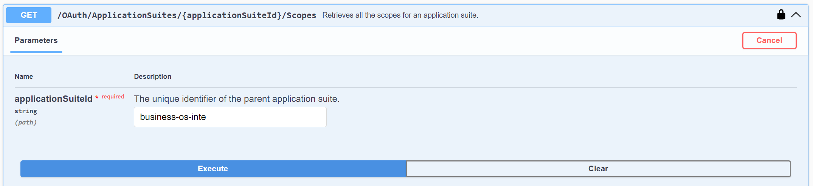
3.1.2 stg
what
{
"scopes": [
{
"id": "build.rw",
"applicationSuiteId": "business-os-inte",
"scope": "business-os-inte.build.rw",
"internalDescription": "Read and write skills, models, agents, and workflows.",
"assignedToApiKeyForServices": [],
"requiresOwnerConsent": true
},
{
"id": "request.rw",
"applicationSuiteId": "business-os-inte",
"scope": "business-os-inte.request.rw",
"internalDescription": "Read and write sessions and requests.",
"assignedToApiKeyForServices": [],
"requiresOwnerConsent": true
}
]
}
build.rw
business-os-inte.build.rw
request.rw
business-os-inte.request.rw
Tokens Service Management
business-os-inte

Slide 11
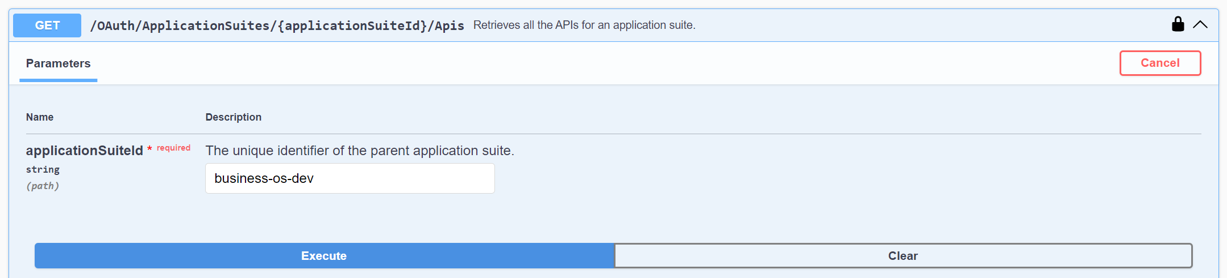
3.2 => api
what
{
"apis": [
{
"id": "backend",
"applicationSuiteId": "business-os-dev",
"clientId": "business-os-dev.api.backend",
"scopes": [
"business-os-dev.build.rw",
"business-os-dev.request.rw"
],
"internalDescription": "Cegid Pulse OS backend
"scopeIds": [
"build.rw",
"request.rw"
]
}
]
}
backend
business-os-dev.api.backend
business-os-dev.build.rw
business-os-dev.request.rw
build.rw
request.rw
Tokens Service Management
business-os-dev

Slide 12
3.2.1 dev
what
{
"apis": [
{
"id": "backend",
"applicationSuiteId": "business-os-dev",
"clientId": "business-os-dev.api.backend",
"scopes": [
"business-os-dev.build.rw",
"business-os-dev.request.rw"
],
"internalDescription": "Cegid Pulse OS backend
"scopeIds": [
"build.rw",
"request.rw"
]
}
]
}
backend
business-os-dev.api.backend
business-os-dev.build.rw
business-os-dev.request.rw
build.rw
request.rw
Tokens Service Management
business-os-dev

Slide 13
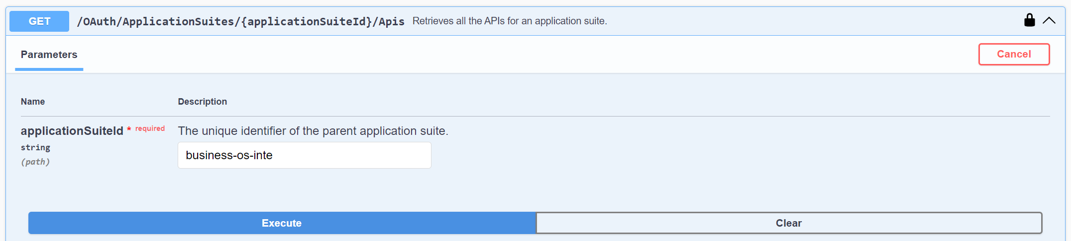
3.2.2 stg
what
{
"apis": [
{
"id": "backend",
"applicationSuiteId": "business-os-inte",
"clientId": "business-os-inte.api.backend",
"scopes": [
"business-os-inte.build.rw",
"business-os-inte.request.rw"
],
"internalDescription": "Cegid Pulse OS backend
"scopeIds": [
"build.rw",
"request.rw"
]
}
]
}
backend
business-os-inte.api.backend
business-os-inte.build.rw
business-os-inte.request.rw
build.rw
request.rw
Tokens Service Management
business-os-dev

Slide 14
3.3 applications
Sign In application Client Id
If your application
is using
the Sign In Token Exchanged flow,
the Client Id
of
your application
registered on
the Sign In Service of Cegid Account

Slide 15
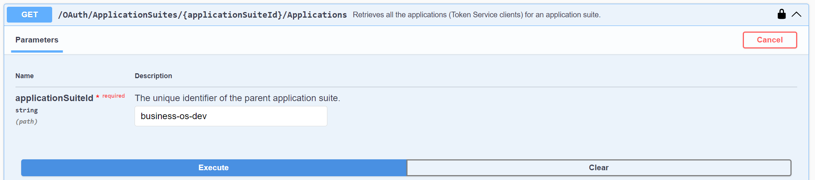
3.3.1 swagger
{
"id": "pulseapi",
"applicationSuiteId": "business-os-dev",
"accessTokenValiditySeconds": 3600,
"allowClientCredentials": false,
"allowOfflineAccess": true,
"applicationType": "AuthorizationCodeWithPkce",
"clientId": "business-os-dev.app.pulseapi",
"clientIdAlias": null,
"internalDescription": "Cegid Pulse OS API Token Service",
"redirectUris": [
"http://localhost:8989/docs/oauth2-redirect",
"https://businessos-rest-services.azurewebsites.net/docs/oauth2-redirect",
"https://pulse-os-evaluation-api.azurewebsites.net/docs/oauth2-redirect"
],
"refreshTokenValiditySeconds": 86400,
"requireClientSecret": false,
"reusableRefreshToken": true,
"scopes": [
{
"scopeId": "business-os-dev.build.rw",
"granted": true
},
{
"scopeId": "business-os-dev.request.rw",
"granted": true
}
],
"signinApplicationClientId": null
}
pulseapi
what
AuthorizationCodeWithPkce
business-os-dev.app.pulseapi
{
"id": "postman",
"applicationSuiteId": "business-os-dev",
"accessTokenValiditySeconds": 3600,
"allowClientCredentials": false,
"allowOfflineAccess": false,
"applicationType": "AuthorizationCodeWithPkce",
"clientId": "business-os-dev.app.postman",
"clientIdAlias": null,
"internalDescription": "To test in postman",
"redirectUris": [
"https://oauth.pstmn.io/v1/callback"
],
"refreshTokenValiditySeconds": null,
"requireClientSecret": false,
"reusableRefreshToken": false,
"scopes": [
{
"scopeId": "iam.account.get",
"granted": true
},
{
"scopeId": "business-os-dev.build.rw",
"granted": true
},
{
"scopeId": "business-os-dev.request.rw",
"granted": true
}
],
"signinApplicationClientId": null
}
http://localhost:8989/docs/oauth2-redirect
https://businessos-rest-services.azurewebsites.net/docs/oauth2-redirect
https://pulse-os-evaluation-api.azurewebsites.net/docs/oauth2-redirect
business-os-dev.build.rw
business-os-dev.request.rw
business-os-dev
Tokens Service Management

Slide 16
3.3.2 studio
{
"id": "studio",
"applicationSuiteId": "business-os-dev",
"accessTokenValiditySeconds": 600,
"allowClientCredentials": false,
"allowOfflineAccess": true,
"applicationType": "AuthorizationCodeWithPkce",
"clientId": "business-os-dev.app.studio",
"clientIdAlias": null,
"internalDescription": "Pulse OS Studio",
"redirectUris": [
"http://localhost:8000/",
"https://businessos-studio.azurewebsites.net/",
"https://pulse-os-evaluation-studio.azurewebsites.net/"
],
"refreshTokenValiditySeconds": 86400,
"requireClientSecret": false,
"reusableRefreshToken": false,
"scopes": [
{
"scopeId": "business-os-dev.build.rw",
"granted": true
},
{
"scopeId": "business-os-dev.request.rw",
"granted": true
}
],
"signinApplicationClientId": null
}
studio
what
AuthorizationCodeWithPkce
business-os-dev.app.studio
http://localhost:8000/
https://businessos-studio.azurewebsites.net/
https://pulse-os-evaluation-studio.azurewebsites.net/
business-os-dev.build.rw
business-os-dev.request.rw
business-os-dev
Tokens Service Management

Slide 17
3.4 consent

Slide 18
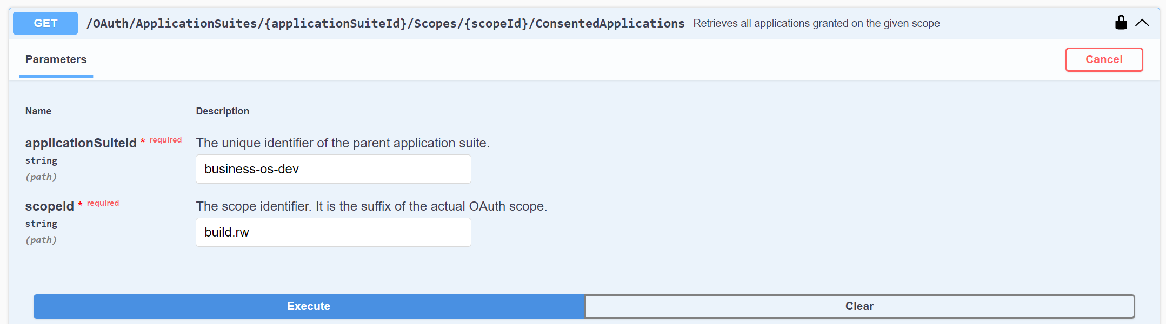
3.4.1 swagger
{
"id": "pulseapi",
"applicationSuiteId": "business-os-dev",
"accessTokenValiditySeconds": 3600,
"allowClientCredentials": false,
"allowOfflineAccess": true,
"applicationType": "AuthorizationCodeWithPkce",
"clientId": "business-os-dev.app.pulseapi",
"clientIdAlias": null,
"internalDescription": "Cegid Pulse OS API Token Service",
"redirectUris": [
"http://localhost:8989/docs/oauth2-redirect",
"https://businessos-rest-services.azurewebsites.net/docs/oauth2-redirect",
"https://pulse-os-evaluation-api.azurewebsites.net/docs/oauth2-redirect"
],
"refreshTokenValiditySeconds": 86400,
"requireClientSecret": false,
"reusableRefreshToken": true,
"scopes": [
{
"scopeId": "business-os-dev.build.rw",
"granted": true
},
{
"scopeId": "business-os-dev.request.rw",
"granted": true
}
],
"signinApplicationClientId": null
},
pulseapi
what
AuthorizationCodeWithPkce
business-os-dev.app.pulseapi
http://localhost:8989/docs/oauth2-redirect
https://businessos-rest-services.azurewebsites.net/docs/oauth2-redirect
https://pulse-os-evaluation-api.azurewebsites.net/docs/oauth2-redirect
business-os-dev.build.rw
business-os-dev.request.rw
business-os-dev
Tokens Service Management

Slide 19
3.4.2 studio
{
"id": "studio",
"applicationSuiteId": "business-os-dev",
"accessTokenValiditySeconds": 600,
"allowClientCredentials": false,
"allowOfflineAccess": true,
"applicationType": "AuthorizationCodeWithPkce",
"clientId": "business-os-dev.app.studio",
"clientIdAlias": null,
"internalDescription": "Pulse OS Studio",
"redirectUris": [
"http://localhost:8000/",
"https://businessos-studio.azurewebsites.net/",
"https://pulse-os-evaluation-studio.azurewebsites.net/"
],
"refreshTokenValiditySeconds": 86400,
"requireClientSecret": false,
"reusableRefreshToken": false,
"scopes": [
{
"scopeId": "business-os-dev.build.rw",
"granted": true
},
{
"scopeId": "business-os-dev.request.rw",
"granted": true
}
],
"signinApplicationClientId": null
}
studio
what
AuthorizationCodeWithPkce
business-os-dev.app.studio
http://localhost:8000/
https://businessos-studio.azurewebsites.net/
https://pulse-os-evaluation-studio.azurewebsites.net/
business-os-dev.build.rw
business-os-dev.request.rw
business-os-dev
Tokens Service Management

Slide 20
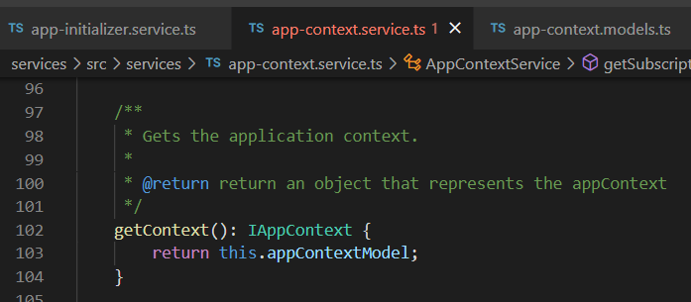



Z. template
new project
ExecuteAsync
square post-it
download
exe
download
exe
why
A slash
followed
by
two consecutive asterisks
D:\A1_research\C2_c0dice\B1_jmeter\A1_install
functionalities
introduction
build-exe
entity framework plus
zig help
⊂
4
every key-frame
defines the operation
deploy

