Slide 1
1. what
what
/.well-known/openid-configuration
endpoint
is part of
the OpenID Connect (OIDC)
protocol
builds on top of
OAuth 2.0
provide
identity verification
and
authentication services
is used to
retrieve
a discovery document
OpenID Provider Configuration Document
from
an OpenID Provider (OP)
well-known endpoint
Chat GPT
document
contains
metadata
about
the OpenID Provider’s
configuration
helps clients
to
interact
with it
for
authentication

Slide 2
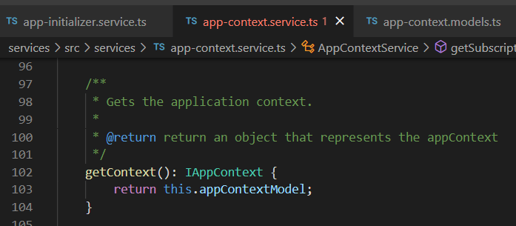






Z. template
new project
ExecuteAsync
square post-it
download
exe
download
exe
why
A slash
followed
by
two consecutive asterisks
D:\A1_research\C2_c0dice\B1_jmeter\A1_install
functionalities
introduction
build-exe
entity framework plus
zig help
⊂
4
every key-frame
defines the operation
deploy

