Slide 1

1. documentation
authentication

Slide 2
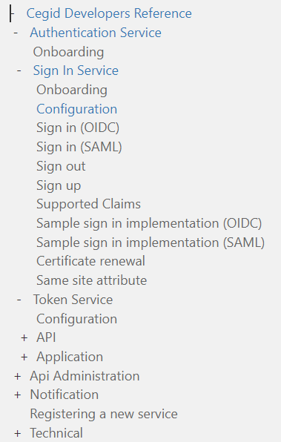
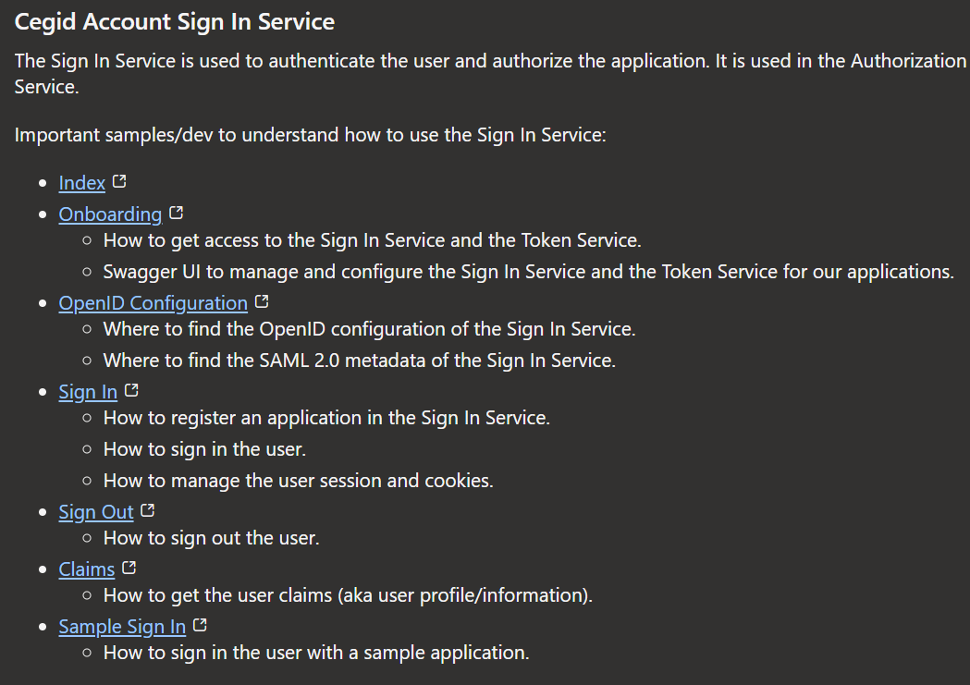
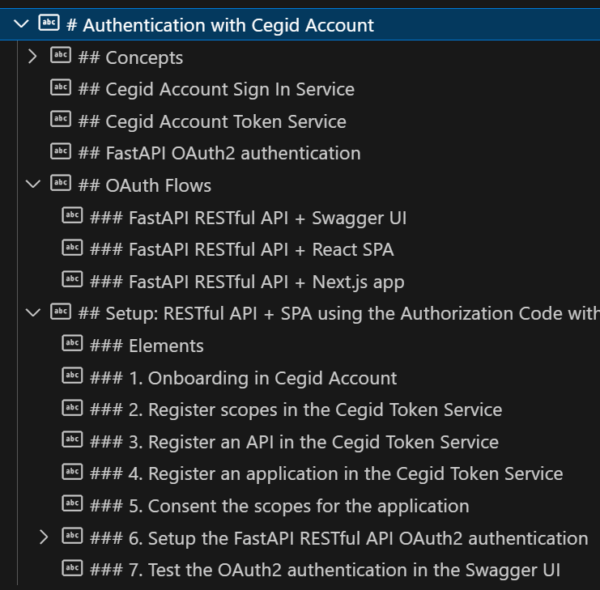
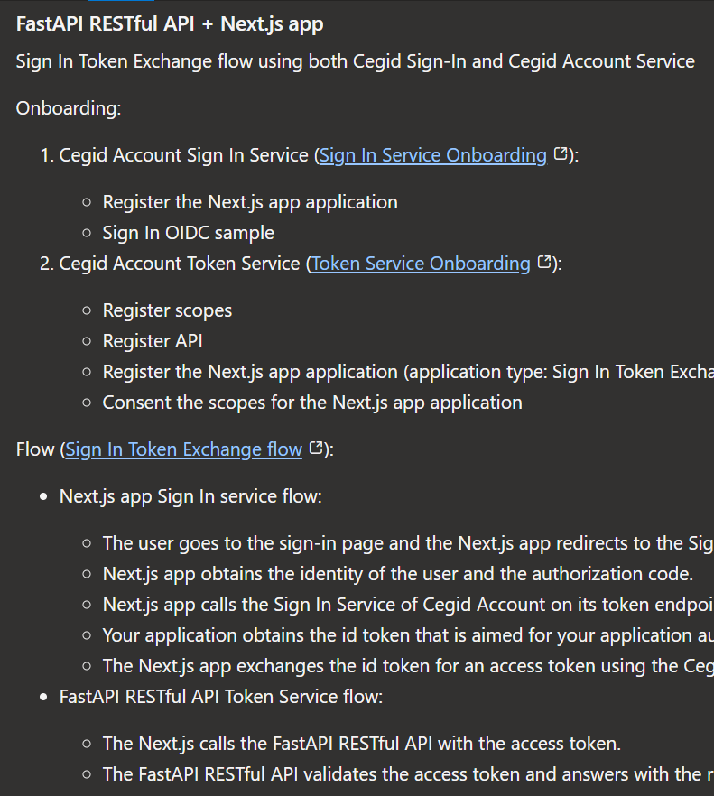


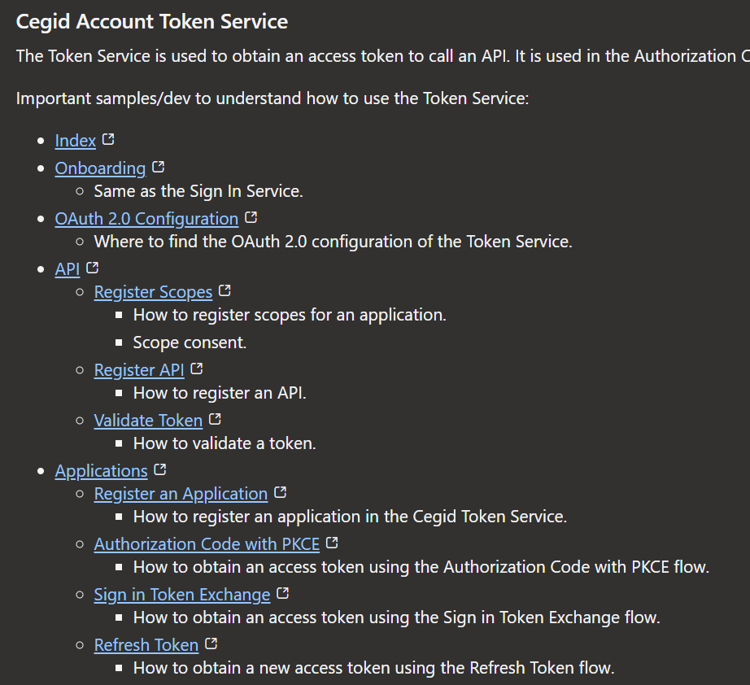
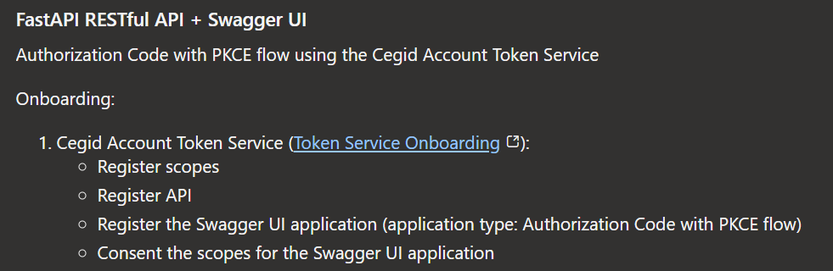

2. services
services/signin/details
Swagger
Studio
GenUi
internal: sign in
flow: GEN UI
internal: GenUi
cegid: developers
internal: swagger
interna: token
flow: swagger

Slide 3
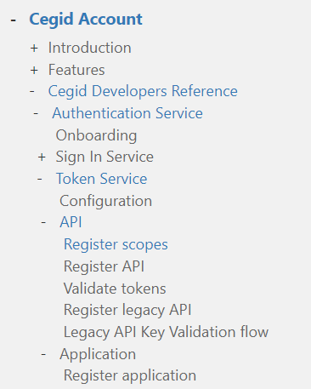
3. oauth2
FastAPI
cegid: developers/Authentication
internal: setup
oauth2/details

Slide 4
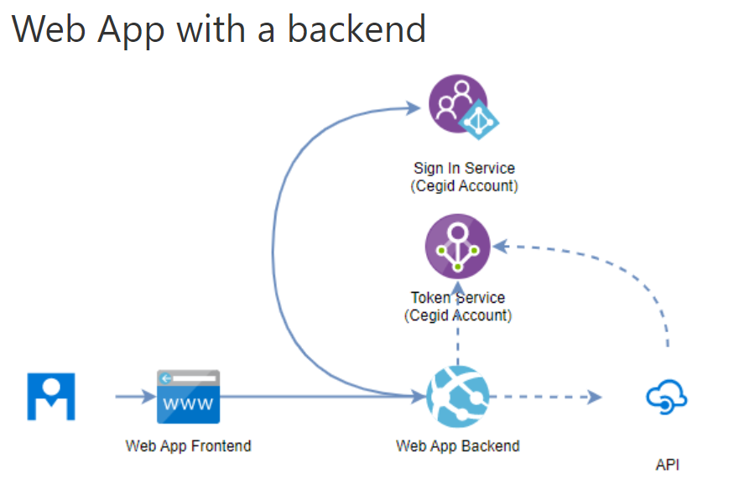
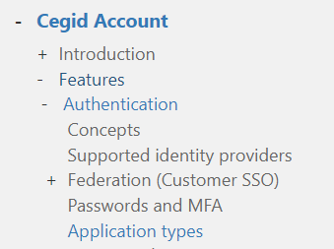
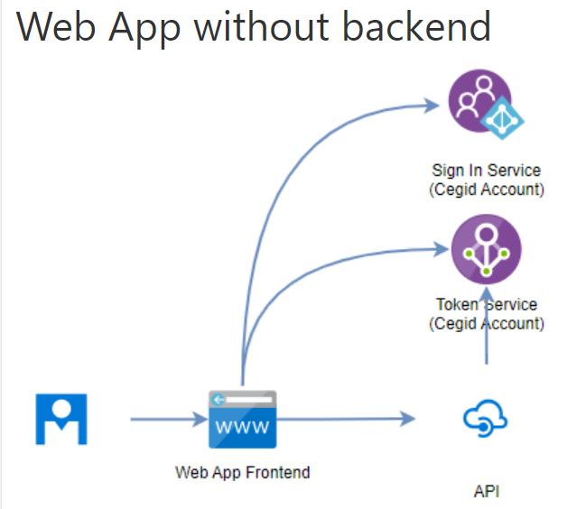
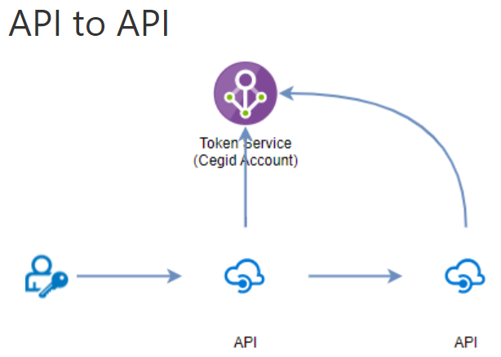
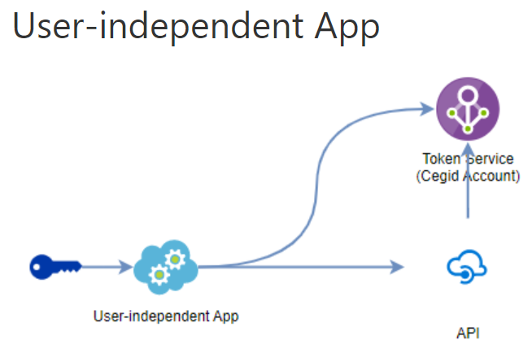
4. flows
need to
read
carefully

Slide 5
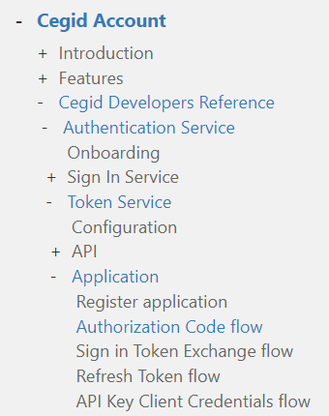
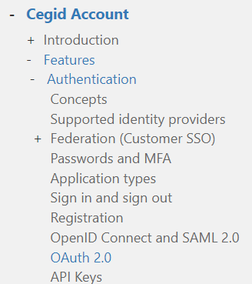
4.1 oauth2
swagger
cegid: features/oauth2
studio
assistant
cegid: developers/flows
internal: oauth-flows

Slide 6
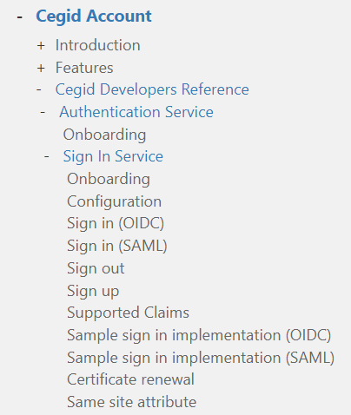
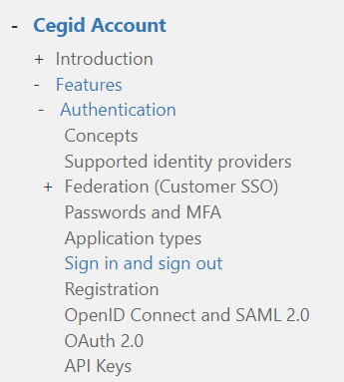
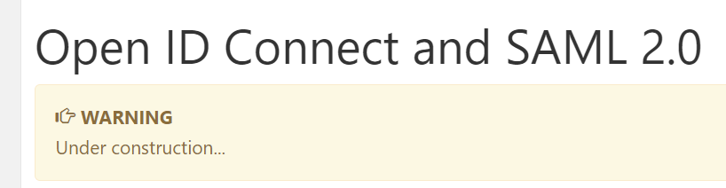
4.3 OIDC
swagger
studio
assistant
cegid: features/sign in and out
cegid: developers/oidc
internal: oauth-flows

Slide 7
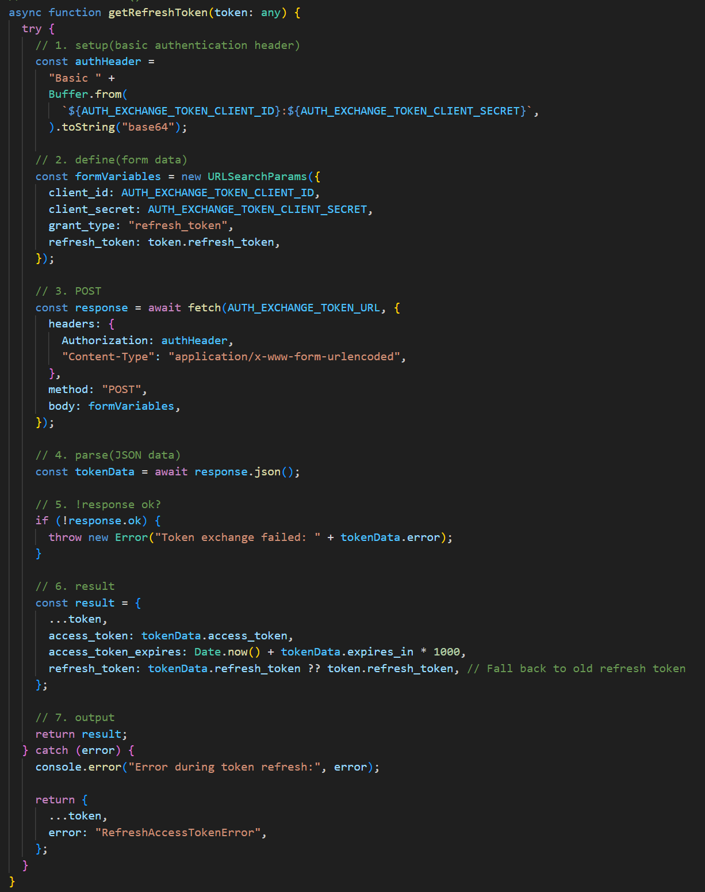
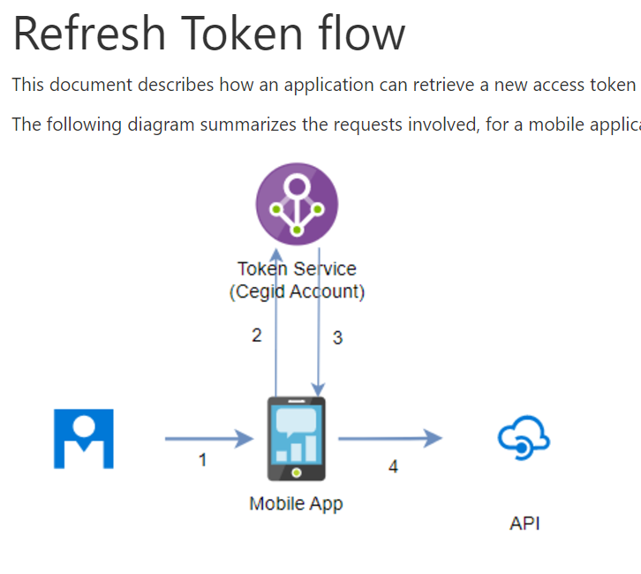

4.4 refresh
cegid: developers/refresh token
assistant library/tutorials/refresh-token-rotation
assistant library/code
assistant library/types
D:\repos\pulse-os.assistant\lib\auth.ts

Slide 8
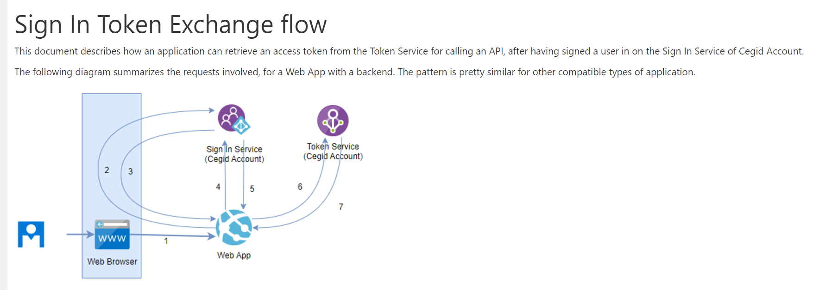
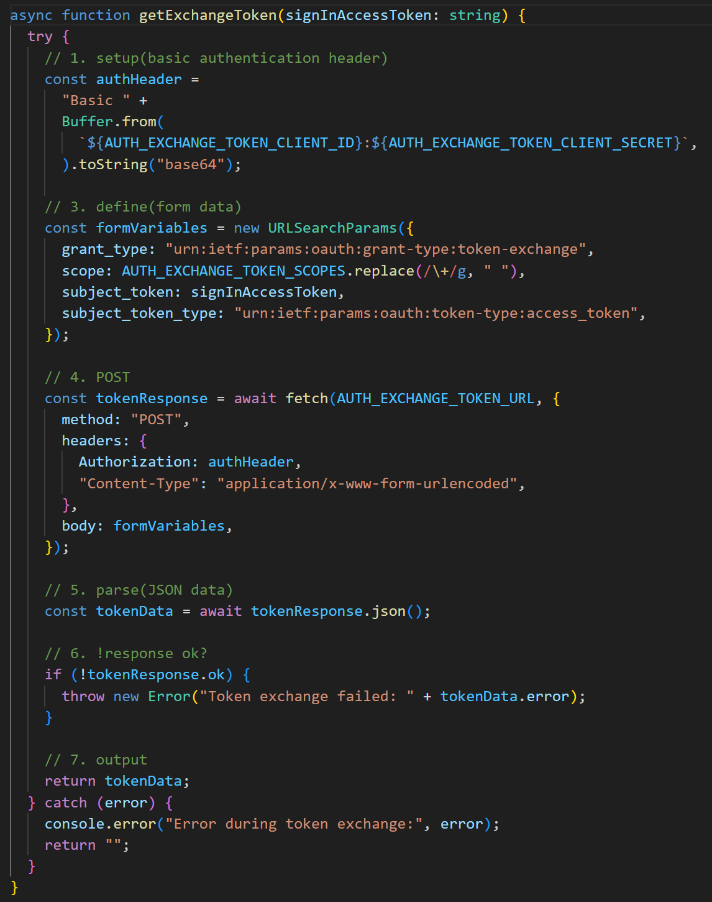
4.5 exchange
cegid: developers/SigninTokenExchange
D:\repos\pulse-os.assistant\lib\auth.ts

Slide 9
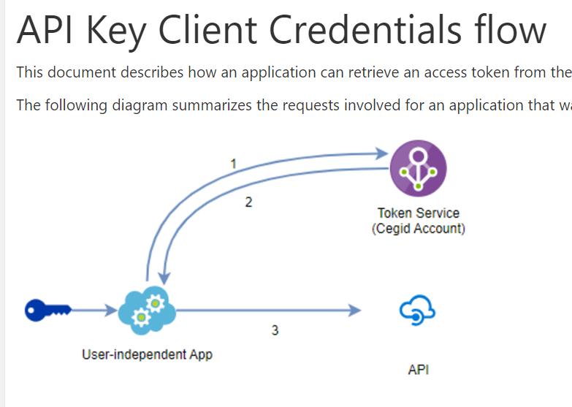
4.5 client credentials
cegid: developers/client credentials
cegid: developers/client credentials/api keys
cegid: developers/client credentials/register API
tests/code/sources

Slide 10
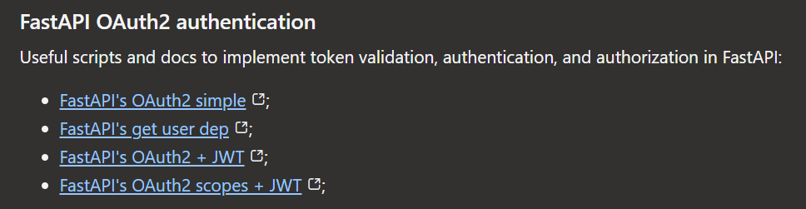
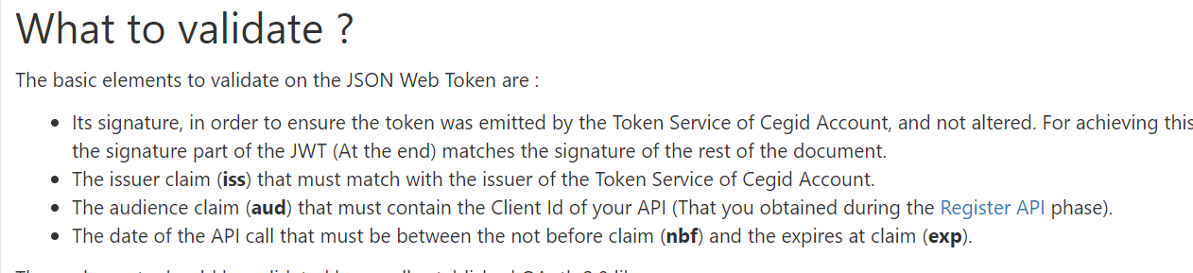
5. FastAPI
internal: FastAPI
cegid: validate tokens

Slide 11
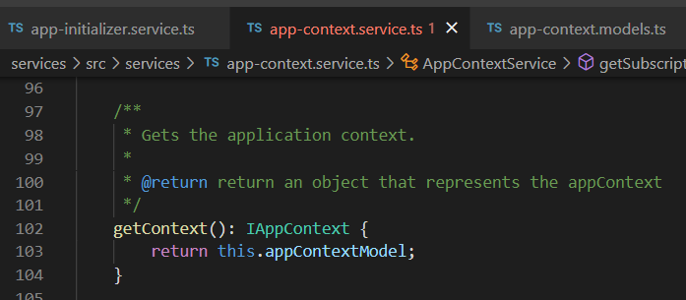


Z. template
new project
ExecuteAsync
square post-it
download
exe
download
exe
why
A slash
followed
by
two consecutive asterisks
D:\A1_research\C2_c0dice\B1_jmeter\A1_install
functionalities
introduction
build-exe
entity framework plus
zig help
⊂
4
every key-frame
defines the operation
deploy

