Slide 1

1. map/setup
developers
authentication

Slide 2

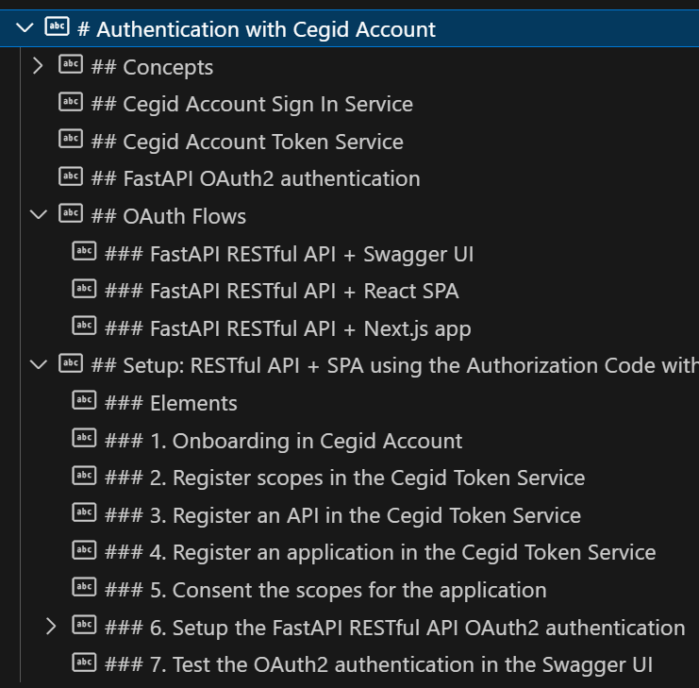
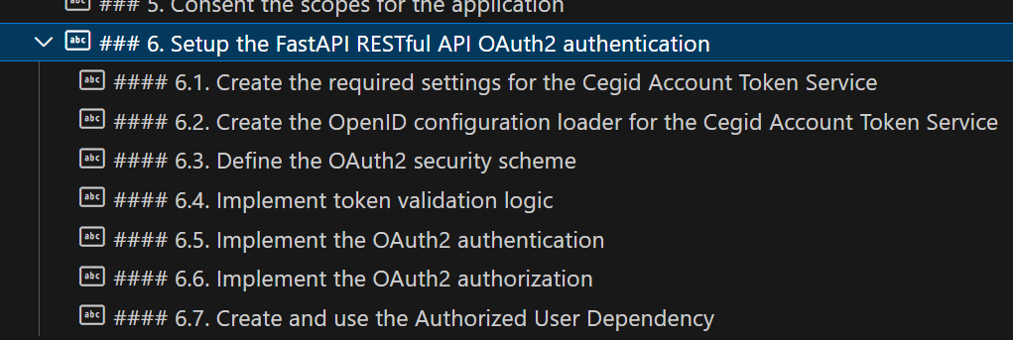
2. what
internal: setup

Slide 3
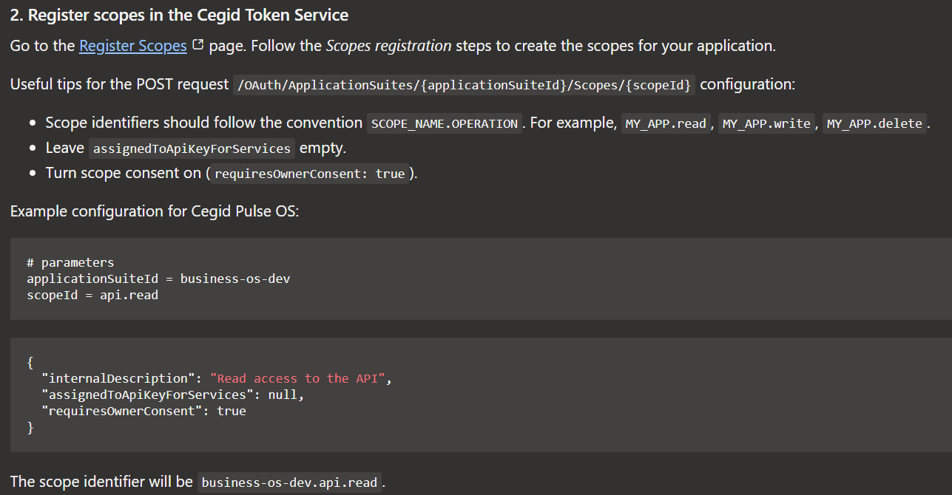
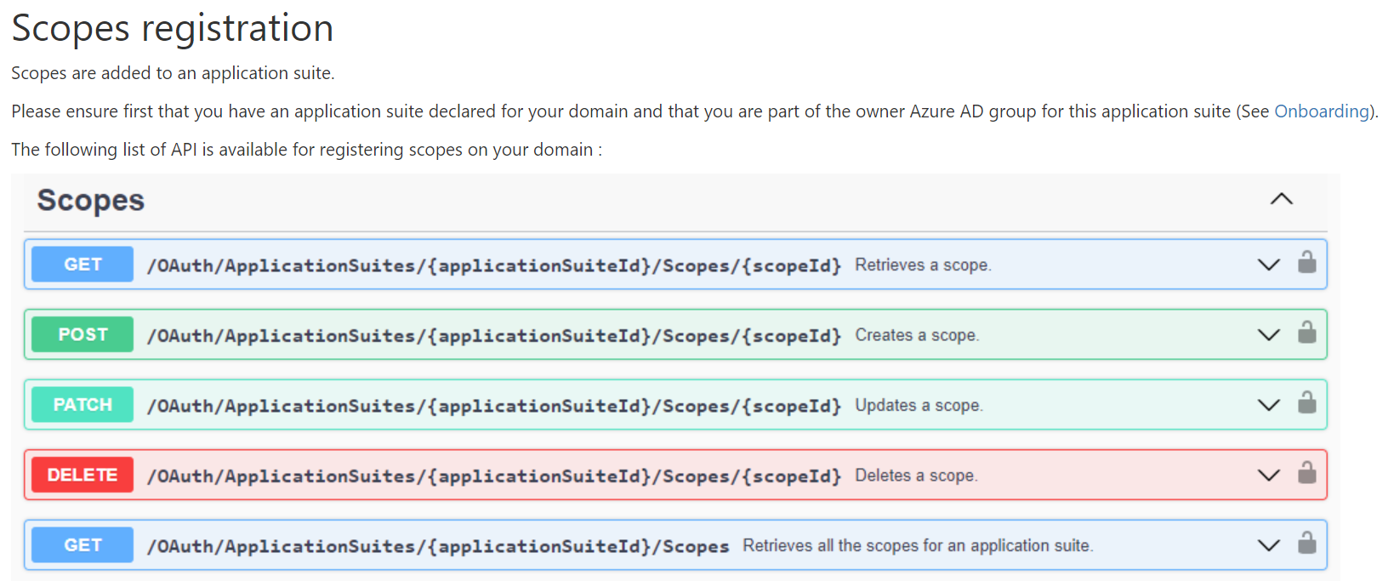
3. scopes
internal: setup rest full API/scopes
cegid: scopes

Slide 4
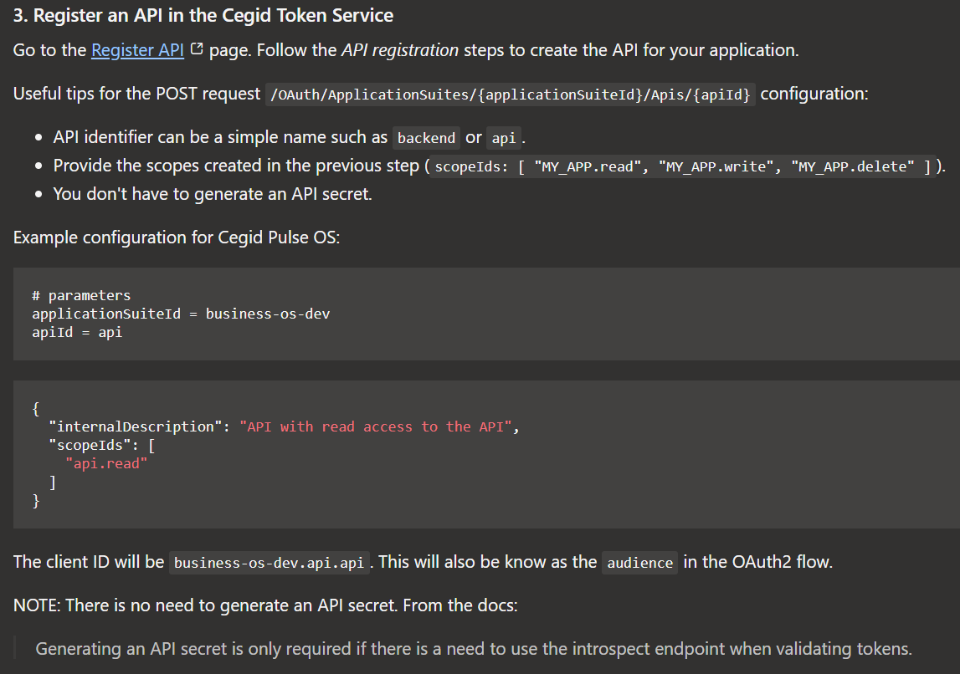
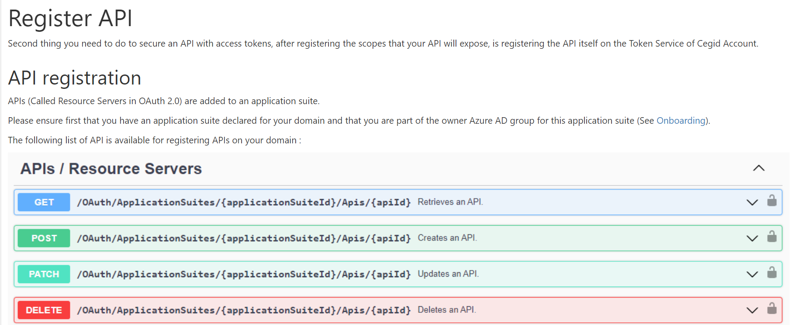
4. api
internal: setup rest full API/api
cegid: api

Slide 5
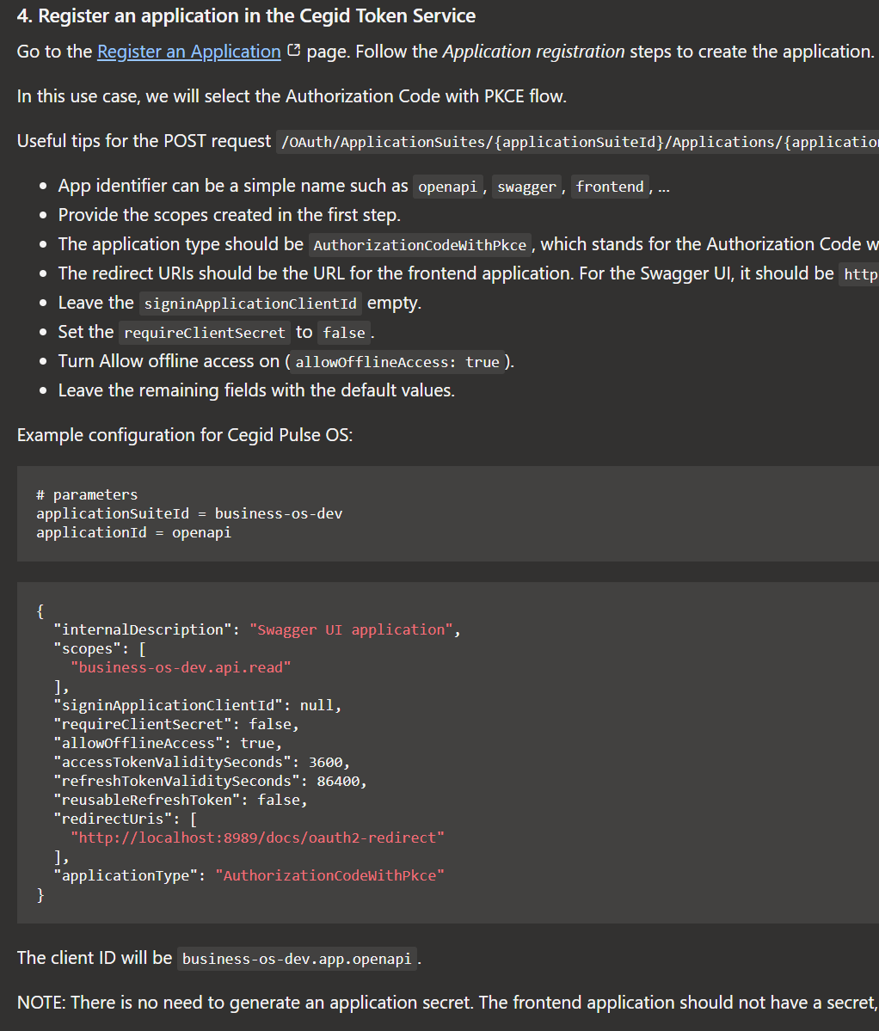
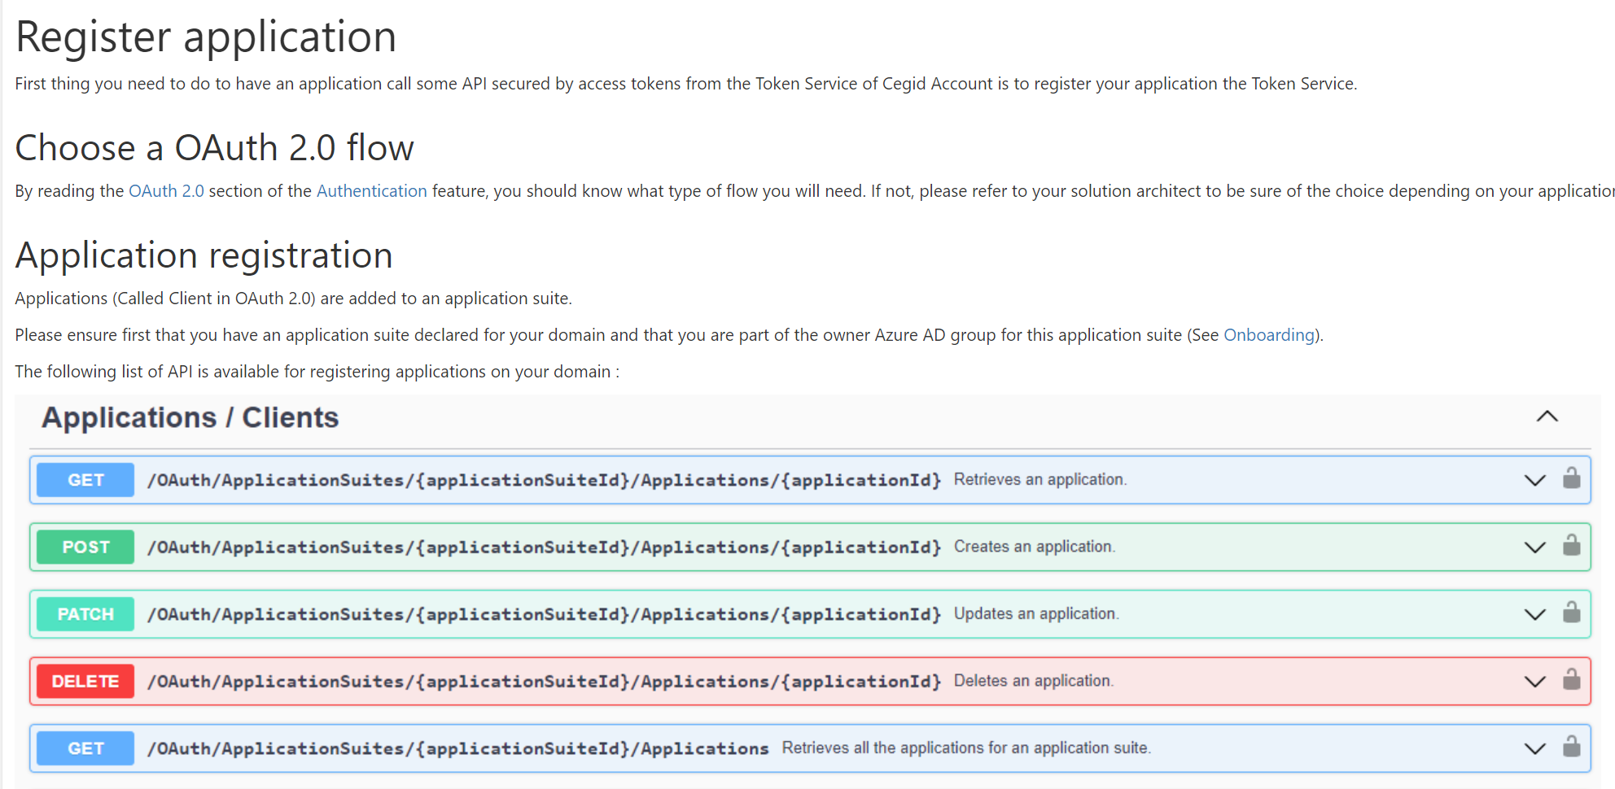
5. application
internal: setup rest full API/application
cegid: application

Slide 6
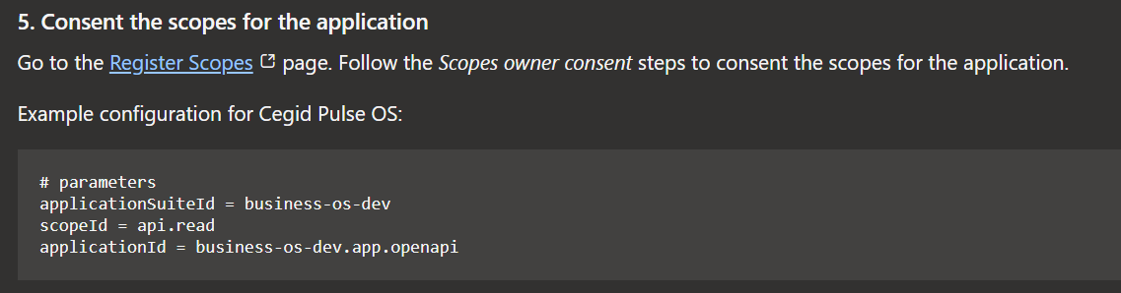
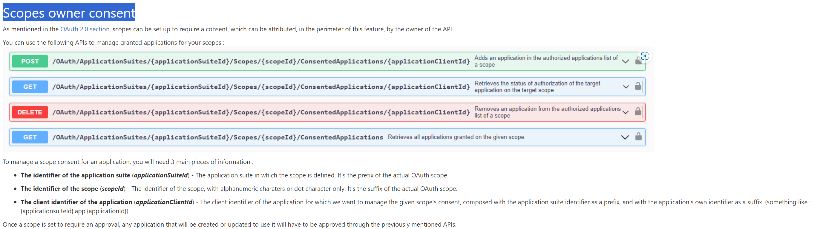
6. consent
internal: setup rest full API/consent
cegid: scopes/consent

Slide 7
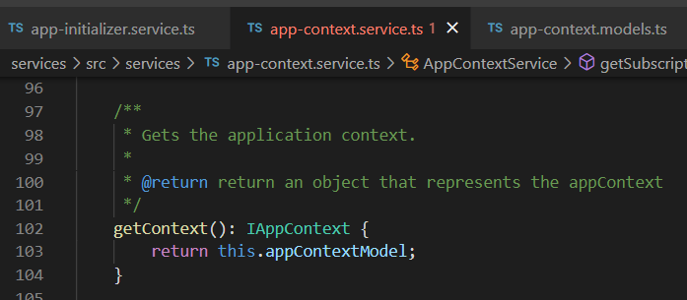




Z. template
new project
ExecuteAsync
square post-it
download
exe
download
exe
why
A slash
followed
by
two consecutive asterisks
D:\A1_research\C2_c0dice\B1_jmeter\A1_install
functionalities
introduction
build-exe
entity framework plus
zig help
⊂
4
every key-frame
defines the operation
deploy

