Slide 1
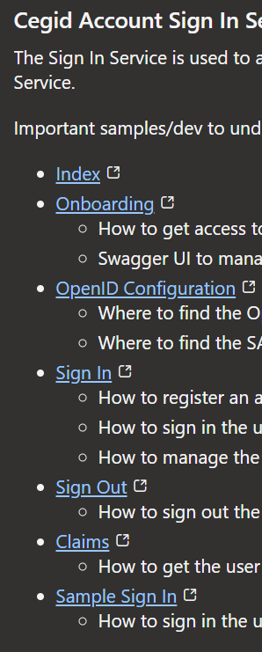
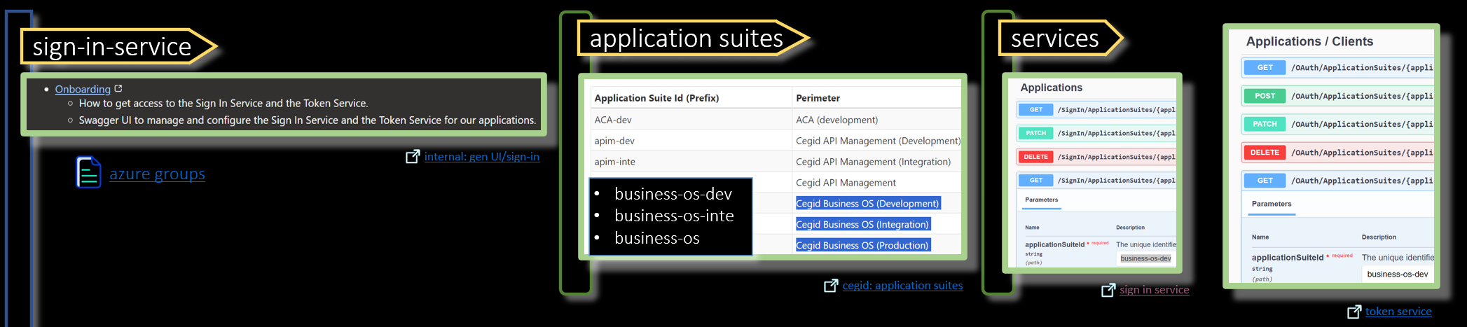

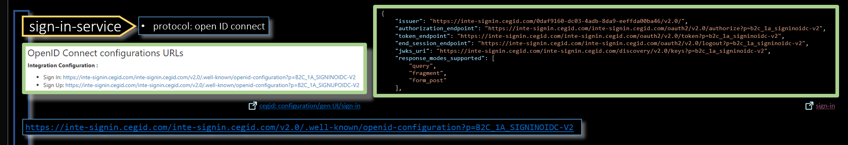
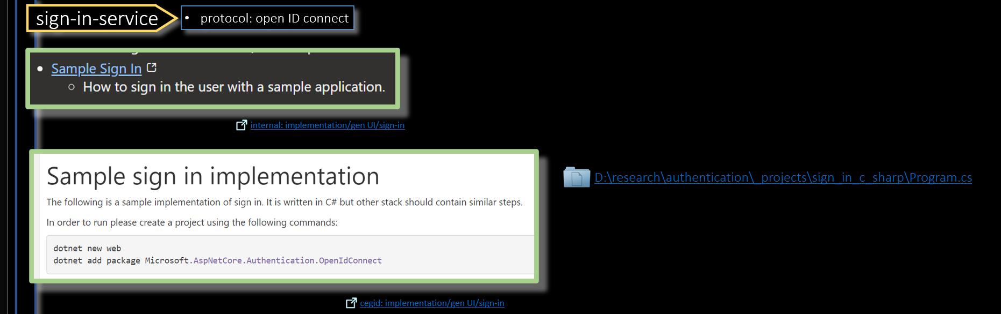

1. gen UI/sign in
process/onboarding
process/well known
process/onboarding
process/code
internal: gen UI/sign in

Slide 2
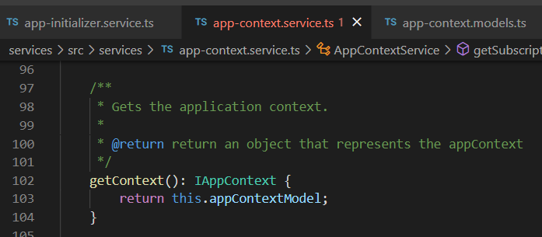





Z. template
new project
ExecuteAsync
square post-it
download
exe
download
exe
why
A slash
followed
by
two consecutive asterisks
D:\A1_research\C2_c0dice\B1_jmeter\A1_install
functionalities
introduction
build-exe
entity framework plus
zig help
⊂
4
every key-frame
defines the operation
deploy

