Slide 1

1. features
authentication

Slide 2

1.1 index
specifications
oauth2
open id connect
what
what
what
tokens
map
map
endpoints
scope
code
response type
client id
flows
code
id token
token
token
id token
id token
token
PKCE

Slide 3
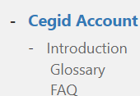

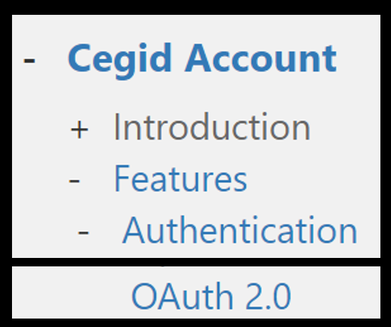
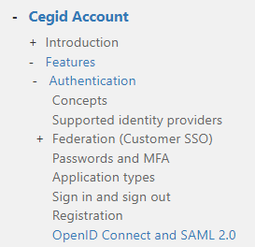
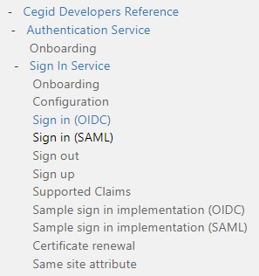
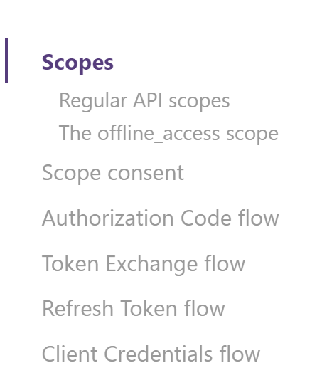
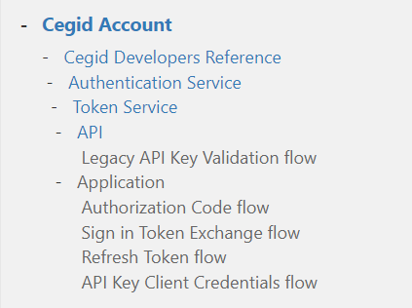
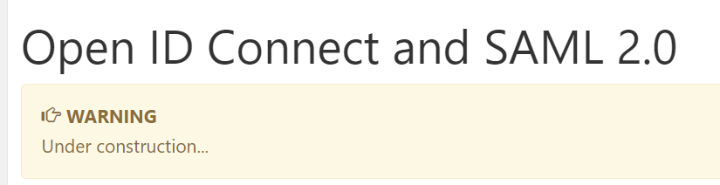

2. map
only for
reference
if needed
cegid documentation
open ID connect
oauth 2
cegid: open id connect
cegid: developers
cegid: features

Slide 4
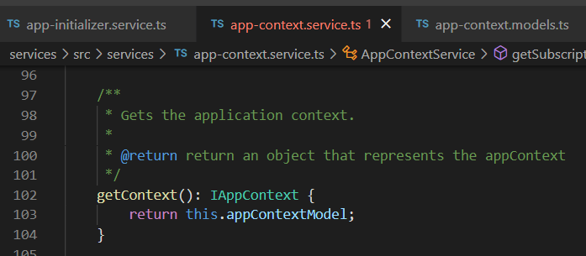



Z. template
new project
ExecuteAsync
square post-it
download
exe
download
exe
why
A slash
followed
by
two consecutive asterisks
D:\A1_research\C2_c0dice\B1_jmeter\A1_install
functionalities
introduction
build-exe
entity framework plus
zig help
⊂
⊂
4
every key-frame
defines the operation
deploy

