Slide 1

1. code
authentication
assistant

Slide 2

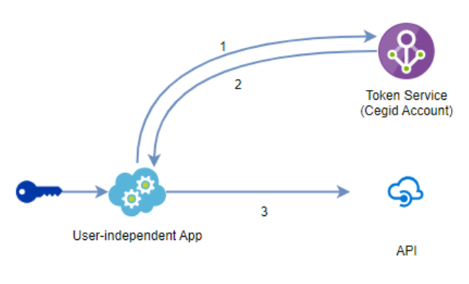
1.1 sources
cegid/developers/client credentials
1
In order to obtain
an access token,
the application must have:
API Key id;
secret
linked to
the customer
that it must "act for"
this supposes
these API Key id and secret
have been:
generated;
stored
ahead of time
during
a registration process
2
the application
can obtain
a new access token
from
the Token Service
with
a simple HTTP request
In order to make this request:
now the token endpoint of the Token Service
produce
an application/x-www-form-urlencoded
content
in
the request
parameters :
grant_type : client_credentials
client_id : the API Key Id retrieved in Step 1
client_secret : API Key secret retrieved in Step 1
scope : list of space separated actual OAuth 2.0 scopes,
that are present in the scopes list
registered on the API Key,
and that do not require owner consent
response
the Token Service
will provide
a JSON content
with
the access token

Slide 3
1.2 onboarding
Features/Authentication/ApiKeys
API keys
is a mechanism
that enables
calling an API
for accessing
a resource
with
an application identity
managed by
the customer
It should be
reserved to
user-independent applications,
meaning that
the business requirement
for
the process that will run
does not involve
knowing
the user who runs it
API keys should be seen as a user
it's a type of identity
that is able
to access
resources
that the
customer host
in
our cloud solutions
has a 'password' (A secret) to prove Cegid Account it is who it claims to be
may have one or multiple access to services on one or multiple accounts
may have some fine-grained access on very specific resources in a given application
(A document, a precise kind of operation, etc...)
is managed by the customer, not by Cegid teams
Cegid Account
is
a Customer IAM
handles security
from
the customer perspective
it is not managing security
of
internal services
when the architecture decision is made
to rely
on infrastructure secrets internal to the cloud operator (Cegid here) for communication between two services, micro-services, or projects.
This means Cegid Account API keys do not replace Azure Active Directory authentication mechanisms (Like Service Principal, Managed Identities)
for example,
or other cloud providers authentication mechanisms to enforce a zero-trust principle
in an application architecture where customer identity can not be used or does not make any sense from the customer perspective.

Slide 4
1.3 provider
Features/Authentication/ApiKeys
If the product must expose an API, secured by API key, it will need to :
Register the service
relative to
their product as "supporting API keys" :
This is optional;
as for
user access rights,
usage of a service
in
Cegid Account
that is relative to
a product
is optional
Details can be found in the documentation about how to Create a service for Cegid Account in the Cegid PM & PO Reference.
Register its API and scopes (that should let API key 'enter') on the Token Service of Cegid Account :
Registration process will vary depending on the authentication flow that will be supported by the API (See details below).
Details can be found in the documentation about API in the Cegid Developers Reference for the Token Service.
If the above option to have a service "supporting API keys" is used, the scope registration should include the assignedToApiKeyForServices field.
Implement API authentication validation mechanism in its API code :
Validation process will vary depending on the authentication flow that will be supported (See details below).
Details can be found in the documentation about API in the Cegid Developers Reference for the Token Service.

Slide 5

2. what
..\..\_projects\sign_in_python

Slide 6
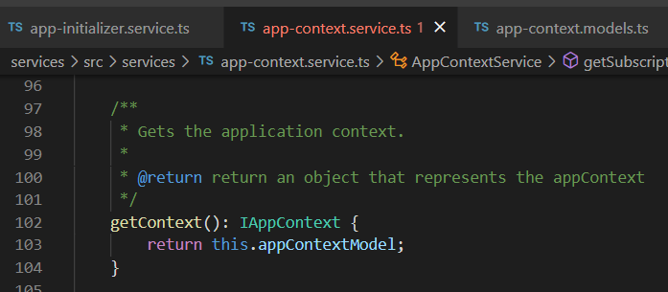




Z. template
new project
ExecuteAsync
square post-it
download
exe
download
exe
why
A slash
followed
by
two consecutive asterisks
D:\A1_research\C2_c0dice\B1_jmeter\A1_install
functionalities
introduction
build-exe
entity framework plus
zig help
⊂
⊂
4
every key-frame
defines the operation
deploy

