Slide 1

1. onboarding
authentication
assistant

Slide 2

2. cegid token TESTS app
cegid token service management

Slide 3
2.1 api
cegid account onboarding endpoints
SWAGGER DEV
login end point
nothing
token end point
{
"apis": [
{
"id": "backend",
"applicationSuiteId": "business-os-dev",
"clientId": "business-os-dev.api.backend",
"scopes": [
"business-os-dev.build.rw",
"business-os-dev.request.rw"
],
"internalDescription": "Cegid Pulse OS backend API to read
and write skills, models, agents, workflows, sessions, and requests.",
"scopeIds": [
"build.rw",
"request.rw"
]
}
]
}

Slide 4
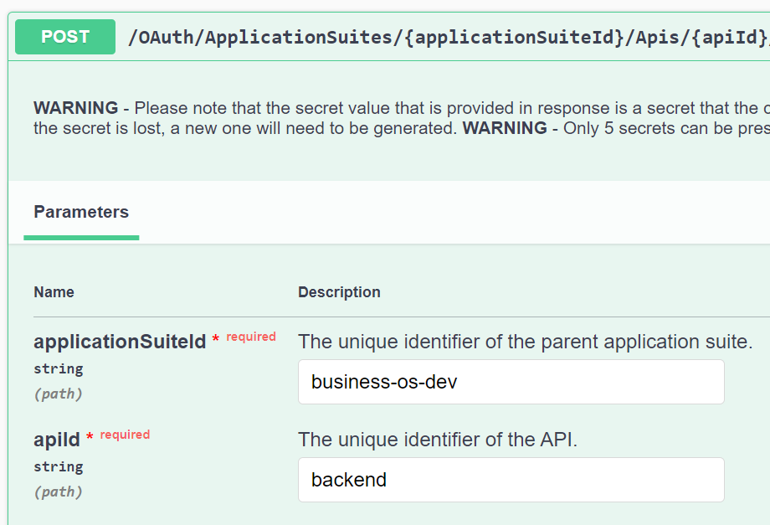
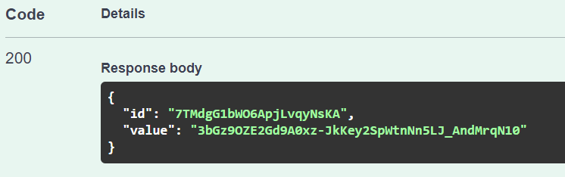
2.1.1 secret
cegid token service management
id
7TMdgG1bWO6ApjLvqyNsKA
API id
backend
API secret
3bGz9OZE2Gd9A0xz-JkKey2SpWtnNn5LJ_AndMrqN10

Slide 5
2.2 app
cegid account onboarding endpoints
TESTS DEV
SWAGGER DEV
login end point
nothing
login end point
nothing
token end point
token end point
{
"id": "skunk.tests",
"applicationSuiteId": "business-os-inte",
"accessTokenValiditySeconds": 3600,
"allowClientCredentials": false,
"allowOfflineAccess": true,
"applicationType": "AuthorizationCodeWithPkce",
"clientId": "business-os-inte.app.skunk.tests",
"clientIdAlias": null,
"internalDescription": "Test app to be used by skunk works",
"redirectUris": [
"http://localhost:8990/callback
],
"refreshTokenValiditySeconds": 86400,
"requireClientSecret": false,
"reusableRefreshToken": true,
"scopes": [
{
"scopeId": "business-os-inte.build.rw",
"granted": true
},
{
"scopeId": "business-os-inte.request.rw",
"granted": true
},
{
"scopeId": "devisfact-dev.aiapi.global",
"granted": true
}
],
"signinApplicationClientId": null
}
{
"id": "pulseosapi",
"applicationSuiteId": "business-os-inte",
"accessTokenValiditySeconds": 3600,
"allowClientCredentials": false,
"allowOfflineAccess": true,
"applicationType": "AuthorizationCodeWithPkce",
"clientId": "business-os-inte.app.pulseosapi",
"clientIdAlias": null,
"internalDescription": "Cegid Pulse OS Swagger",
"redirectUris": [
"http://localhost:8989/docs/oauth2-redirect",
"https://oauth.pstmn.io/v1/callback",
"https://st-pulse-api.azurewebsites.net/docs/oauth2-redirect"
],
"refreshTokenValiditySeconds": 86400,
"requireClientSecret": false,
"reusableRefreshToken": true,
"scopes": [
{
"scopeId": "business-os-inte.build.rw",
"granted": true
},
{
"scopeId": "business-os-inte.request.rw",
"granted": true
}
],
"signinApplicationClientId": null
}

Slide 6
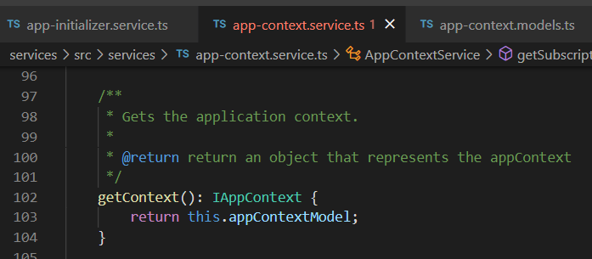





Z. template
new project
ExecuteAsync
square post-it
download
exe
download
exe
why
A slash
followed
by
two consecutive asterisks
D:\A1_research\C2_c0dice\B1_jmeter\A1_install
functionalities
introduction
build-exe
entity framework plus
zig help
⊂
⊂
4
every key-frame
defines the operation
deploy

