Slide 1

1. authentication
portfolio

Slide 2

1.1 index
theory
documentation
implementation

Slide 3
1.1.1 theory
features
specifications
oauth2
open id connect
what
what
what
tokens
map
map
endpoints
flows
scope
code
authorization code
response type
TBD
client id
implicit
flows
resource owner
code
id token
client credentials
token
refresh token
token exchange
token
BFF
id token
id token
token
PKCE

Slide 4
1.1.2 documentation
documentation map
cegid services (end-points)
oauth2
flows
oauth2
OIDC
refresh
exchange
client credentials
Fast API

Slide 5
1.1.3 implementation
developers
process
onboarding
onboarding/details
this is the name
of
the section
in
Cegid documentation
well known
details
code
details
CTU/postman
assistant
tests
business
assistant integration with SG

Slide 6

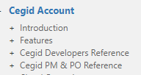
1.2 sources
internal documentation
cegid documentation
well known: OIDC
well known: oauth2
client credentials
Authentication/TokenService/Application/ApiKeyClientCredentials
tests
register new user
mail confirmation
tools
logs
decode tokens
decode base64
Kqlmagic quick start

Slide 7

1.3 resources
_resources\cegid
contains JSON data
from
CEGID authentication swagger
_resources\postman
contains JSON data
from
PENARD
to authenticate
_resources\Diagrams of All The OpenID Connect Flows.pdf
_resources\Diagrams And Movies Of All The OAuth 2.0 Flows.pdf

Slide 8

2. summary
1
review the video to remember the concepts
video
specifications
2
understand the flows: what? why? how?
is app authorized?
can client access resource?
call API
server inspect content
user is authenticated?
to get user profile data
why/what
access token
ID token
parameter | OAuth2 | OIDC | result (video) | end points | credentials |  | cegid
response_type | authorization code | code | authorization code; access token, ID token | authorization; token | client_id
 | implicit | token | access token, ID token | authorization | client_id
 |  | id_token | ID token
 | token exchange
grant type | resource owner |  |  | token | user/password
 | client credentials |  |  |  | user/password | confidential
 | refresh token |  |  |  | client_id, client_secret
cegid: features/oauth2/authorization code
cegid: features/sign in and out
cegid: developers/SigninTokenExchange
cegid: developers/client credentials
cegid: developers/Refresh token
PKCE
only if OIDC
3
application suites
business-os-dev
business-os-inte
business-os
Tokens Service Management

Slide 9
3. problems
openid-connect-do-you-need
first party / third party
cookies
What cookies are used for
build Login, Signup app and authenticate with cookies
Cross Site Request Forgery (CSRF)
Cookies and sessions
Frontend Malicious - Part 2 -The Insecurity of OAuth 2.0 in Frontends
The insecurity of OAuth 2.0 in frontends
why-is-oauth-still-hard

Slide 10
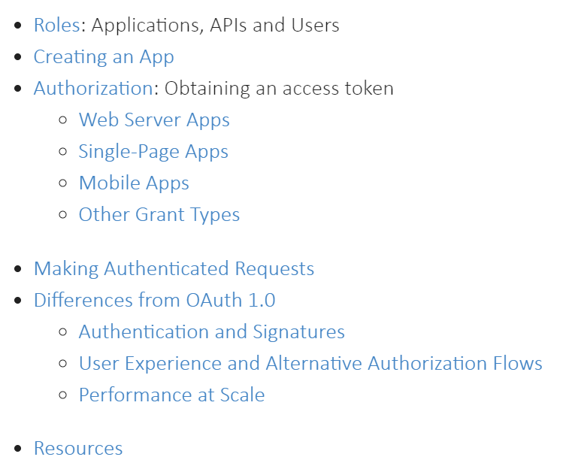
4. questions
relate flows with cegid
why CEGID swagger uses different endpoints from our swagger?
understand application parameters when creating in token endpoint
understand exchange token flow
can I use this flow to exchange a ID token for an authorization token?
claims vs scopes
oauth-2-simplified
single-page-apps -> implicit flow
which-oauth-2-0-flow-should-i-use
documentation/flows
client id
secret: when? ask Sebastien?
redirect-uri-registration
registering-new-application/
OAuth Claims Ontology: Using Claims in OAuth and How They Relate to Scopes
BFF
backend-for-frontend-pattern-with-auth0-and-dotnet

Slide 11
5. signature
_resources\signature\Captura de ecrã 2025-01-09 174135.gif

Slide 12
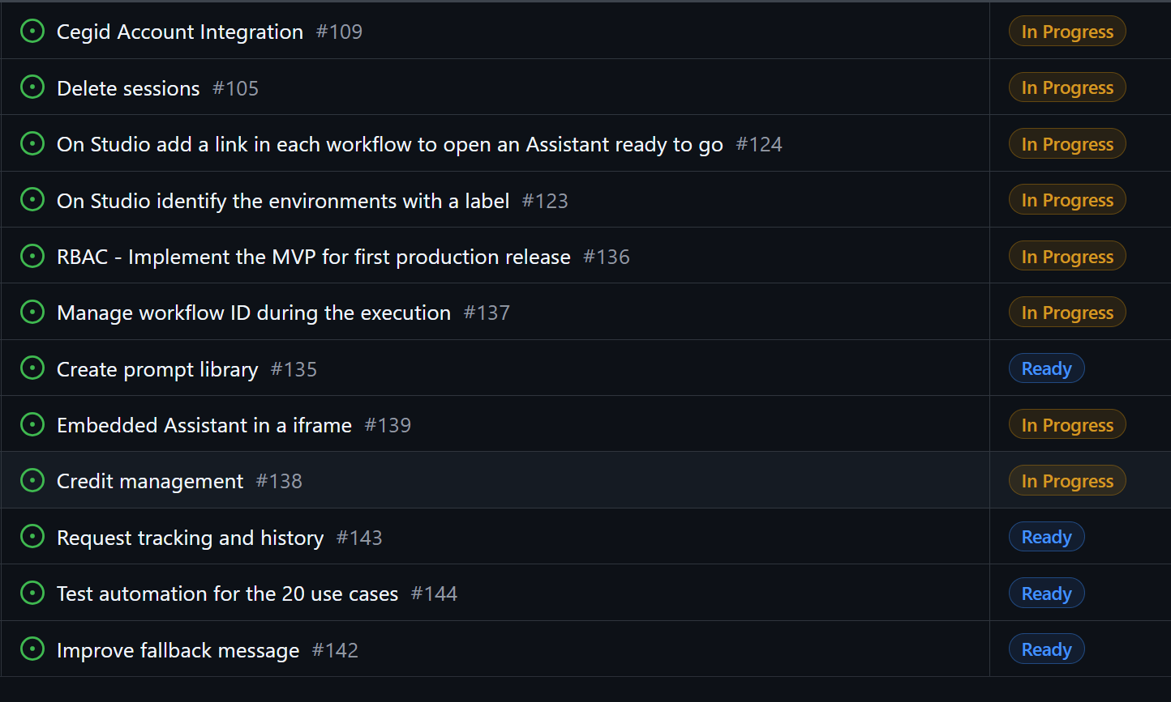
5. status
done
done
done
done
meet tomorrow with Raphael and you
will be done by architecture team

Slide 13
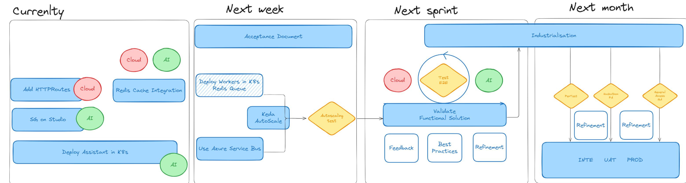
5.1 infra
INFRA PLAN FROM ARCHITECTURE TEAM
all done
waiting for architecture team

Slide 14
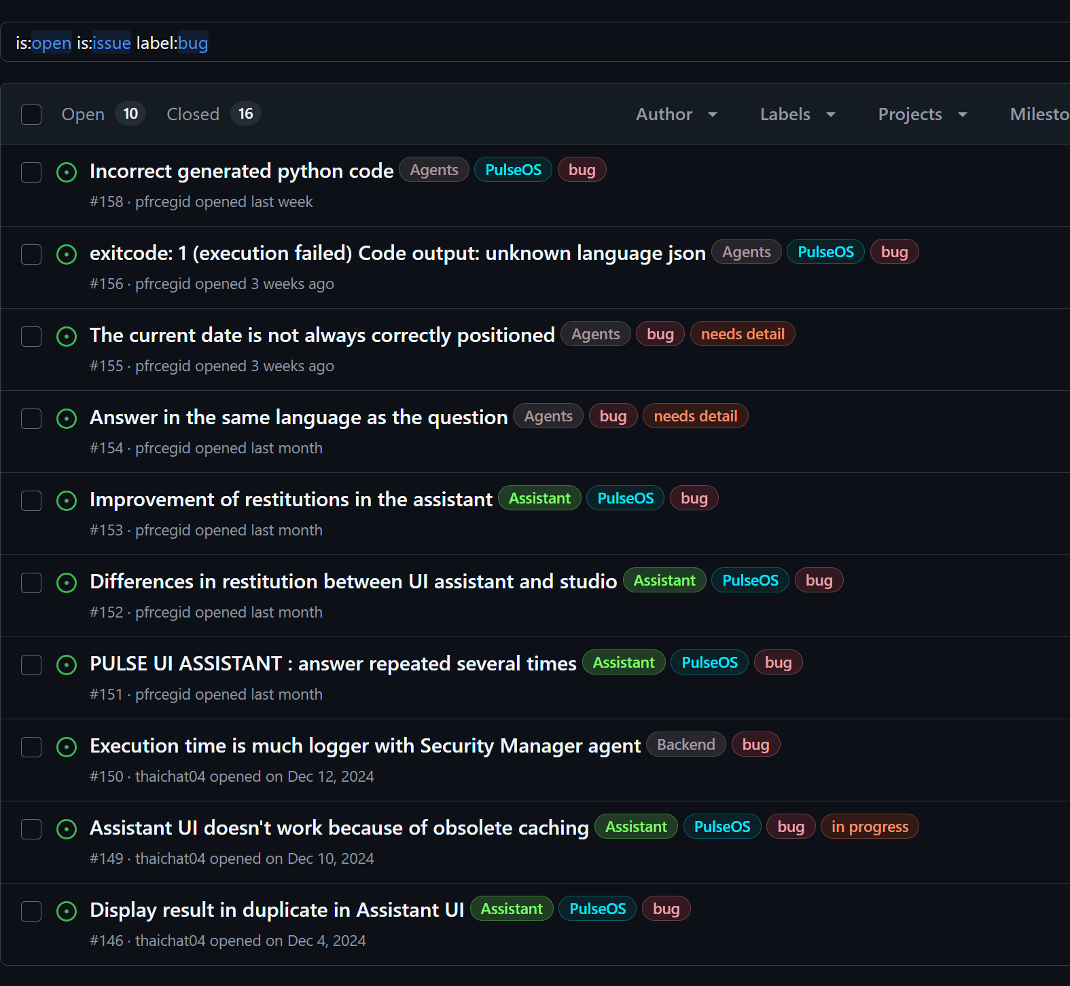
5.2 issues
to be solved next week

Slide 15
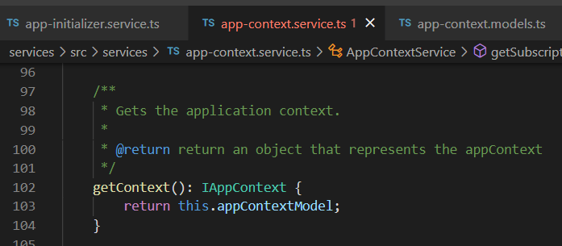



Z. template
new project
ExecuteAsync
square post-it
download
exe
download
exe
why
A slash
followed
by
two consecutive asterisks
D:\A1_research\C2_c0dice\B1_jmeter\A1_install
functionalities
introduction
build-exe
entity framework plus
zig help
⊂
⊂
4
every key-frame
defines the operation
deploy

