Slide 1

1. pipelines
portfolio

Slide 2
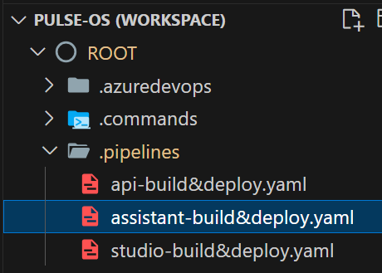
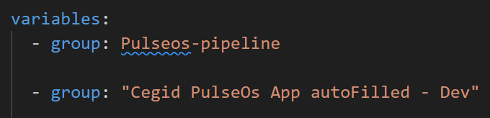
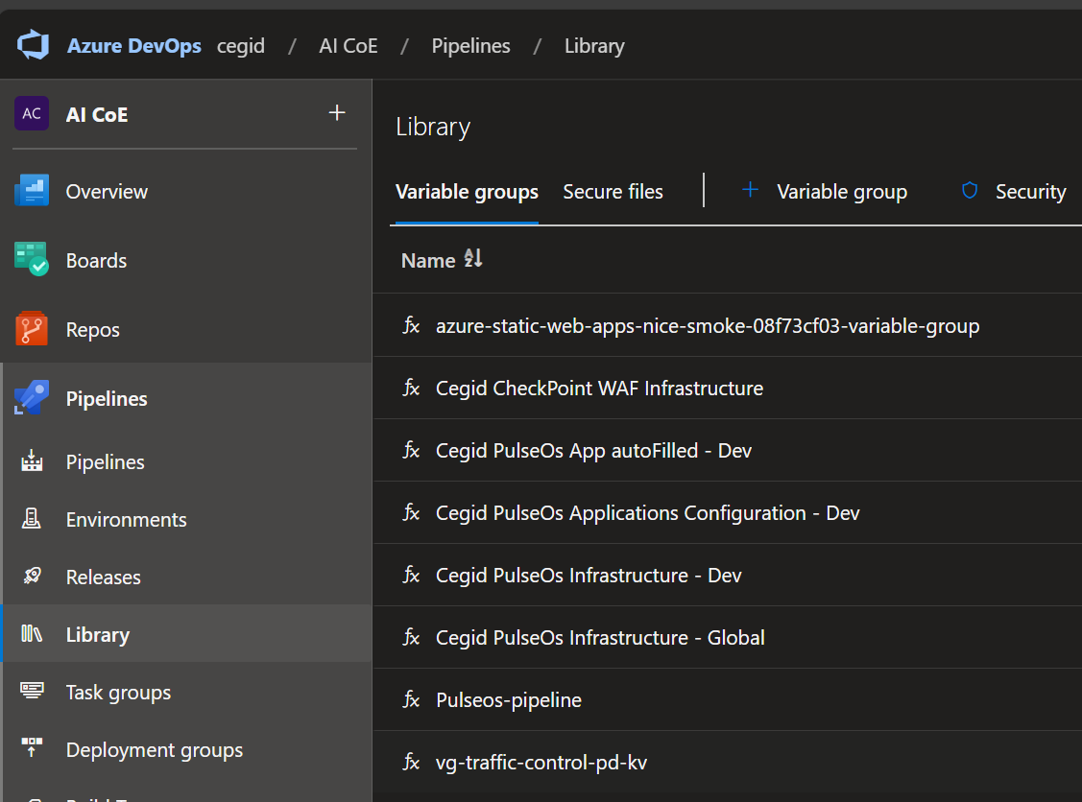
2. variables

Slide 3
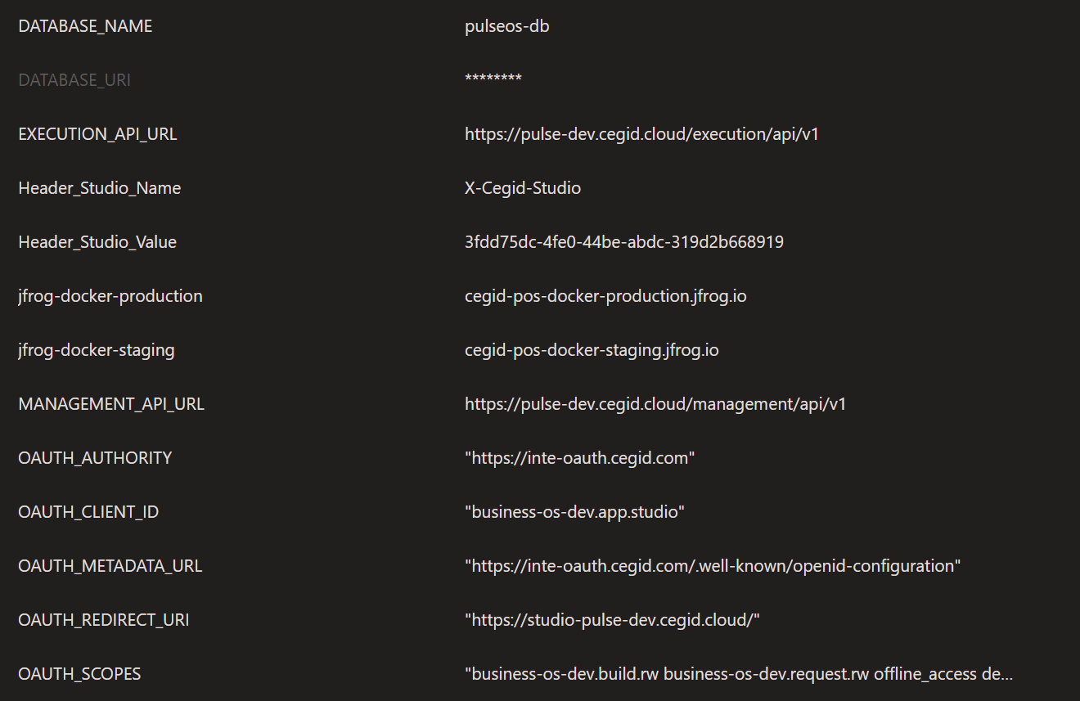
2.1 pulseos-pipeline

Slide 4
3. lens

Slide 5
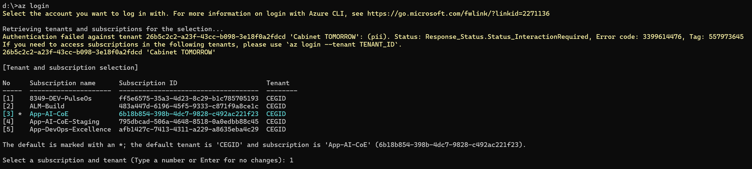
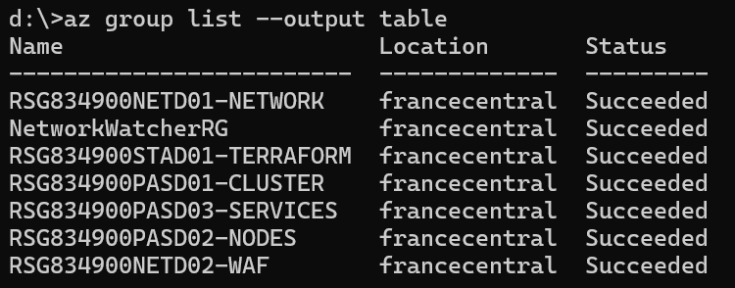
3.1 setup
az login
select the k8s subscription
az account show --output table
display current subscription
az group list --output table
display resource groups
az aks get-credentials --resource-group RSG834900PASD01-CLUSTER --name CON834900AKSD01 --admin
connect to k8s cluster

Slide 6

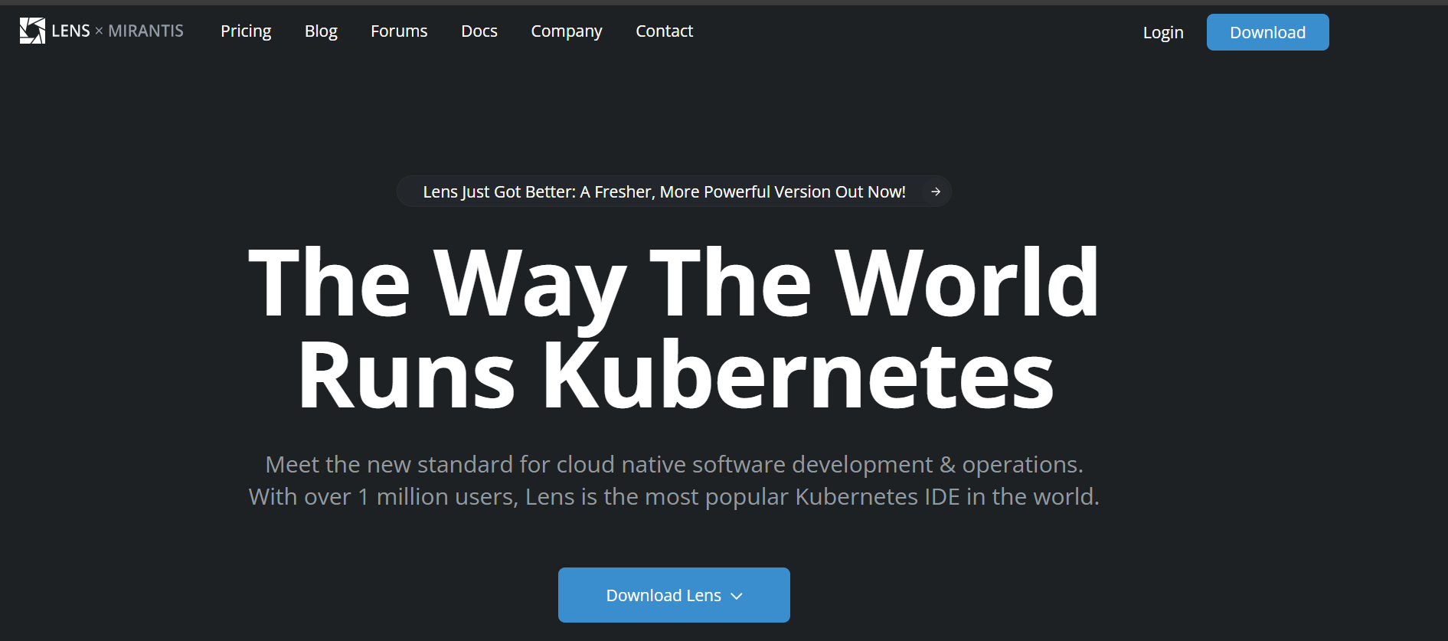
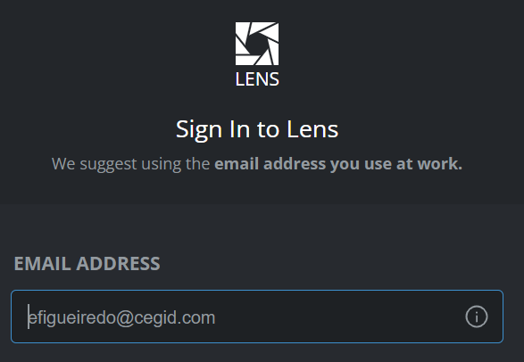
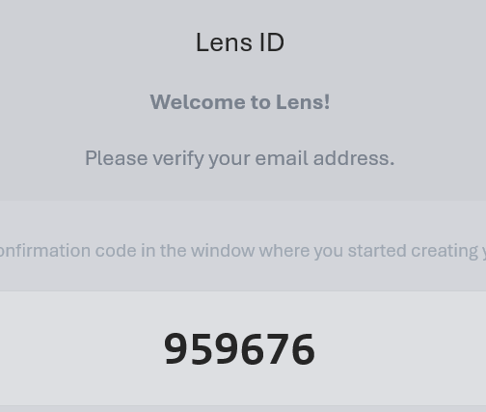
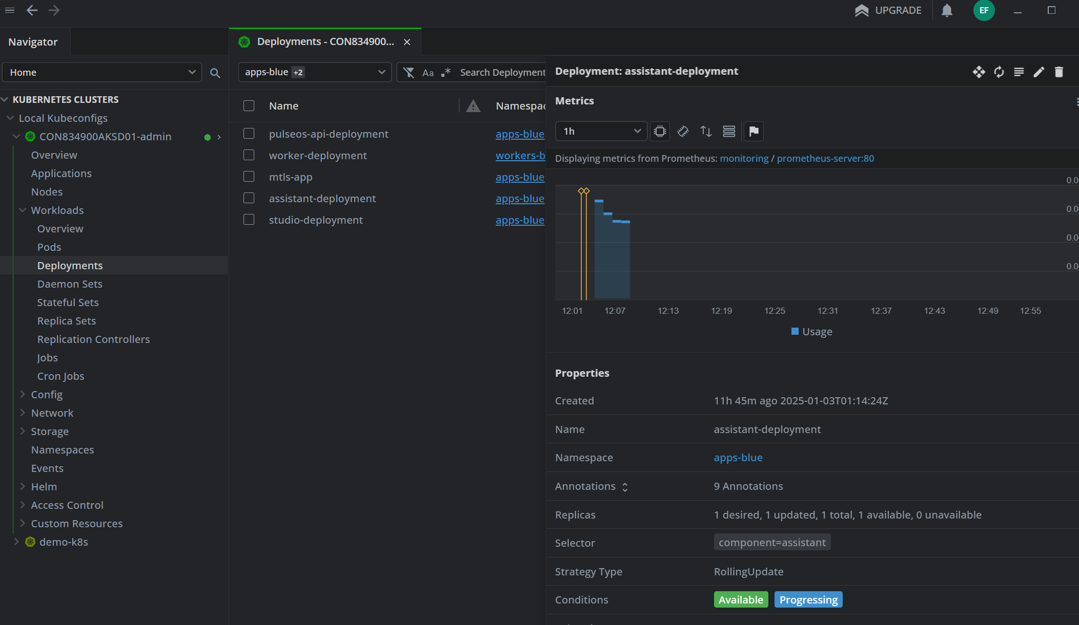
3.2 install
k8slens
automatically
created
after setup

Slide 7
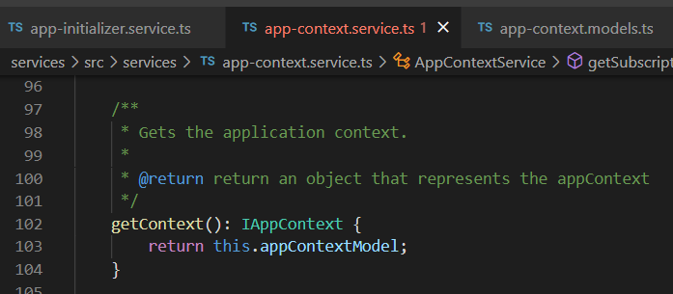





Z. template
new project
ExecuteAsync
square post-it
download
exe
download
exe
why
A slash
followed
by
two consecutive asterisks
D:\A1_research\C2_c0dice\B1_jmeter\A1_install
functionalities
introduction
build-exe
entity framework plus
zig help
⊂
⊂
4
every key-frame
defines the operation
deploy

