Slide 1



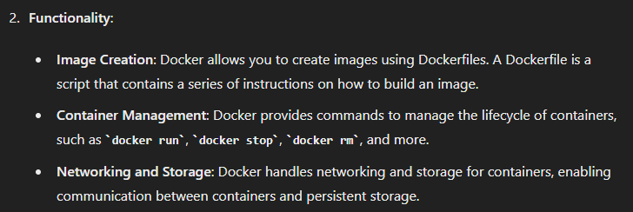
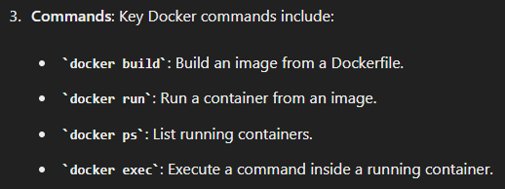
1. docker
portfolio
portfolio
what

Slide 2
1.1 index
overview
docker
local
push
aws
compose

Slide 3
2. lexicon

Slide 4
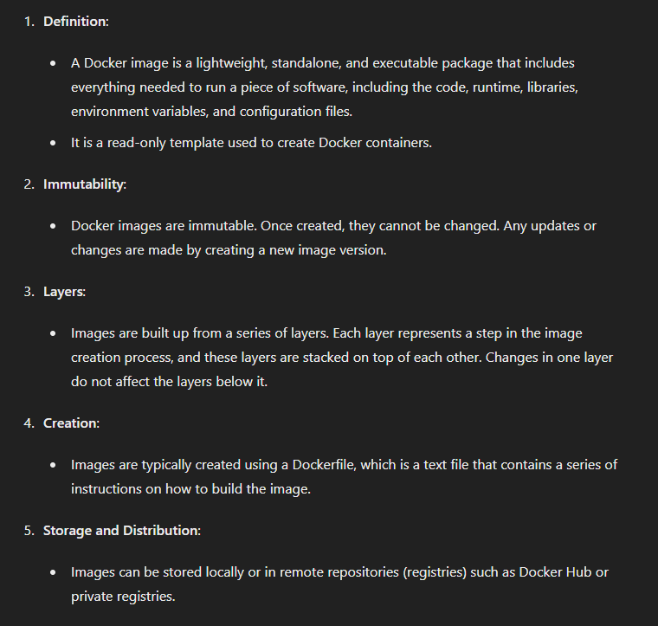
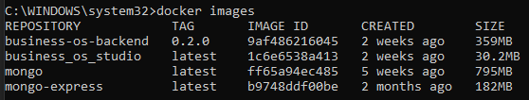
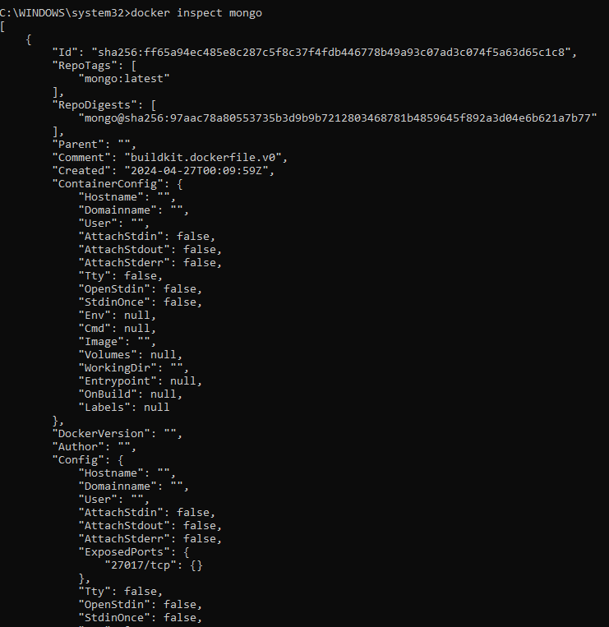
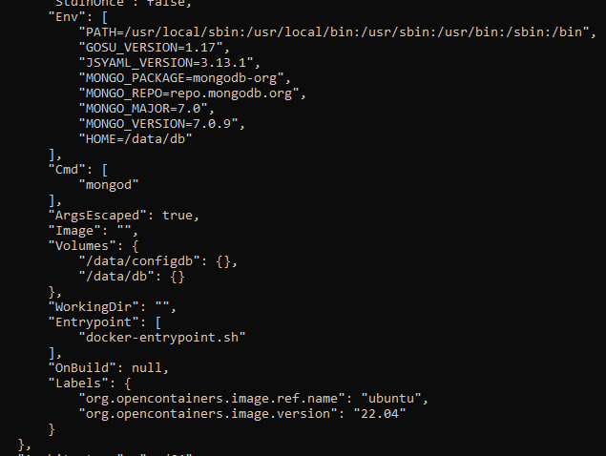
2.1 image
docker images
docker rmi <image_id>
docker pull <image_name>
docker inspect mongo

Slide 5
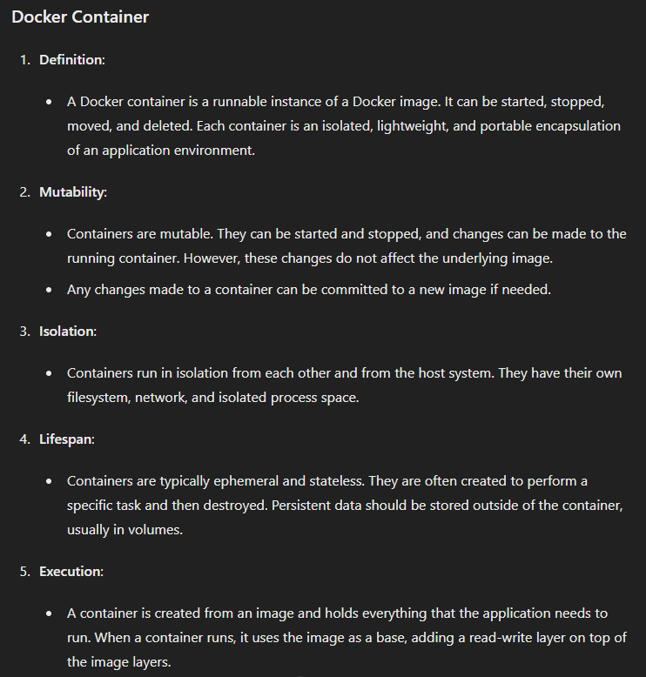
2.2 container

Slide 6
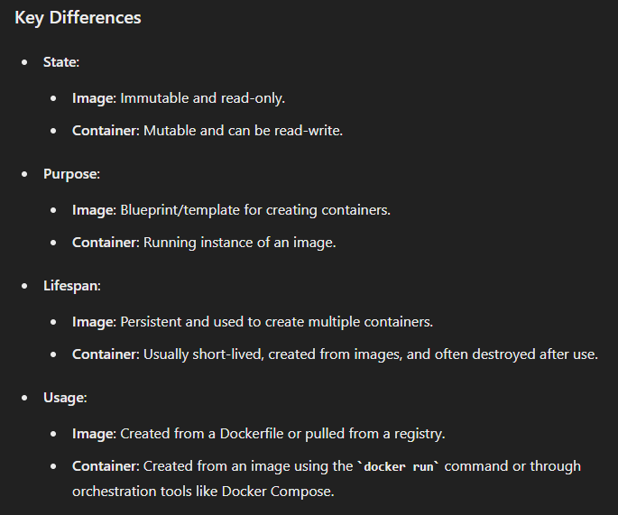
2.3 differences

Slide 7

3. internals
what

Slide 8
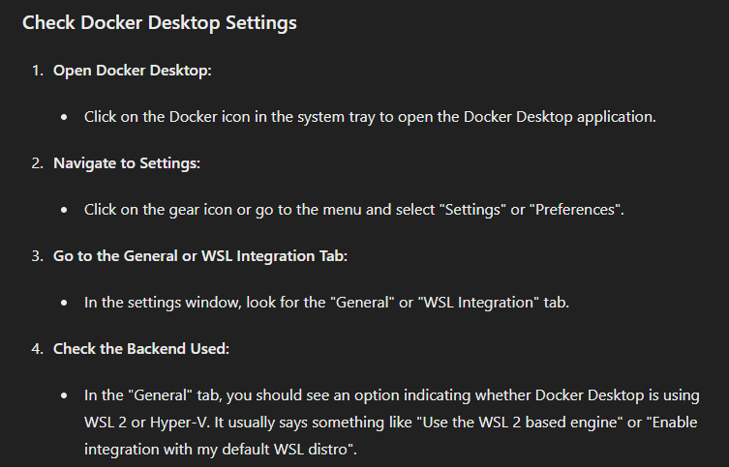


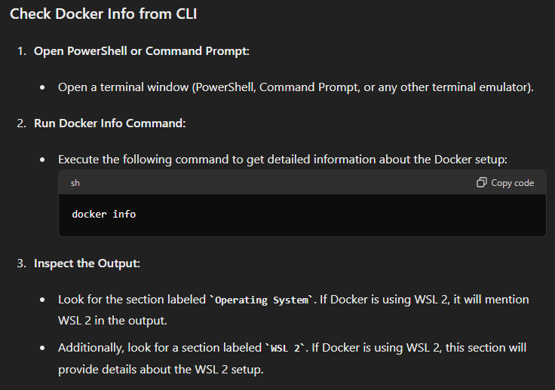
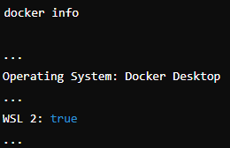
3.1 check
what

Slide 9
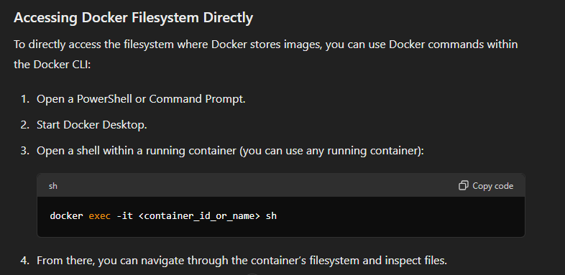
3.2 direct
what

Slide 10
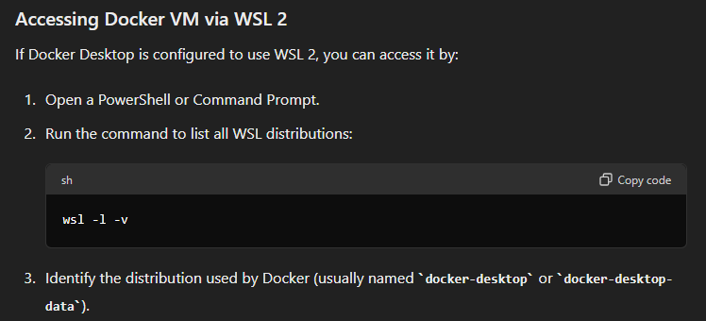
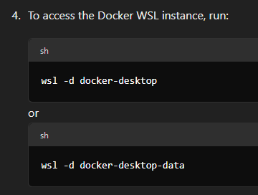
3.3 wsl
what

Slide 11
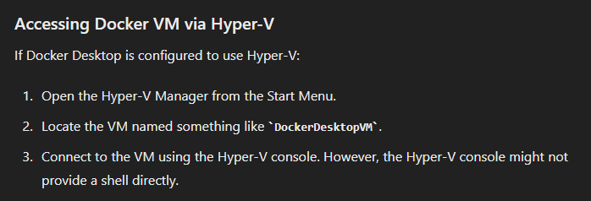
3.4 hipper-v
what

Slide 12
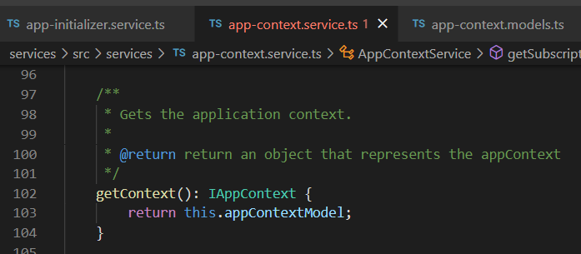




Z. template
new project
ExecuteAsync
square post-it
download
exe
download
exe
why
A slash
followed
by
two consecutive asterisks
D:\A1_research\C2_c0dice\B1_jmeter\A1_install
functionalities
introduction
build-exe
entity framework plus
zig help
⊂
4
every key-frame
defines the operation
success

