Slide 1

1. cursor
portfolio

Slide 2
1.1 index

Slide 3

1.2 sources
main site

Slide 4
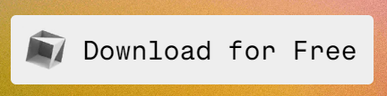
2. download
main site

Slide 5
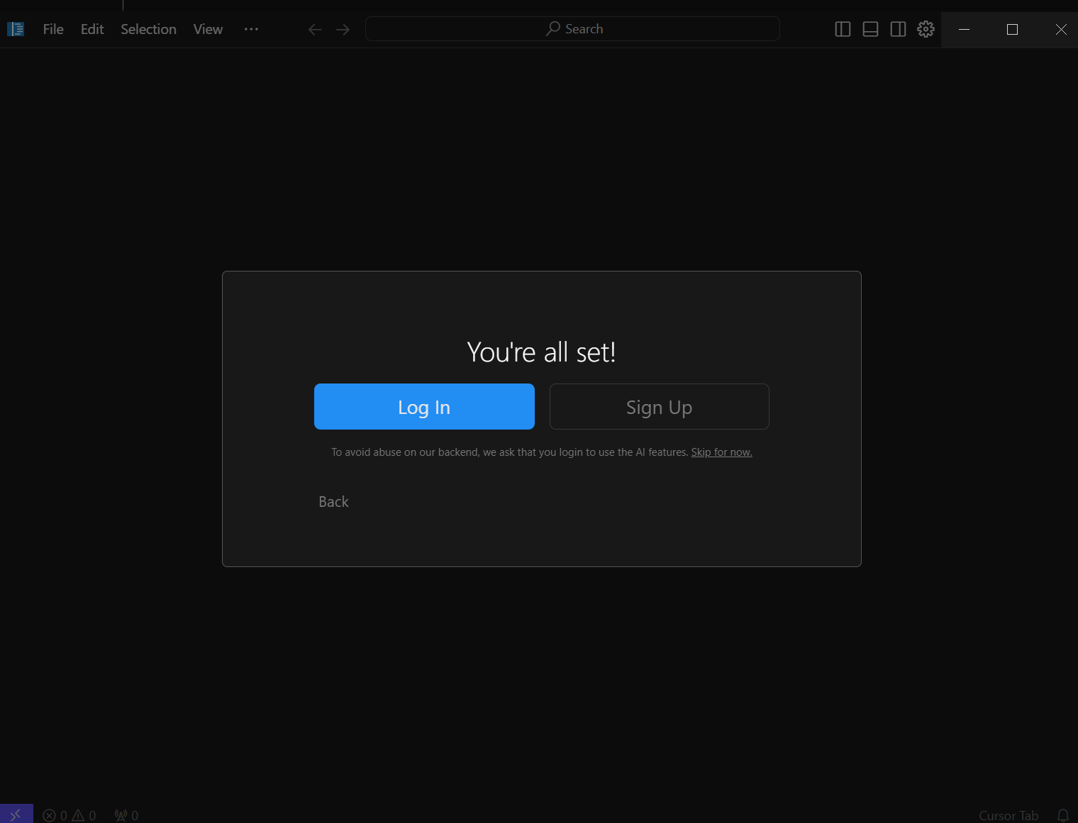
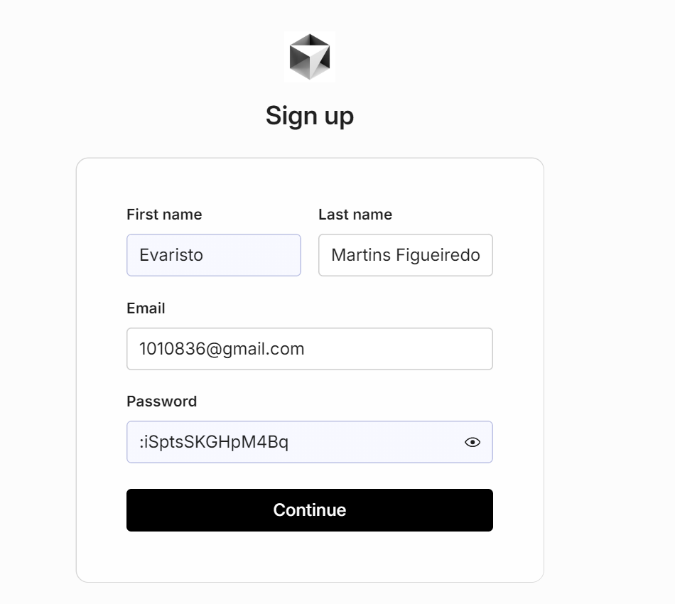
2. setup
:iSptsSKGHpM4Bq

Slide 6
3. onboarding

Slide 7
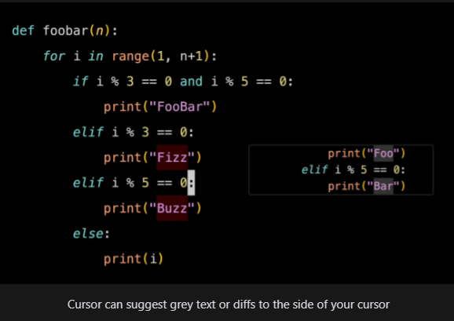
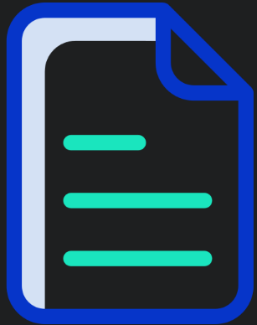
3.1 auto complete
what
docs

Slide 8
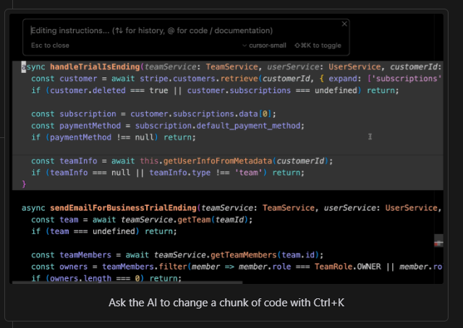
3.2 change code
what
CTRL + K

Slide 9
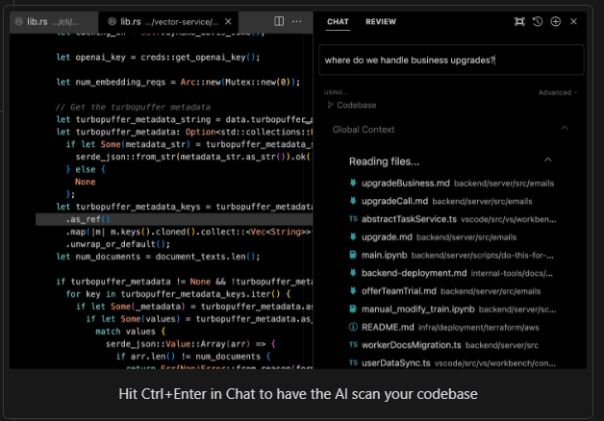
3.3 questions
what
CTRL + Enter

Slide 10
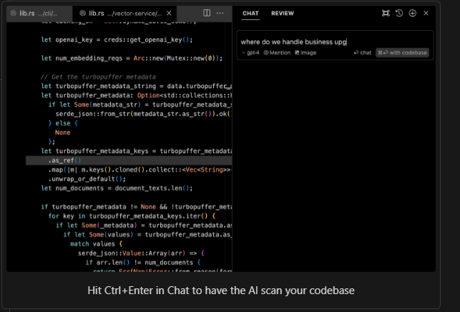
3.4 code base
what
CTRL + Enter

Slide 11
4. docs

Slide 12
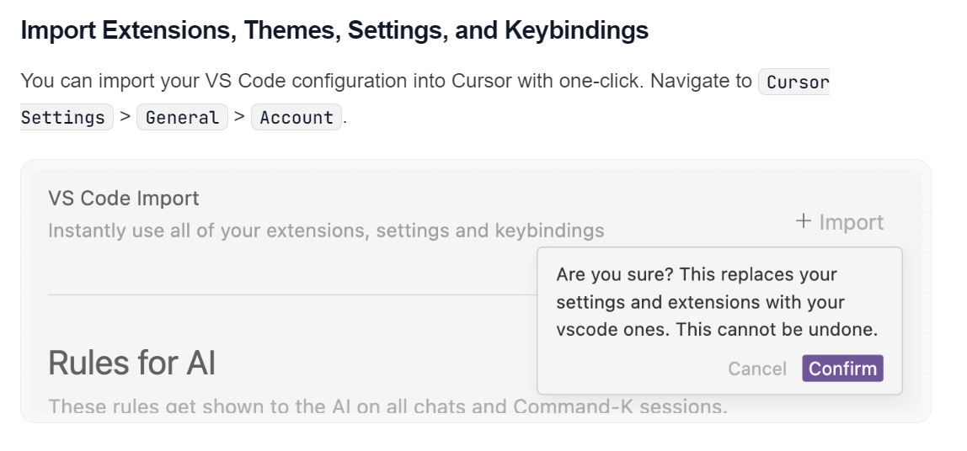
4.1 vsCode
what
settings
general
account
entity framework plus
try lather

Slide 13
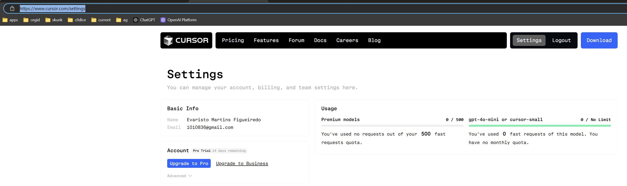
4.2 usage
what
check use
documentation

Slide 14
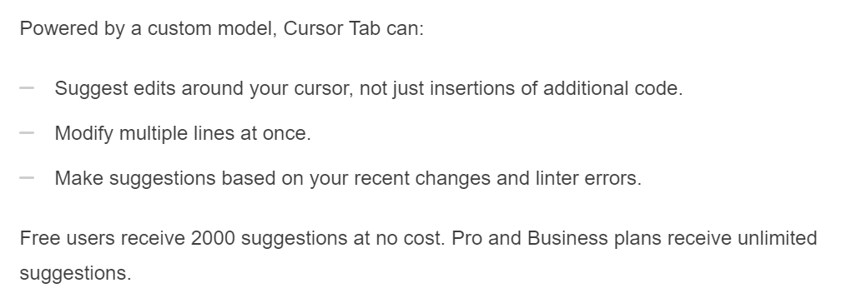
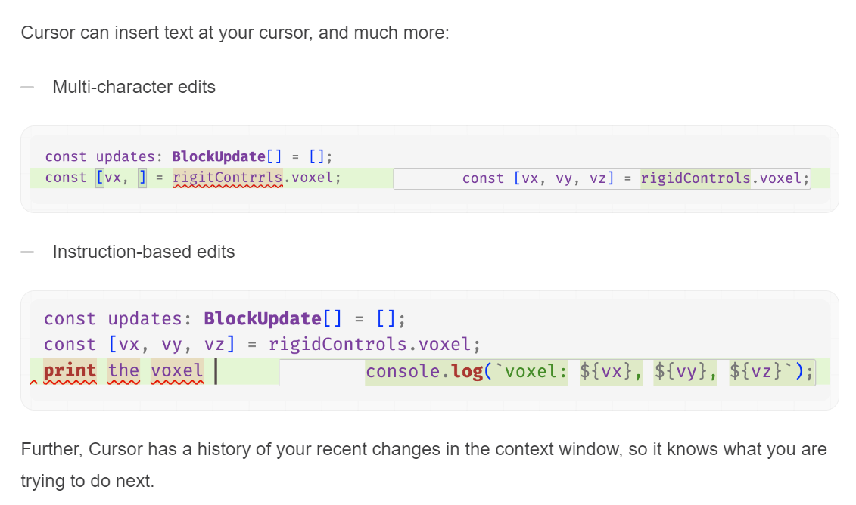
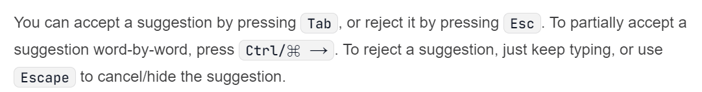
4.2 auto complete
what
documentation
documentation
how
Tab
accept
Esc
reject
Ctrl + ->
partial
onboarding

Slide 15
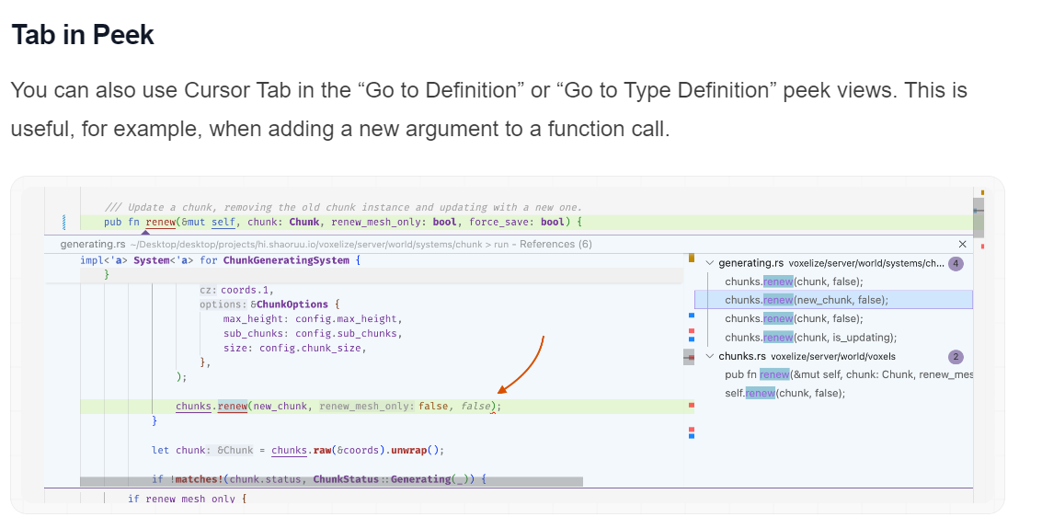
4.2.1 go to definition
what
documentation
documentation

Slide 16
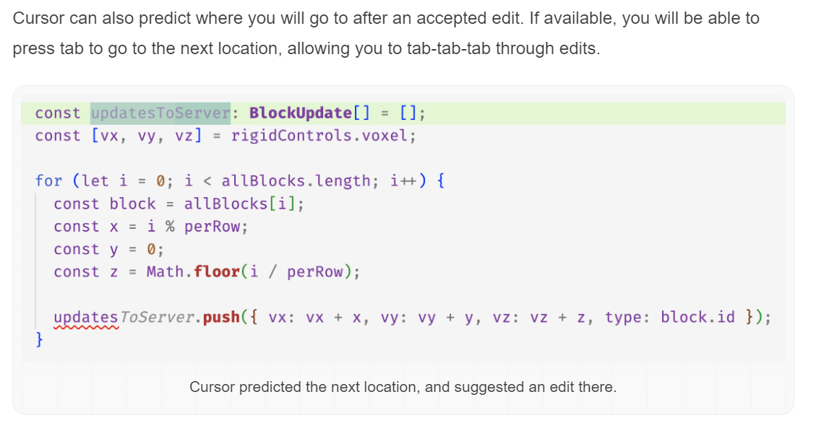
4.2.2 cursor prediction
what
cursor prediction

Slide 17
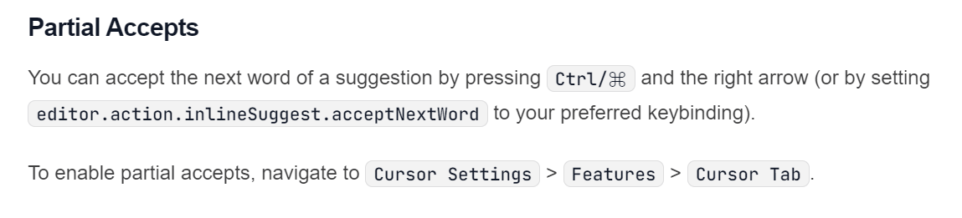
4.2.3 partial accepts
what
partial-accepts

Slide 18
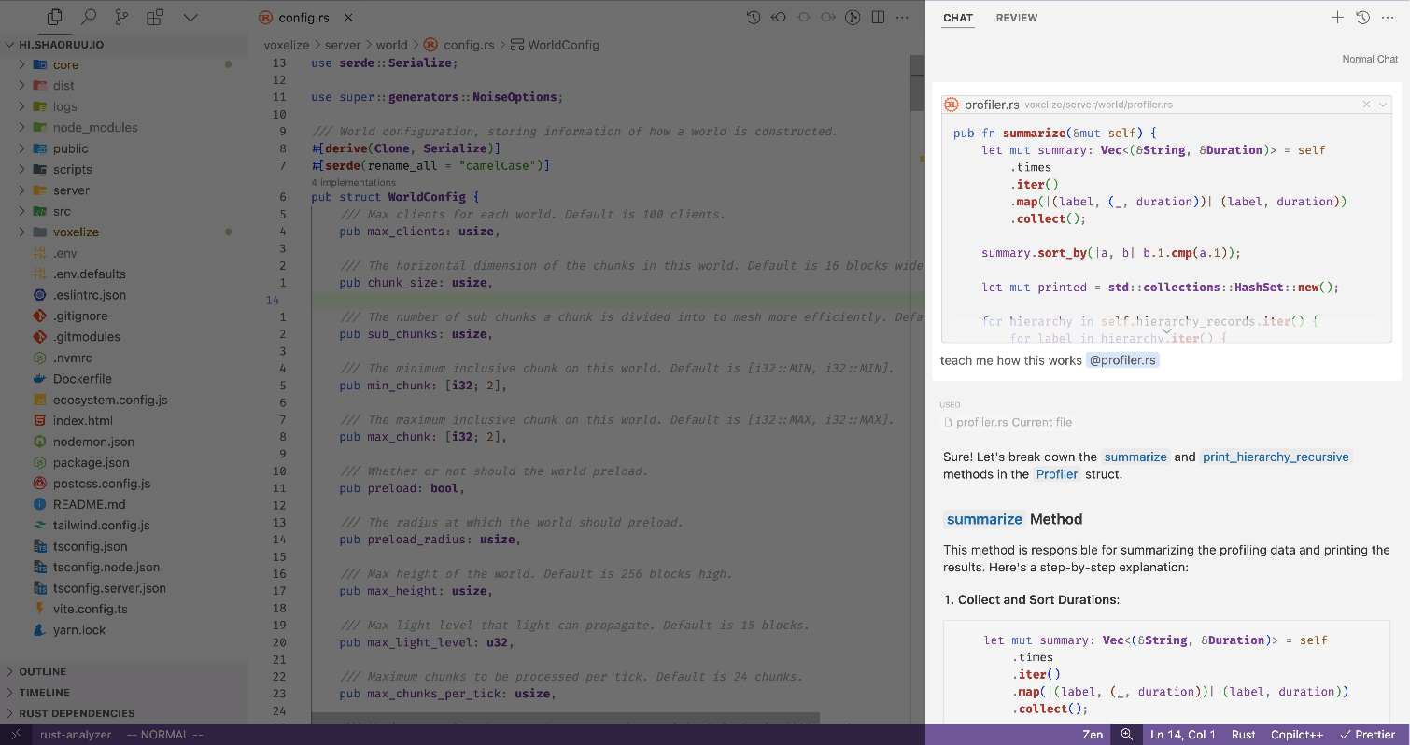
4.3 chat
is in the AI pane,
which is on
the opposite side
of
your primary sidebar
what
can toggle the AI pane
by pressing
Ctrl + L
to submit your query,
press
Enter
chat
several built in features to provide context in chat
automatically including context across your entire codebase,
searching the web,
indexing documentation,
user-specified references to code blocks
built to eliminate
the tedious copy-pasting
context
onboarding

Slide 19
4.3.1 redo questions
You can go back to any previous user messages
to edit
and
rerun
your queries
this will overwrite
any messages
after that
and
regenerate new ones
what
user-and-ai-messages

Slide 20
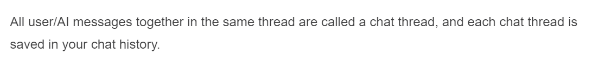
4.3.2 history
what
By pressing on the “Previous Chats” button
on
the top right
of
the AI pane,
you can see the chat history
Ctrl + Alt + L
chat-history

Slide 21
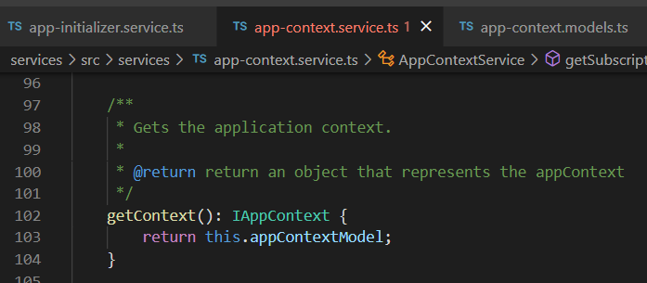



Z. template
new project
ExecuteAsync
square post-it
download
exe
download
exe
why
A slash
followed
by
two consecutive asterisks
D:\A1_research\C2_c0dice\B1_jmeter\A1_install
functionalities
introduction
build-exe
entity framework plus
zig help
⊂
4
every key-frame
defines the operation
success

