Slide 1

1. dev ops
portfolio

Slide 2
1.1 index

Slide 3

1.2 sources
github
link-to-from-github
azure/devops/boards/github
azure/devops/boards/github/install-github-app
github.com/settings/installations

Slide 4
2. summary
1
used to group work items by team, product, or feature area
help in organizing work items based on the logical or functional components of your project.
logical/functional
components
of
the project
create areas
default
when you create a team,
Azure DevOps automatically creates
an Area Path
with the team's name
sets it
as the default
for
that team
new work items
created by the team
are automatically assigned
to
this Area Path
time periods
of
the project
also known as sprints,
assign work items
to
specific time-boxed intervals,
such as sprints, milestones,
or other time-related periods
2
create iterations
they are essential
for
planning and tracking work
over time
3
create team
each team
can be assigned
one or more
Area Paths
which determine
the set of work items
that appear
on the team’s
backlogs and boards
when a team
is assigned an Area Path,
all work items under that path
become associated with the team
this association
ensures that
the team's Agile tools
such as backlogs, boards, and sprints
display only
the work items
relevant to that team
by configuring Area Paths
appropriately,
organizations can manage multiple teams
within a single project,
each with
its own distinct set of work items and focus areas

Slide 5
2.1 backlog
backlog visibility
Work items
assigned to
both the correct:
Area Path;
Iteration Path
will appear
on
the team's backlog
if a work item
is assigned
to an Area Path
not associated
with your team,
it won't appear
on your team's backlog,
regardless of its Iteration Path
if a work item
is assigned to
an Iteration Path
not selected by your team,
it won't appear on your team's backlog,
regardless of its Area Path
filtering
Both Area and Iteration Paths
act as filters
for work items
the Area Path filters
work items by team or feature area,
the Iteration Path filters
work items by time period
for a work item
to appear
on your team's backlog,
it must be assigned to:
an Area Path
an Iteration Path
associated
with your team

Slide 6
2. areas

Slide 7
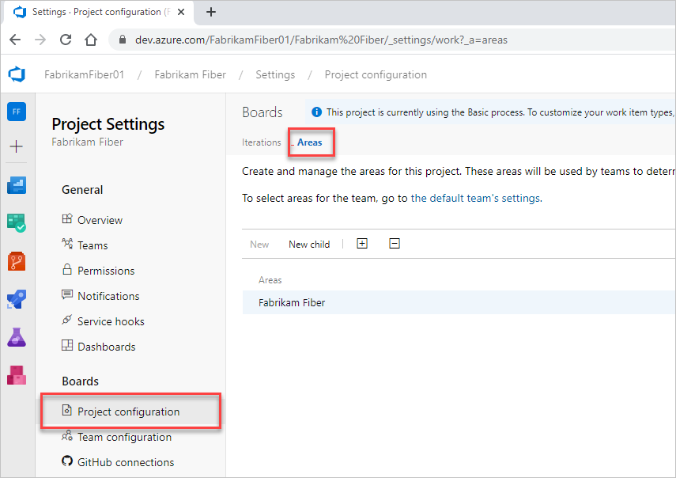
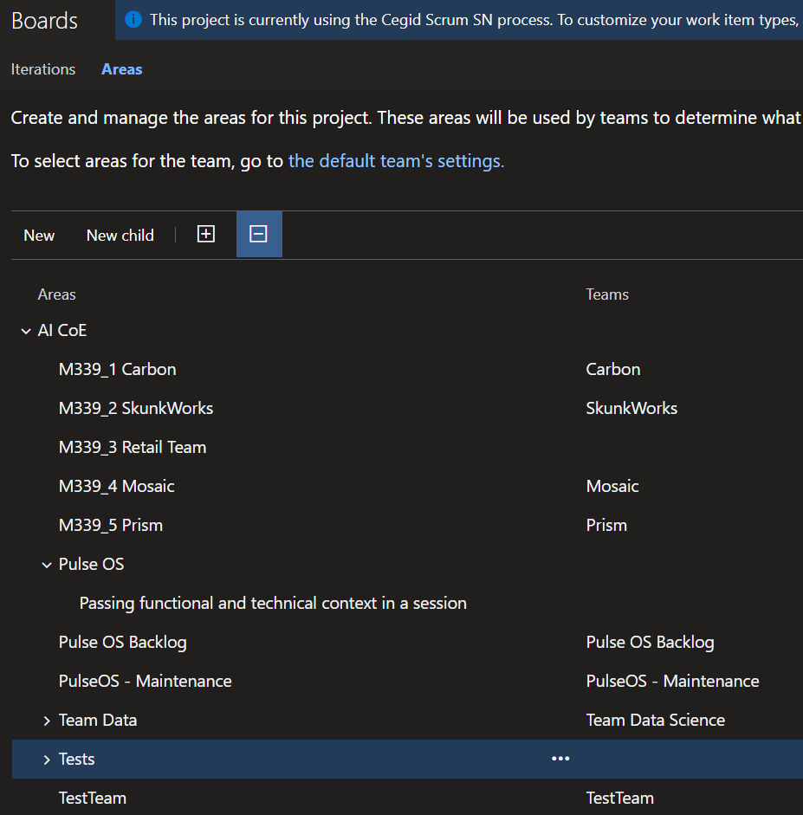
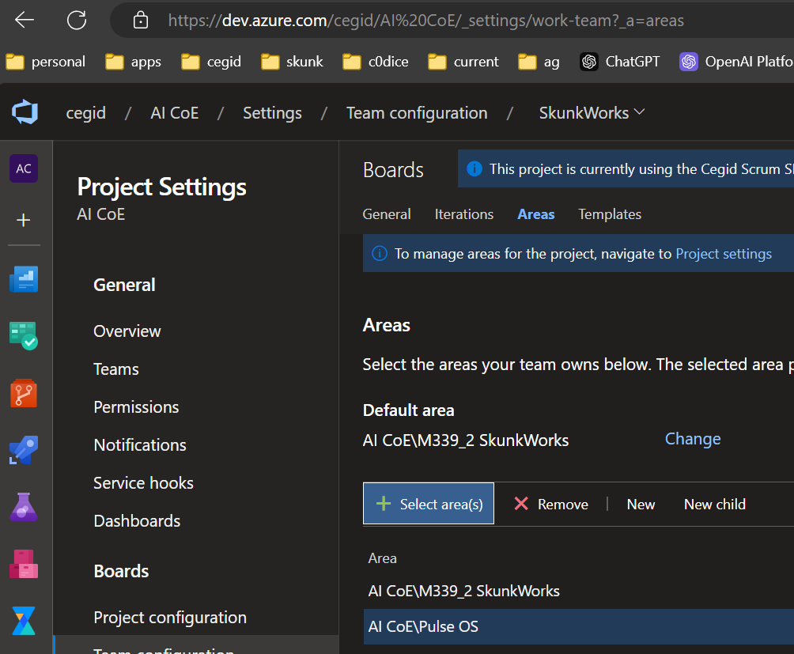
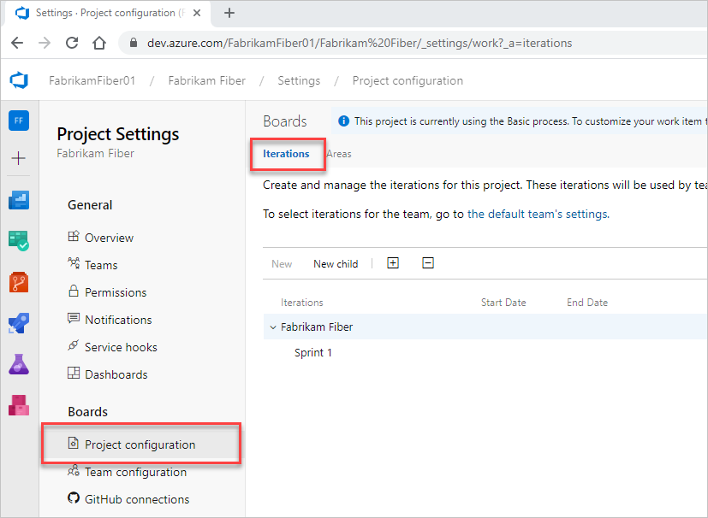
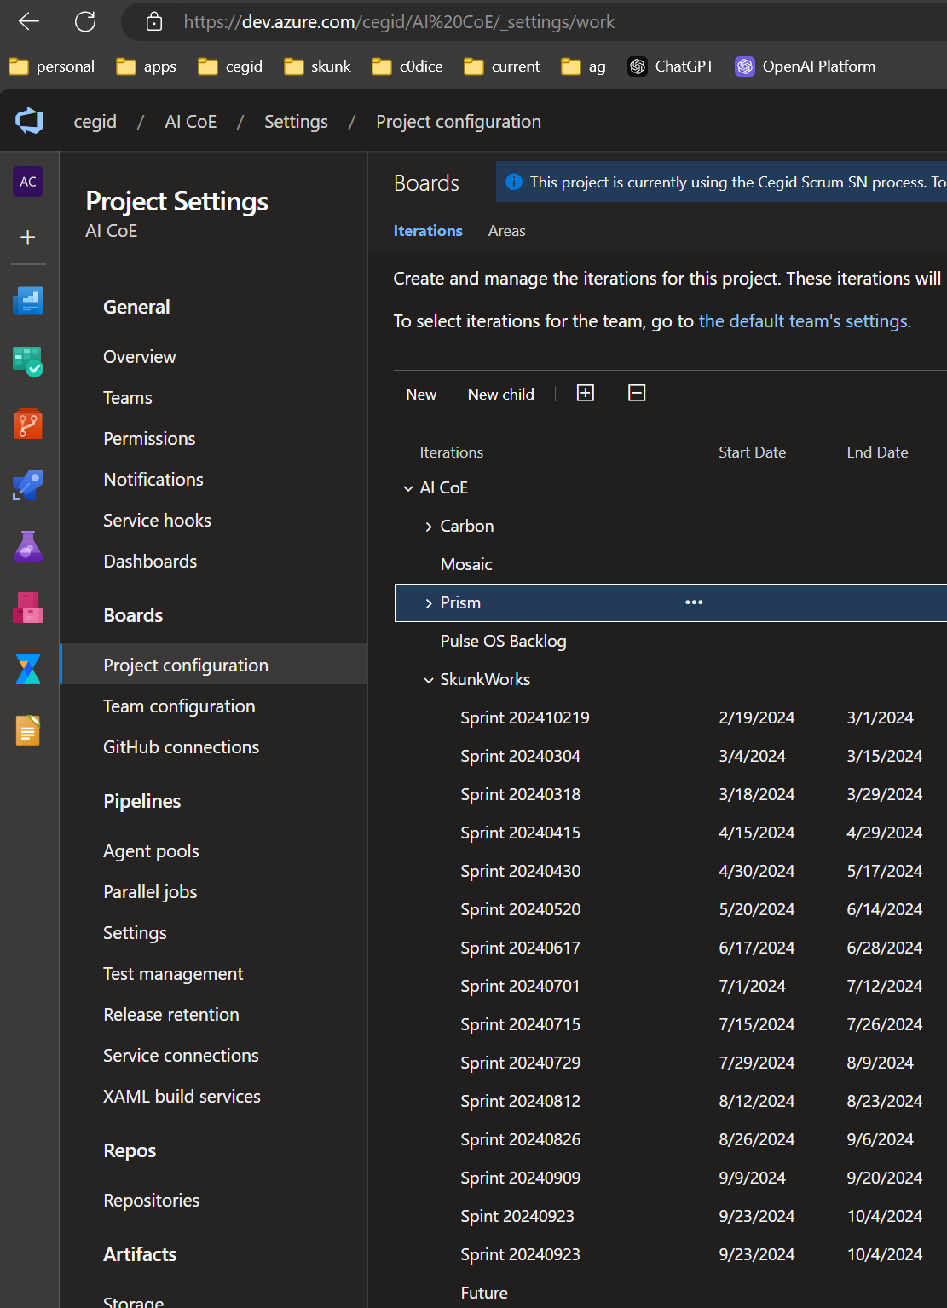
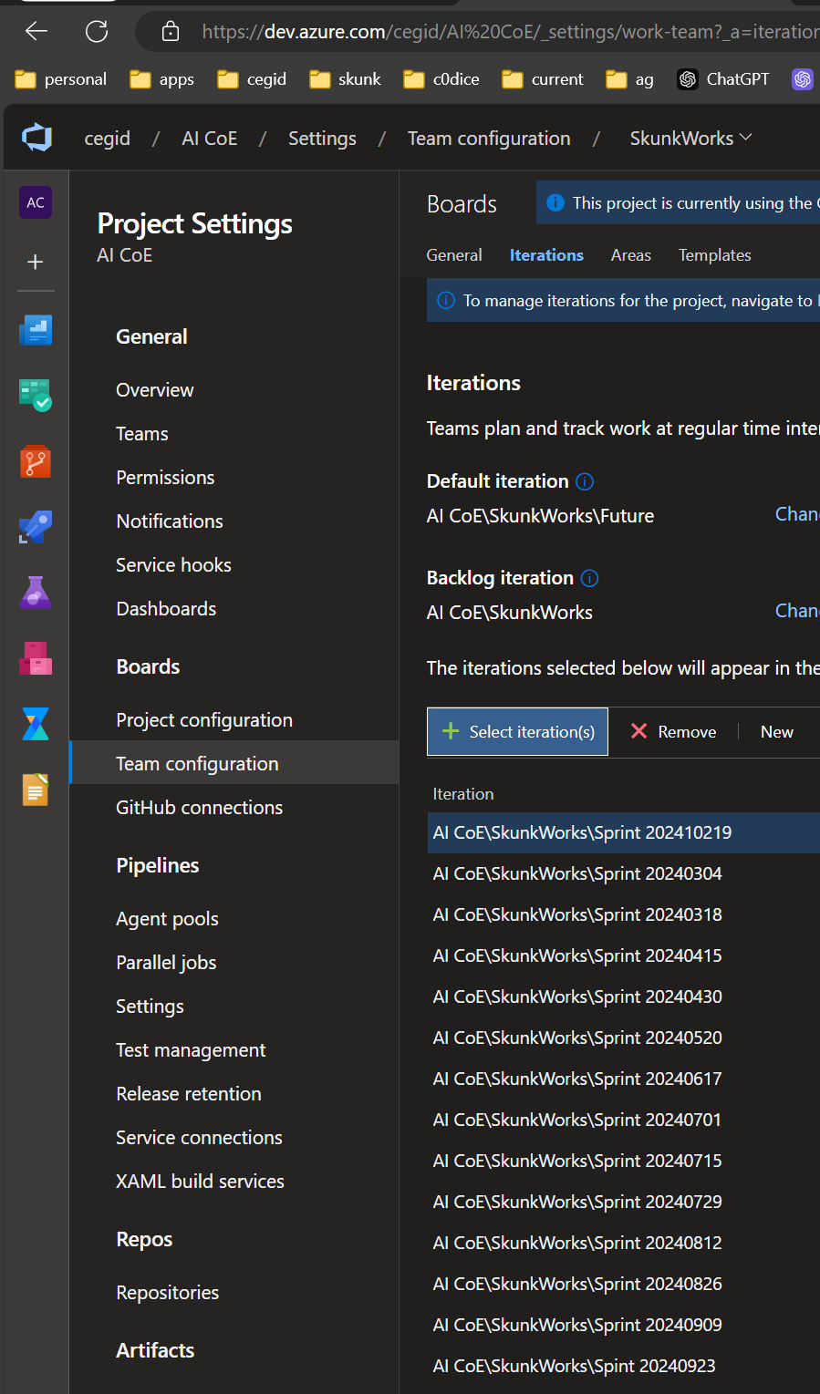
2.1 what
what
path
group work items by
team,
product,
feature area.
path
project
team
iteration
group work into
sprints,
milestones,
or other time-related periods
iterations
project
team
how

Slide 8
3. templates
templates

Slide 9
4. backlogs
create-your-backlog
configure
monitoring & report
how-backlogs-work-in-azure-devops****
create team

Slide 10
4.1 sources
create-your-backlog
configure
monitoring & report
how-backlogs-work-in-azure-devops****
create team

Slide 11
5. boards
video
configure
moniring & report

Slide 12
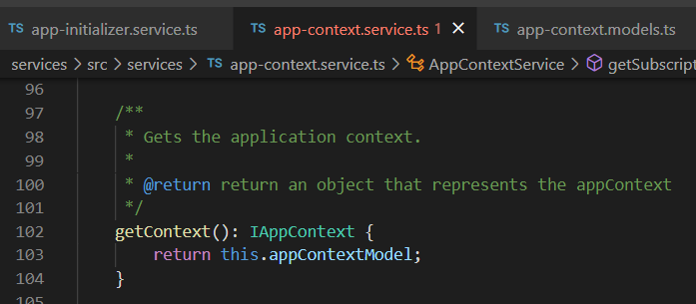




Z. template
new project
ExecuteAsync
square post-it
download
exe
download
exe
why
A slash
followed
by
two consecutive asterisks
D:\A1_research\C2_c0dice\B1_jmeter\A1_install
functionalities
introduction
build-exe
entity framework plus
zig help
⊂
4
every key-frame
defines the operation
success

