Slide 1

1. commands
docker
portfolio

Slide 2
1.1 index
push

Slide 3
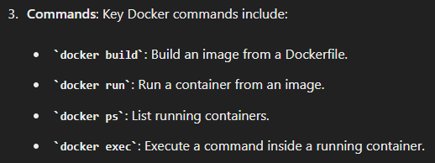

2. docker
what
settings
compose/settings
reset
compose/reset
build
local/build
8. build
docker build -t my_webservice:latest .
run
local/run
9. run
docker run -p 5000:5000 my_webservice
clean
compose/clean
5. clean
docker container rm –f $(docker container ls –aq)
docker image rm –f $(docker image ls –q)

Slide 4
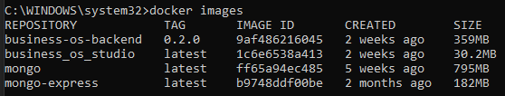
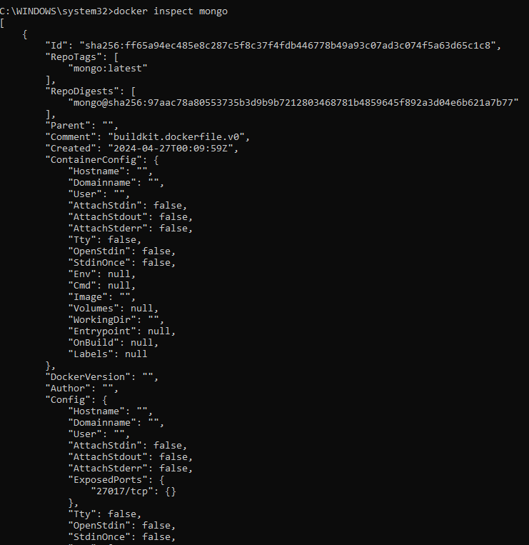
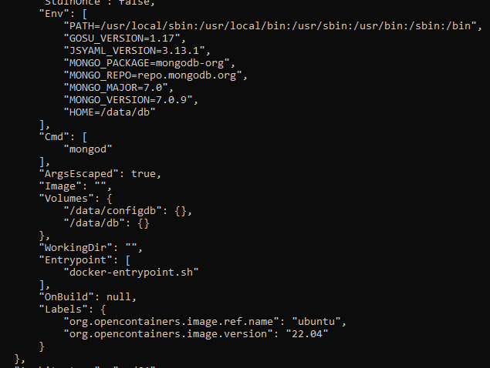
3. image
docker images
docker rmi <image_id>
docker pull <image_name>
docker inspect mongo

Slide 5
4. docker file
local/docker file
7. docker file

Slide 6
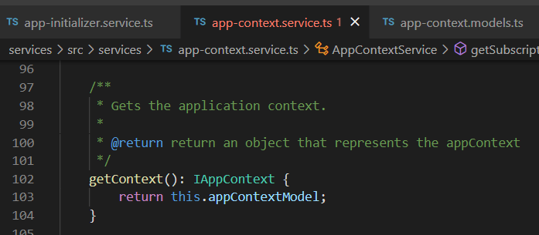




Z. template
new project
ExecuteAsync
square post-it
download
exe
download
exe
why
A slash
followed
by
two consecutive asterisks
D:\A1_research\C2_c0dice\B1_jmeter\A1_install
functionalities
introduction
build-exe
entity framework plus
zig help
⊂
4
every key-frame
defines the operation
success

