Slide 1

1. push
docker

Slide 2
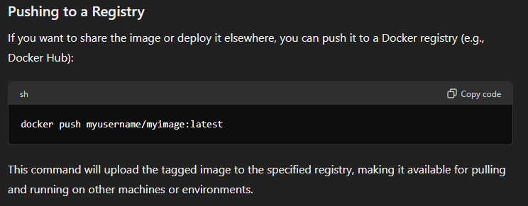
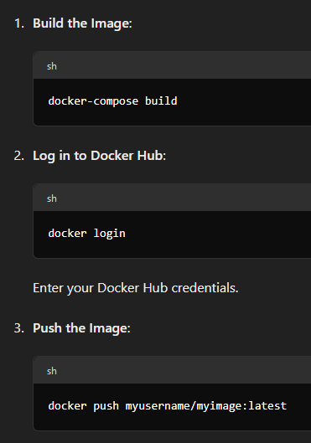
2. docker HUB
what

Slide 3
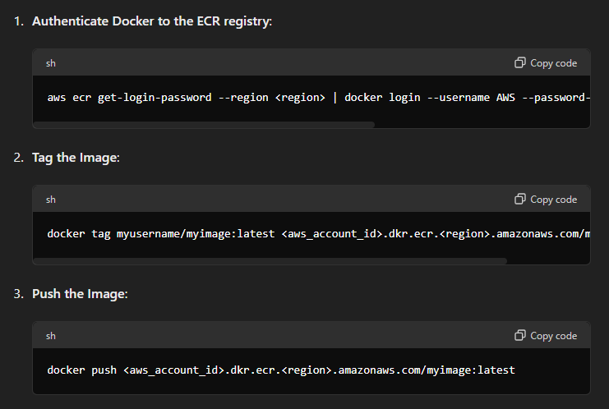
3. aws
what

Slide 4
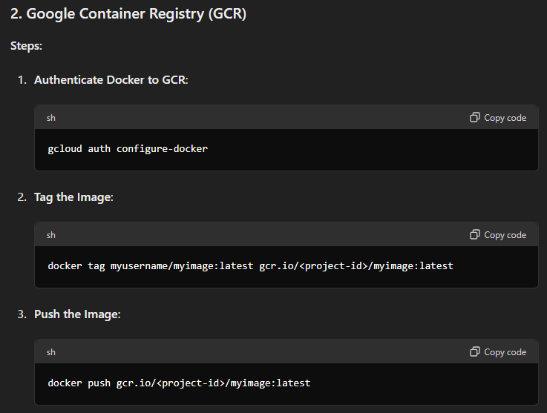
4. google
what

Slide 5
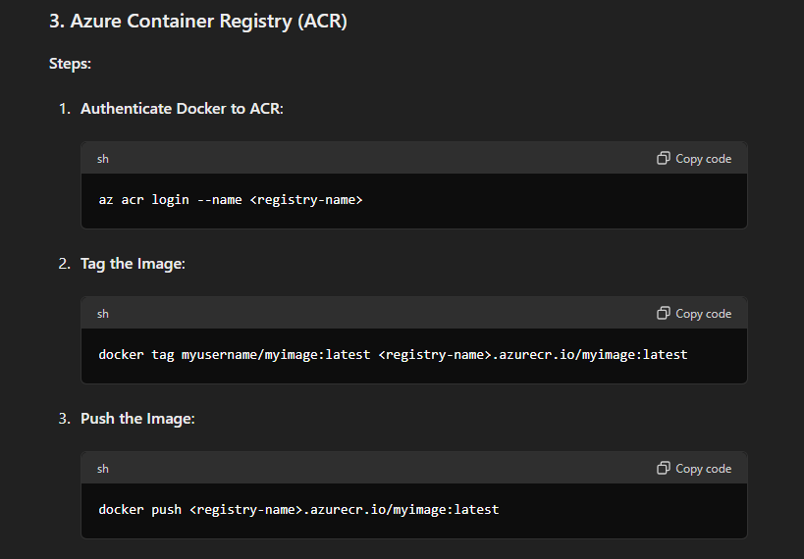
5. azure
what

Slide 6
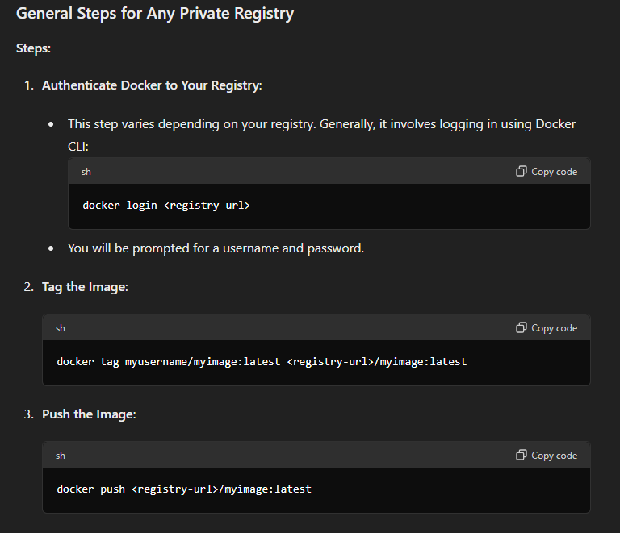
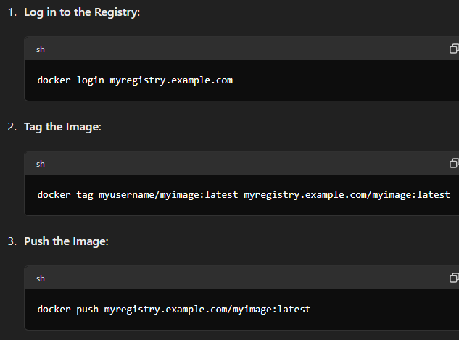
6. custom
what

Slide 7
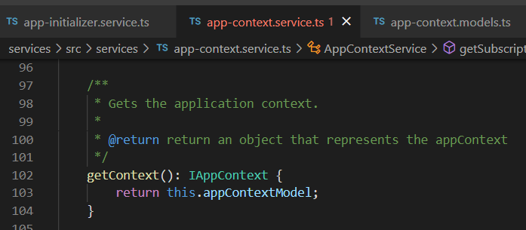





Z. template
new project
ExecuteAsync
square post-it
download
exe
download
exe
why
A slash
followed
by
two consecutive asterisks
D:\A1_research\C2_c0dice\B1_jmeter\A1_install
functionalities
introduction
build-exe
entity framework plus
zig help
⊂
4
every key-frame
defines the operation
success

