Slide 1

1. compose
docker

Slide 2
1.1 index
setup
services
build
volumes

Slide 3

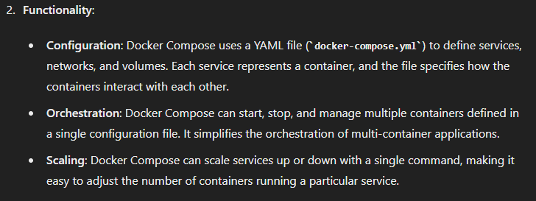
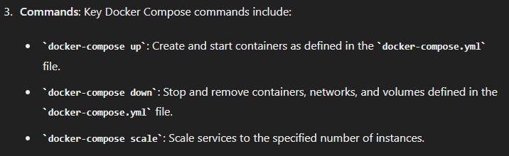
2. what
what

Slide 4


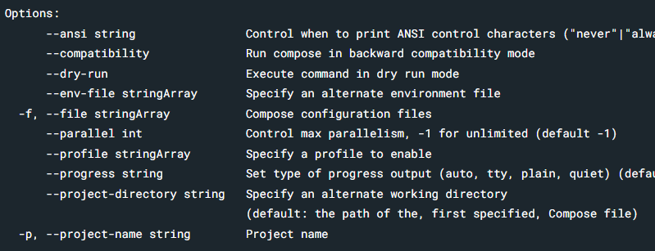
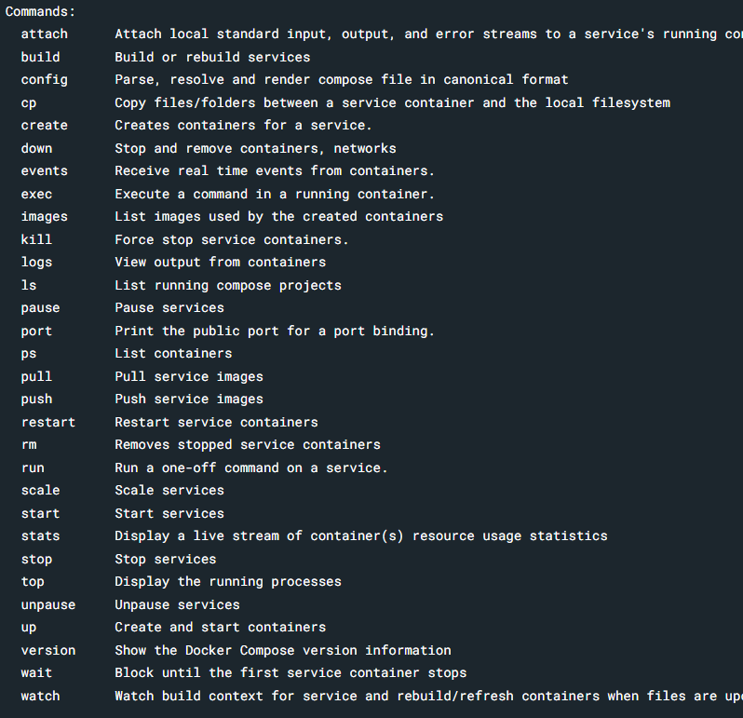
3. command
what
command line arguments

Slide 5
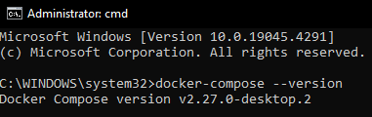
4. install
install
is installed
with
docker desktop

Slide 6
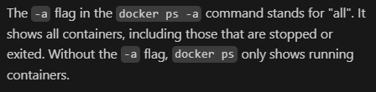
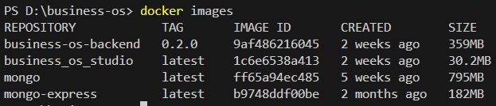
5. clean
video: clean
containers
docker container rm –f $(docker container ls –aq)
images
docker image rm –f $(docker image ls –q)

Slide 7
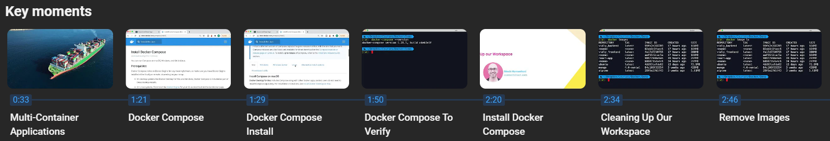
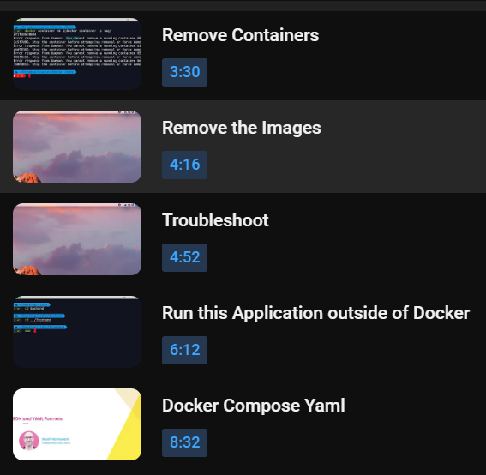
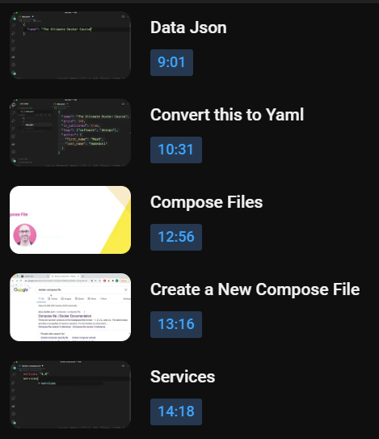
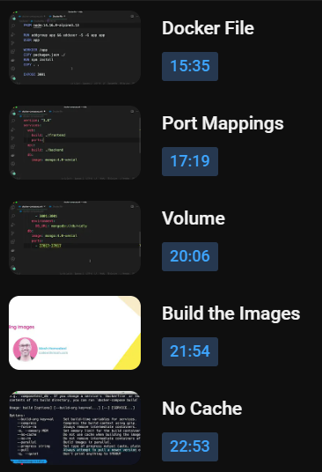
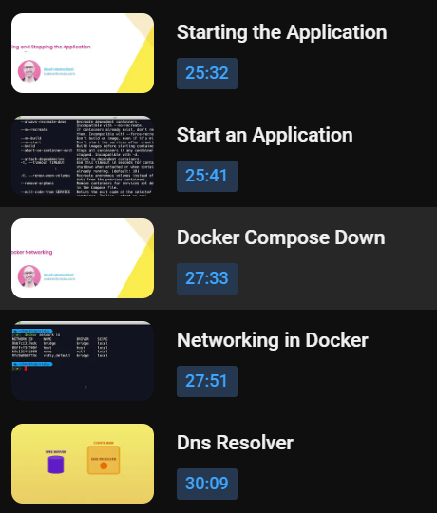

5.1 video
video: clean

Slide 8
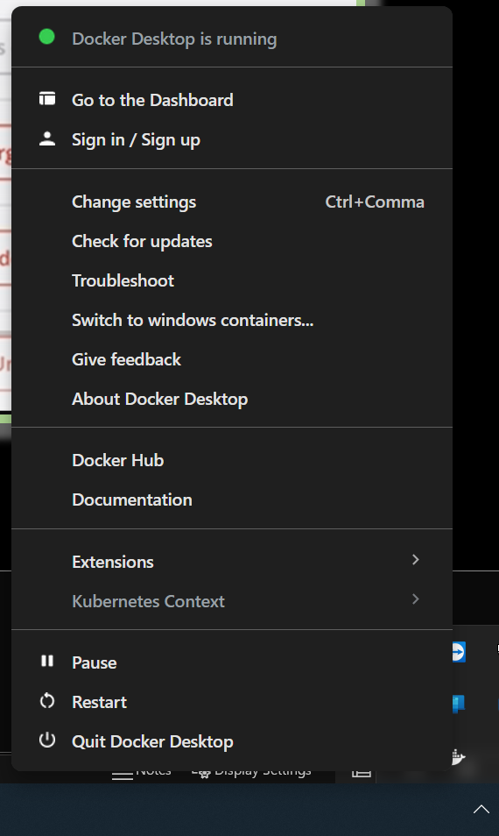
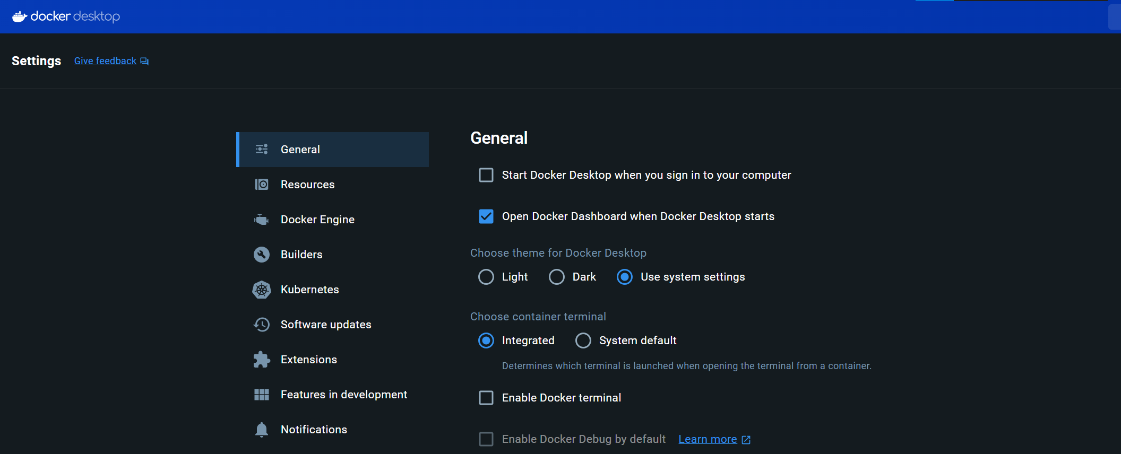
6. settings
settings

Slide 9
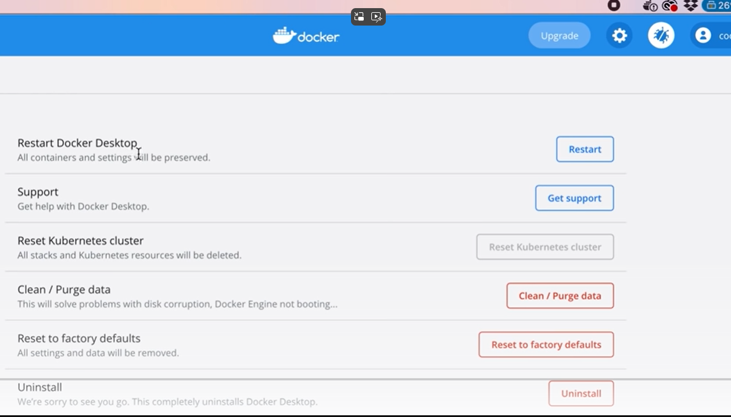
6.1 reset
reset

Slide 10
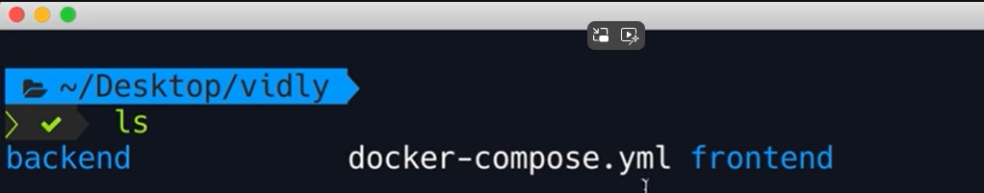

7. application
application
docker compose

Slide 11
8. yaml
yaml

Slide 12
9. setup
setup

Slide 13
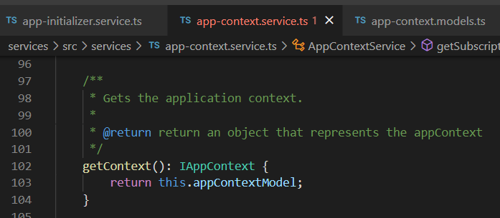




Z. template
new project
ExecuteAsync
square post-it
download
exe
download
exe
why
A slash
followed
by
two consecutive asterisks
D:\A1_research\C2_c0dice\B1_jmeter\A1_install
functionalities
introduction
build-exe
entity framework plus
zig help
⊂
4
every key-frame
defines the operation
success

