Slide 1

1. services
setup
compose
docker

Slide 2
1.1 index
build

Slide 3


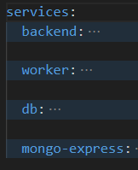










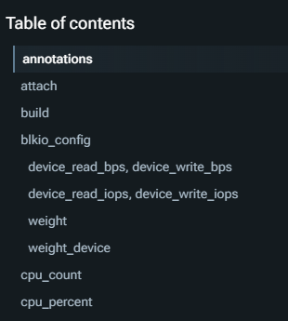
1.2 what
services
before
know
manual
reference

Slide 4

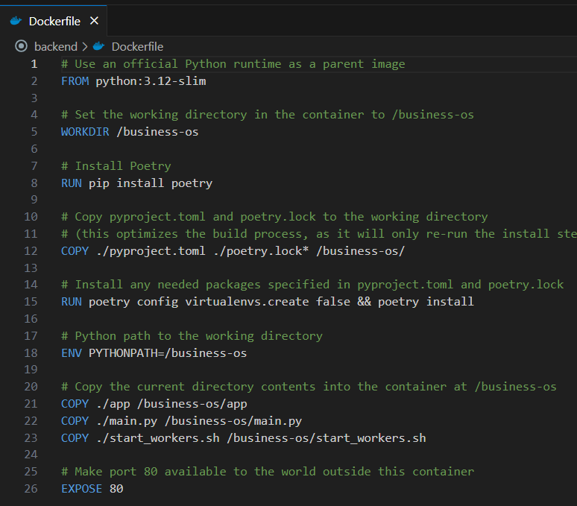


2. build
build
D:\business-os\backend\Dockerfile

Slide 5


3. image
image
for db
not build
HUB
Docker Hub Container Image Library | App Containerization

Slide 6




4. ports
ports
array
backend
frontend
db: mongo
mongo-express
NONE

Slide 7

5. environment
video: environment
manual: environment

Slide 8
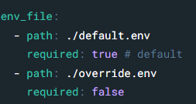
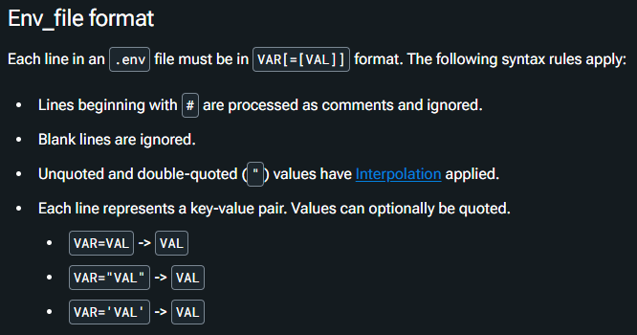
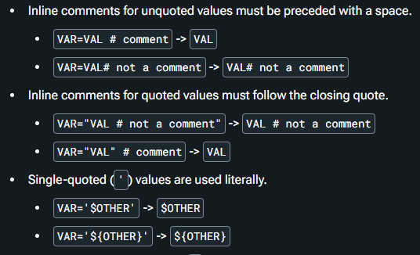
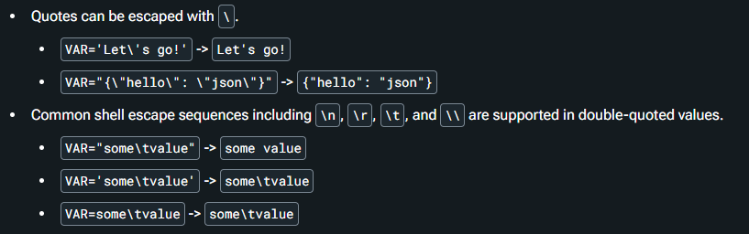
6. env-file
env file

Slide 9
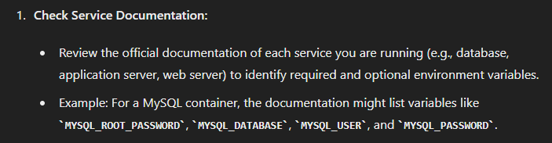
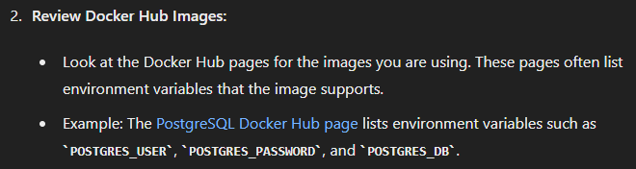
6.1 mongo

Slide 10
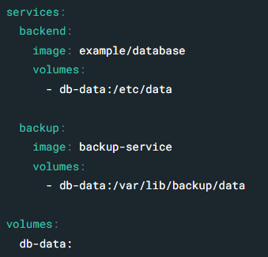
7. volumes
video: volumes
manual: examples
volumes

Slide 11
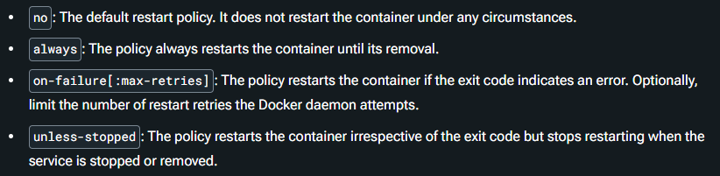
8. restart
manual: restart

Slide 12
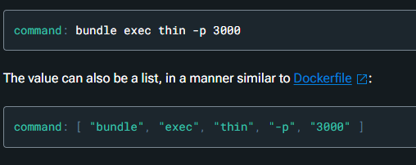
9. command
manual: command

Slide 13
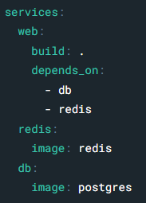
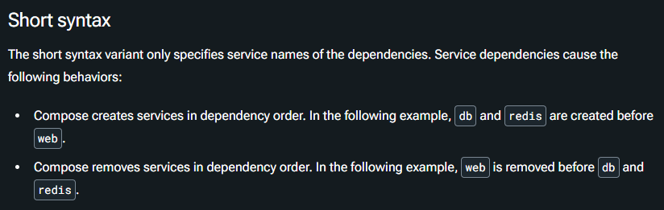
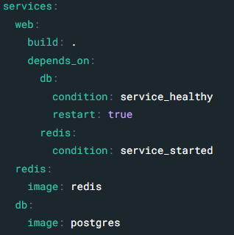
10. depends on
manual: depends on

Slide 14
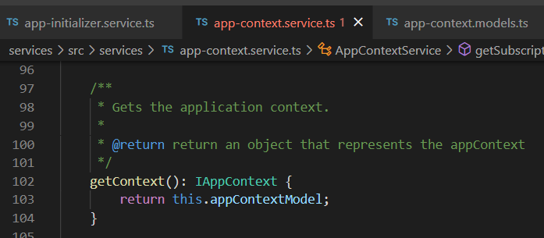



Z. template
new project
ExecuteAsync
square post-it
download
exe
download
exe
why
A slash
followed
by
two consecutive asterisks
D:\A1_research\C2_c0dice\B1_jmeter\A1_install
functionalities
introduction
build-exe
entity framework plus
zig help
⊂
4
every key-frame
defines the operation
success

