Slide 1

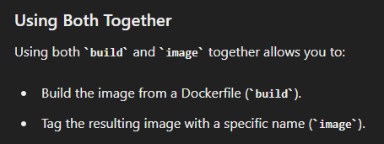
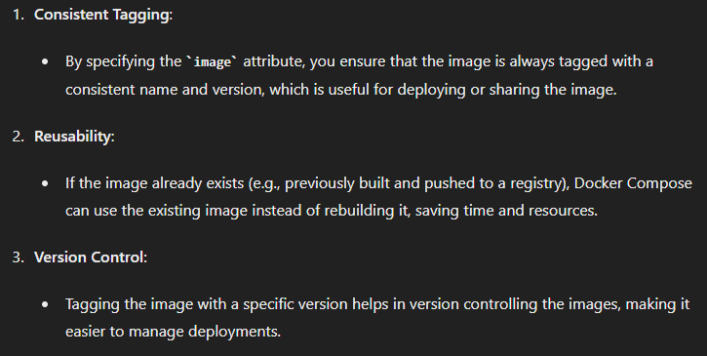
1. build
services
what
setup
compose
docker
why

Slide 2
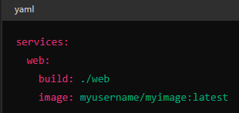


2. how
how
compose up
compose build

Slide 3
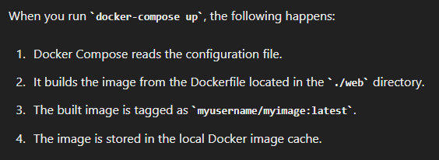
2.1 process
what

Slide 4
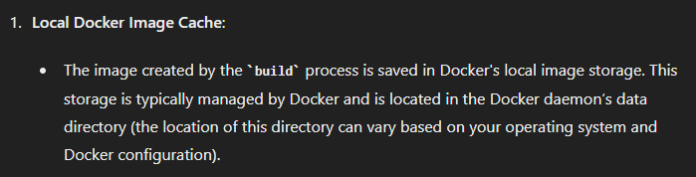
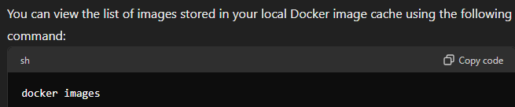
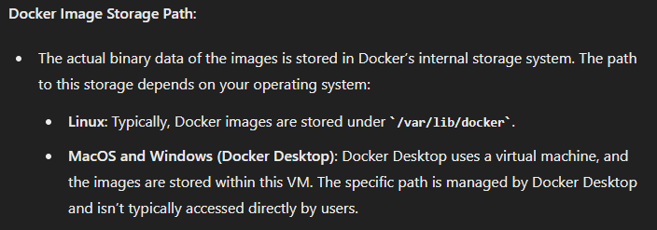
2.2 path
what
list
where

Slide 5
2.3 push
push

Slide 6
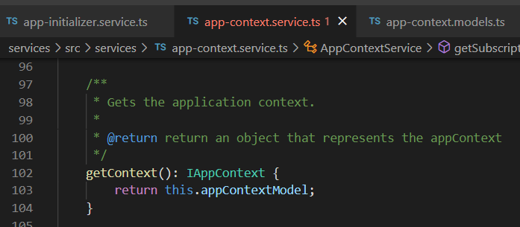





Z. template
new project
ExecuteAsync
square post-it
download
exe
download
exe
why
A slash
followed
by
two consecutive asterisks
D:\A1_research\C2_c0dice\B1_jmeter\A1_install
functionalities
introduction
build-exe
entity framework plus
zig help
⊂
4
every key-frame
defines the operation
success

