Slide 1


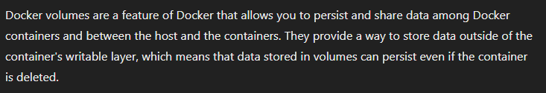
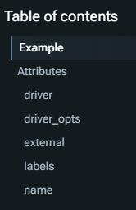
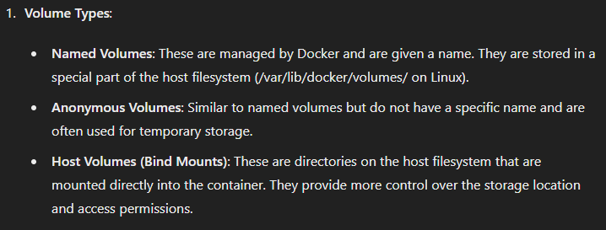


1. volumes
setup
manual
compose
what
docker
reference
types
services volumes

Slide 2
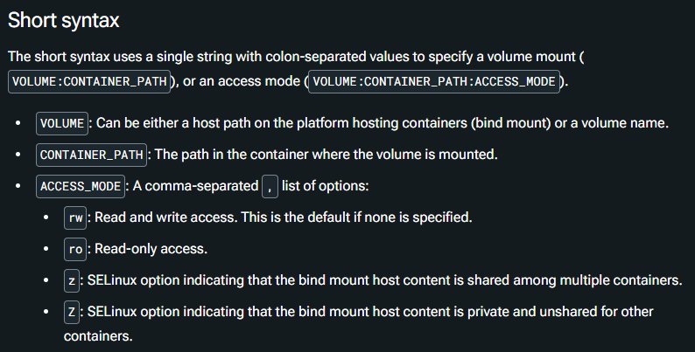
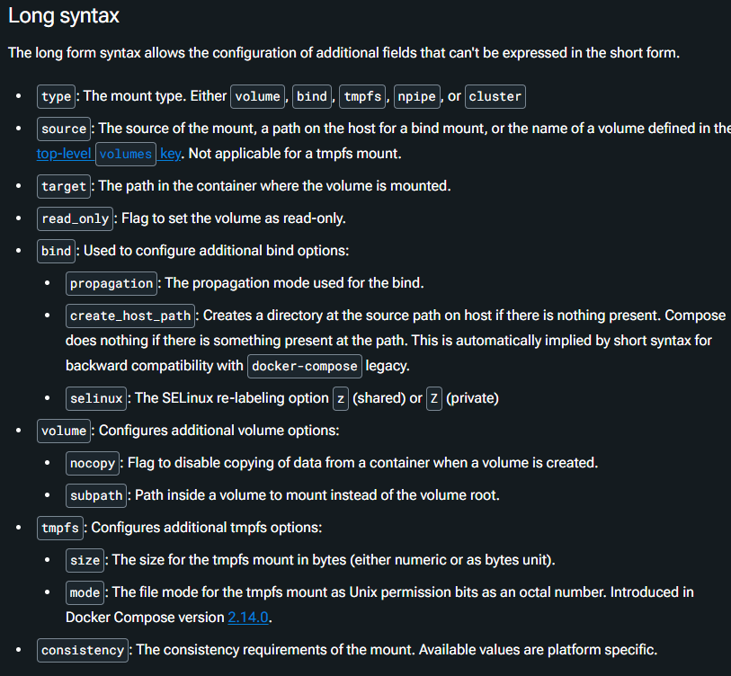
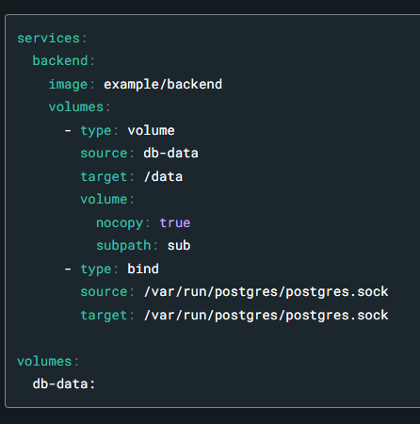
2. syntax
what
Services top-level elements | Docker Docs

Slide 3
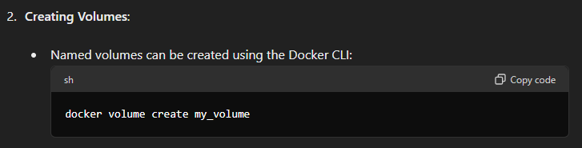
3. create
what

Slide 4
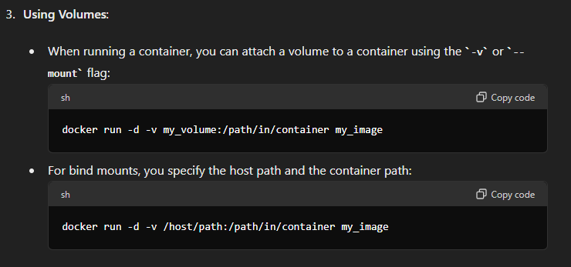
4. use
what

Slide 5
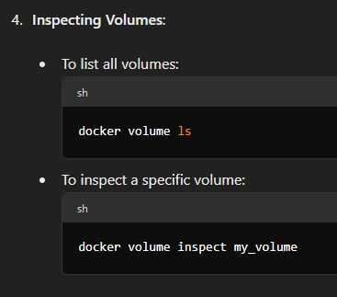
5. inspect
what

Slide 6
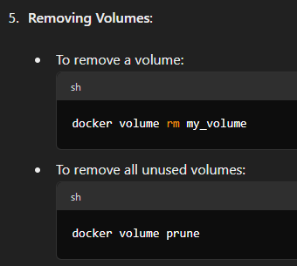
6. remove
what

Slide 7
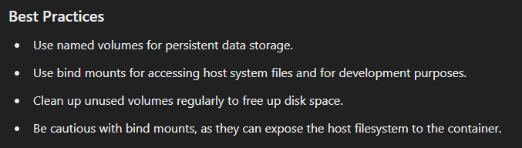
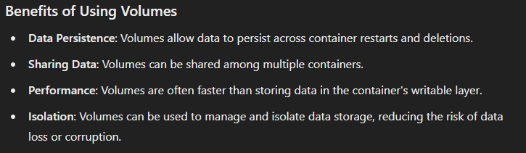
7. best practices
what

Slide 8
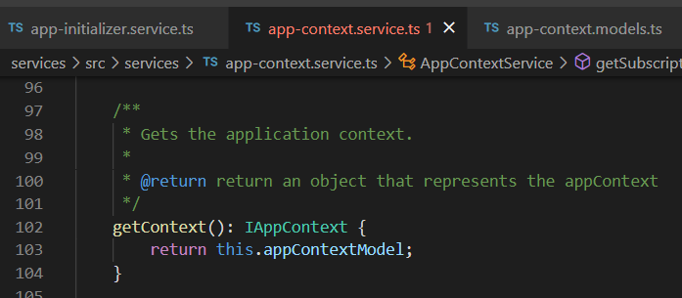



Z. template
new project
ExecuteAsync
square post-it
download
exe
download
exe
why
A slash
followed
by
two consecutive asterisks
D:\A1_research\C2_c0dice\B1_jmeter\A1_install
functionalities
introduction
build-exe
entity framework plus
zig help
⊂
4
every key-frame
defines the operation
success

