Slide 1

1. logs
portfolio

Slide 2
1.1 index

Slide 3

1.2 sources
Azure Monitor
App insights

Slide 4
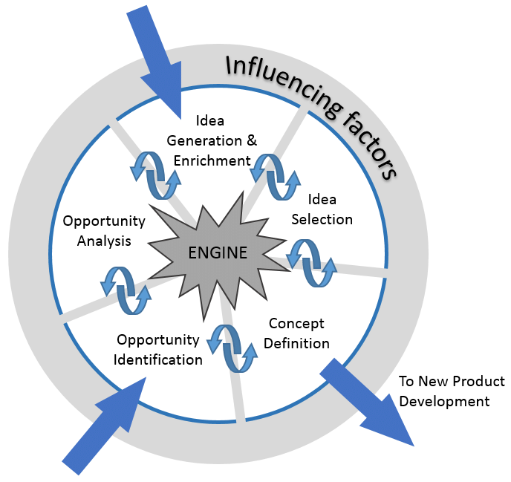
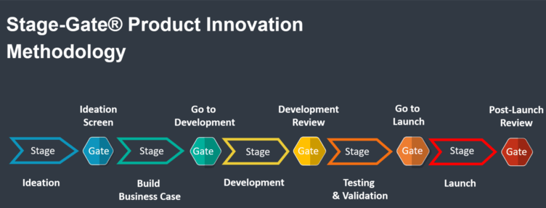
2. glossary
NCD – New Concept Definition Process
+
Stage Gate
Opportunity identification
NCD process
GATE 0
Product development

Slide 5
2.1 NFR
non functional requirements
performance
How fast does the system return results?
reliability
How often does the system experience critical failures?

Slide 6
2.1.1 monitoring
monitoring
looking at the dashboard
of
a car
observability
being able to understand
how
every part of the engine
works
by
looking inside the car
you get predefined information like
speed,
fuel level,
engine temperature
diagnosing a problem
based
on how various parts
are
behaving
and
interacting
in real-time
which will alert you
if something
is
wrong

Slide 7
2.1.2 observability
Aspect | Monitoring | Observability
Definition | Tracking system health and performance via predefined metrics or logs. | Understanding the internal state of a system based on telemetry (logs, metrics, and traces).
Focus | Known issues or expected behaviors. | Unknown issues and gaining insights into system behavior.
Approach | Reactive, based on set thresholds and predefined alerts. | Proactive and diagnostic, focused on exploring and diagnosing system behaviors.
Proactive/Reactive | Primarily reactive—alerts when something goes wrong. | Both proactive and diagnostic—helps in understanding and solving unknown issues.
Tools | Azure Monitor, Prometheus, Datadog, Zabbix. | Open Telemetry, Jaeger, Honeycomb, Datadog.
Telemetry Type | Predefined metrics and logs. | Metrics, logs, and traces for comprehensive analysis.
Scope | Answers "Is the system working as expected?" | Answers "Why did this error happen?" and "What is causing performance issues?"
Predefined/Dynamic | Focuses on predefined metrics and logs. | Flexible, involves gathering telemetry for unknown failures.
Use Case | Best for systems with known, predictable failure modes. | Essential for complex, distributed, microservices-based architectures.
Response | Triggers alerts to notify when something is wrong. | Enables investigation and root cause analysis of issues.

Slide 8
2.2 azure monitor
what
set of integrated Azure resources
that
collects
and
aggregate
data
across multiple
Azure subscriptions
collects and aggregates
the data
from
every layer and component
of
your system
stores this data
in
a common
data platform
this stored data
is then
consumed by
a common set
of
tools
these tools
can
correlate,
analyze,
visualize,
and/or respond
to the data.
Azure Monitor - What

Slide 9
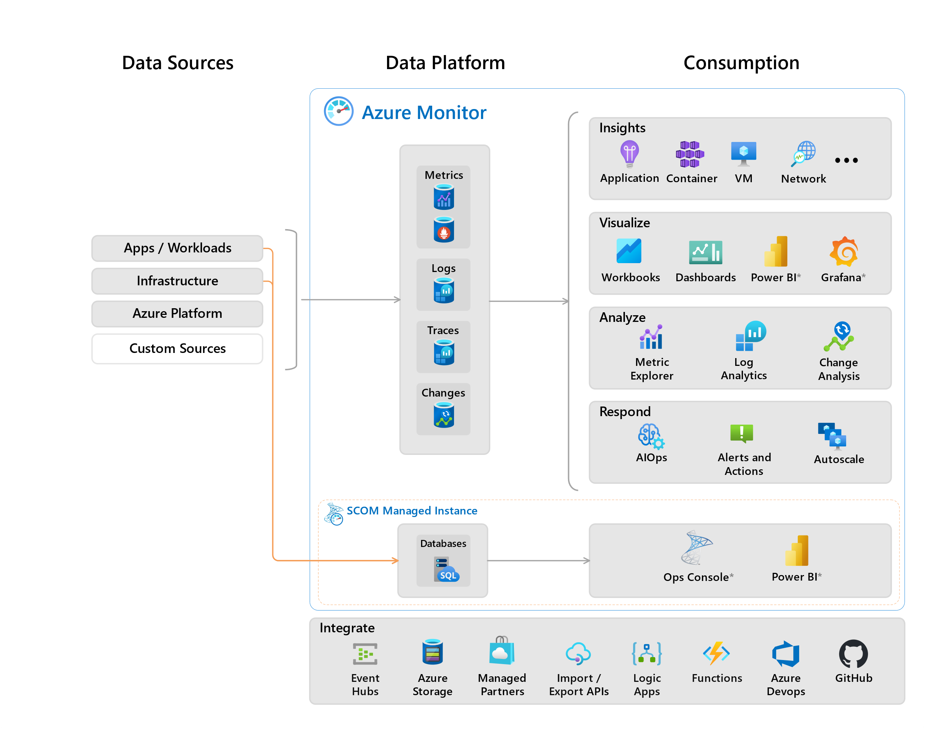
2.2.1 components
types of resources
being
monitored
stores
the collected
monitoring data
components
that use
data
from
the data platform
what
data sources
data sources
data platform
azure monitor's core data platform
has stores for
metrics,
logs,
traces,
and changes.
System Center Operations Manager MI
uses
its own database
hosted
in SQL Managed Instance
to be
researched

Slide 10

2.2.2 data collection
why
gathering data
to
populate
data sources
Collection method | Description
Application instrumentation | Application Insights is enabled through either Auto-Instrumentation (agent) or by adding the Application Insights SDK to your application code. In addition, Application Insights is in process of implementing Open Telemetry. For more information, reference How do I instrument an application?.
Agents | Agents can collect monitoring data from the guest operating system of Azure and hybrid virtual machines.
Data collection rules | Use data collection rules to specify what data should be collected, how to transform it, and where to send it.
Zero Config | Data is automatically sent to a destination without user configuration. Platform metrics are the most common example.
Diagnostic settings | Use diagnostic settings to determine where to send resource log and activity log data on the data platform.
Azure Monitor REST API | The Logs Ingestion API in Azure Monitor lets you send data to a Log Analytics workspace in Azure Monitor Logs. You can also send metrics into the Azure Monitor Metrics store using the custom metrics API.
what
app insights
data collection

Slide 11
2.3 app insights
what
a feature
of
Azure Monitor
used for
Application Performance Management (APM)
for
live web applications
Azure Monitor - What
how
provides many experiences
to
enhance the
performance,
reliability,
and quality
of
your applications
Application dashboard: An at-a-glance assessment of your application's health and performance.
Application map: A visual overview of application architecture and components' interactions.
Live metrics: A real-time analytics dashboard for insight into application activity and performance.
Transaction search: Trace and diagnose transactions to identify issues and optimize performance.
Availability view: Proactively monitor and test the availability and responsiveness of application endpoints.
Failures view: Identify and analyze failures in your application to minimize downtime.
Performance view: Review application performance metrics and potential bottlenecks.

Slide 12
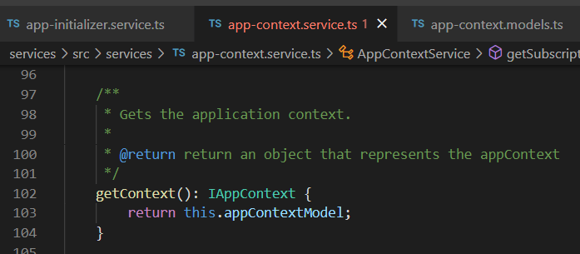



Z. template
new project
ExecuteAsync
square post-it
download
exe
download
exe
why
A slash
followed
by
two consecutive asterisks
D:\A1_research\C2_c0dice\B1_jmeter\A1_install
functionalities
introduction
build-exe
entity framework plus
zig help
⊂
4
every key-frame
defines the operation
success

