Slide 1

1. mongo
portfolio

Slide 2
1.1 index
fast api

Slide 3

1.2 sources
Aggregation
MongoDB "Joins" & $lookup (explained simply)
MongoDB Relationships: A Quick Guide (knowledgehut.com)
vídeo: SQL vs. No SQL
*** vídeo: SQL vs. No SQL
***** sql-vs-mongodb-choosing-right-database-your-business-era-emily-oldson/
Long strings — MySQL for Developers — PlanetScale

Slide 4
2. what
description
is a
document
database
scalability
and
flexibility
querying
and
indexing
what-is-mongo db
document database
is
a type of NoSQL
database
can be used to
store
and
query
data as JSON-like
documents.
developers can use
JSON documents
in
their code
and
save them
directly
into
the document
database
the flexible,
semi-structured,
hierarchical
nature
of
documents
and
document databases
allows them
to evolve
with applications’ needs
document
document

Slide 5
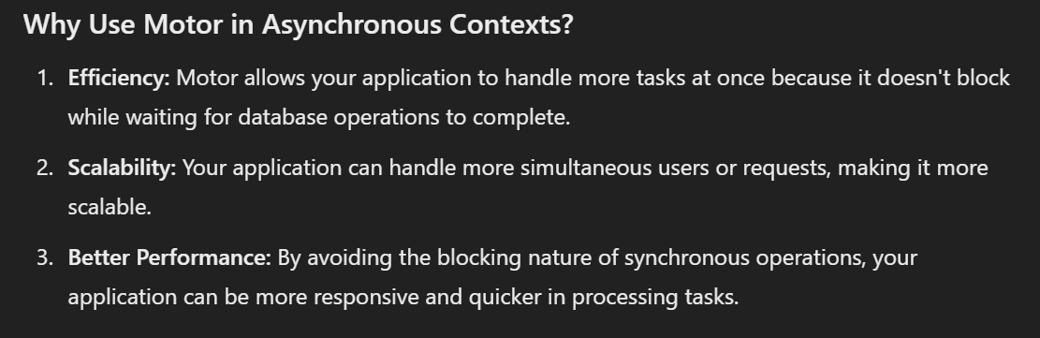

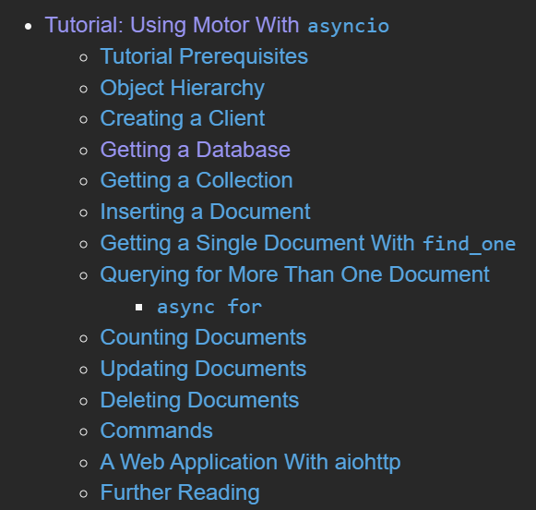
3. asynchronous
what
pymongo vs Motor (github.com)
..\..\python\mongo
blocking
Tutorial: Using Motor With asyncio — Motor 3.5.0 documentation

Slide 6
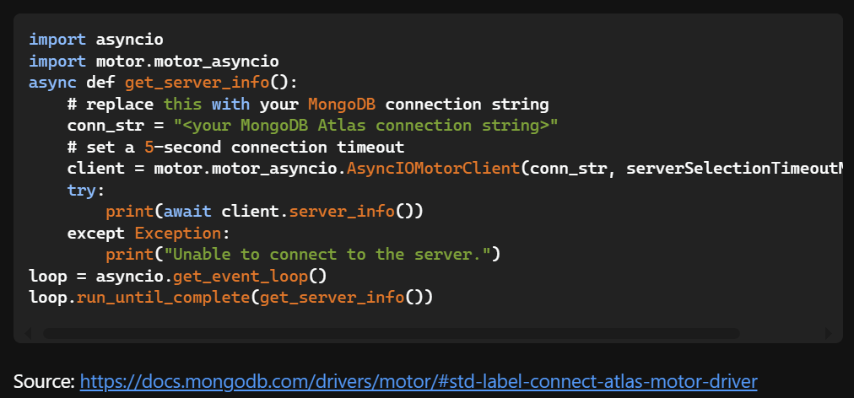
3.1 check connection
what
testing-motor-motorclient-connection

Slide 7
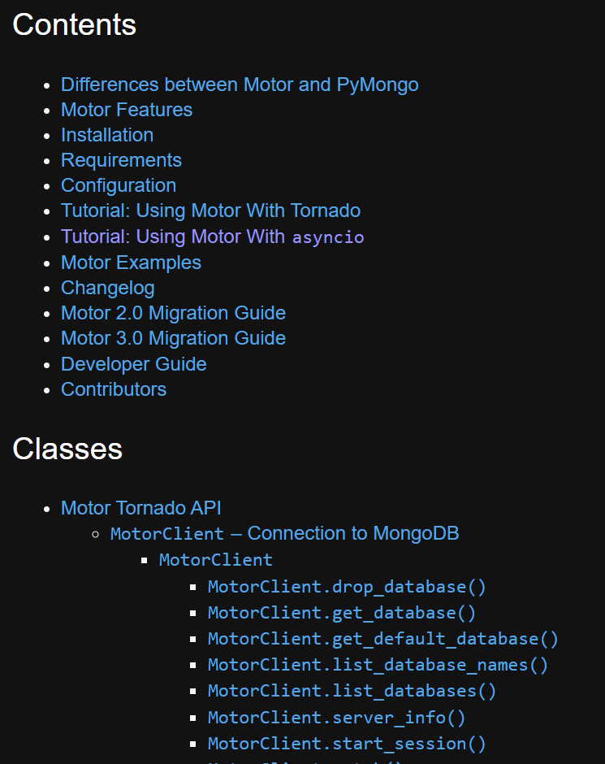
3.2 motor
what
Motor: Asynchronous Python driver for MongoDB — Motor 3.5.0 documentation

Slide 8
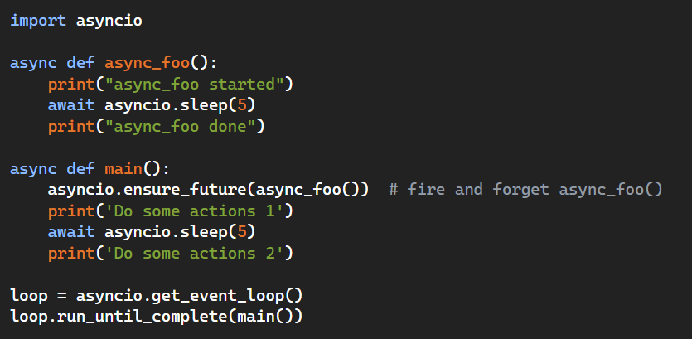
3.3 main
what
Simplest async/await example possible in Python

Slide 9
3.4 types

Slide 10
3.4.1 client
what
AsyncIOMotorClient – Connection to MongoDB
AsyncIOMotorClient
AsyncIOMotorClient.drop_database()
AsyncIOMotorClient.get_database()
AsyncIOMotorClient.get_default_database()
AsyncIOMotorClient.list_database_names()
AsyncIOMotorClient.list_databases()
AsyncIOMotorClient.server_info()
AsyncIOMotorClient.start_session()
AsyncIOMotorClient.watch()
AsyncIOMotorClient.HOST
AsyncIOMotorClient.PORT
AsyncIOMotorClient.address
AsyncIOMotorClient.arbiters
AsyncIOMotorClient.close
AsyncIOMotorClient.codec_options
AsyncIOMotorClient.is_mongos
AsyncIOMotorClient.is_primary
AsyncIOMotorClient.nodes
AsyncIOMotorClient.options
AsyncIOMotorClient.primary
AsyncIOMotorClient.read_concern
AsyncIOMotorClient.read_preference
AsyncIOMotorClient.secondaries
AsyncIOMotorClient.topology_description
AsyncIOMotorClient.write_concern
Async IO Motor Client

Slide 11
3.4.2 database
what
AsyncIOMotorDatabase
AsyncIOMotorDatabase
AsyncIOMotorDatabase.aggregate()
AsyncIOMotorDatabase.command()
AsyncIOMotorDatabase.create_collection()
AsyncIOMotorDatabase.cursor_command()
AsyncIOMotorDatabase.dereference()
AsyncIOMotorDatabase.drop_collection()
AsyncIOMotorDatabase.get_collection()
AsyncIOMotorDatabase.list_collection_names()
AsyncIOMotorDatabase.list_collections()
AsyncIOMotorDatabase.validate_collection()
AsyncIOMotorDatabase.watch()
AsyncIOMotorDatabase.with_options()
AsyncIOMotorDatabase.client
AsyncIOMotorDatabase.codec_options
AsyncIOMotorDatabase.name
AsyncIOMotorDatabase.read_concern
AsyncIOMotorDatabase.read_preference
AsyncIOMotorDatabase.write_concern
AsyncIOMotorDatabase

Slide 12
3.4.3 collection
what
AsyncIOMotorCollection
AsyncIOMotorCollection
AsyncIOMotorCollection.database
AsyncIOMotorCollection.aggregate()
AsyncIOMotorCollection.aggregate_raw_batches()
AsyncIOMotorCollection.bulk_write()
AsyncIOMotorCollection.count_documents()
AsyncIOMotorCollection.create_index()
AsyncIOMotorCollection.create_indexes()
AsyncIOMotorCollection.create_search_index()
AsyncIOMotorCollection.create_search_indexes()
AsyncIOMotorCollection.delete_many()
AsyncIOMotorCollection.delete_one()
AsyncIOMotorCollection.distinct()
AsyncIOMotorCollection.drop()
AsyncIOMotorCollection.drop_index()
AsyncIOMotorCollection.drop_indexes()
AsyncIOMotorCollection.drop_search_index()
AsyncIOMotorCollection.estimated_document_count()
AsyncIOMotorCollection.find()
AsyncIOMotorCollection.find_one()
AsyncIOMotorCollection.find_one_and_delete()
AsyncIOMotorCollection.find_one_and_replace()
AsyncIOMotorCollection.find_one_and_update()
AsyncIOMotorCollection.find_raw_batches()
AsyncIOMotorCollection.index_information()
AsyncIOMotorCollection.insert_many()
AsyncIOMotorCollection.insert_one()
AsyncIOMotorCollection.list_indexes()
AsyncIOMotorCollection.list_search_indexes()
AsyncIOMotorCollection.options()
AsyncIOMotorCollection.rename()
AsyncIOMotorCollection.replace_one()
AsyncIOMotorCollection.update_many()
AsyncIOMotorCollection.update_one()
AsyncIOMotorCollection.update_search_index()
AsyncIOMotorCollection.watch()
AsyncIOMotorCollection.with_options()
AsyncIOMotorCollection.codec_options
AsyncIOMotorCollection.full_name
AsyncIOMotorCollection.name
AsyncIOMotorCollection.read_concern
AsyncIOMotorCollection.read_preference
AsyncIOMotorCollection.write_concern
AsyncIOMotorCollection

Slide 13
3.4.4 cursor
what
AsyncIOMotorCursor
AsyncIOMotorCursor
AsyncIOMotorCursor.add_option()
AsyncIOMotorCursor.allow_disk_use()
AsyncIOMotorCursor.clone()
AsyncIOMotorCursor.close()
AsyncIOMotorCursor.collation()
AsyncIOMotorCursor.comment()
AsyncIOMotorCursor.distinct()
AsyncIOMotorCursor.each()
AsyncIOMotorCursor.explain()
AsyncIOMotorCursor.hint()
AsyncIOMotorCursor.limit()
AsyncIOMotorCursor.max()
AsyncIOMotorCursor.max_await_time_ms()
AsyncIOMotorCursor.max_scan()
AsyncIOMotorCursor.max_time_ms()
AsyncIOMotorCursor.min()
AsyncIOMotorCursor.next()
AsyncIOMotorCursor.next_object()
AsyncIOMotorCursor.remove_option()
AsyncIOMotorCursor.rewind()
AsyncIOMotorCursor.skip()
AsyncIOMotorCursor.sort()
AsyncIOMotorCursor.to_list()
AsyncIOMotorCursor.where()
AsyncIOMotorCursor.address
AsyncIOMotorCursor.alive
AsyncIOMotorCursor.cursor_id
AsyncIOMotorCursor.fetch_next
AsyncIOMotorCursor.session
AsyncIOMotorCursor

Slide 14
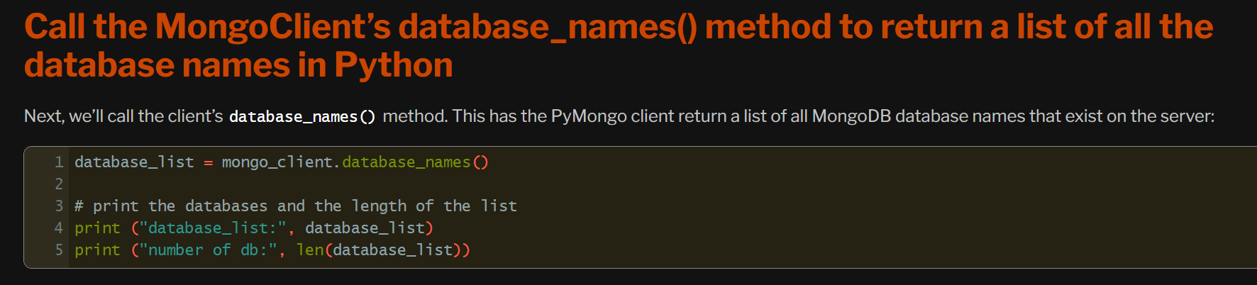
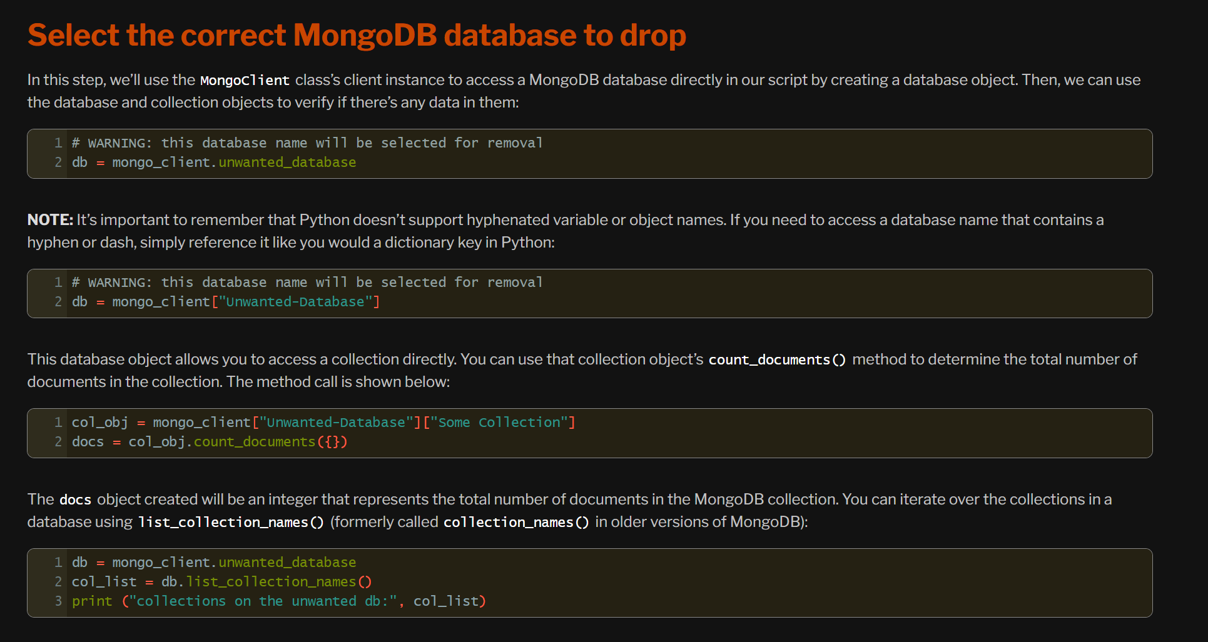
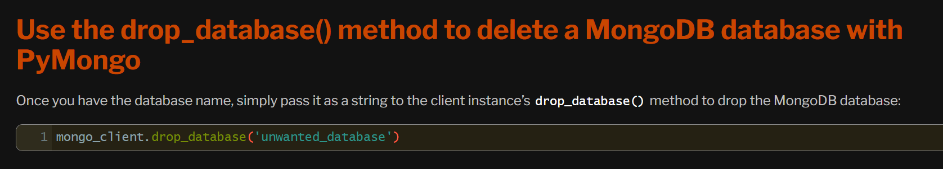
4. databases
what
How To Delete a MongoDB Database Using Python

Slide 15
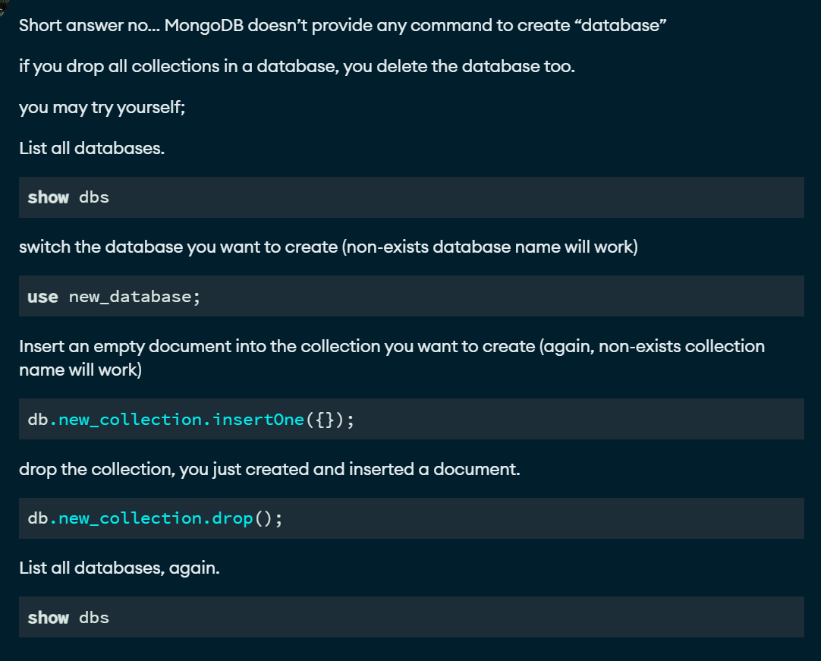
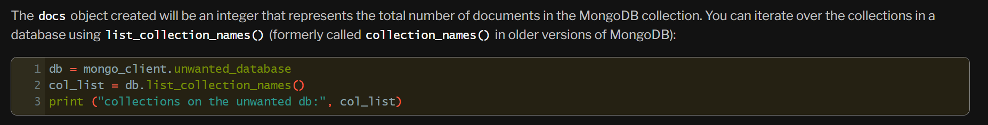
5. collections
what
create database with no collections or documents
list collections names

Slide 16
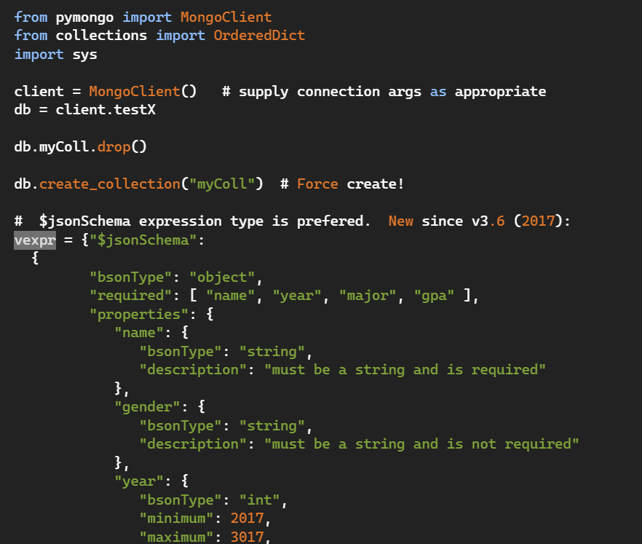

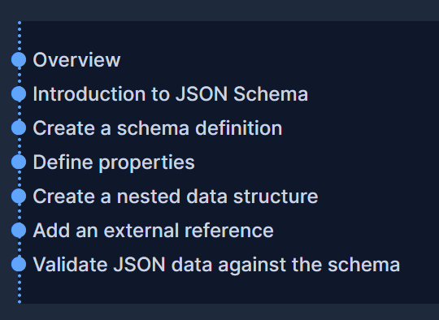
5.1 schema
what
*** tutorial
does pymongo have validation rules built in
JSON Schema - Creating your first schema

Slide 17
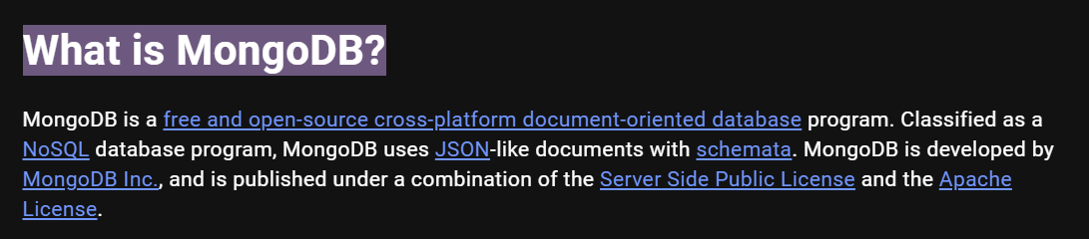
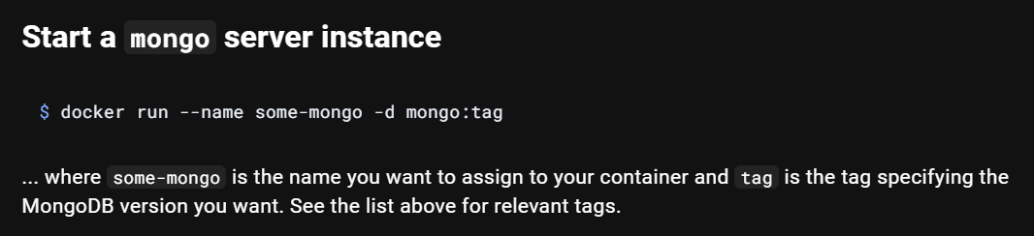
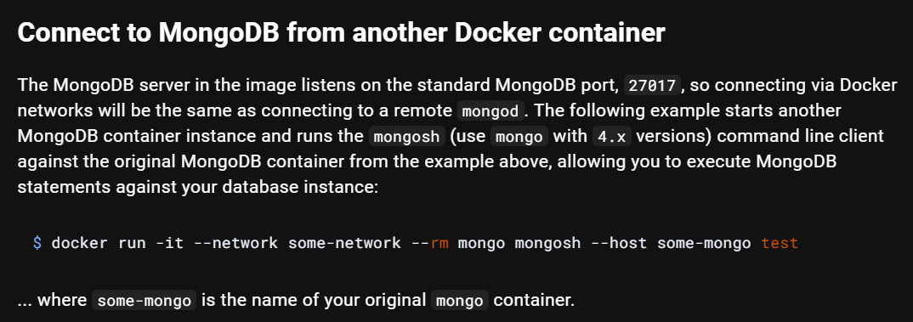
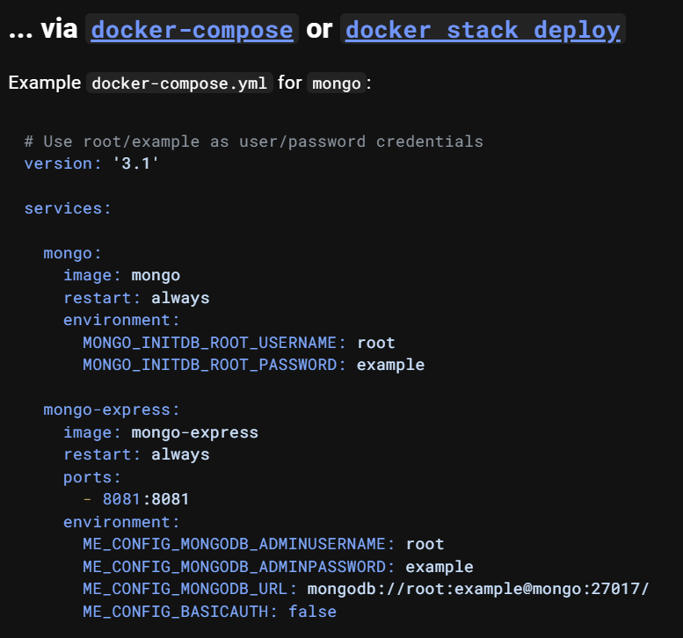
6. docker
what
DOCKER: mongo - MAIN
how

Slide 18
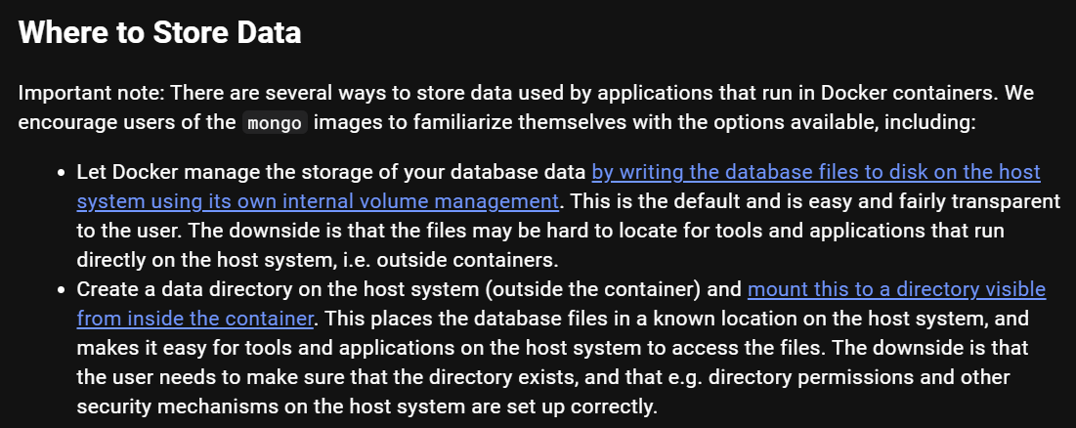
6.1 data
what
DOCKER: mongo - CAVEATS

Slide 19

6.2 environment
what
DOCKER: mongo - ENV
DOCKER: mongo TUTORIAL

Slide 20
7. pymongo

Slide 21
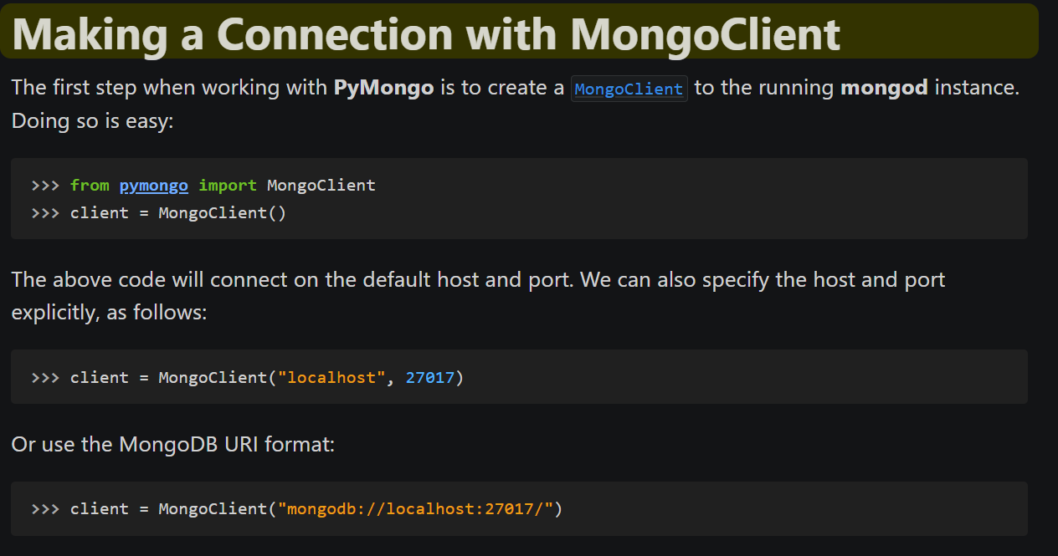
7.1 connection
what
Tutorial - pymongo 4.8.0 documentation

Slide 22
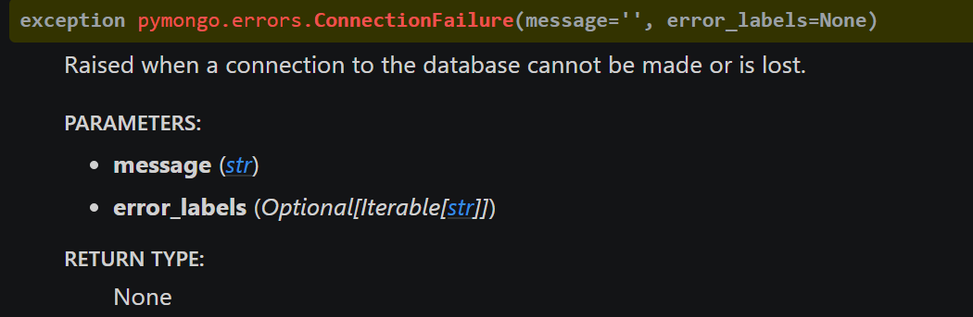
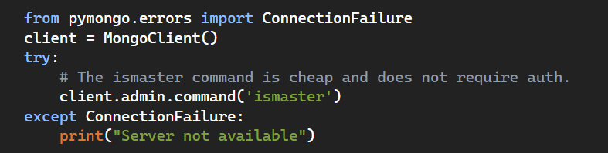
7.2 errors
what
exceptions raised by the pymongo
how
how to properly use try/except with pymongo

Slide 23
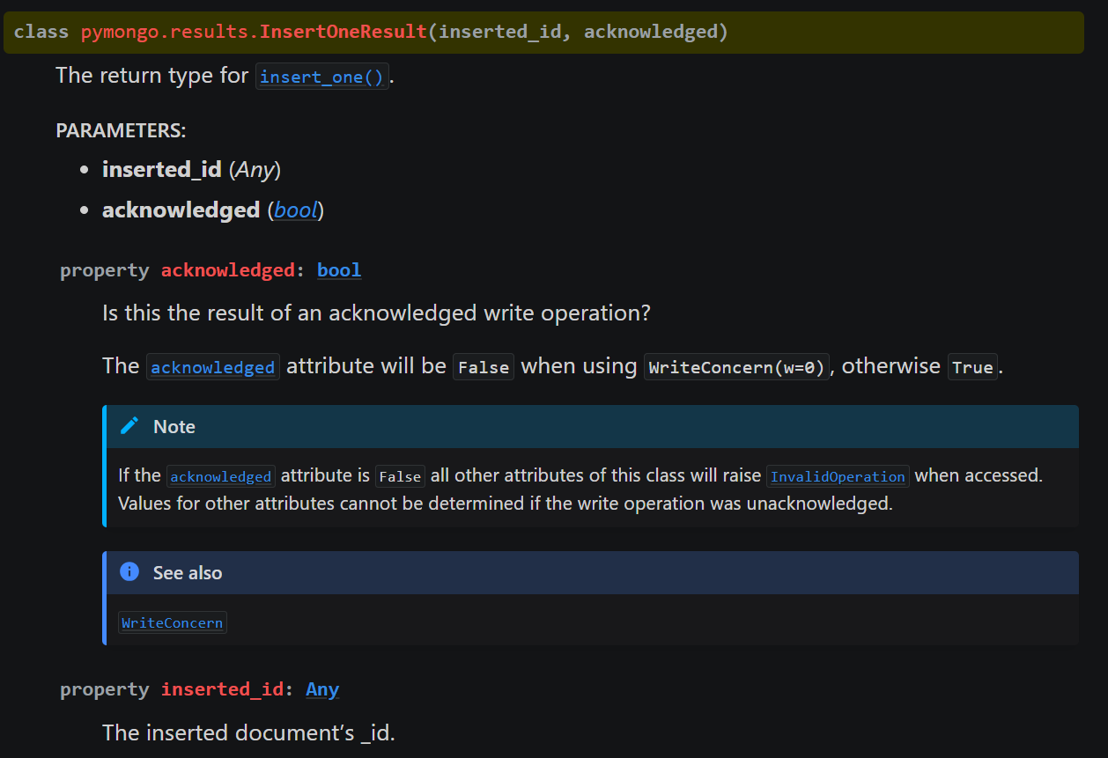
7.3 return
what
results – Result class definitions – Pymongo 4.7.3 documentation

Slide 24

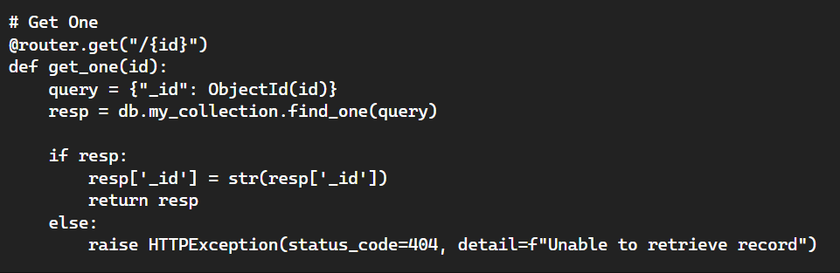
8. object ID
what
Search for a document by Object Id in mongo db
convert object id to string

Slide 25
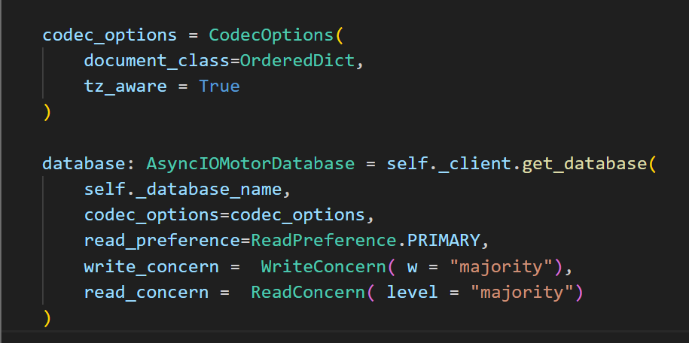
9. configuration
get database
codec options
ordered-dictionaries-in-pymongo
read preferences
write concern
example
default
read concern
Default MongoDB Read Concerns/Write Concerns

Slide 26
A. best practices
MongoDB Schema Design Best Practices

Slide 27
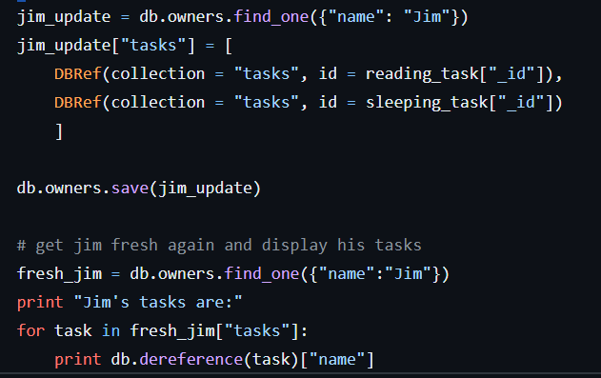
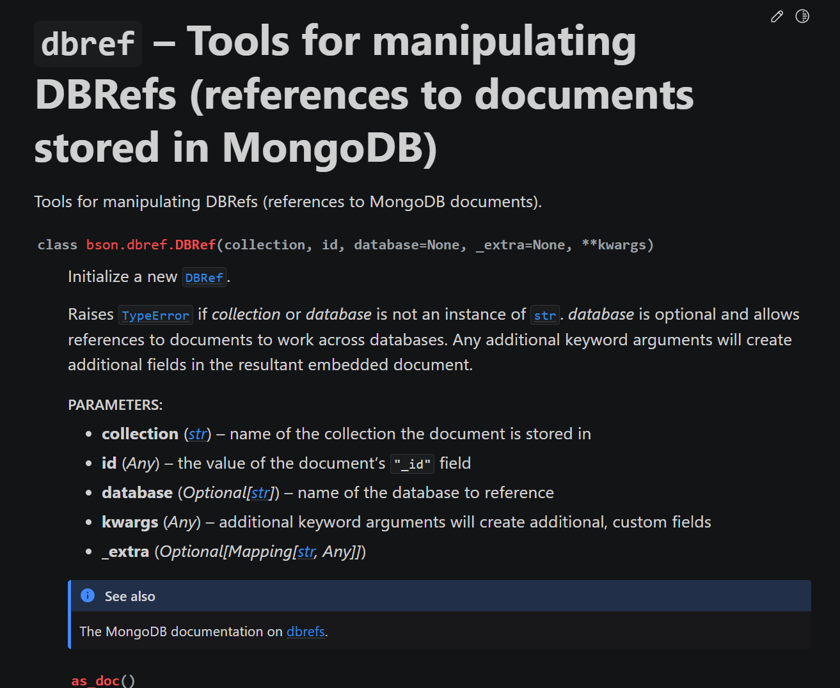
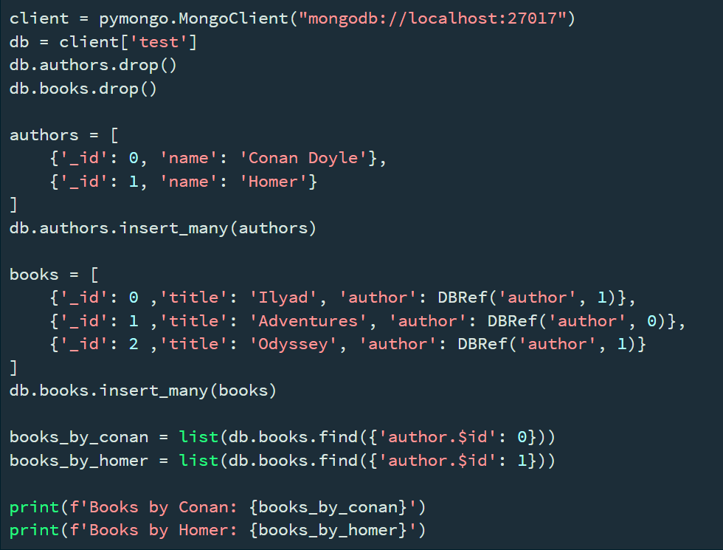
B. db ref
pymongo example
db ref
filter
dereference

Slide 28
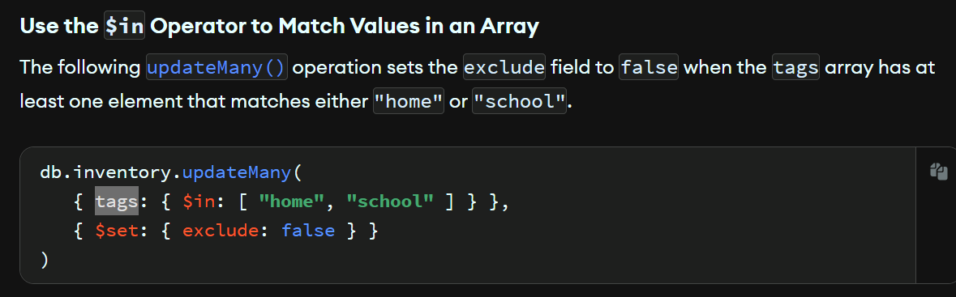
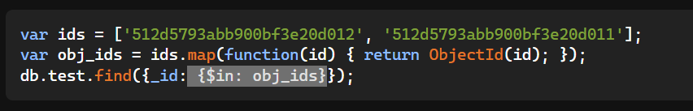
C. in
$in - MongoDB Manual v7.0
Mongo, find through list of ids

Slide 29
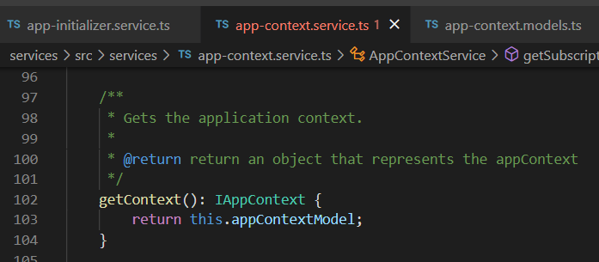



Z. template
new project
ExecuteAsync
square post-it
download
exe
download
exe
why
A slash
followed
by
two consecutive asterisks
D:\A1_research\C2_c0dice\B1_jmeter\A1_install
functionalities
introduction
build-exe
entity framework plus
zig help
⊂
4
every key-frame
defines the operation
success

