Slide 1

1. next js
portfolio

Slide 2
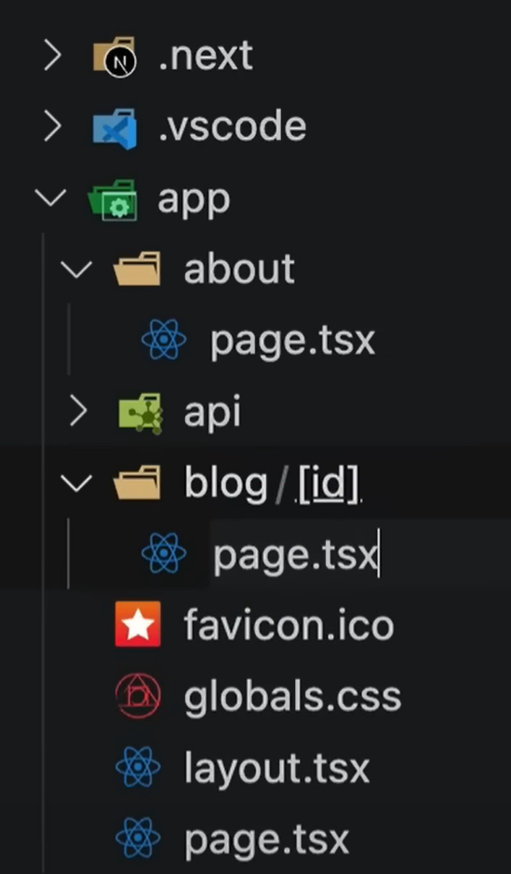

2. routing
1
folder app: root for routes
4
page for /about
5
dynamic route
2
layout to be used in route segment
3
page for /
video on next.js routing

Slide 3
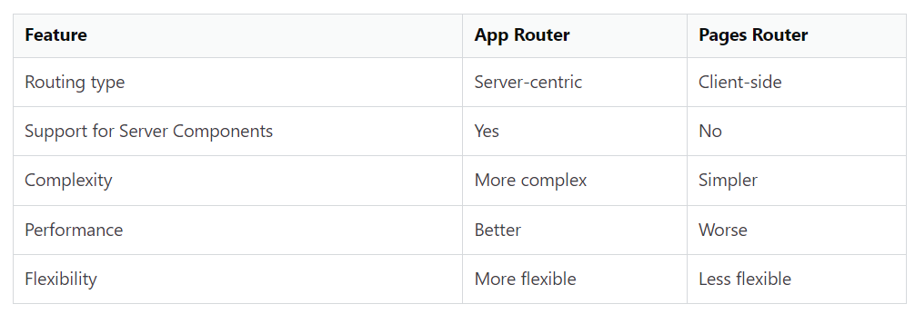
2.1 pages
pages vs app

Slide 4
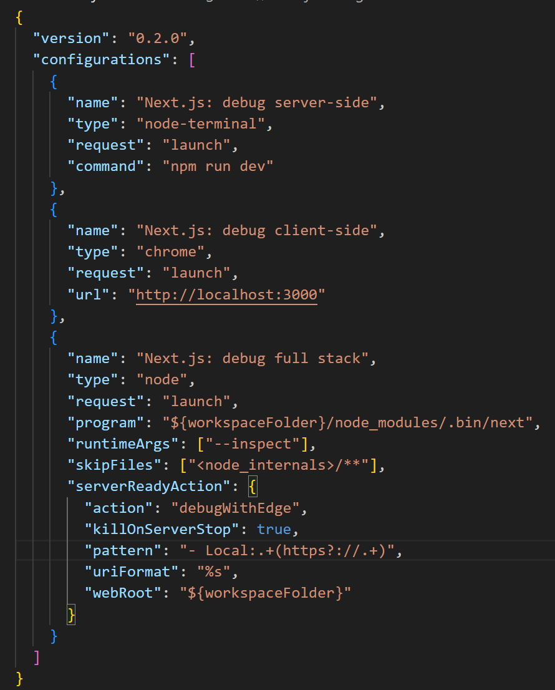
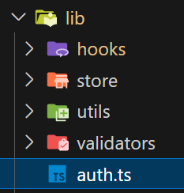
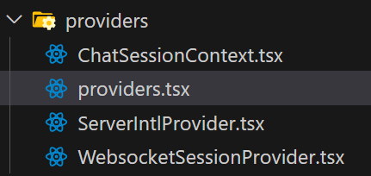
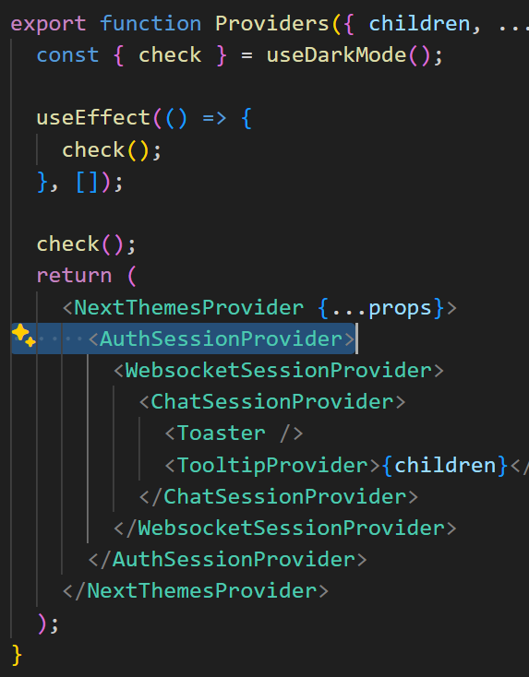
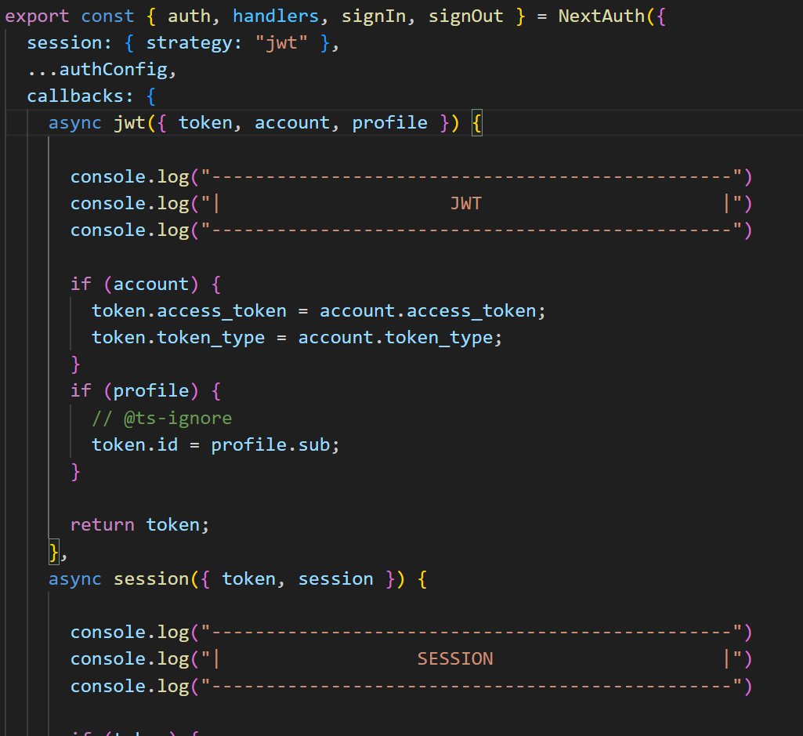

3. debug
allows for debug in:
this is backend code
is displayed
in
console
not working
auth call backs
components can be debugged in backend
configuring/debugging
_resources\launch.json

Slide 5
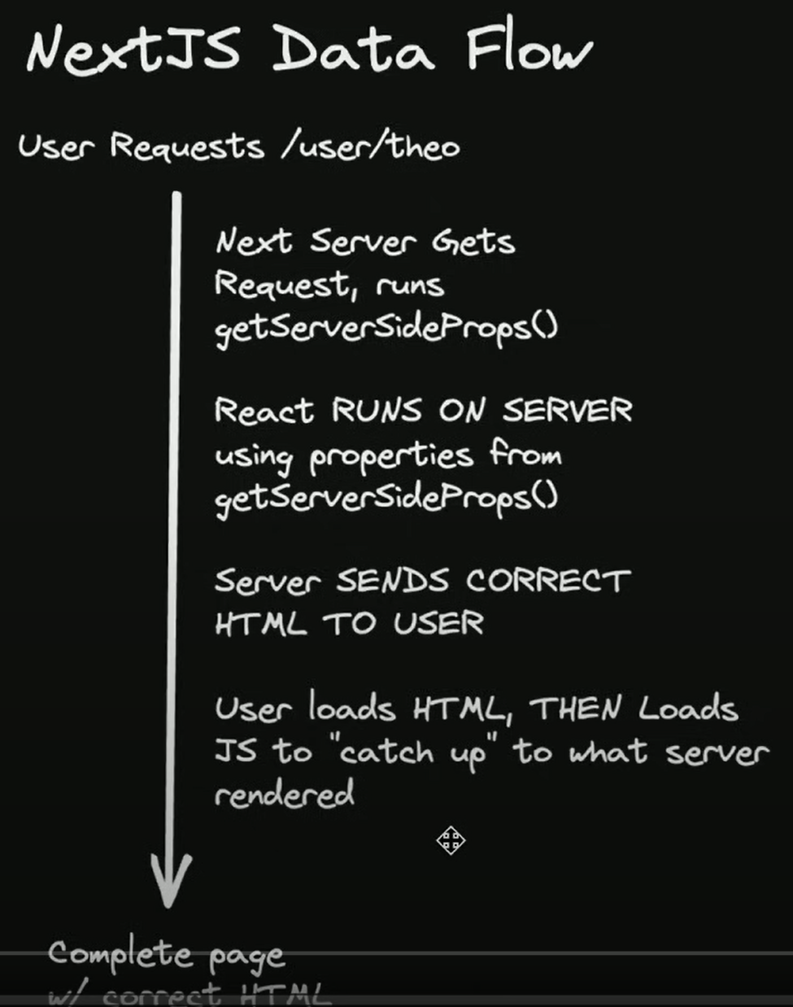
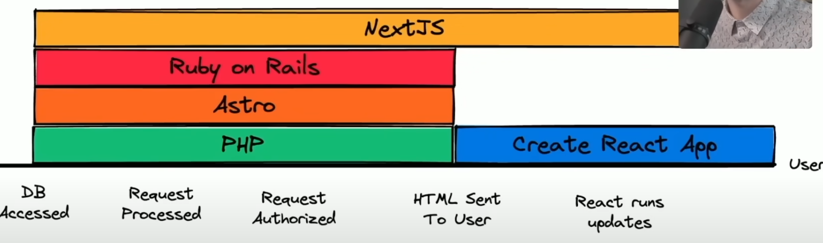
4. concepts
video: how next.js really works
next.js is a backend framework

Slide 6
5. auth
authentication/assistant

Slide 7
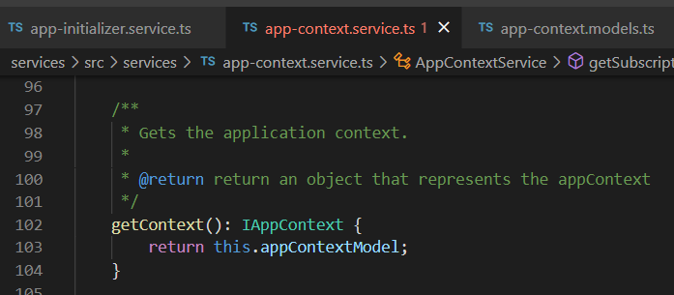



Z. template
new project
ExecuteAsync
square post-it
download
exe
download
exe
why
A slash
followed
by
two consecutive asterisks
D:\A1_research\C2_c0dice\B1_jmeter\A1_install
functionalities
introduction
build-exe
entity framework plus
zig help
⊂
4
every key-frame
defines the operation
deploy

