Slide 1

1. power bi
portfolio

Slide 2
1.1 index
mongodb

Slide 3
1.2 sources

Slide 4

2. overview
video: Microsoft Power BI Desktop for Beginners: In 4 Steps!
2:15 - Data Ingestion: Seamless Data Import Techniques (Step 1)

Slide 5
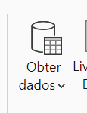
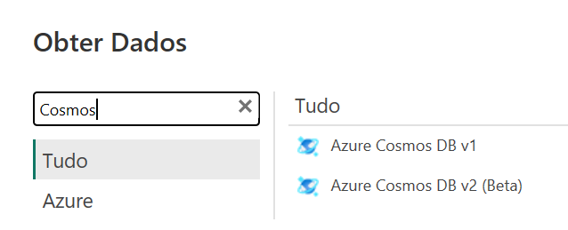
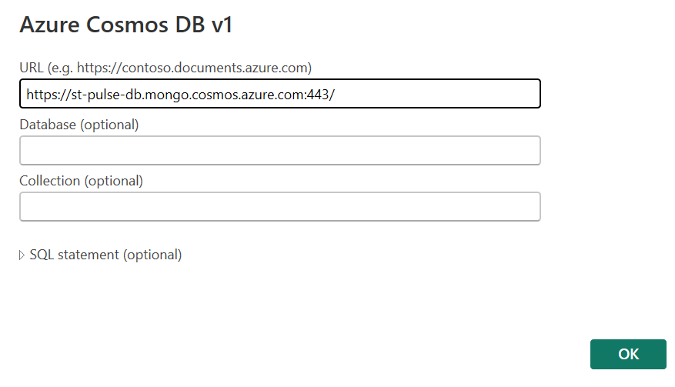
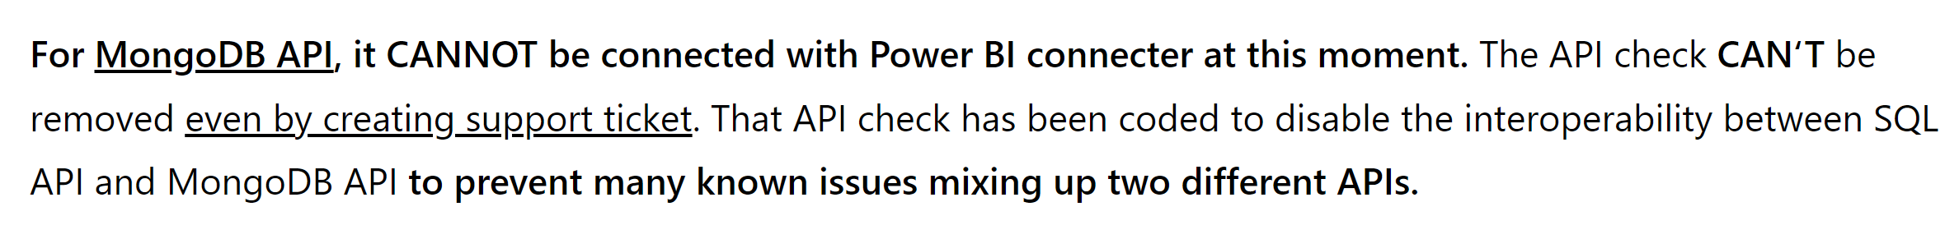
3. mongo
azure DEV/DB
azure STG/DB
video: Power BI Connect to Azure Cosmos Db
connect
connect string
https://st-pulse-db.mongo.cosmos.azure.com:443/
can not connect

Slide 6
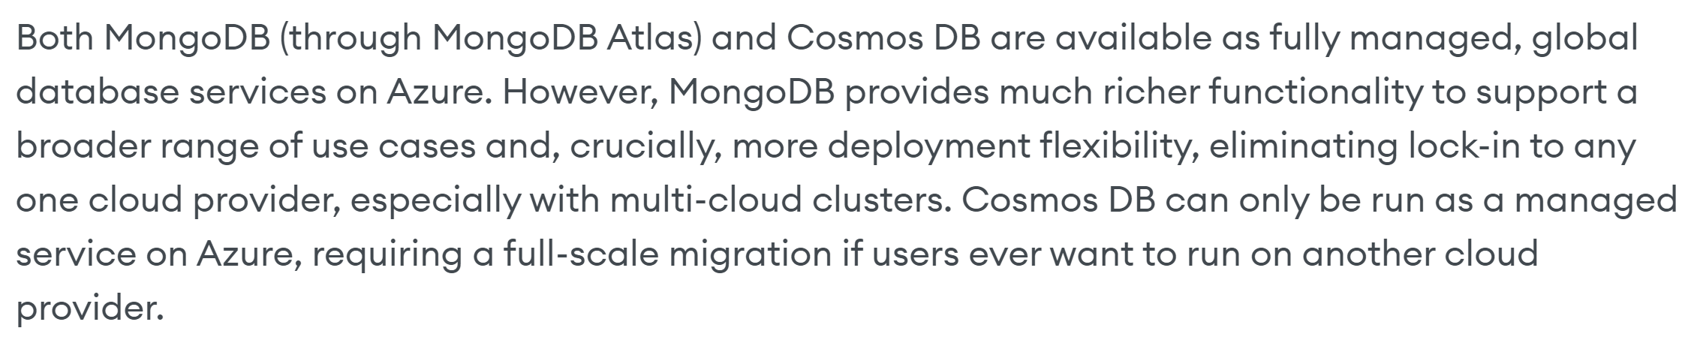
3.1 cosmos
mongodb-vs-cosmos-db

Slide 7
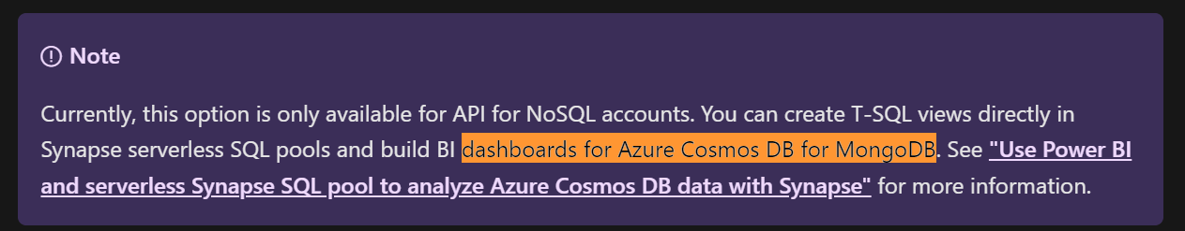
3.2 problem
powerbi-visualize
drivers
drivers 1
what is cosmos mongodb
error discussion 1
error discussion 2
error discussion 3
error discussion 3
Atlas

Slide 8
4. training
get-started-with-power-bi

Slide 9
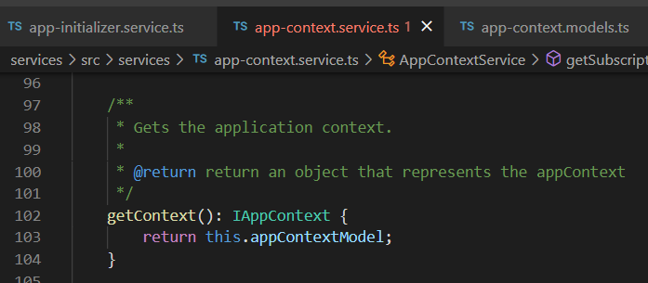




Z. template
new project
ExecuteAsync
square post-it
download
exe
download
exe
why
A slash
followed
by
two consecutive asterisks
D:\A1_research\C2_c0dice\B1_jmeter\A1_install
functionalities
introduction
build-exe
entity framework plus
zig help
⊂
4
every key-frame
defines the operation
deploy

