Slide 1

1. blocking
python

Slide 2


1.1 sources
python
asyncio-event-loop
node js
overview-of-blocking-vs-non-blocking
FastApi async ***
event-loop
thread pool
event-loop
GIL
the-python-gil
thread-state-and-the-global-interpreter-lock
async-concurrency-in-python-and-node-js
..\..\python\mongo

Slide 3
1.2 resources
blocking\Intro_to_Async_Concurrency_in_Python_vs_Node_JS.pdf

Slide 4
2. what
 | JavaScript | Python
origins | designed as a language for web browsers to handle user interactions network requests asynchronously asynchronous: non-blocking I/O | designed as a general-purpose scripting language with an emphasis on readability simplicity asynchronous: not primary concern
evolution | Node.js high concurrency architecture non-blocking, event-driven asynchronous: callbacks | asyncio blocking by Default standard I/O operations are blocking asynchronous: coroutines
chatgpt

Slide 5
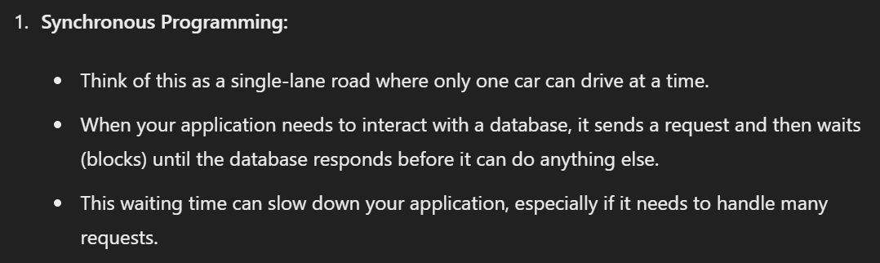
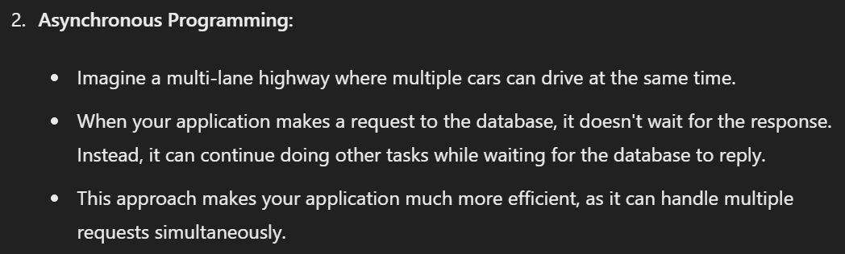
3. asynchronous
JavaScript | Python
callbacks are a special type of function passed as an argument to another function. called when the function that contains the callback as an argument completes its execution allows the code in the callback to run in the meantime Node.js APIs are written in a way that supports callbacks | Coroutines are a more generalized form of subroutines subroutines are entered at one point and exited at another point. coroutines can be entered, exited, and resumed at many different points. they can be implemented with the async def statement
chatgpt

Slide 6
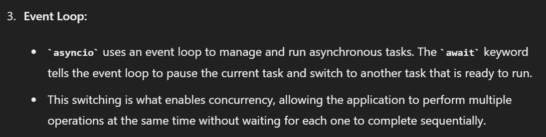
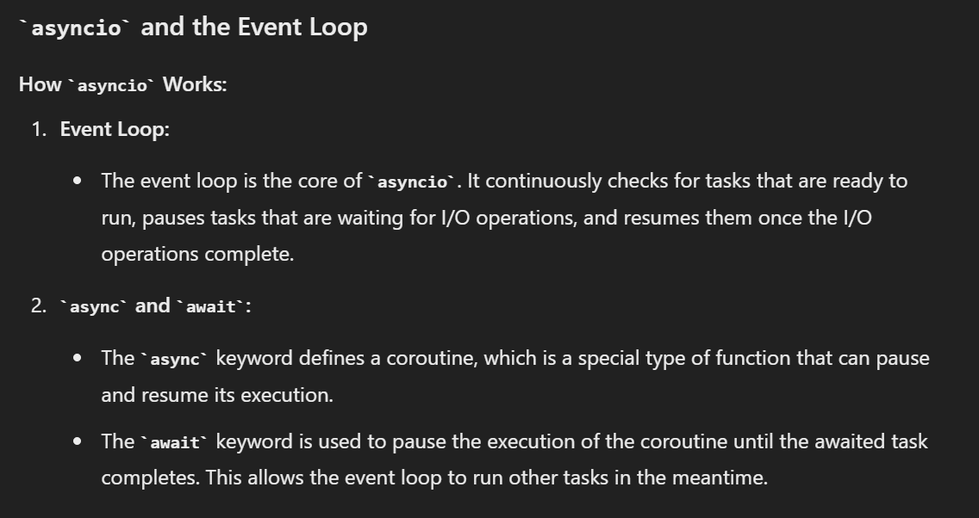
3.1 event loop
 | JavaScript | Python
event loop | allows to perform non-blocking I/O operations JavaScript is single-threaded assigning operations to the operating system | execute coroutines. execute callbacks. perform network input/output. run subprocesses

Slide 7
3.2 async/await
JavaScript | Python
promises more readable way | coroutines more readable way
chatgpt

Slide 8
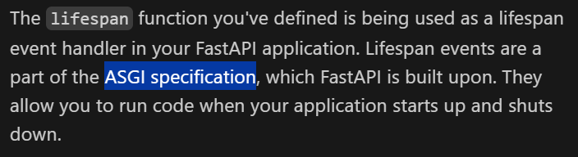
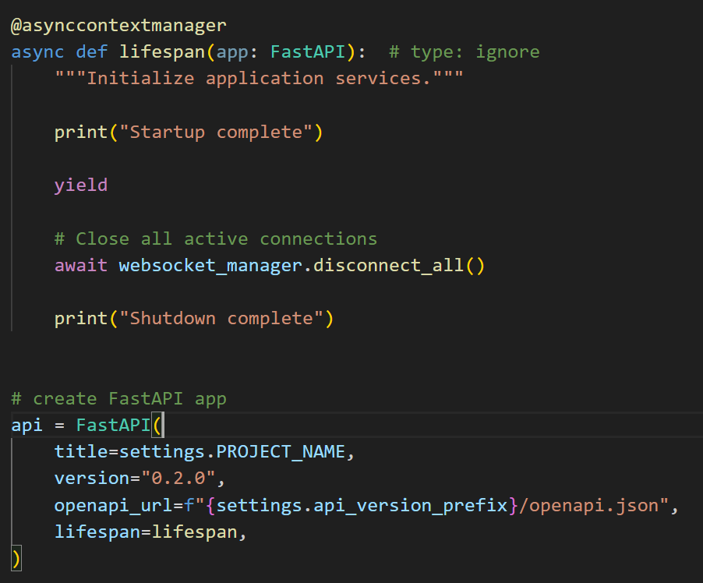
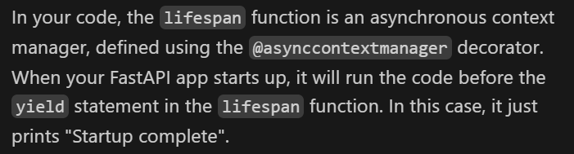
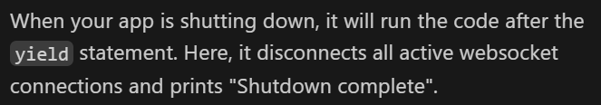
3.3 ASGI
what
to be done
asgi - documentation

Slide 9
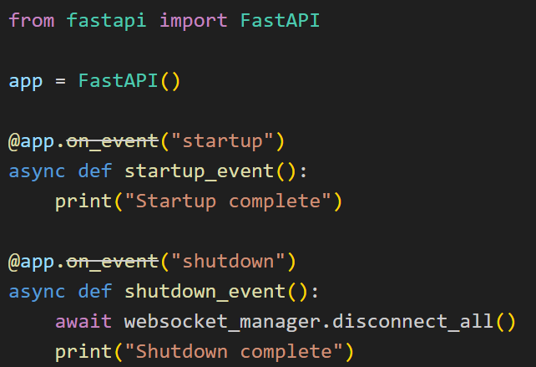
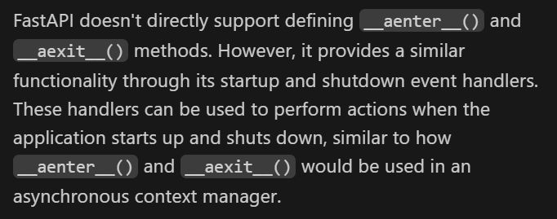
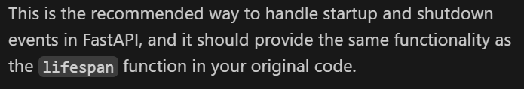
3.3.1 alternative
what

Slide 10
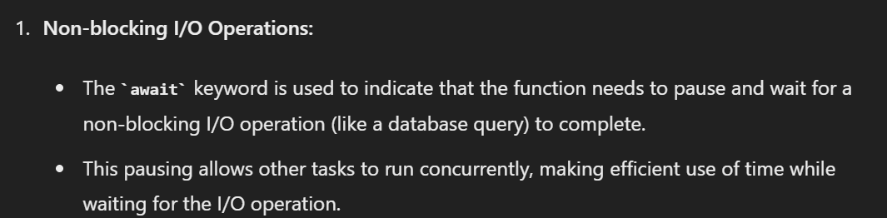
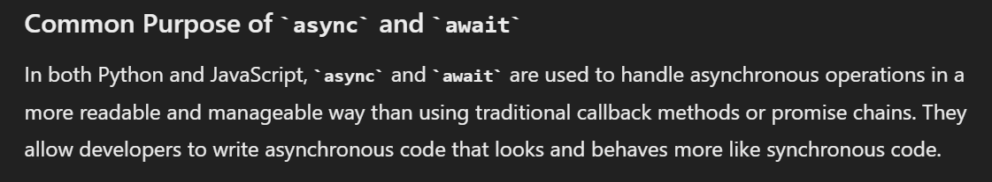
4. async/await
what

Slide 11
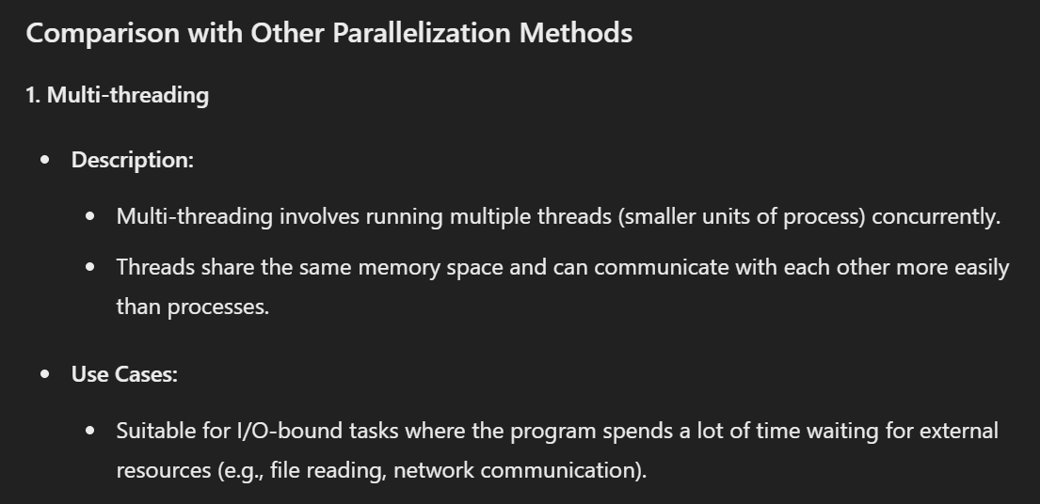
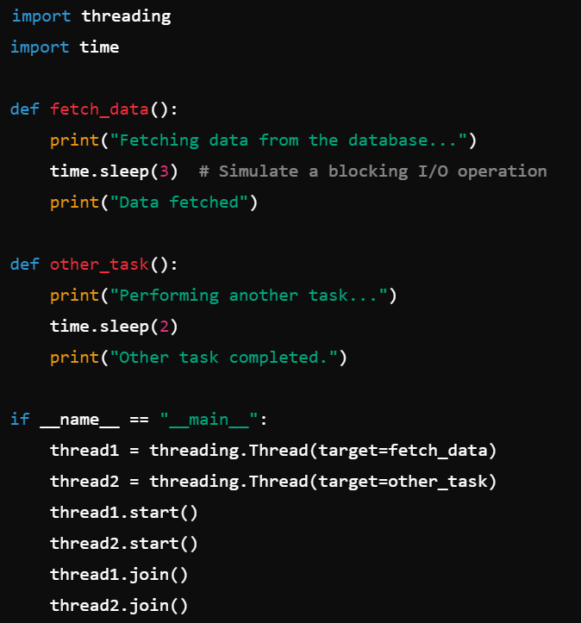
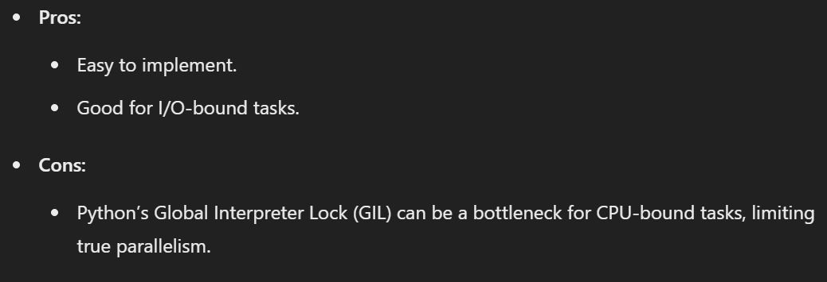
5. multithread
what

Slide 12
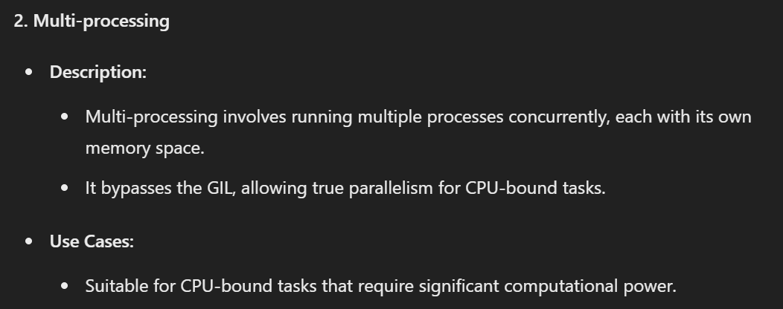
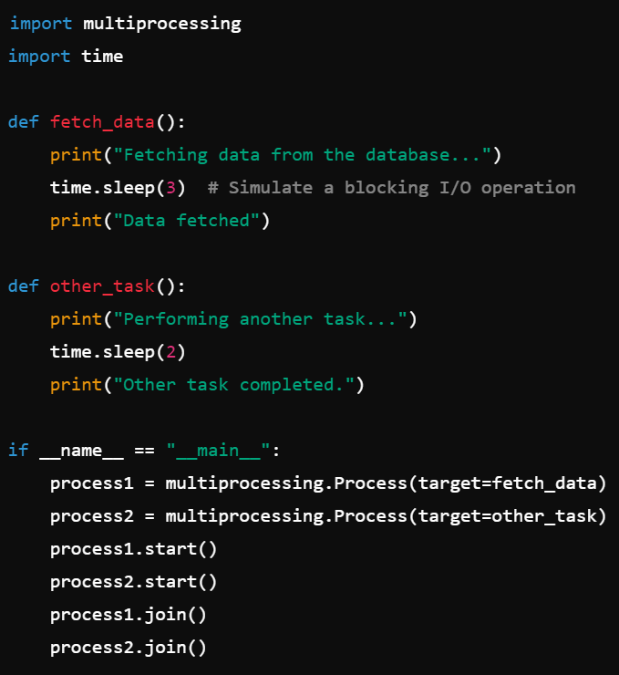
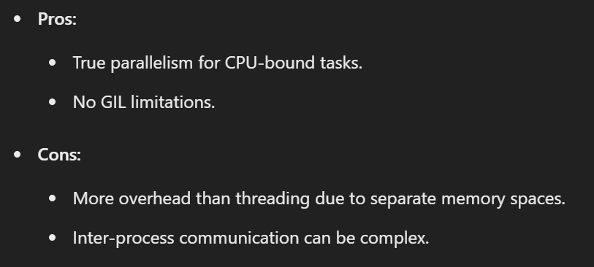
6. multi-process
what

Slide 13
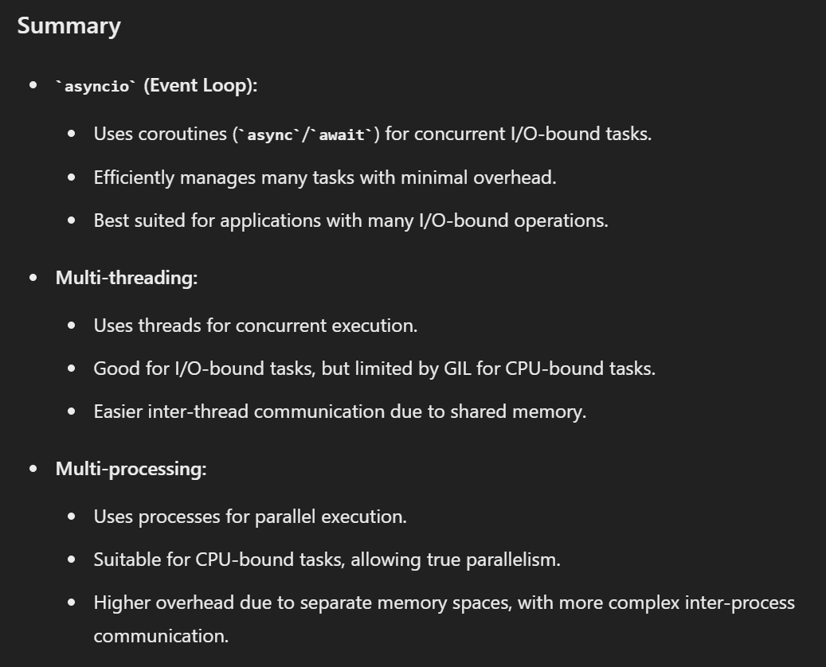
7. summary
what

Slide 14
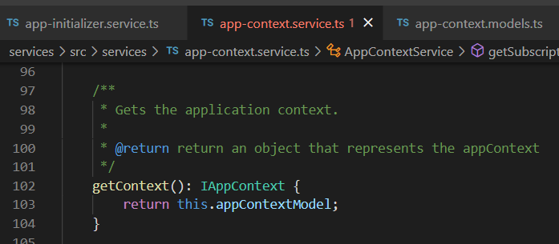



Z. template
new project
ExecuteAsync
square post-it
download
exe
download
exe
why
A slash
followed
by
two consecutive asterisks
D:\A1_research\C2_c0dice\B1_jmeter\A1_install
functionalities
introduction
build-exe
entity framework plus
zig help
⊂
4
every key-frame
defines the operation
success

