Slide 1

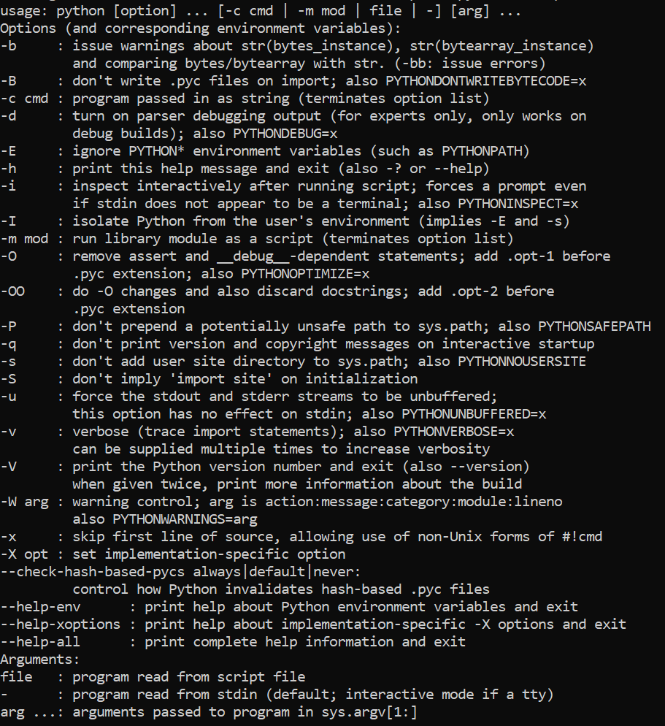

1. command
python
what
where
cmdline

Slide 2
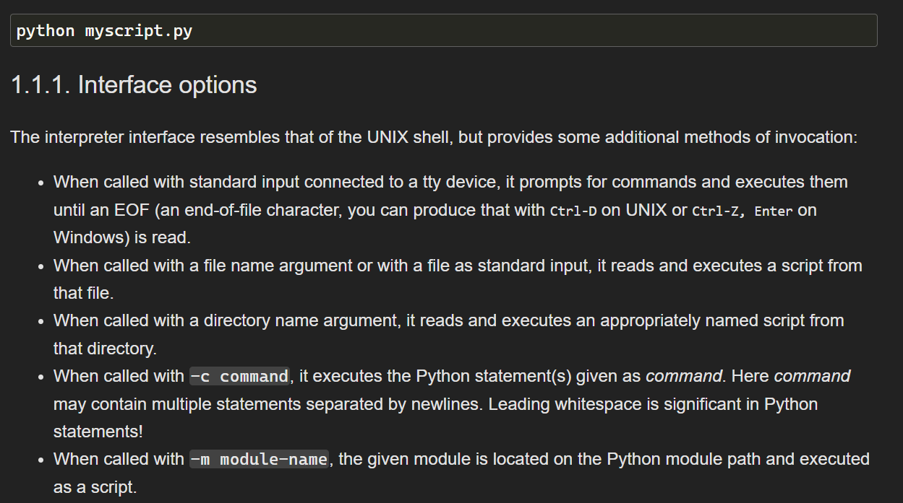
2. run
what

Slide 3
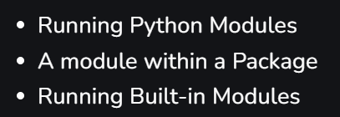
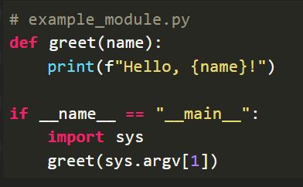

3. m
what
is
a command-line option
that allows
to run
a module
as a script
this means
execute
Python code
directly from
the command line
without the need
for
an external script file
by using -m,
you can invoke
Python modules
as
standalone programs
what-is-the-use-of-python-m-flag/

Slide 4
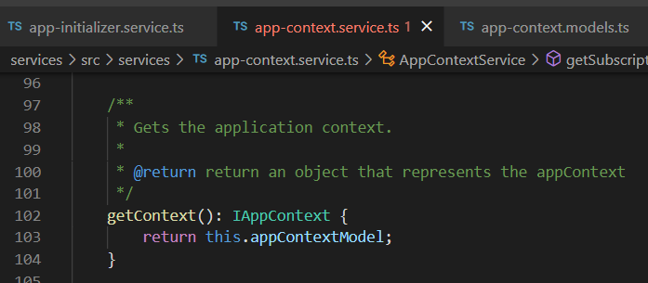




Z. template
new project
ExecuteAsync
square post-it
download
exe
download
exe
why
A slash
followed
by
two consecutive asterisks
D:\A1_research\C2_c0dice\B1_jmeter\A1_install
functionalities
introduction
build-exe
entity framework plus
zig help
⊂
4
every key-frame
defines the operation
success

