Slide 1

1. rich
console
python

Slide 2

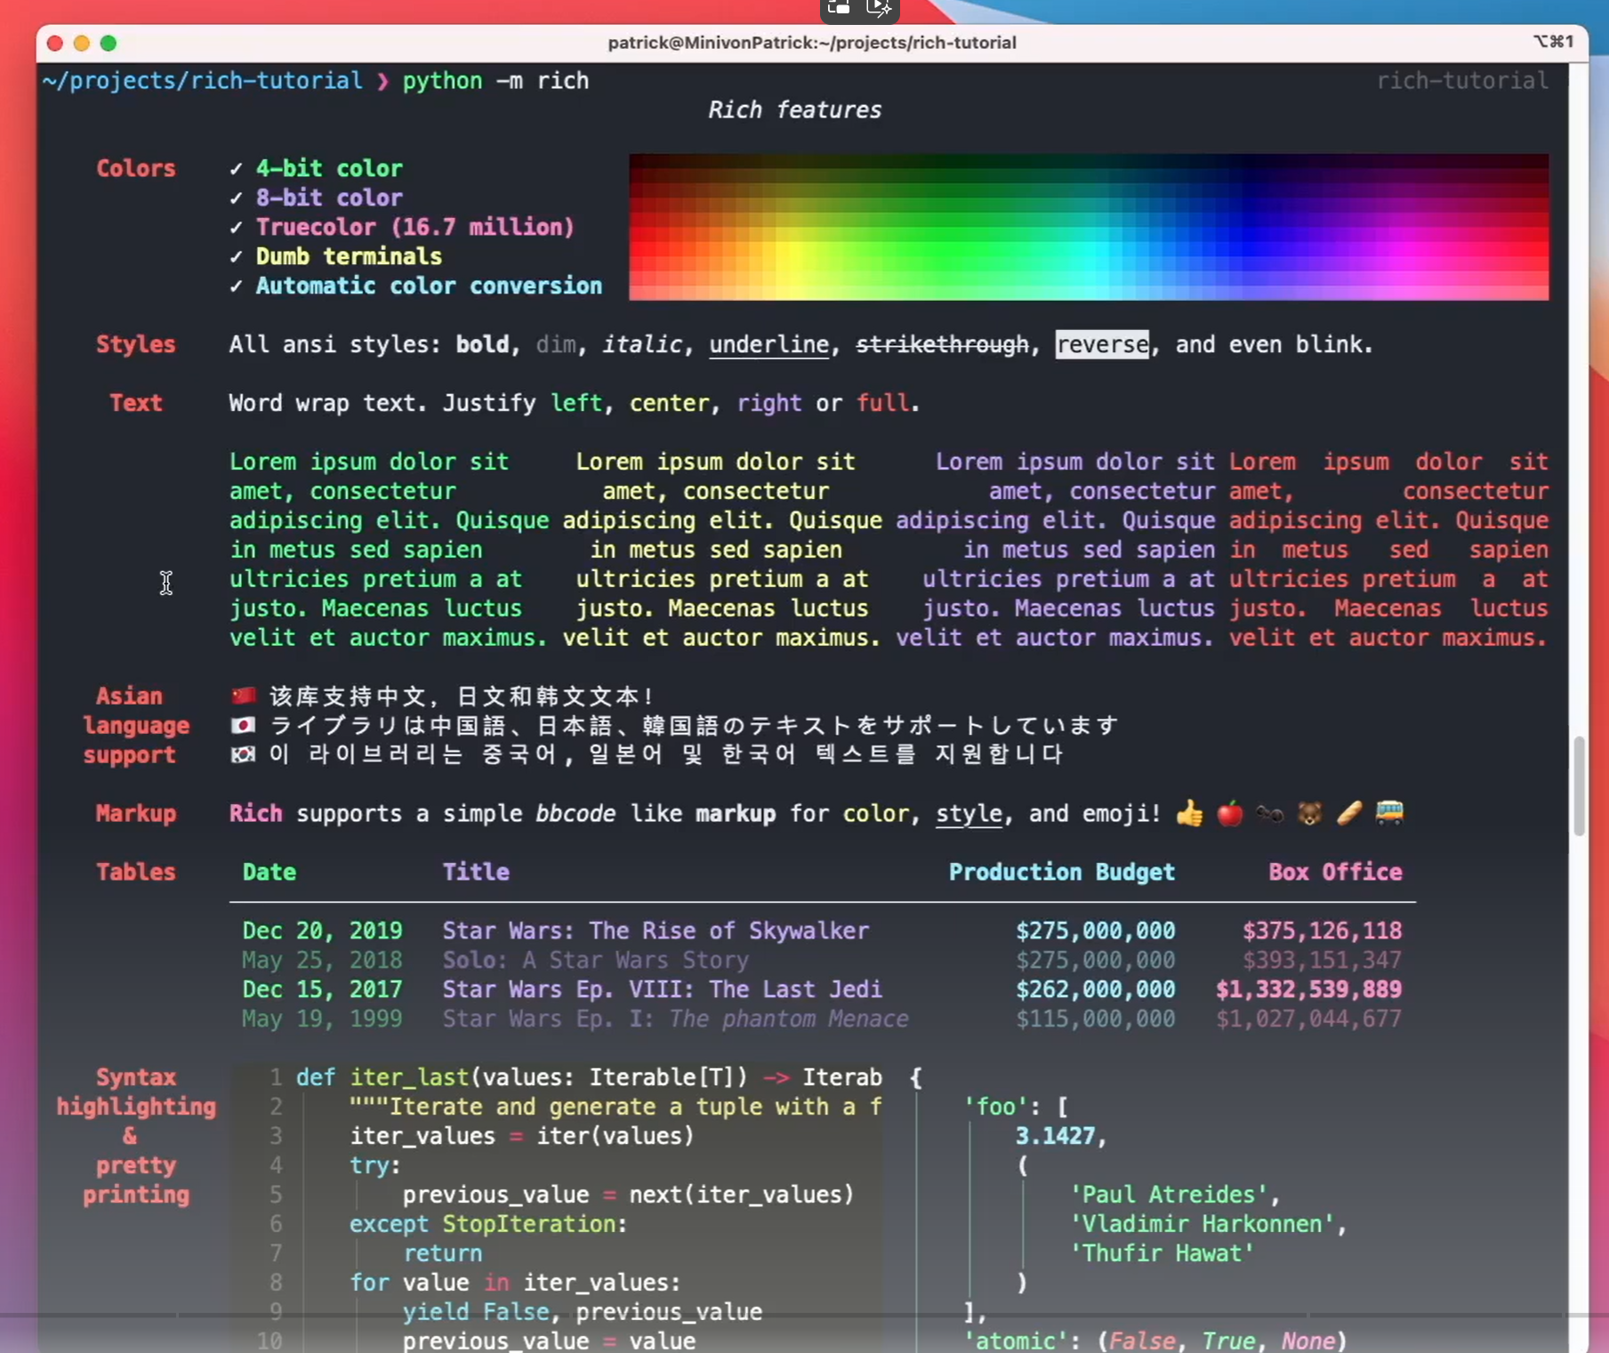
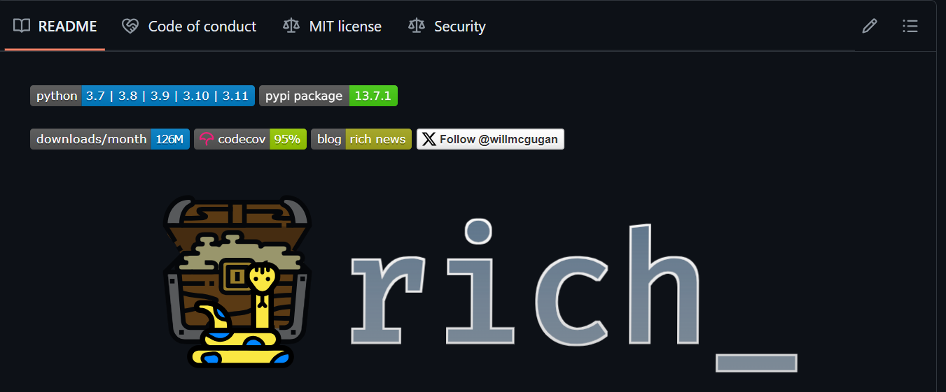
1.1. sources
video: rich
Timeline:
00:00 – Introduction
00:52 - 01 print
01:30 - 02 Console
03:05 - 03 Text
03:55 - 04 Theme
04:57 - 05 Emoji
05:28 - 06 Log
06:09 - 07 Traceback
08:24 - 08 Save
09:25 - 09 Table
11:02 - 10 Markdown
12:02 - 11 Progress Bar
textualize
video
documentation: rich
yield
Introduction
Console API
Styles
Console Markup
Rich Text
Highlighting
Pretty Printing
Logging Handler
Traceback
Prompt
Columns
Render Groups
Markdown
Padding
Panel
Progress Display
Syntax
Tables
Tree
Live Display
Layout
Console Protocol
Reference
Appendix
console\_resources
GitHub

Slide 3
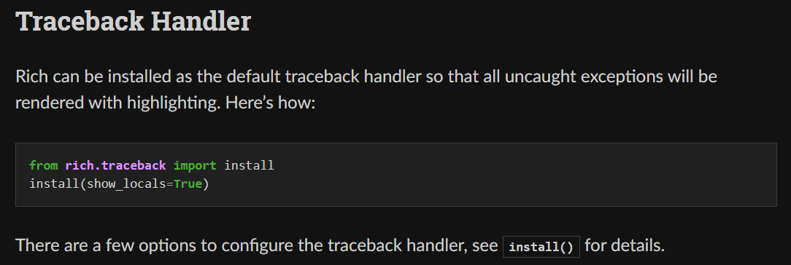
2. traceback
what
traceback

Slide 4
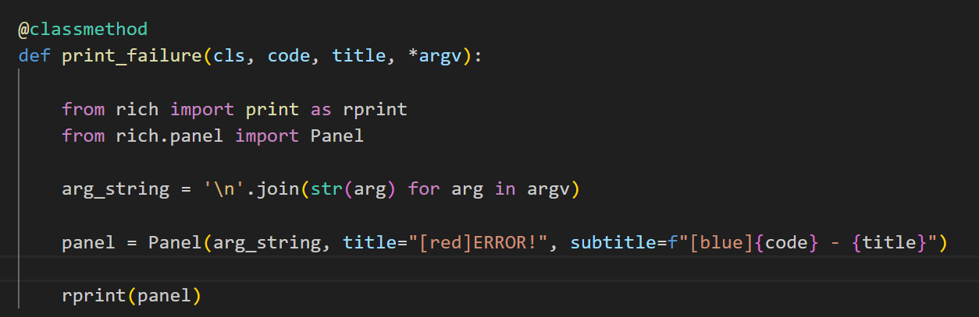
3. panel
what
panel

Slide 5
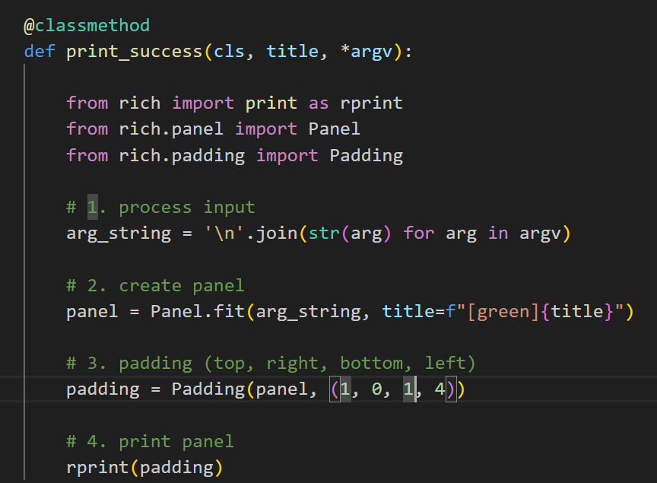
4. padding
what
padding

Slide 6
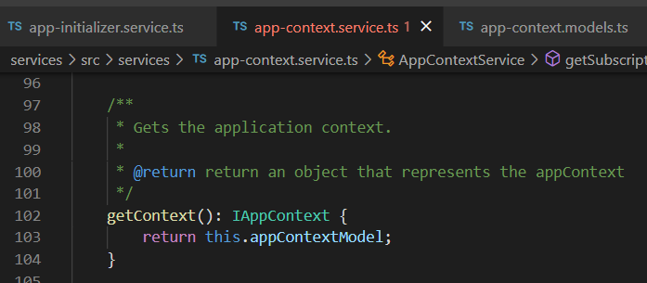




Z. template
new project
ExecuteAsync
square post-it
download
exe
download
exe
why
A slash
followed
by
two consecutive asterisks
D:\A1_research\C2_c0dice\B1_jmeter\A1_install
functionalities
introduction
build-exe
entity framework plus
zig help
⊂
4
every key-frame
defines the operation
success

