Slide 1

1. textualize
console
python

Slide 2
1.1. index
web

Slide 3

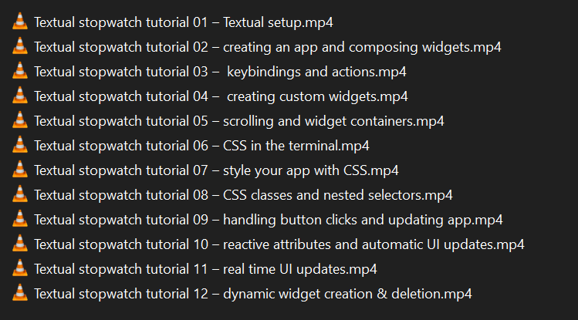

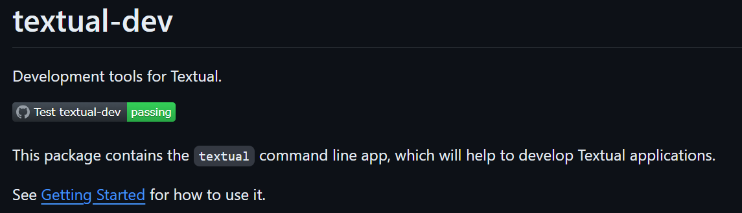
1.2. sources
textualize: main
video list: stopwatch
Home
Introduction
Tutorial
Guide
Widgets
Reference
API
How To
FAQ
Roadmap
Blog
github: Textualize/textual
_resources\videos stop watch
yield
github: Textualize/textual-dev
video list: reactivity
guide: reactivity

Slide 4
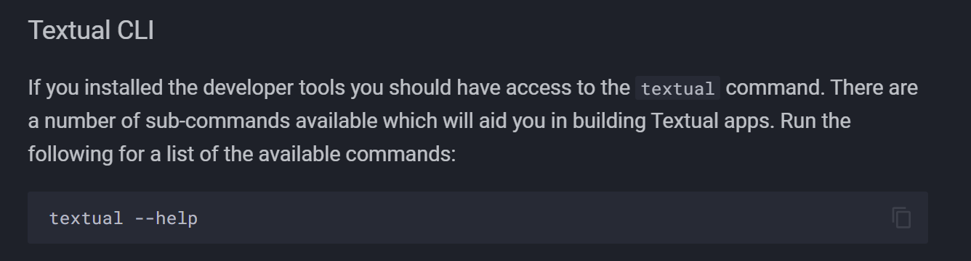
2. install
command
pdm add textual
install
tools
pdm add textual-dev

Slide 5
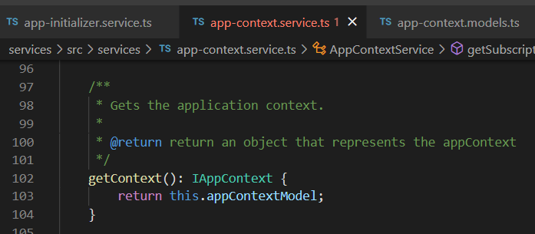



Z. template
new project
ExecuteAsync
square post-it
download
exe
download
exe
why
A slash
followed
by
two consecutive asterisks
D:\A1_research\C2_c0dice\B1_jmeter\A1_install
functionalities
introduction
build-exe
entity framework plus
zig help
⊂
4
every key-frame
defines the operation
success

