Slide 1

1. web
textualize
console
python

Slide 2

1.1. sources
github: Textualize/textual-web

Slide 3
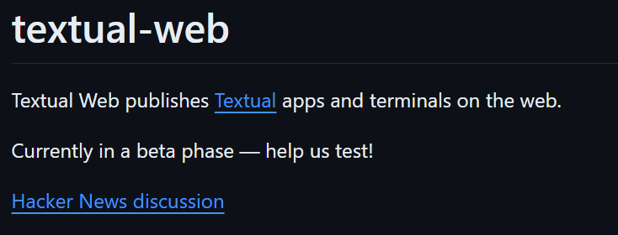
2. what
description

Slide 4
3. install
command
pdm add -d textual-web

Slide 5
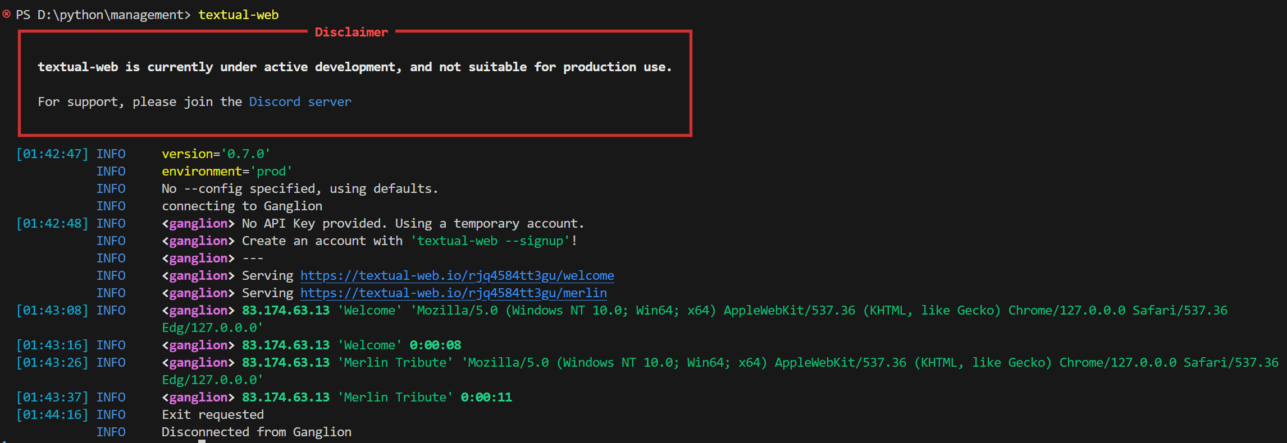
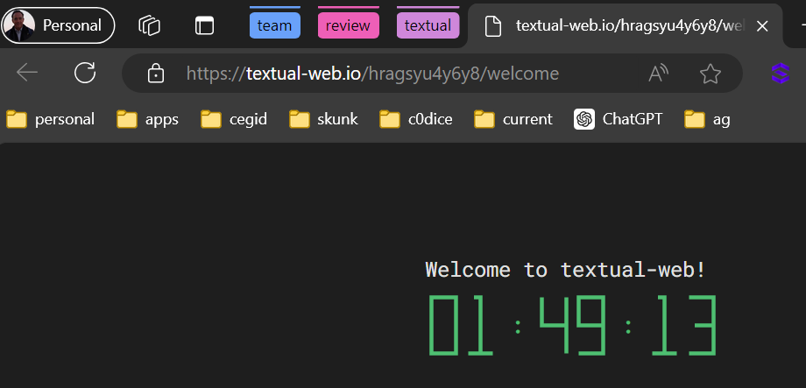
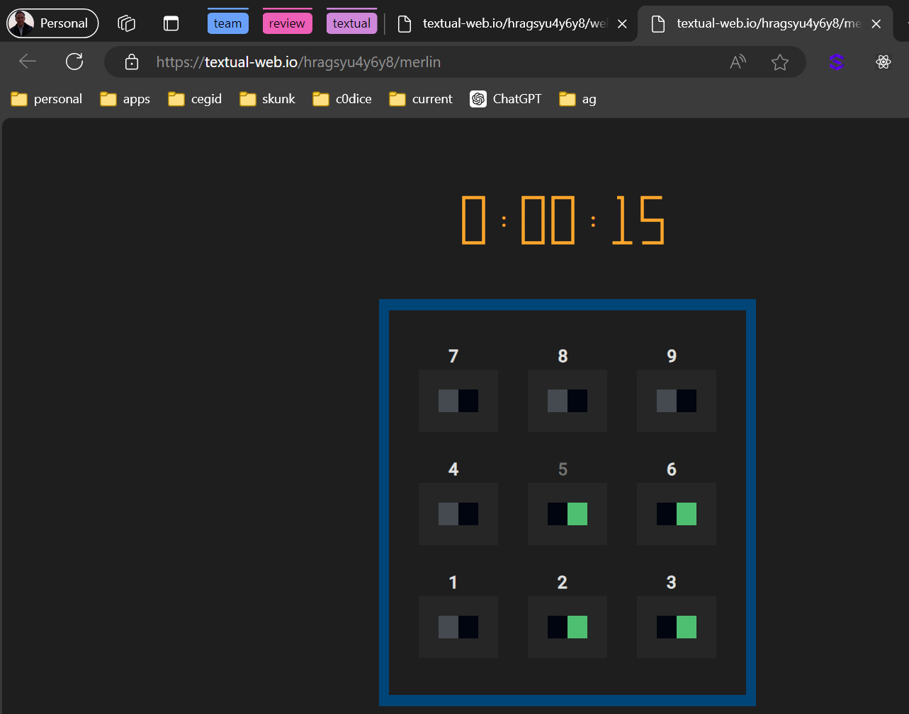
4. test
command
textual-web

Slide 6
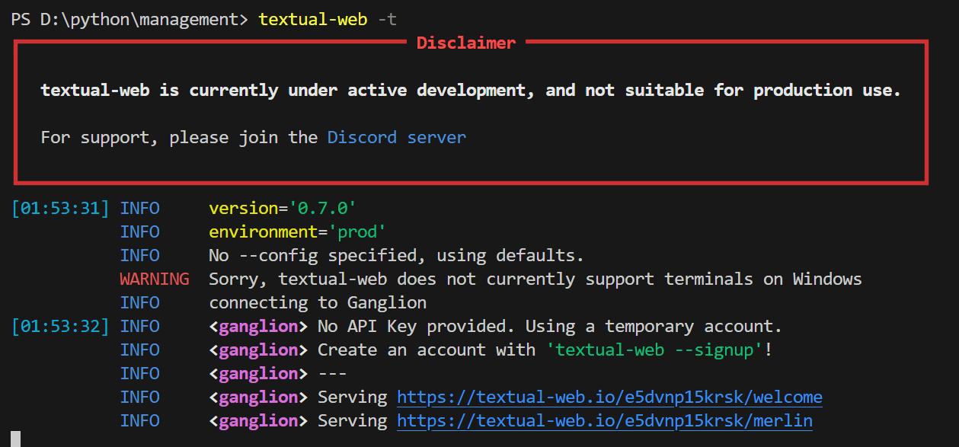
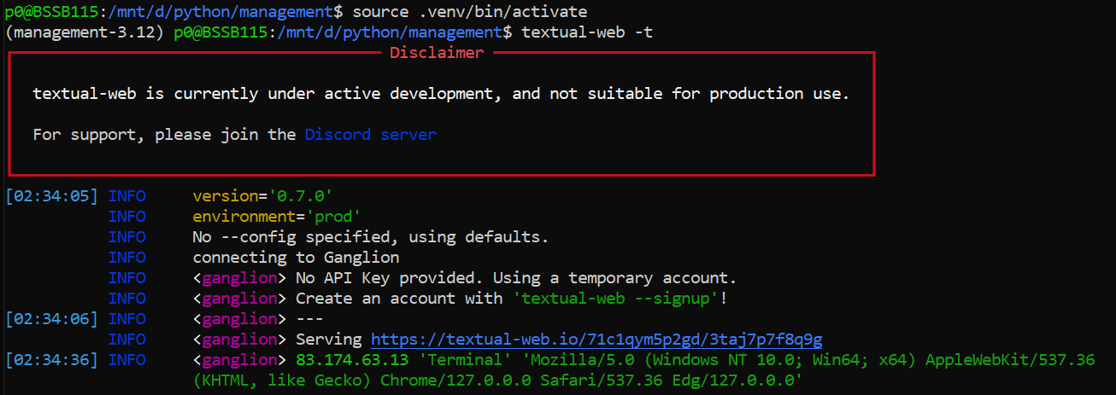
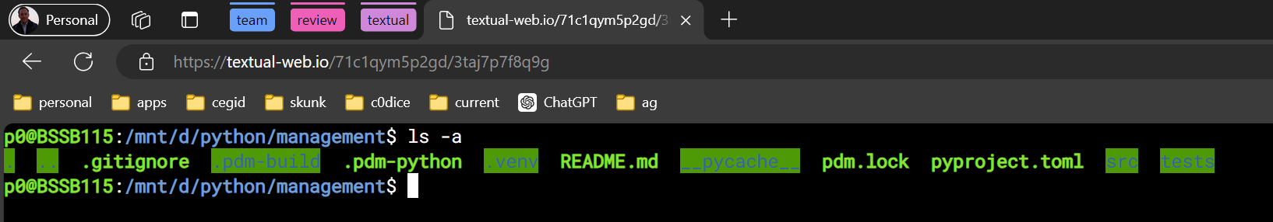
5. terminal
command
textual-web -t
wsl

Slide 7
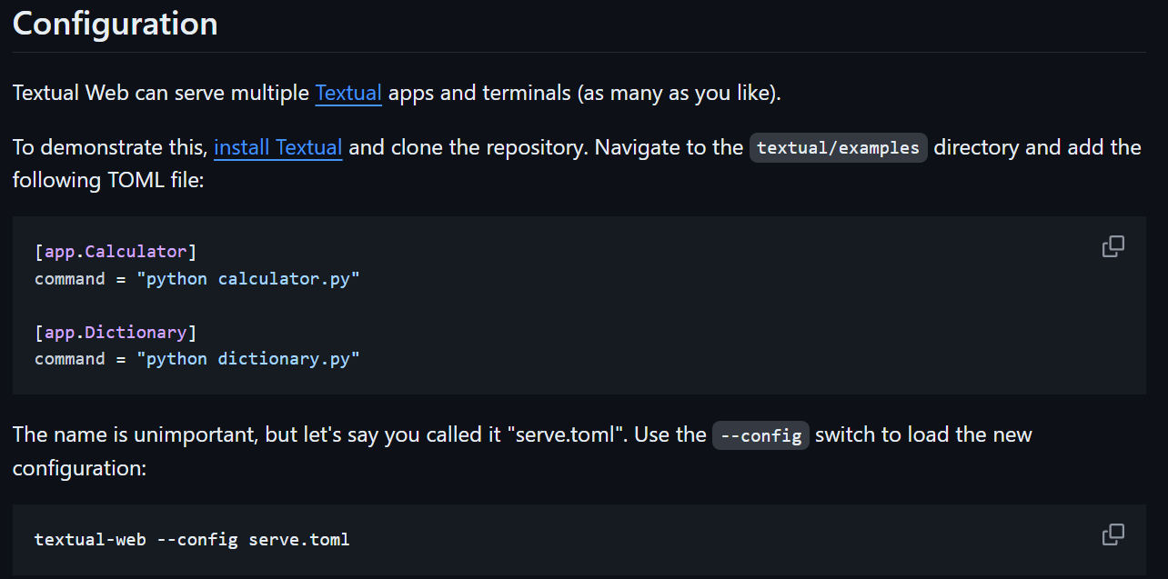
6. run app
how
create configuration: serve. Toml
textual-web –config serve.toml
to be done

Slide 8
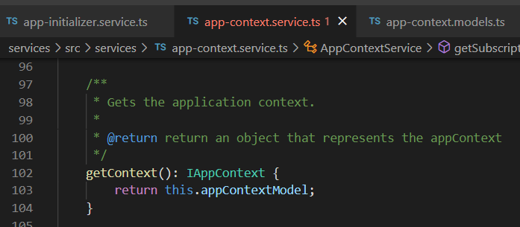




Z. template
new project
ExecuteAsync
square post-it
download
exe
download
exe
why
A slash
followed
by
two consecutive asterisks
D:\A1_research\C2_c0dice\B1_jmeter\A1_install
functionalities
introduction
build-exe
entity framework plus
zig help
⊂
4
every key-frame
defines the operation
success

