Slide 1

1. deployment
environment
python

Slide 2
1.1 index
devpi
formats

Slide 3

1.2 sources
documentation: twine
distributing-packages-using-setuptools/
How to Build a Complete Python Package Step-by-Step - YouTube
code example
setup tools
Publish Your Own Python Package - YouTube
pipy
project
setup

Slide 4
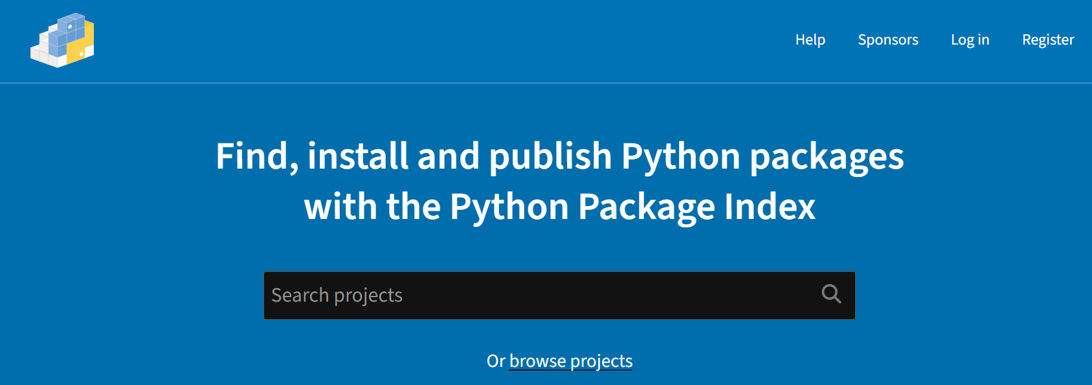
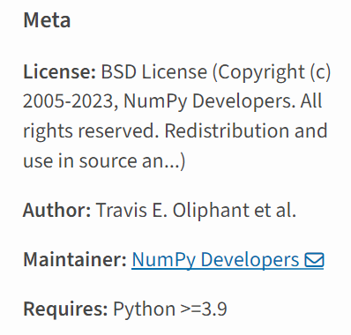
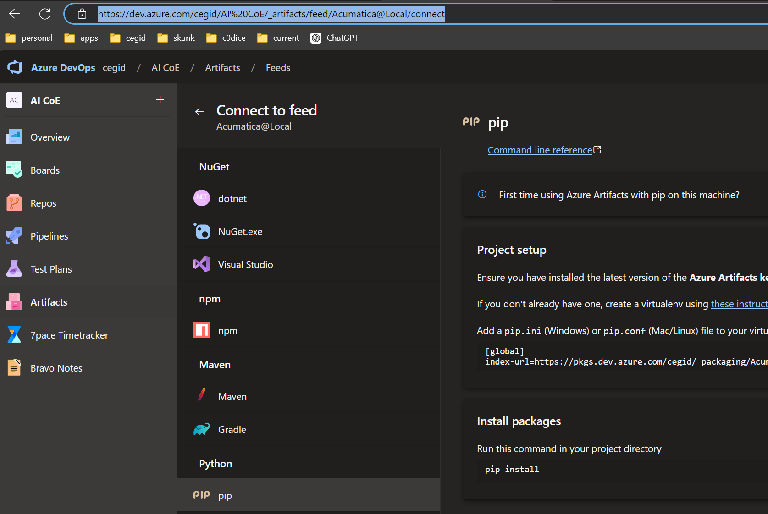

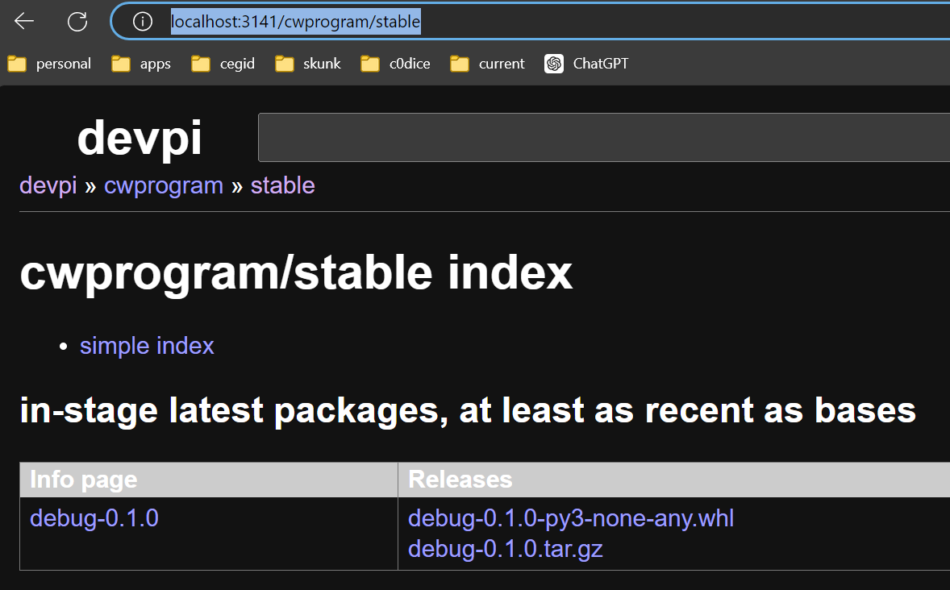
2. repositories
pipy
search
pipy
azure
numpy
azure
local
local

Slide 5
3. wheels
video: history

Slide 6
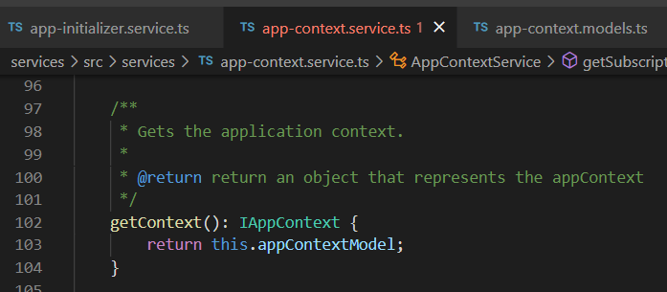


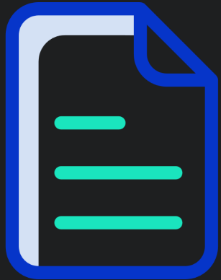

Z. template
new project
ExecuteAsync
square post-it
download
exe
download
exe
why
A slash
followed
by
two consecutive asterisks
D:\A1_research\C2_c0dice\B1_jmeter\A1_install
functionalities
introduction
build-exe
entity framework plus
zig help
⊂
4
every key-frame
defines the operation
success

