Slide 1

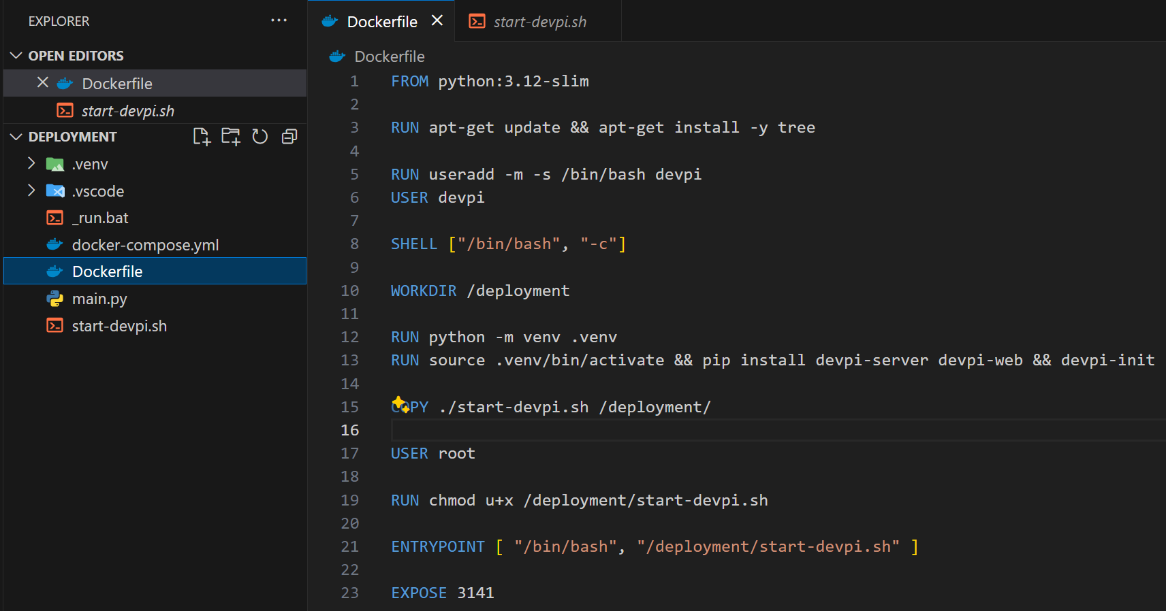

1. docker
install
for debug
project
create environment
local user for security
pip install devpi-server devpi-web
change shell to use “source”
docker
initialize
sudo useradd -m -s /bin/bash devpi
initialize data folder:
/home/devpi/.devpi/server
make executable
run server
server port
D:\python\deployment
C:\Users\evaristo.figueiredo\.devpi

Slide 2
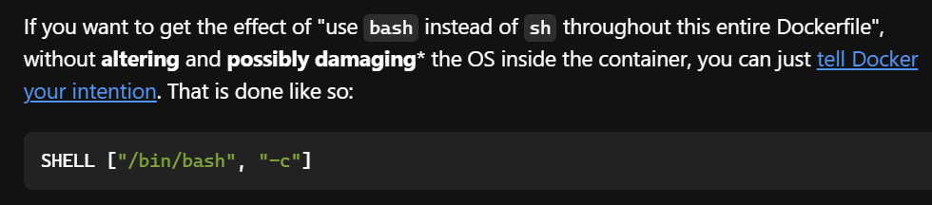
2. bash
what
using-the-run-instruction-in-a-dockerfile-with-source-does-not-work

Slide 3
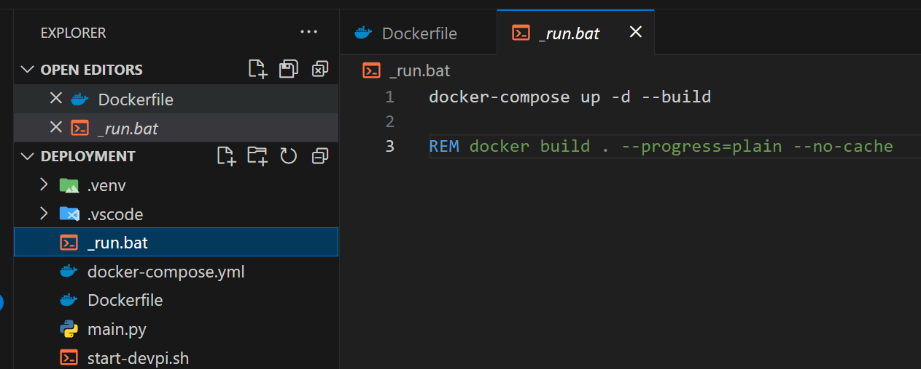
3. debug
what
build-not-showing-any-output-from-commands
use this commands to display info about the build
RUN pwd
RUN ls -a
RUN tree -a ./.venv/bin

Slide 4
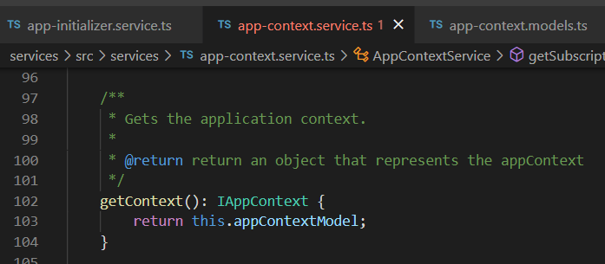




Z. template
new project
ExecuteAsync
square post-it
download
exe
download
exe
why
A slash
followed
by
two consecutive asterisks
D:\A1_research\C2_c0dice\B1_jmeter\A1_install
functionalities
introduction
build-exe
entity framework plus
zig help
⊂
4
every key-frame
defines the operation
success

