Slide 1

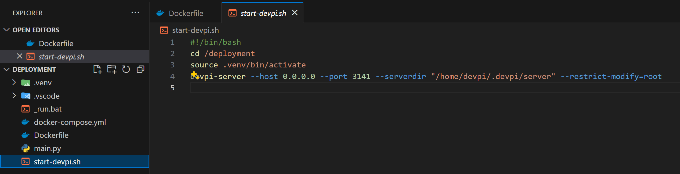

1. entry point
start dev.sh
this batch
was only valid
if I was going to run
the server
as a service
using docker
is not possible
to run
services
root
2. install
needed
to create
user: root
initialize

Slide 2
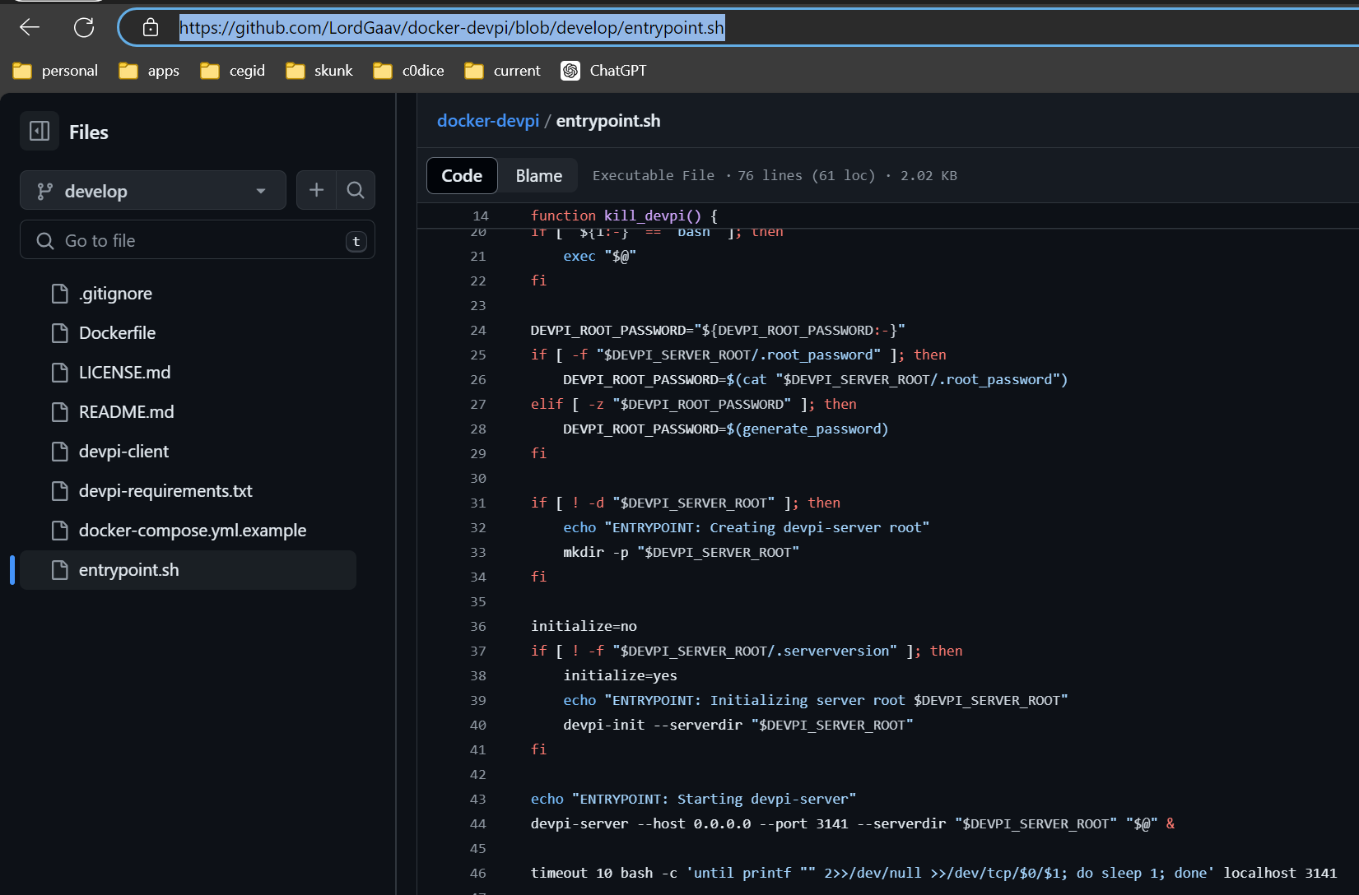
2. github
what
github: entrypoint.sh

Slide 3
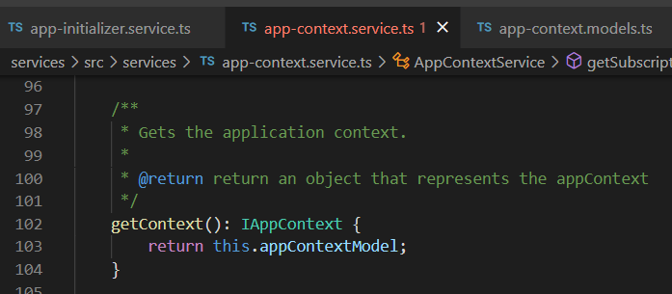




Z. template
new project
ExecuteAsync
square post-it
download
exe
download
exe
why
A slash
followed
by
two consecutive asterisks
D:\A1_research\C2_c0dice\B1_jmeter\A1_install
functionalities
introduction
build-exe
entity framework plus
zig help
⊂
4
every key-frame
defines the operation
success

