Slide 1

1. package managers
deployment
environment
python

Slide 2
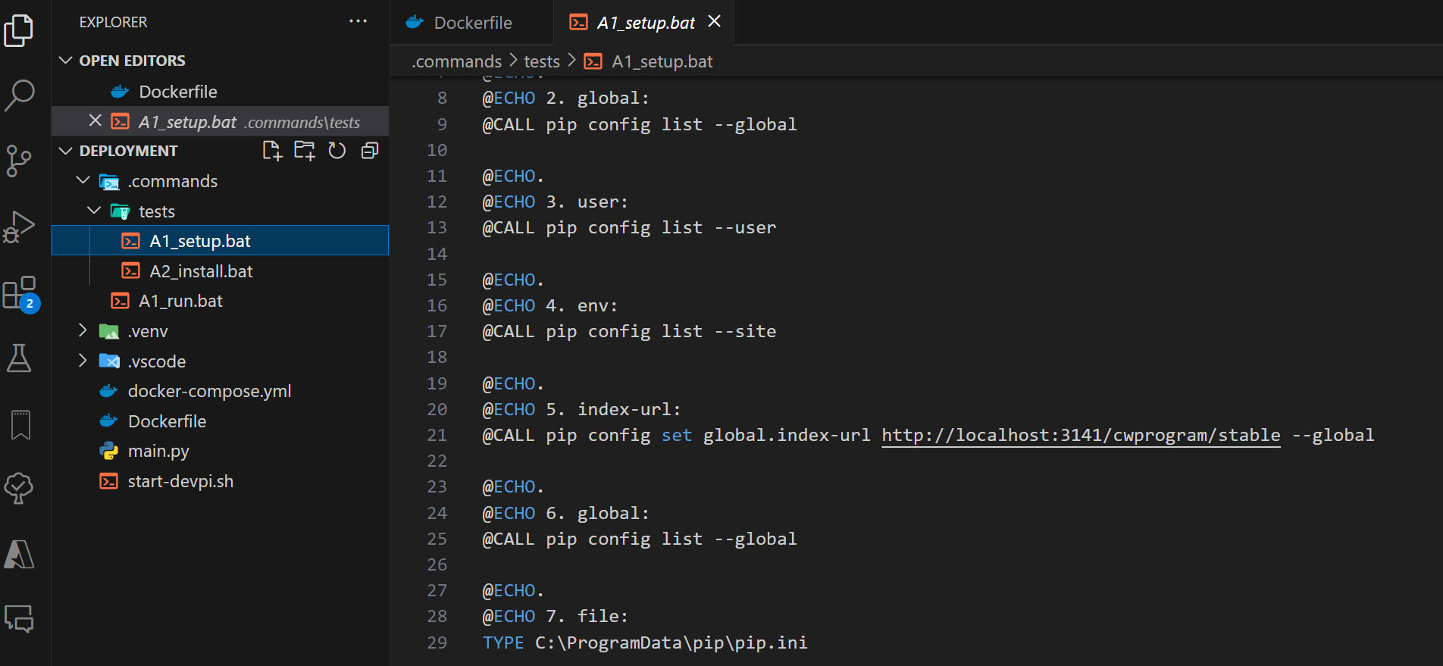
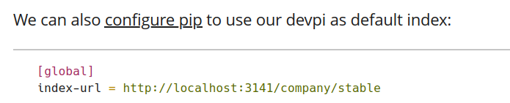



2. pip
setup pip
pip/scope
D:\python\deployment\.commands\tests
getting started with devpi
getting_started_with_devpi.pdf

Slide 3
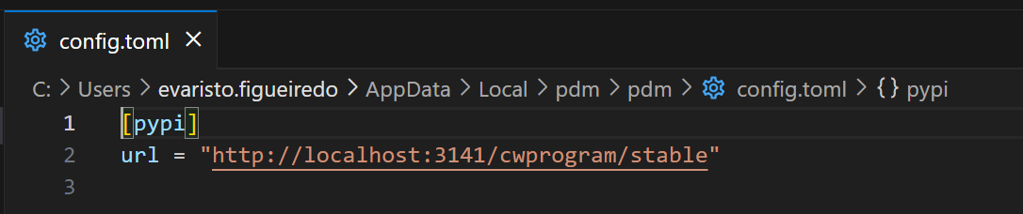
3. pdm
setup pdm
C:\Users\evaristo.figueiredo\AppData\Local\pdm\pdm\config.toml
pdm config pypi.url "http://localhost:3141/cwprogram/stable"

Slide 4
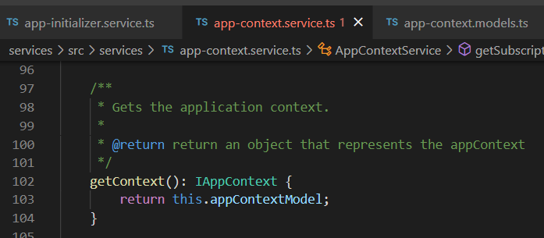


Z. template
new project
ExecuteAsync
square post-it
download
exe
download
exe
why
A slash
followed
by
two consecutive asterisks
D:\A1_research\C2_c0dice\B1_jmeter\A1_install
functionalities
introduction
build-exe
entity framework plus
zig help
⊂
4
every key-frame
defines the operation
success

