Slide 1
1. setup

Slide 2

2. client
what
pip install devpi-client
users management

Slide 3

3. users
connect to server
devpi use http://localhost:3141
connect to the server
root password
devpi login root
password: <enter>
devpi user -m root password=9715
3.2 entry point
root
root password and new user
new user
devpi user -c cwprogram password=9715 email=1010836@gmail.com

Slide 4
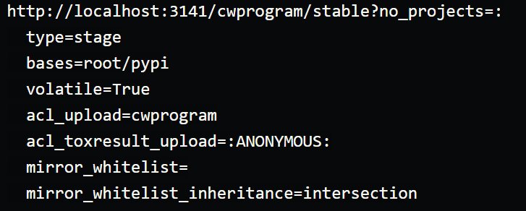
4. repository
what
devpi index -c cwprogram/stable bases=root/pypi volatile=True
cwprogram/stable
indicates
this is a stable named index
attributed to
the cwprogram user
create new repository
bases=root/pypi
lets the system know
to attempt
PyPi
if a package
is not found
volatile=True
will allow
uploads
to occur
need
more
research
no need
for
pypi?

Slide 5
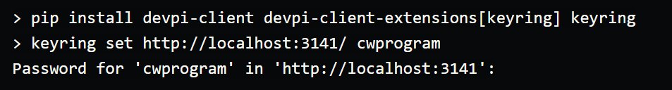
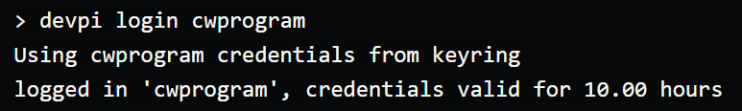

5. security
what
To facilitate logins
that do not require
having
the password
in plain sight
python keyring project
client extensions
for devpi
as keyring
is more of
a frontend
to several
keychain managers
a backend has to be available.
need to
research
keyring
not implemented
security
install
configure
login
where is the key?
pip
setup keyring again
due to
pip expecting
a different host format:

Slide 6
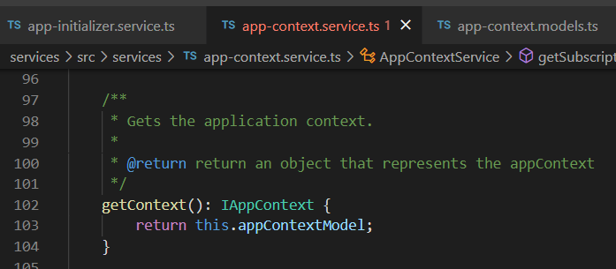




Z. template
new project
ExecuteAsync
square post-it
download
exe
download
exe
why
A slash
followed
by
two consecutive asterisks
D:\A1_research\C2_c0dice\B1_jmeter\A1_install
functionalities
introduction
build-exe
entity framework plus
zig help
⊂
4
every key-frame
defines the operation
success

