Slide 1

1. use
deployment
environment
python

Slide 2

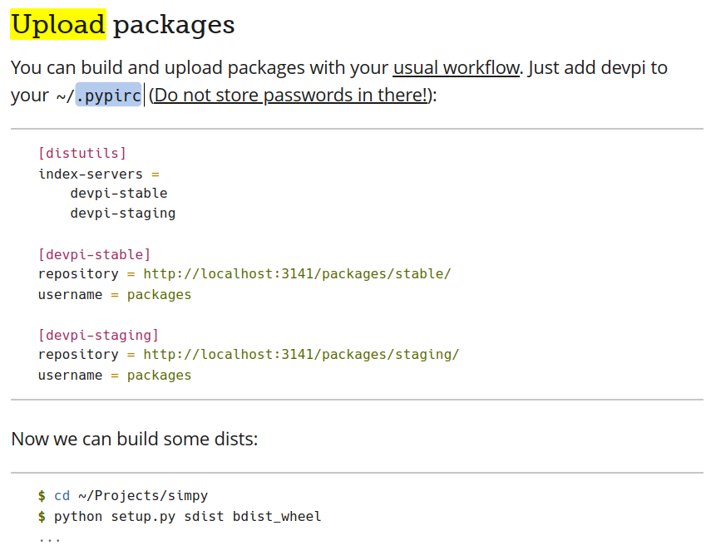
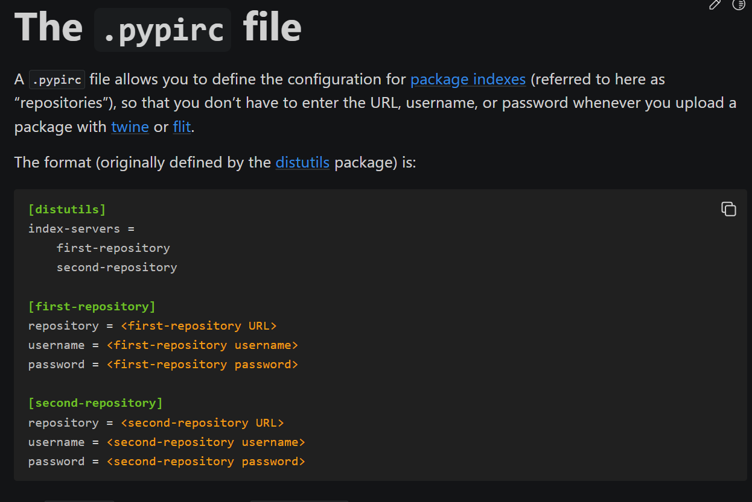

2. uploading
what
devpi upload --sdist --wheel --from-dir D:\python\debug\dist
uploading
pypirc
getting started with devpi
getting_started_with_devpi.pdf

Slide 3
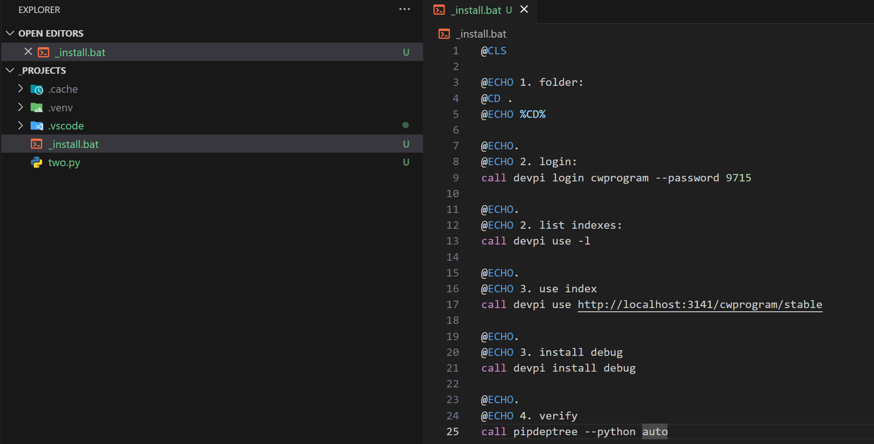
3. install
pip
pip install debug --index-url=http://localhost:3141/cwprogram/stable
..\..\..\..\ai\_reference\autogen\_projects
devpi
devpi install debug

Slide 4
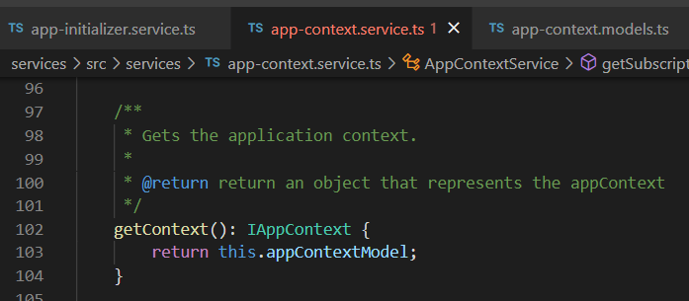



Z. template
new project
ExecuteAsync
square post-it
download
exe
download
exe
why
A slash
followed
by
two consecutive asterisks
D:\A1_research\C2_c0dice\B1_jmeter\A1_install
functionalities
introduction
build-exe
entity framework plus
zig help
⊂
4
every key-frame
defines the operation
success

