Slide 1

1. formats
deployment
environment
python

Slide 2


1.1 sources
video: the history of Python packaging
what: Python Packaging 2.0: Playing Well With Others

Slide 3
2. what
package-formats

Slide 4
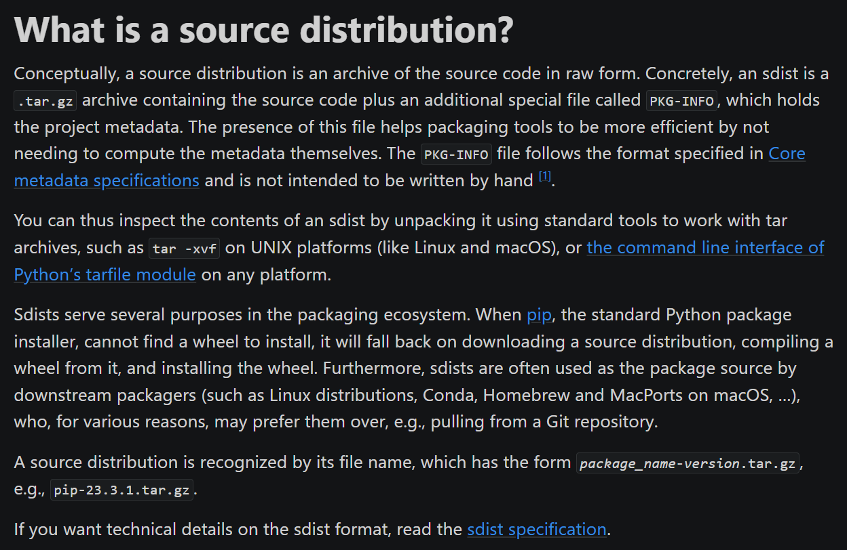
3. source
what
what-is-a-source-distribution

Slide 5
4. eggs
what
what-about-eggs
deprecated

Slide 6
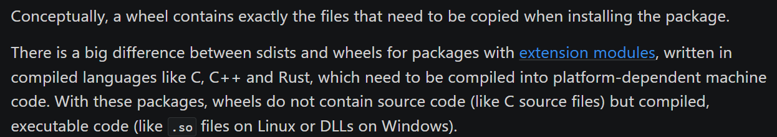
5. wheels
what
what-is-a-wheel

Slide 7
5.1 video
video: history
video: what
file extension whl
zip files
video: name
to be continued

Slide 8
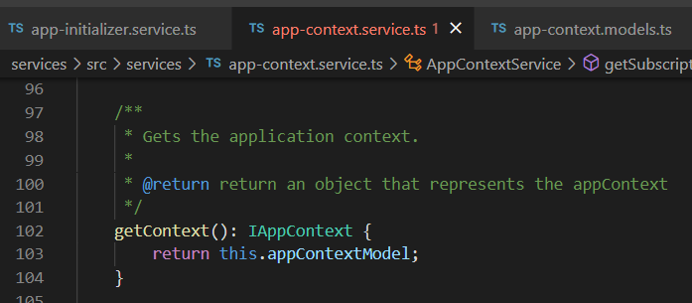




Z. template
new project
ExecuteAsync
square post-it
download
exe
download
exe
why
A slash
followed
by
two consecutive asterisks
D:\A1_research\C2_c0dice\B1_jmeter\A1_install
functionalities
introduction
build-exe
entity framework plus
zig help
⊂
4
every key-frame
defines the operation
success

