Slide 1

1. package management
python
environment

Slide 2
1.1 index
pip
pipenv
poetry
pdm

Slide 3
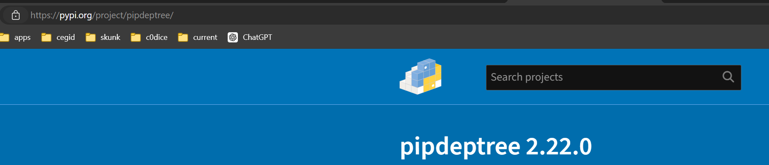

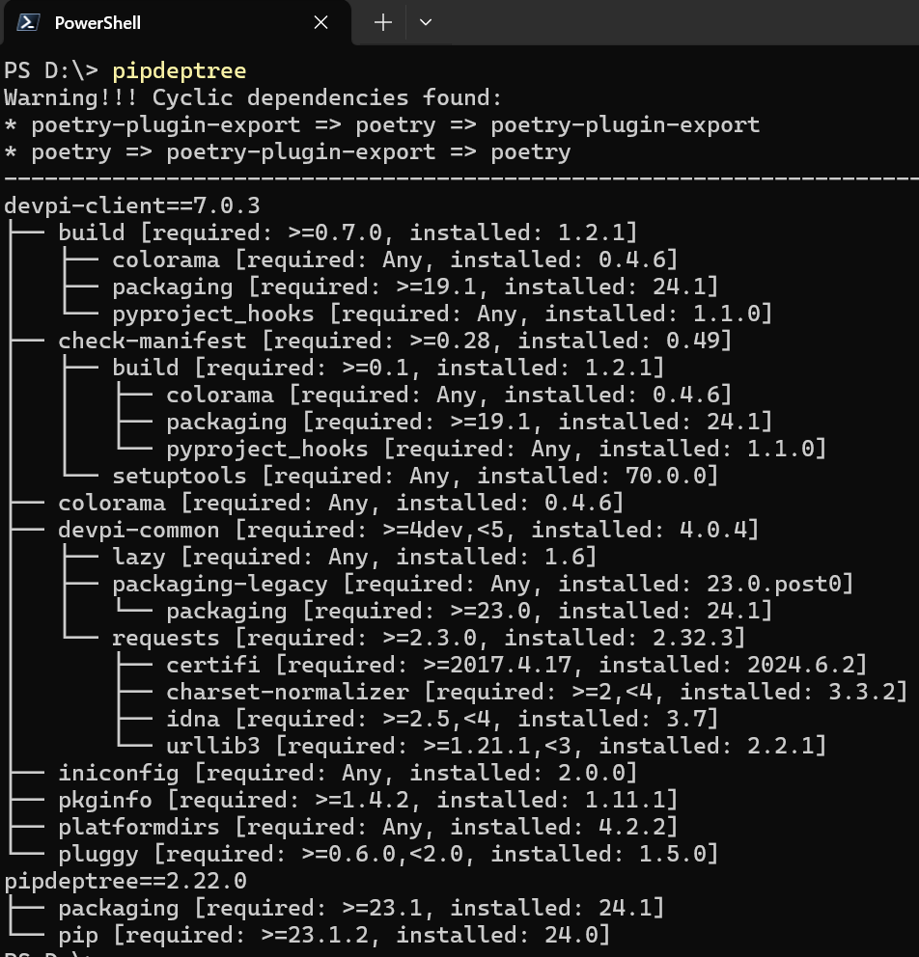
2. tree
what
pipdeptree
is a command line utility
for displaying
the installed python packages
in form of
a dependency tree
it works for
packages installed
globally
in a virtualenv
venv
pipdeptree --python auto

Slide 4
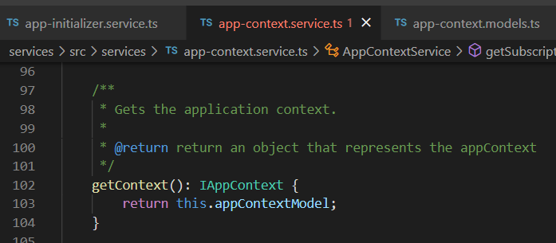




Z. template
new project
ExecuteAsync
square post-it
download
exe
download
exe
why
A slash
followed
by
two consecutive asterisks
D:\A1_research\C2_c0dice\B1_jmeter\A1_install
functionalities
introduction
build-exe
entity framework plus
zig help
⊂
4
every key-frame
defines the operation
success

