Slide 1

1. pdm
python
environment

Slide 2
1.1 resources

Slide 3

1.2 sources
site
cli reference
How to Use PDM to Manage Python Dependencies without a Virtual Environment
new project
Setup a Python project with PDM
templates
vsCode
Beginning Python: Project Management With PDM
Structuring a Python Project with PDM

Slide 4
2. install
install
pip install pdm
pdm self update

Slide 5
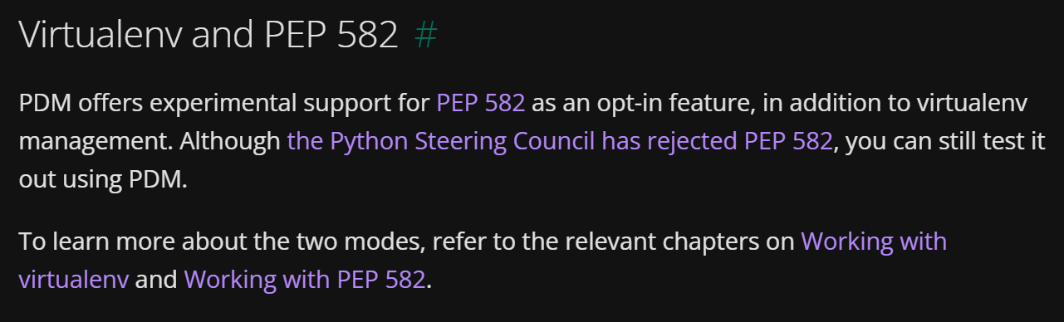
4. venv
virtualenv-and-pep-582
rejected
new
structure

Slide 6
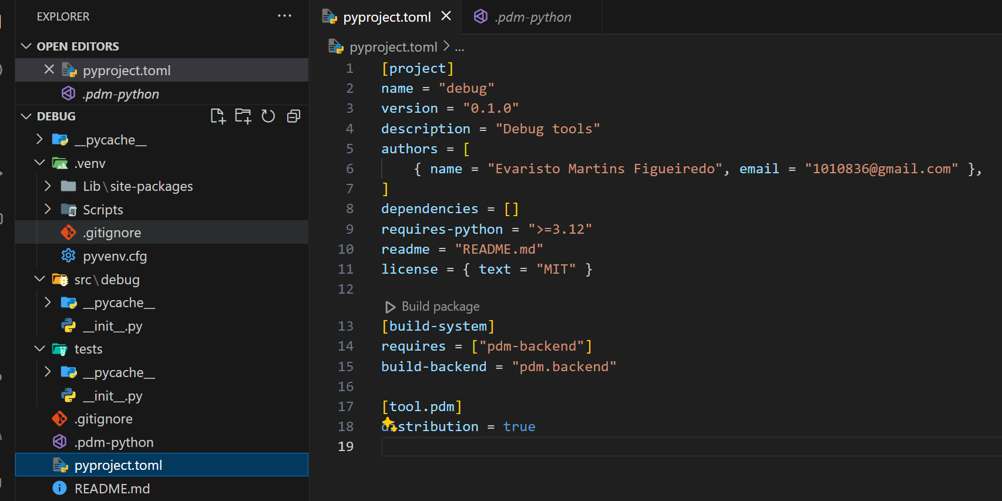
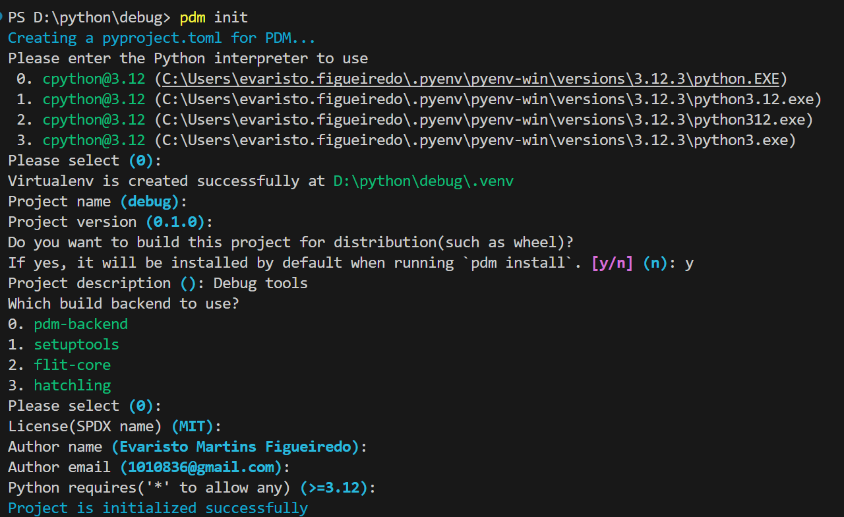
5. init
new
pdm init

Slide 7
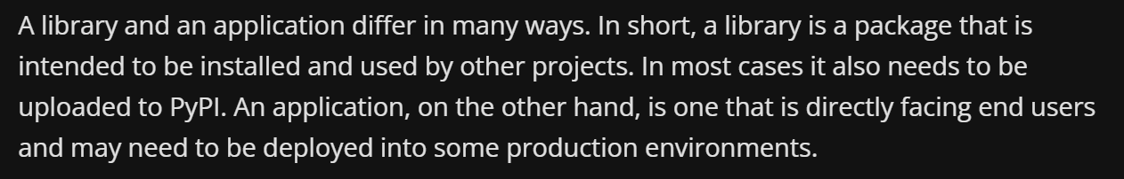
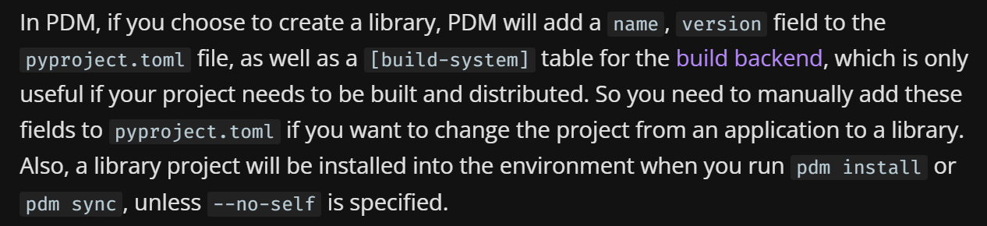
5.1 library
library-or-application

Slide 8
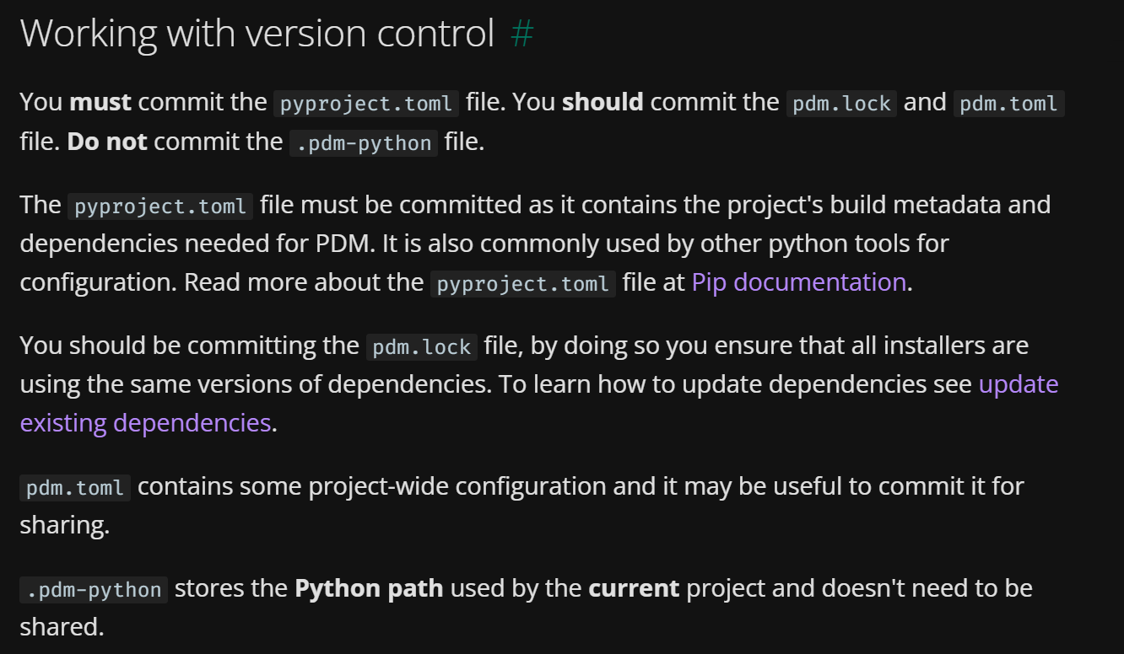
5.2 git
library-or-application

Slide 9
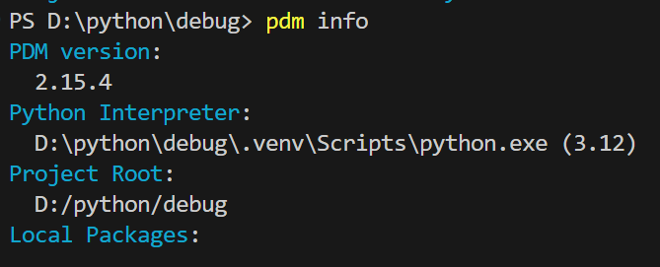
6. info
show-the-current-python-environment
pdm info

Slide 10
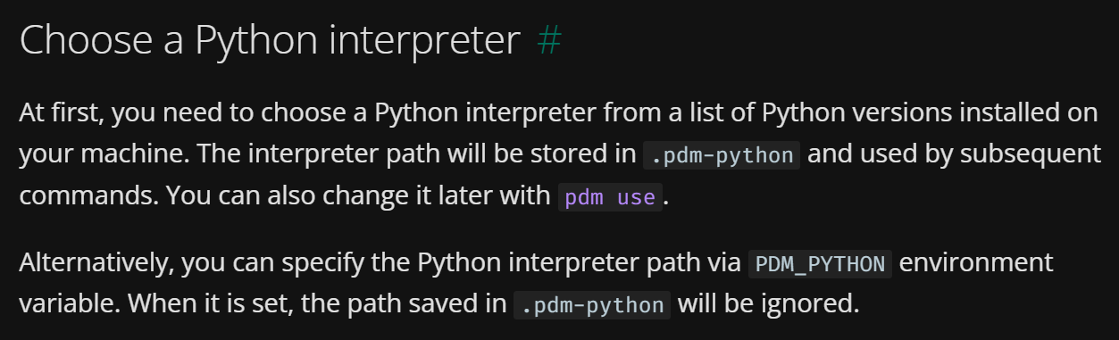
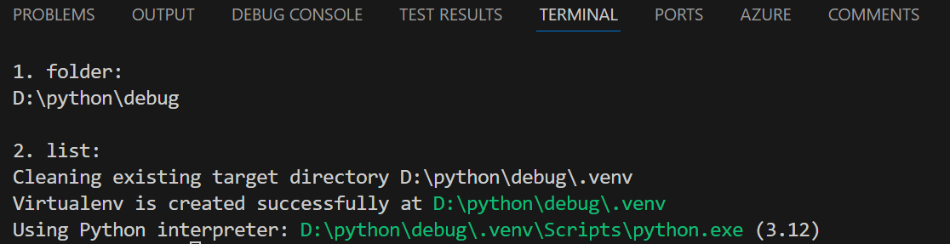
7. use
init
when
init
is run
choose-a-python-interpreter
use
pdm use python
use

Slide 11
7. add
add
pdm add requests # add requests
pdm add requests==2.25.1 # add requests with version constraint
pdm add requests[socks] # add requests with extra dependency
pdm add "flask>=1.0" flask-sqlalchemy # add multiple dependencies with different specifiers
Add dependencies
Local dependencies
URL dependencies
VCS dependencies
Hide credentials in the URL
Add development only dependencies
Editable dependencies
Save version specifiers
Add prereleases

Slide 12
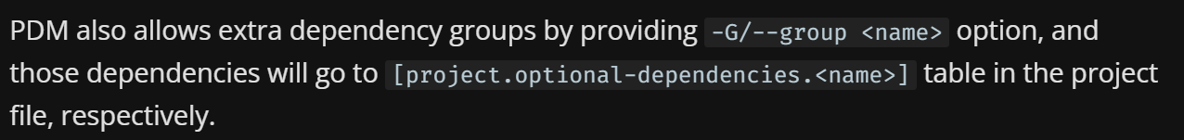
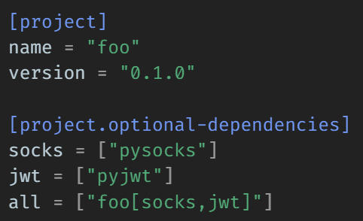
7.1 group
what
pdm add -d -e ..\..\python\debug
development-dependencies

Slide 13
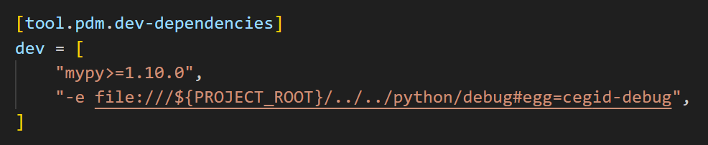
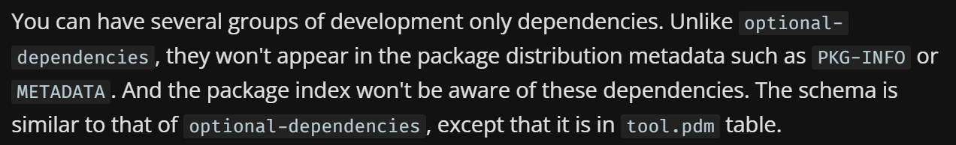
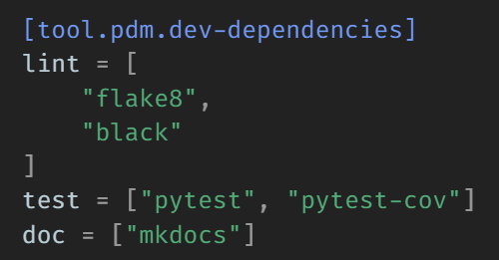
7.2 development
what
pdm add -d mypy
groups
add all
pdm install
development-dependencies

Slide 14
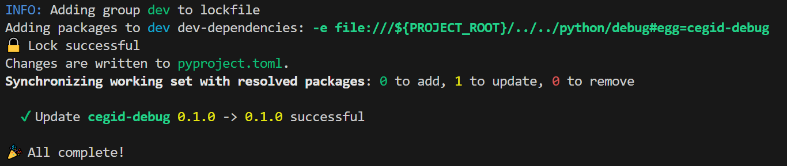
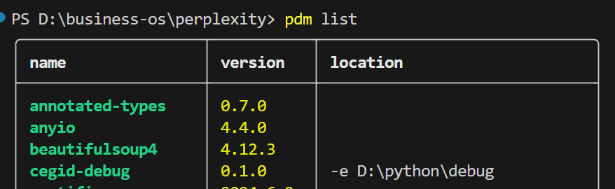
7.3.1 debug
what
pdm add -d -e ..\..\python\debug
pdm remove -d D:\python\debug

Slide 15
8. remove
remove
# Remove requests from the default dependencies
pdm remove requests
# Remove h11 from the 'web' group of optional-dependencies
pdm remove -G web h11
# Remove pytest-cov from the `test` group of dev-dependencies
pdm remove -dG test pytest-cov

Slide 16
9. update
update-existing-dependencies
To update all dependencies in the lock file:
pdm update
To update the specified package(s):
pdm update requests
To update multiple groups of dependencies:
pdm update -G security -G http
Or using comma-separated list:
pdm update -G "security,http"
To update a given package in the specified group:
pdm update -G security cryptography

Slide 17
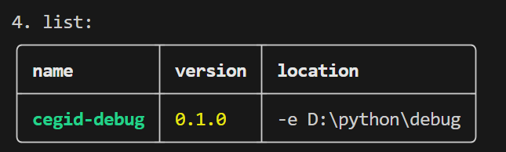
10. list
show-what-packages-are-installed
pdm list
pdm list --include dev
pdm list --exclude test
pdm list --fields name,licenses,version
pdm list –tree
pdm outdated

Slide 18
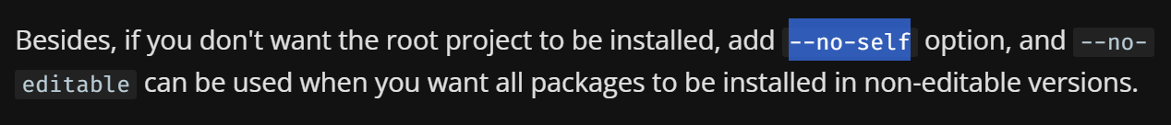
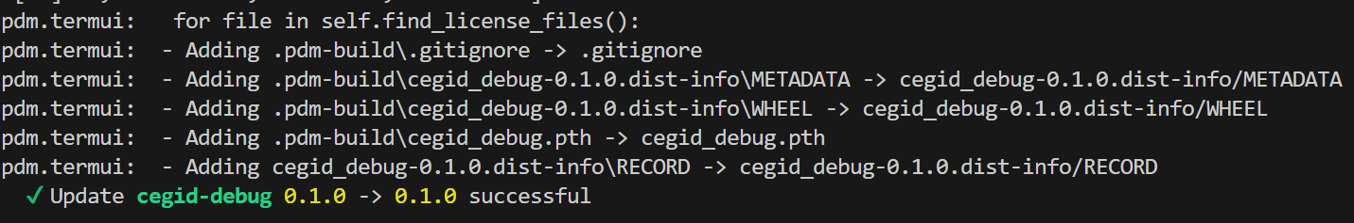
11. install
install
Command | What it does | Comments
pdm install | install all groups locked in the lockfile
pdm install -G extra1 | install prod deps, dev deps, and "extra1" optional group
pdm install -G dev1 | install prod deps and only "dev1" dev group
pdm install -G:all | install prod deps, dev deps and "extra1", "extra2" optional groups
pdm install -G extra1 -G dev1 | install prod deps, "extra1" optional group and only "dev1" dev group
pdm install --prod | install prod only
pdm install --prod -G extra1 | install prod deps and "extra1" optional
pdm install --prod -G dev1 | Fail, --prod can't be given with dev dependencies | Leave the --prod option

Slide 19
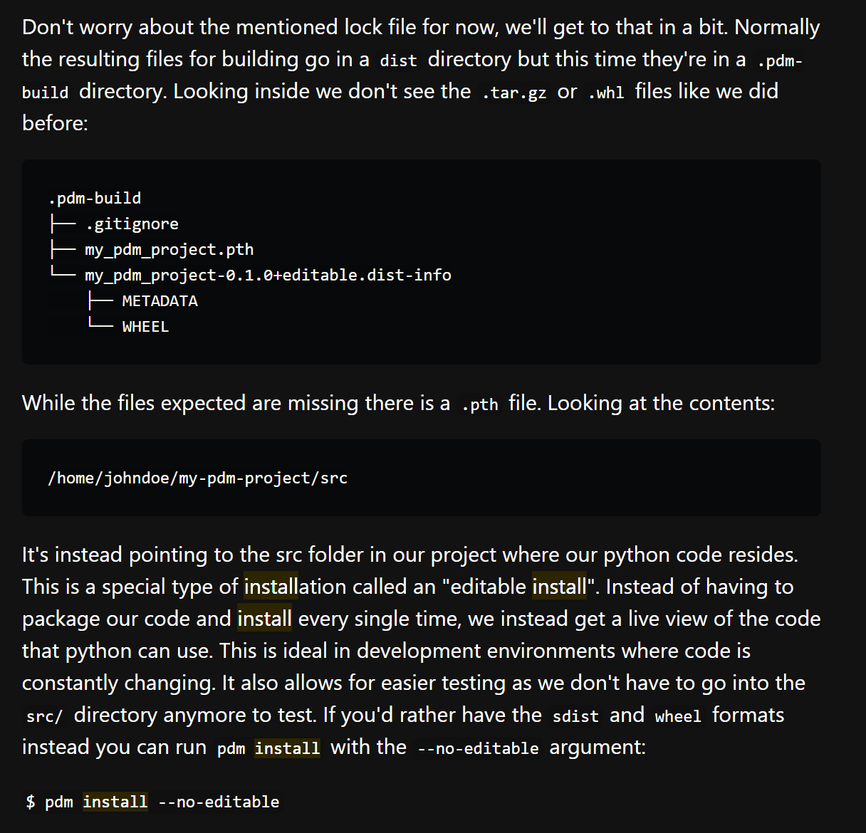
11.1 details
details

Slide 20
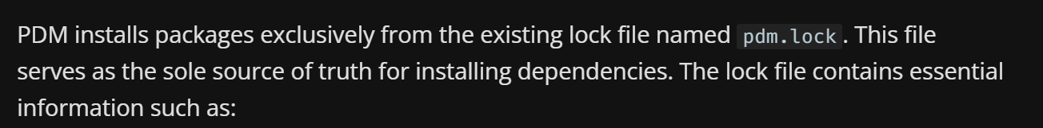
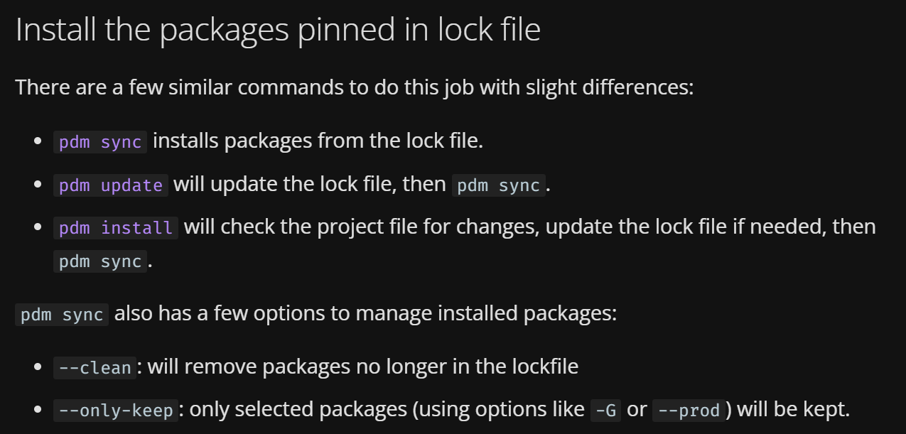
12. lock
lock
need more
study
see site

Slide 21
13. config
list
pdm config
get
pdm config pypi.url
set
pdm config pypi.url "https://test.pypi.org/simple"
local
pdm config --local pypi.url "https://test.pypi.org/simple"
By default,
the configuration
are changed
globally
to make the config
seen by
this project only,
add a --local flag
config

Slide 22
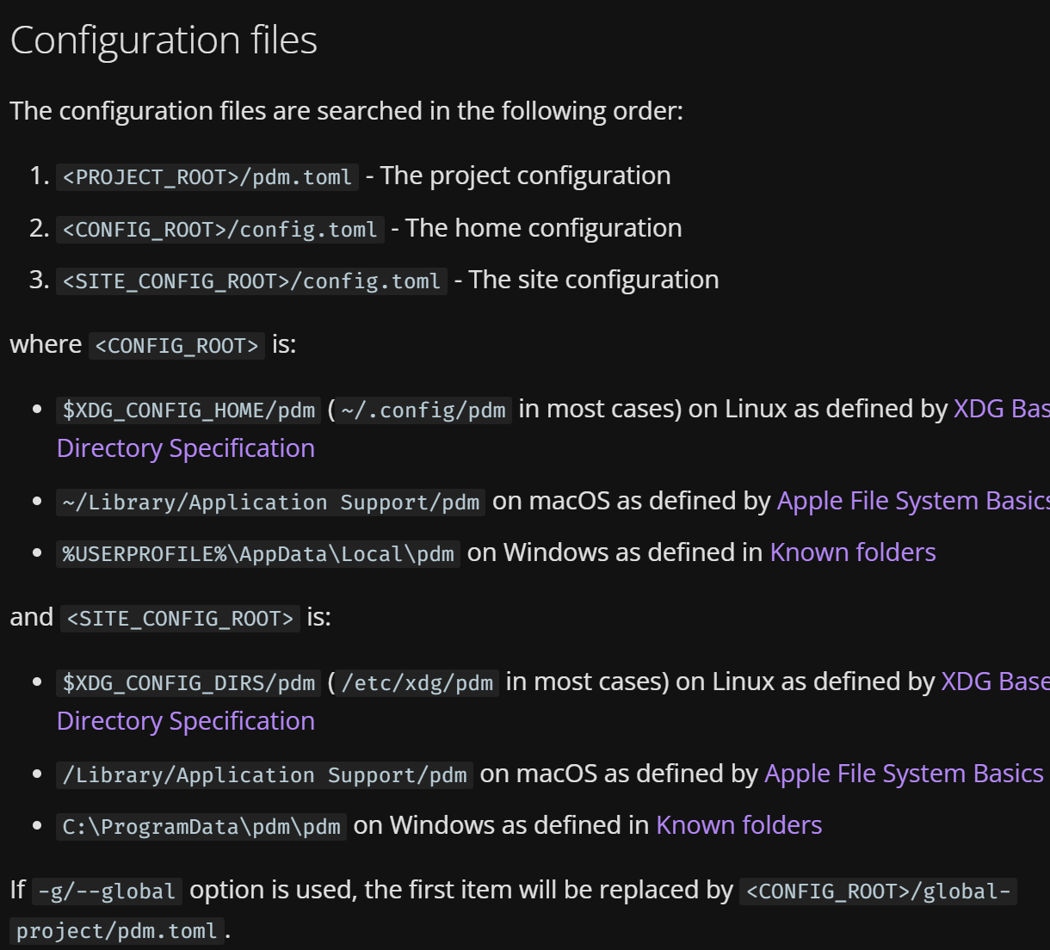

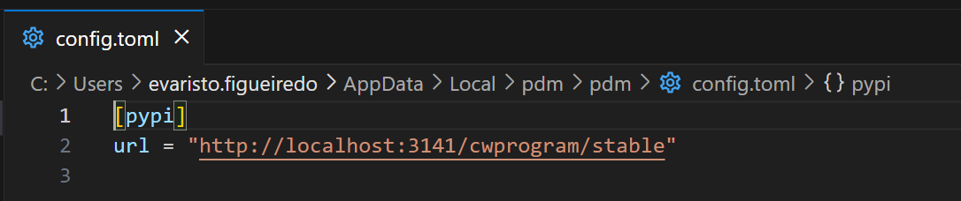
13.1 files
what
config
C:\Users\evaristo.figueiredo\AppData\Local\pdm\pdm\config.toml
pdm config pypi.url "http://localhost:3141/cwprogram/stable"

Slide 23
13.2 settings
settings list

Slide 24
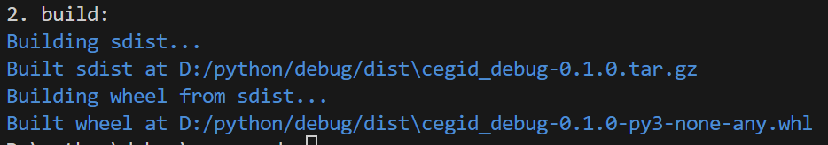
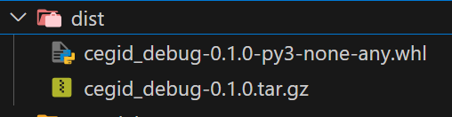
14. build
build
pdm build

Slide 25
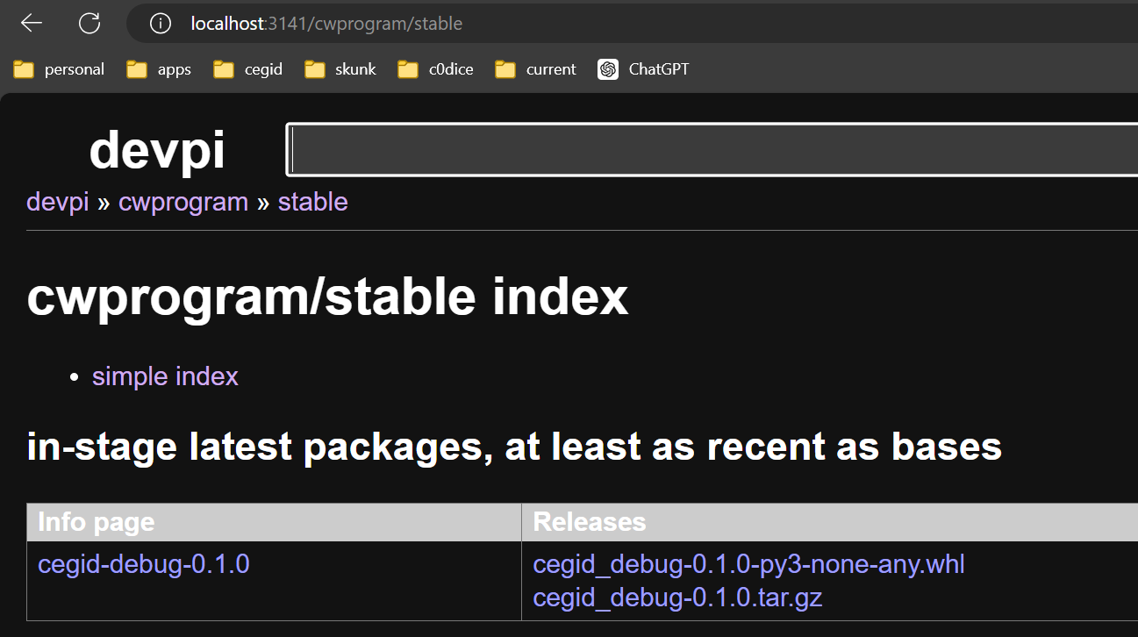
15. publish
publish
pdm publish
pdm publish -r http://localhost:3141/cwprogram/stable/ -u cwprogram -P 9715
backend
Structuring a Python Project with PDM | Yuchen Cheng's Blog (rudeigerc.dev)

Slide 26
15.1 backend
backend
Specify the package files
The common package layout
The module files layout
Include or exclude files
Include files in a namespace package
The src layout
Priority of includes and excludes
Default includes and excludes
Wheel data files
Local build hooks
Run setup tools
is-pure lib
Choose the editable build format
path
editable
Build config settings
Environment variables
Structuring a Python Project with PDM

Slide 27
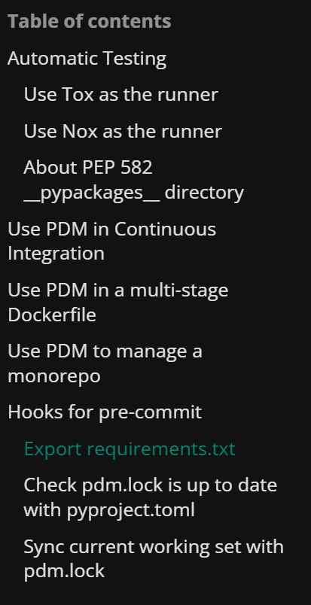
16. CD/CI
Advanced Usage - PDM (pdm-project.org)

Slide 28
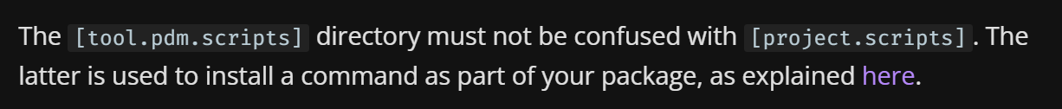
17. scripts
user-scripts
Writing your pyproject.toml - Python Packaging User Guide

Slide 29
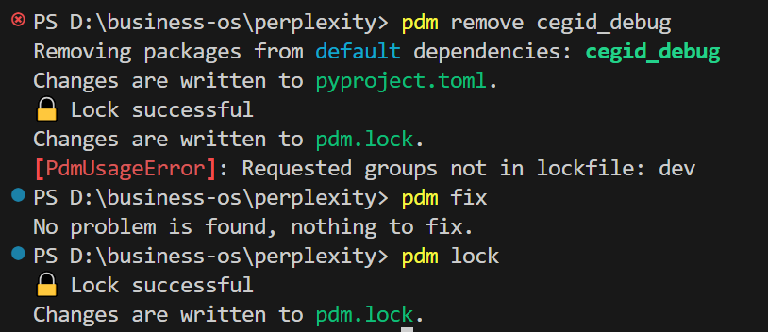
18. lock
what
pdm lock
lock

Slide 30
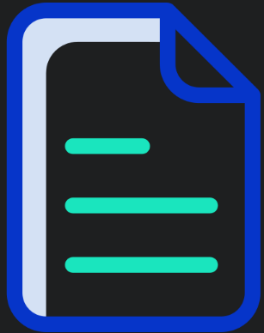
19. pyproject.toml
structure/6. pyproject.toml

Slide 31
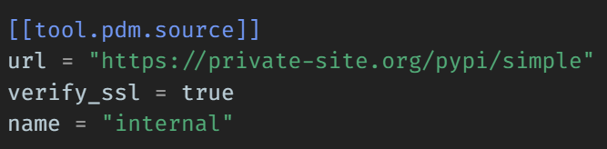
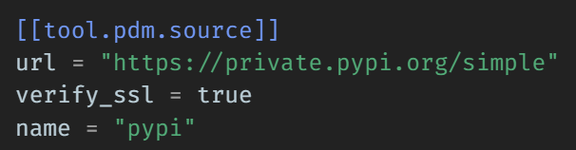
19.1 sources
what
like Pipenv,
you can specify
extra sources
for
finding packages
with
the same format.
sources
structure/6. pyproject.toml

Slide 32
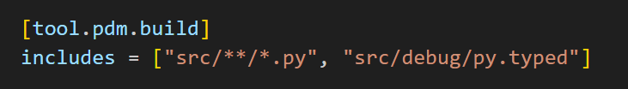
19.2 includes
what
include-and-exclude-package-files
need more
research

Slide 33
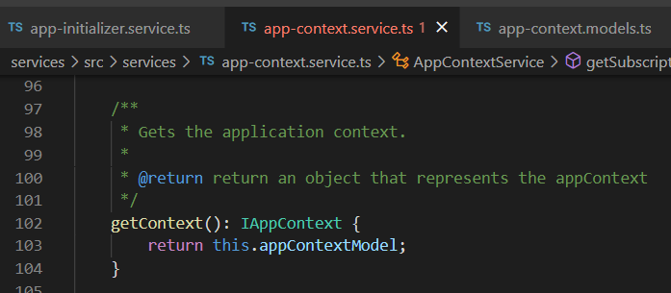


Z. template
new project
ExecuteAsync
square post-it
download
exe
download
exe
why
A slash
followed
by
two consecutive asterisks
D:\A1_research\C2_c0dice\B1_jmeter\A1_install
functionalities
introduction
build-exe
entity framework plus
zig help
⊂
4
every key-frame
defines the operation
C:\Users\evaristo.figueiredo\AppData\Local\pdm\pdm
success

