Slide 1

1. pip
python
environment

Slide 2

1.1 sources
user guide
commands
pip
pip install
pip uninstall
pip inspect
pip list
pip show
pip freeze
pip check
pip download
pip wheel
pip hash
pip search
pip cache
pip config
pip debug

Slide 3
2. what
problem
need third-party packages
those packages
may have
their own dependencies
environment tutorial: pip
ENVIRONMENT MANAGEMENT AND INTROSPECTION
pip install
pip uninstall
pip inspect
pip list
pip show
pip freeze
pip check
HANDLING DISTRIBUTION FILES
pip download
pip wheel
pip hash
PACKAGE INDEX INFORMATION
pip search
MANAGING PIP ITSELF
pip cache
pip config
pip debug

Slide 4
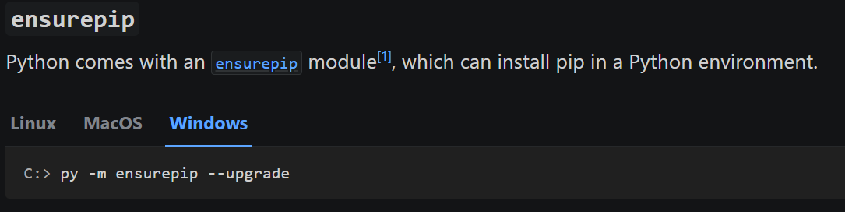
3. download
what
python
installation

Slide 5
4. environment

Slide 6

4.1 list
global
pip list
pip freeze
local
pip list --user
pip freeze --user
list-python-packages

Slide 7
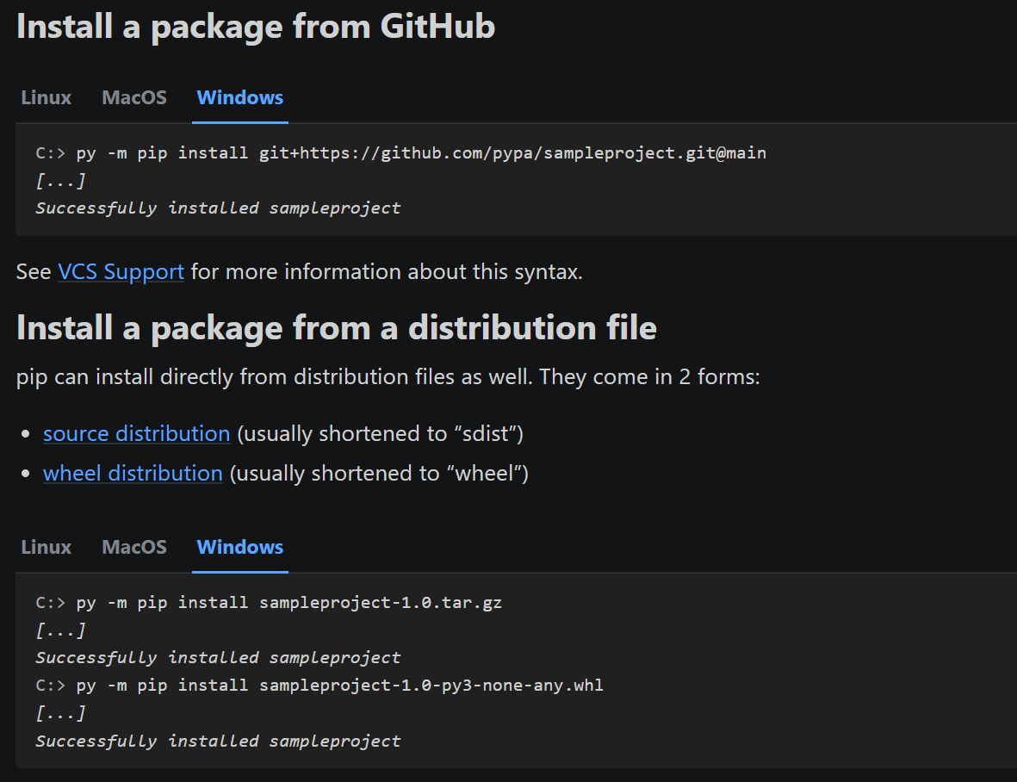
4.2 install
what

Slide 8
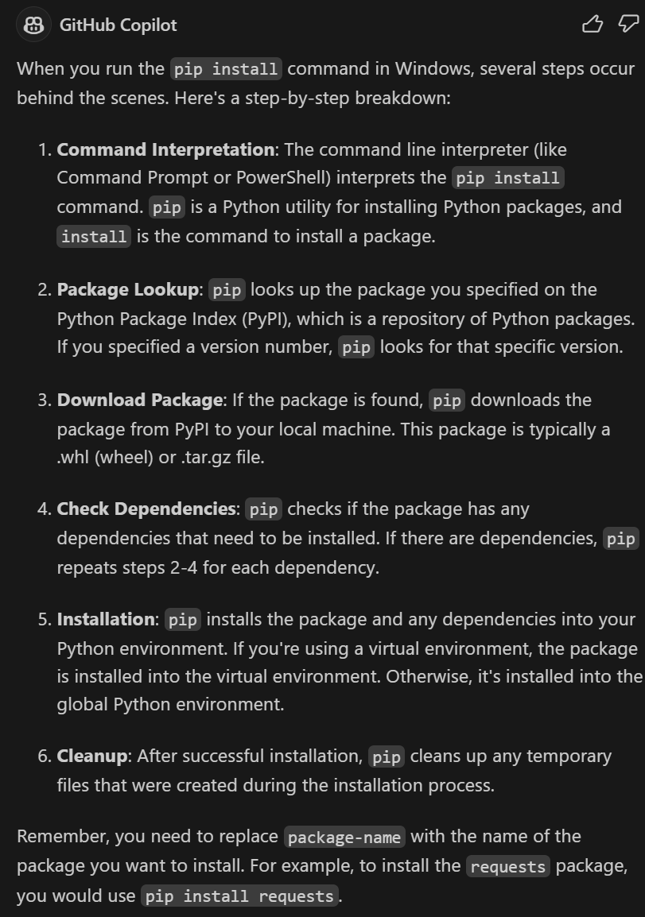
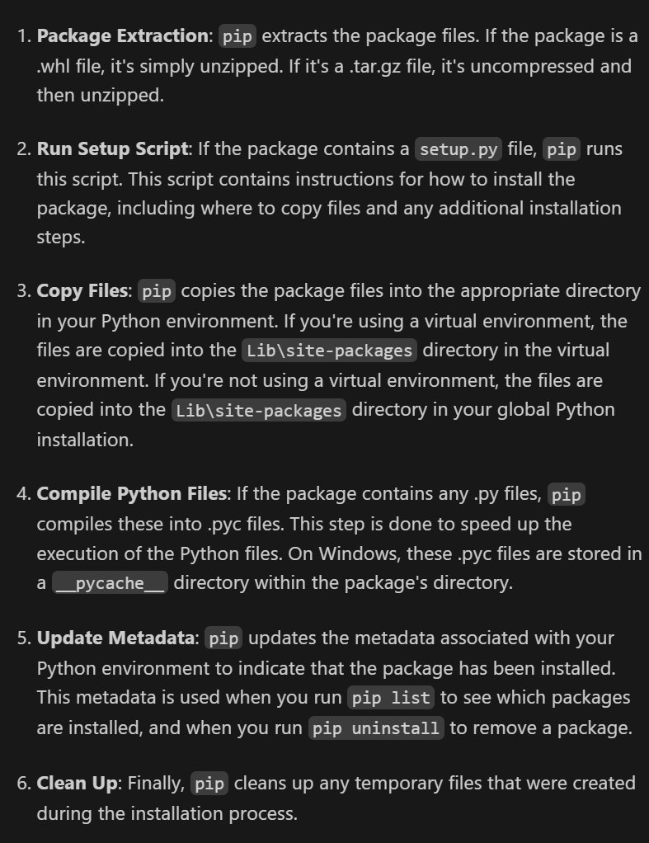
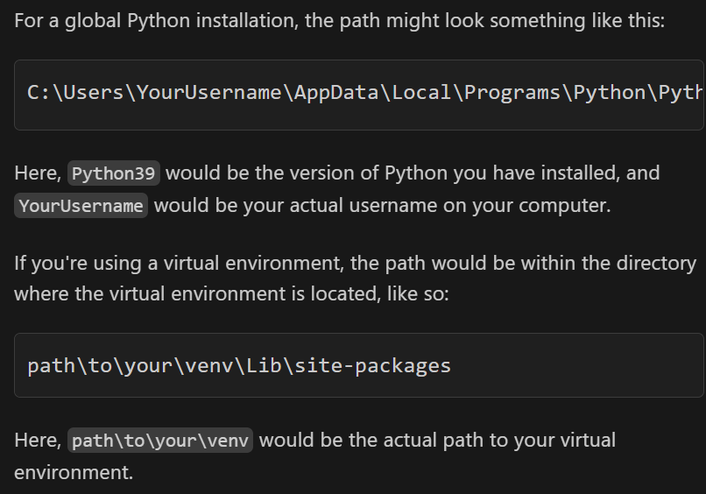
4.2.1 description
what
C:\Users\YourUsername\AppData\Local\Programs\Python\Python39\Lib\site-packages

Slide 9
4.2.2 editable
The command `pip install -e .`
is used
to install a package
in
editable
or
"develop"
mode
from the
current directory (`.`).
in editable mode,
changes to the
source code
immediately affect
the installed package
without needing
to reinstall it
what
pip install -e .
pip install
The `.`
refers to
the current directory
the setup script
(`setup.py`)
for the package
code
is expected to be found
in
the current directory
uninstall
pip uninstall package-name
list
pip list -e

Slide 10
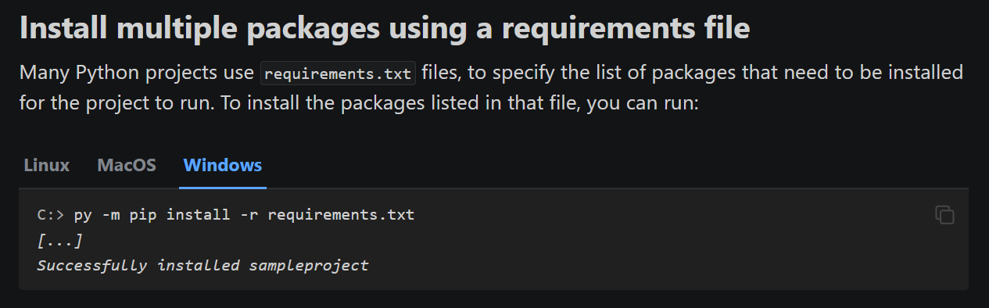
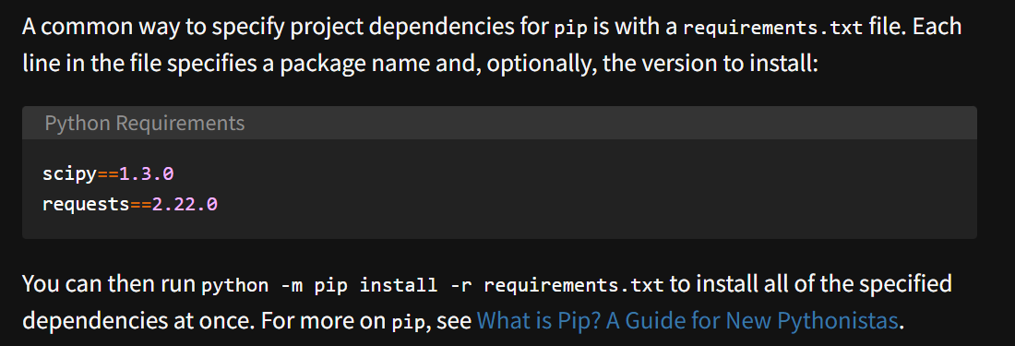
4.2.3 requirements
what
install-multiple-packages-using-a-requirements-file
tutorial

Slide 11
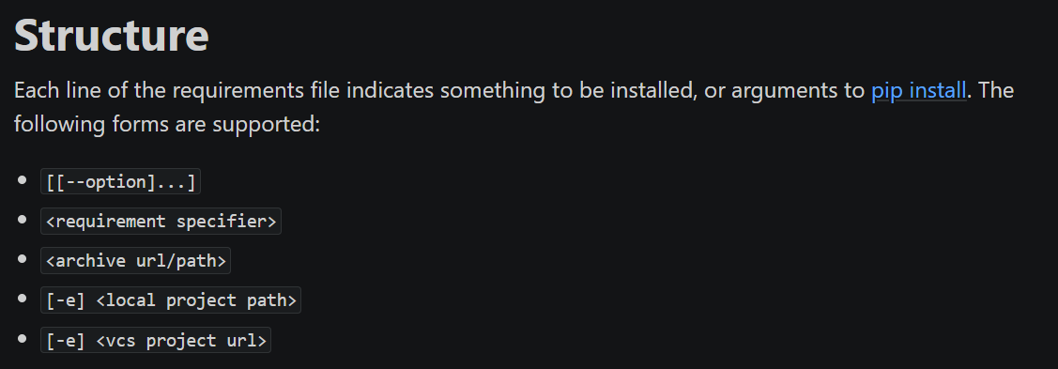
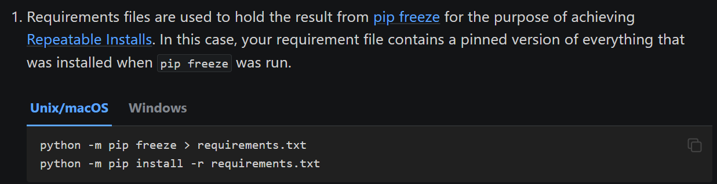
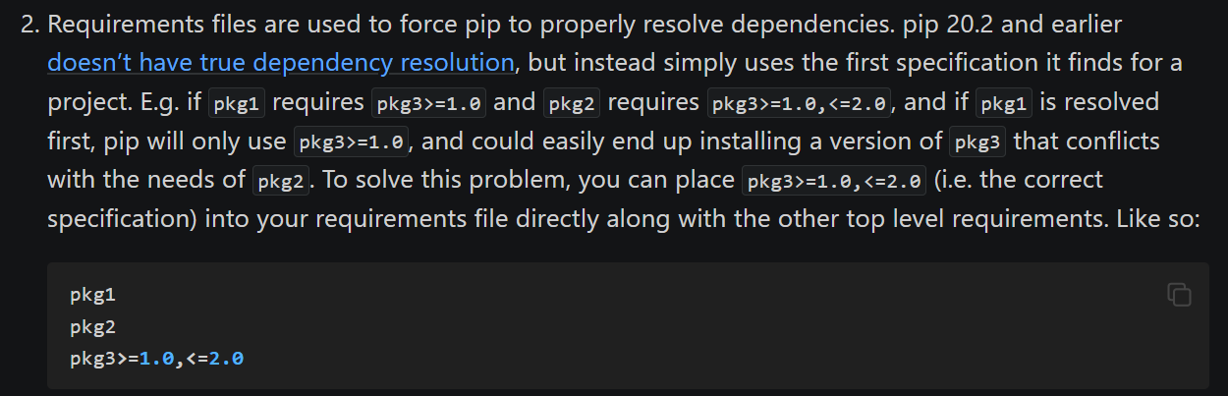
4.2.3.1 description
what
description
requirements-file-format
to do
if not other tool

Slide 12
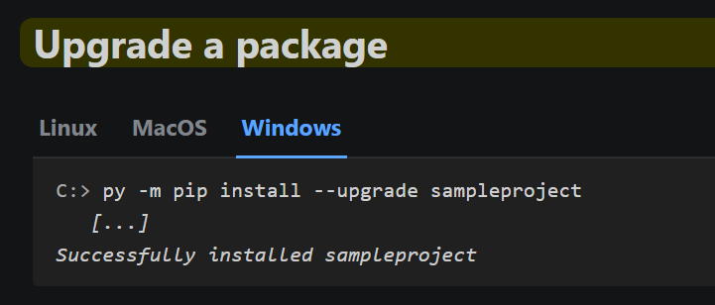
4.3 upgrade
what
upgrade

Slide 13
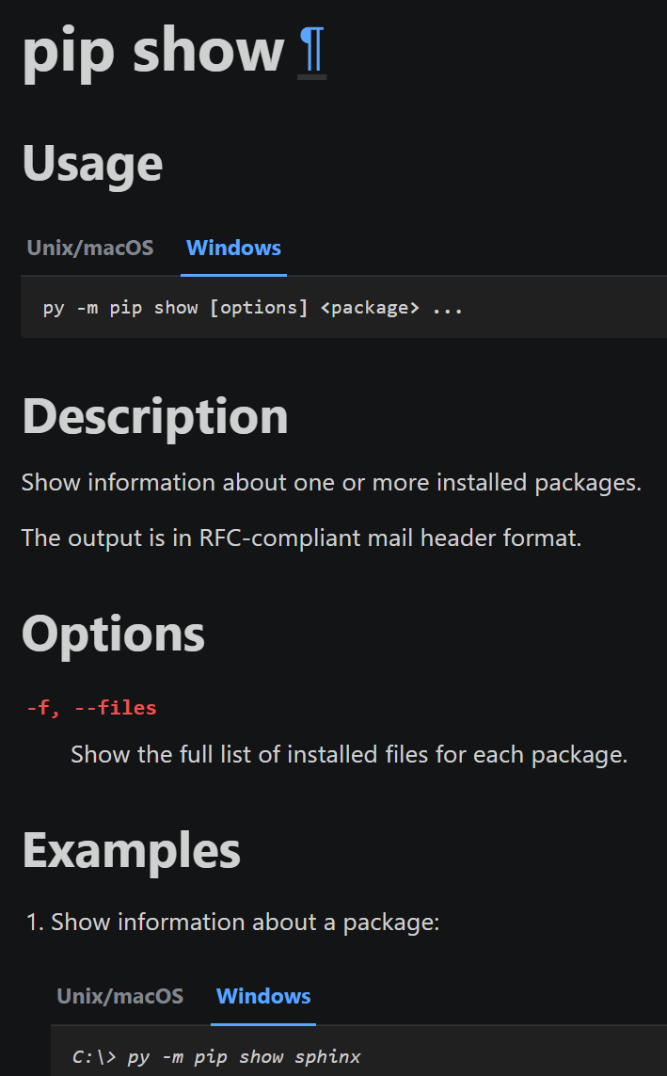
4.4 show
what
show

Slide 14
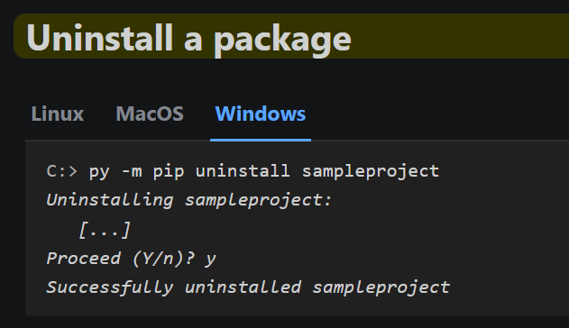
4.4 uninstall
what

Slide 15
5. managing

Slide 16
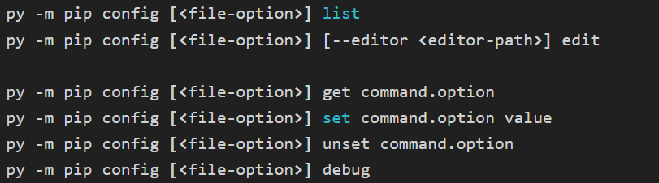
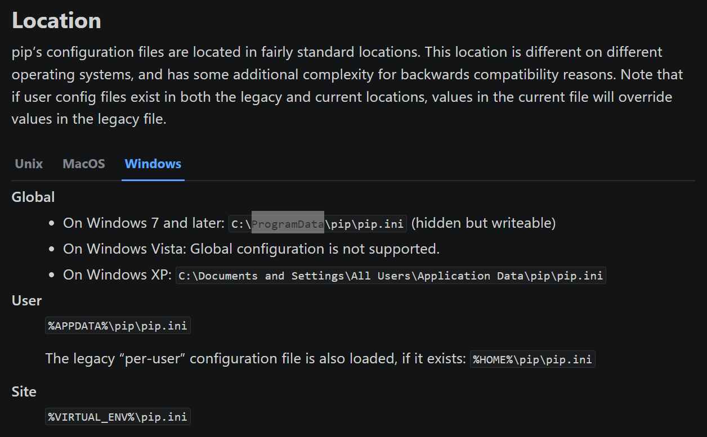
5.1 config
what
config
configuration

Slide 17
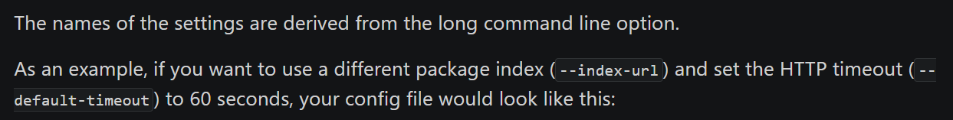
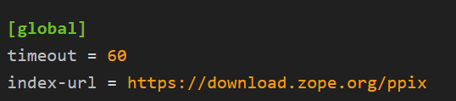
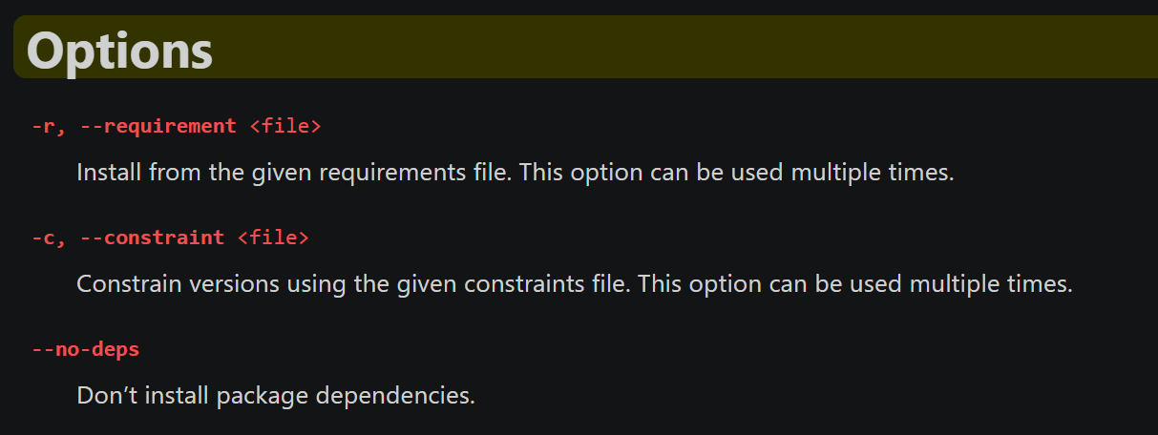
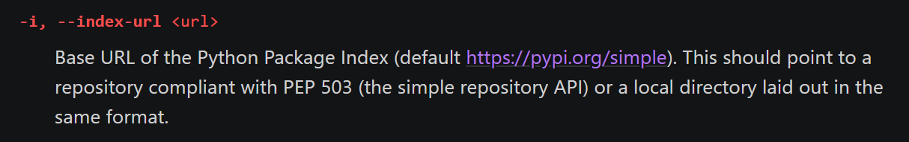
5.1.1 naming
what
naming
find settings
see
command ‘s page
help
install/#options

Slide 18
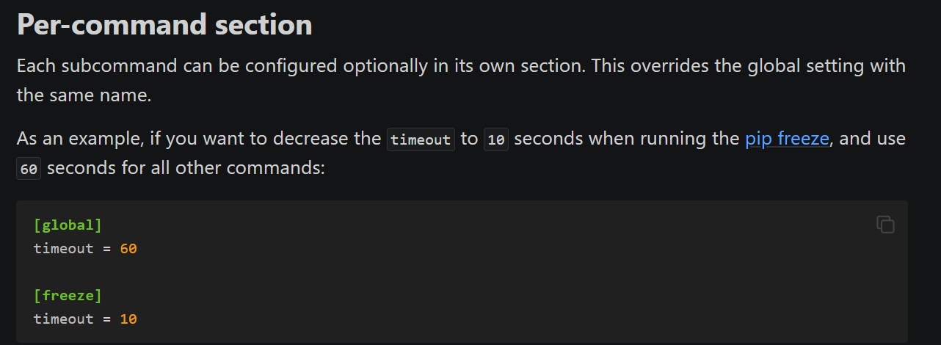
5.1.2 sections
what
sections

Slide 19
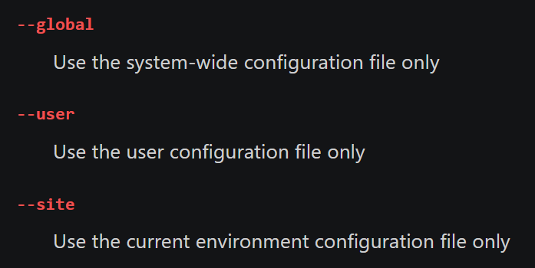
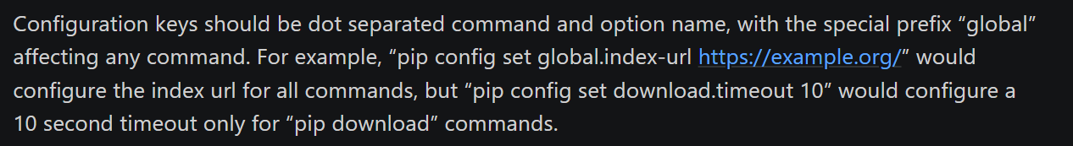
5.1.3 scope
what
sections
pip config list --global
pip config list --user
pip config list --site
pip config set global.index-url http://localhost:3141/cwprogram/stable --global

Slide 20
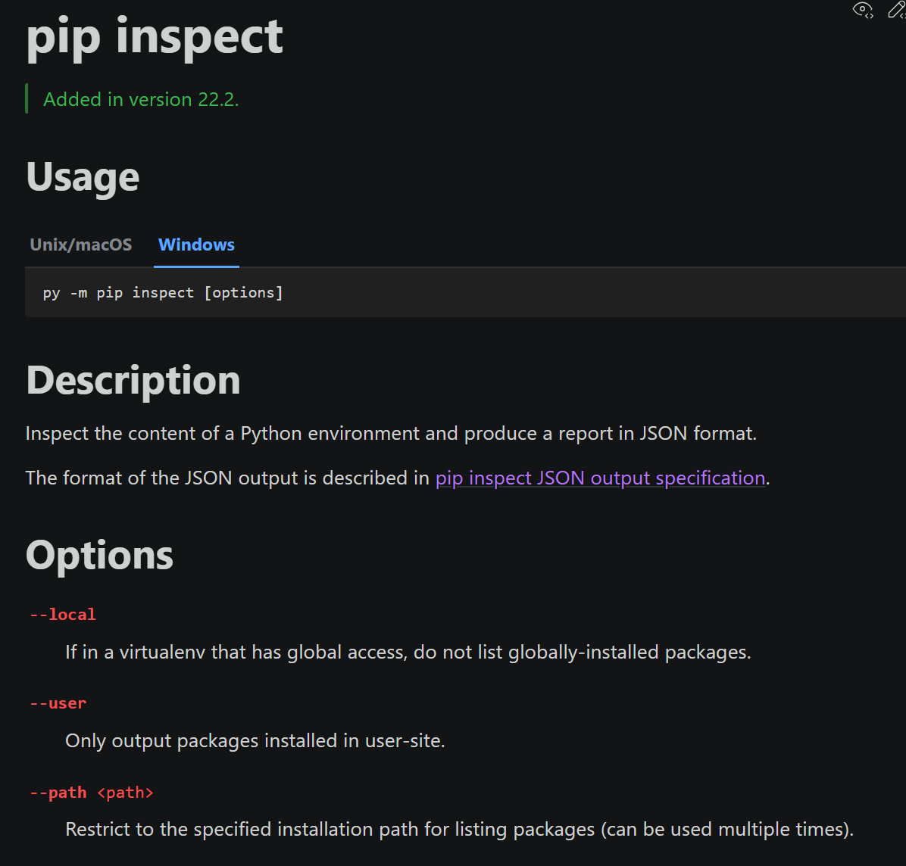
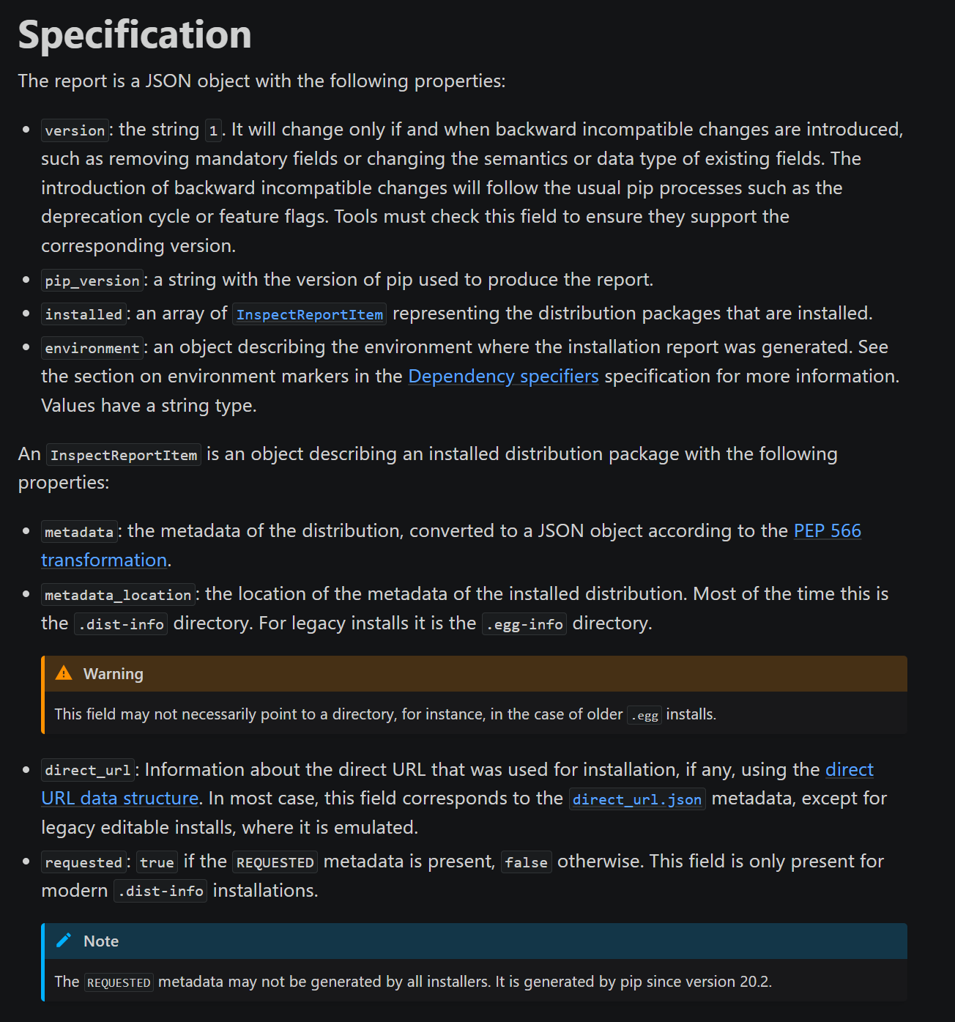
5.2 inspect
what
inspect
report format

Slide 21
6. distribution

Slide 22
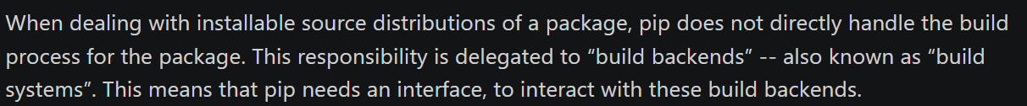
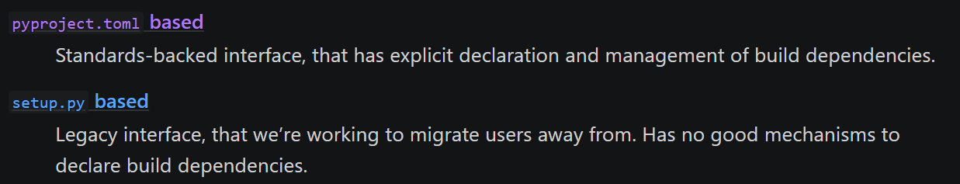
6.1 build systems
what
build systems interfaces

Slide 23
6.2 wheel
what
covers
the wheel scope
of
build
offers
many
additional
features
pip can´t
build
source distributions
wheel

Slide 24
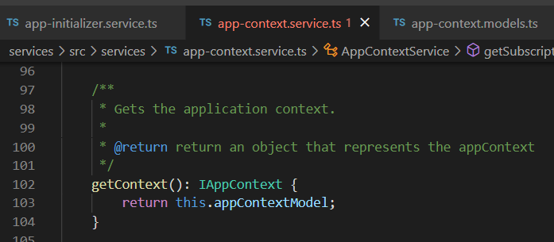


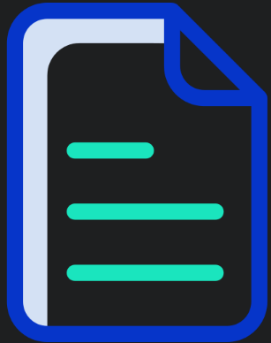

Z. template
new project
ExecuteAsync
square post-it
download
exe
download
exe
why
A slash
followed
by
two consecutive asterisks
D:\A1_research\C2_c0dice\B1_jmeter\A1_install
functionalities
introduction
build-exe
entity framework plus
zig help
⊂
4
every key-frame
defines the operation
success

