Slide 1

1. pipenv
python
environment

Slide 2
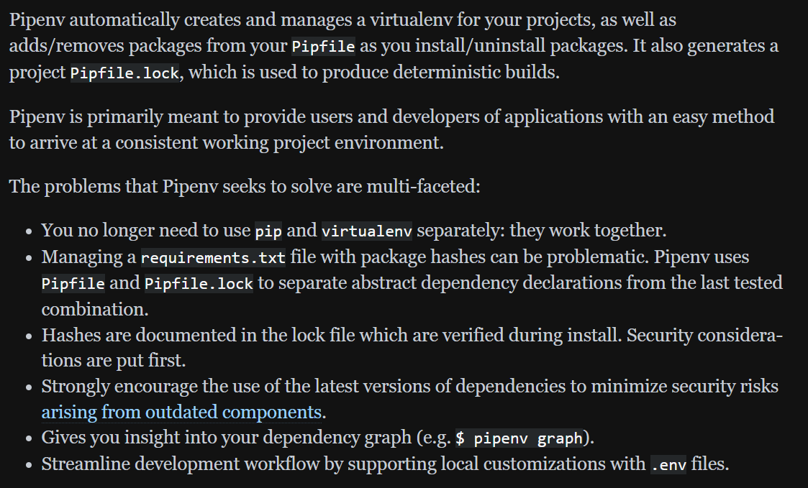

2. what
what
has most of the same basic operations as pip
but thinks about packages a bit differently
tutorial: pipenv
uses pipfile that pipenv creates
when you install a package,
pipenv adds that package to Pipfile
also adds more detailed information
to a new lock file called
Pipfile. Lock.
lock files
act as a snapshot
of
the precise set of packages installed
including
direct dependencies
as well
as their sub-dependencies.
pipenv
virtual environments

Slide 3
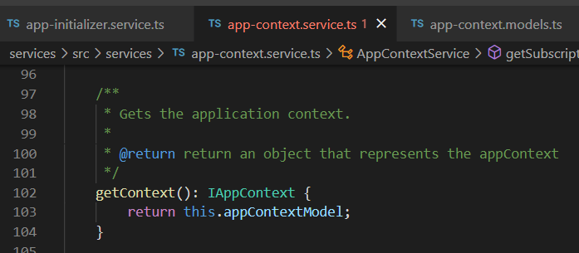




Z. template
new project
ExecuteAsync
square post-it
download
exe
download
exe
why
A slash
followed
by
two consecutive asterisks
D:\A1_research\C2_c0dice\B1_jmeter\A1_install
functionalities
introduction
build-exe
entity framework plus
zig help
⊂
4
every key-frame
defines the operation
success

