Slide 1

1. poetry
python
environment

Slide 2

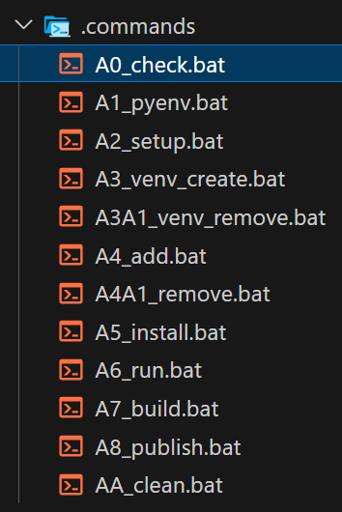
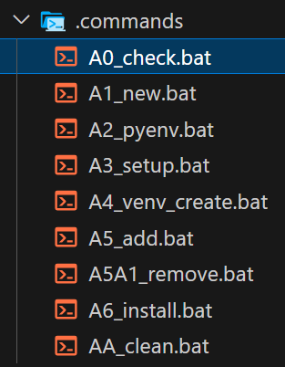
1.1 resources
poetry\poetry debug
poetry\poetry test

Slide 3
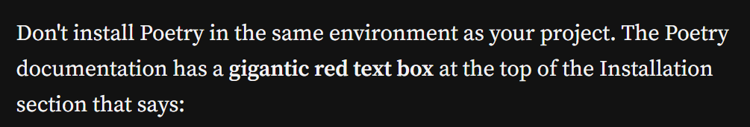

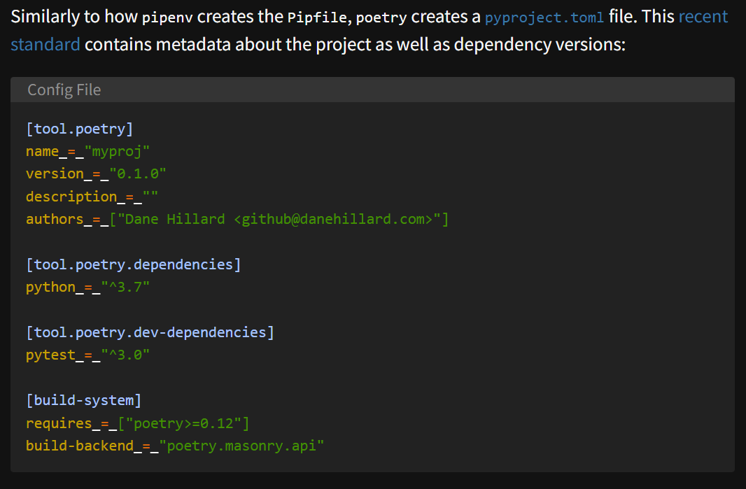
2. what
what
addresses additional facets
of
package management,
including
creating
publishing
packages
tutorial
video
python-virtual-environments-poetry
pyenv-poetry

Slide 4
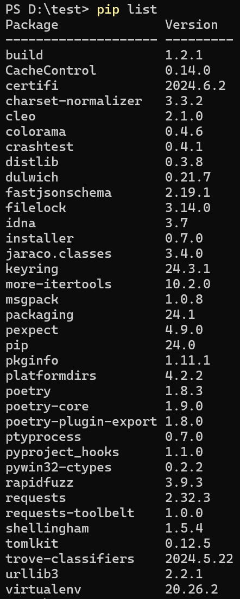
3. install
what
pip install poetry
tutorial
video: install

Slide 5

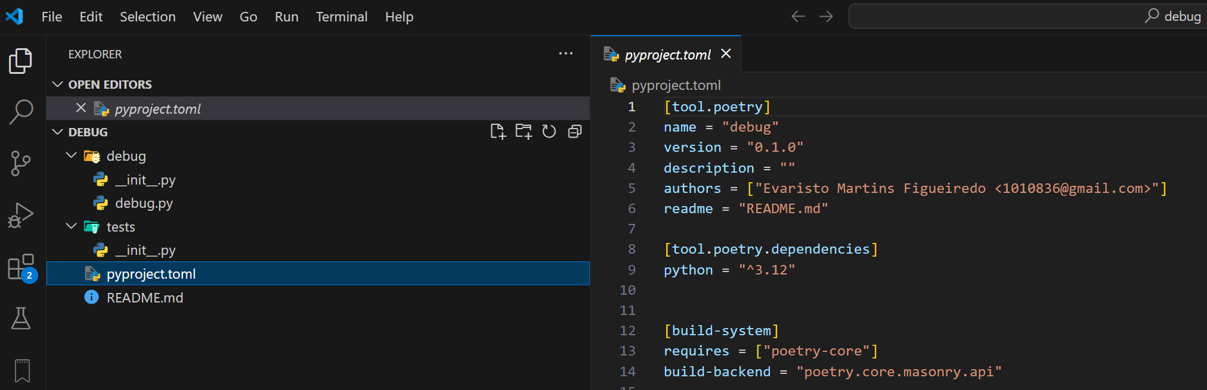
4. new
what
video: new

Slide 6
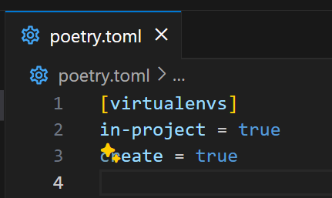
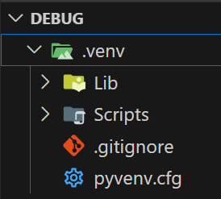
5. configure
what
configuration
virtual envs create
virtual envs in-project
poetry config virtualenvs.create true --local
poetry config virtualenvs.in-project true --local

Slide 7

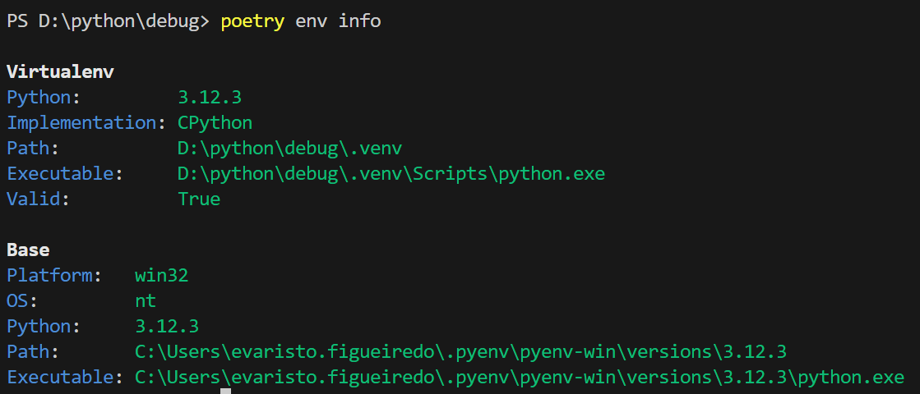
6. virtual environment
virtual environments
poetry env use C:\Users\evaristo.figueiredo\.pyenv\pyenv-win\versions\3.12.3\python.exe
poetry env list
poetry env info
poetry env remove .venv
poetry shell
exit

Slide 8
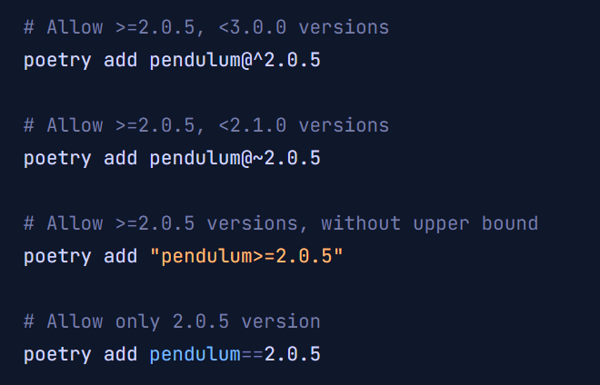
7. add
what
poetry add –D mypy
poetry add requests pendulum
video: add development
documentation: add
Repositories | Documentation | Poetry - Python dependency management and packaging made easy (python-poetry.org)

Slide 9
8. remove
what
poetry remove pendulum
documentation: remove

Slide 10
8. show
what
poetry show --tree
documentation: show

Slide 11
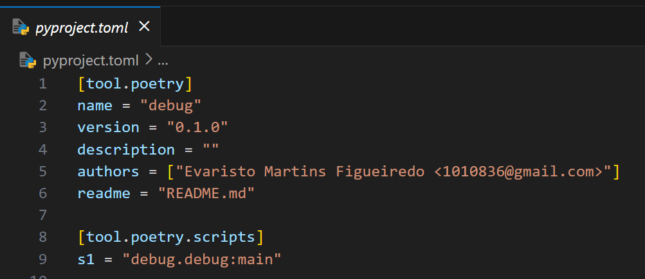
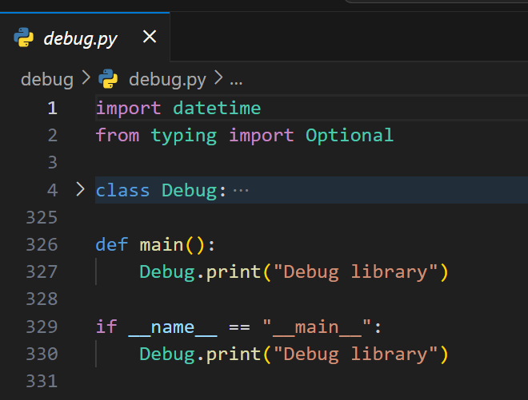
8. scripts
what
[tool.poetry.scripts]
debug = 'skunk_debug.debug:main'
scripts

Slide 12
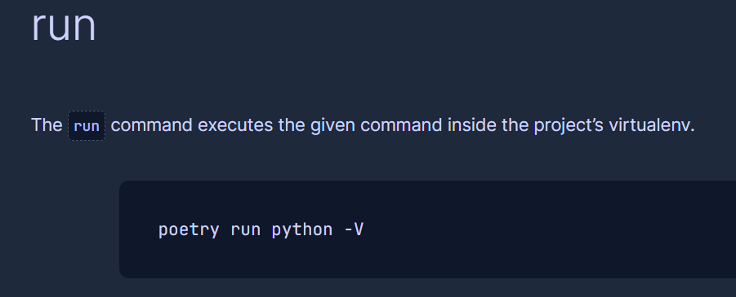
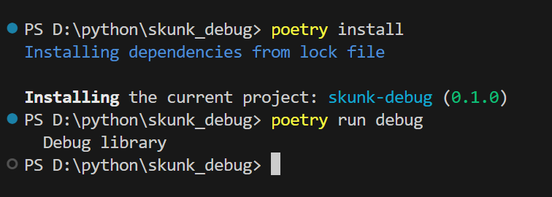
9. run
what
run
poetry install
poetry run debug

Slide 13
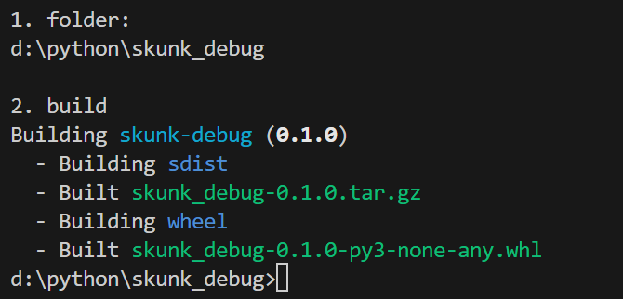
10. build
video: build
poetry build

Slide 14
11. publish
to do see project
in vsCode
skunk_debug

Slide 15
12. vsCode
what
vsCode poetry
same as venv

Slide 16
13. folders
cache
C:\Users\evaristo.figueiredo\AppData\Local\pypoetry
global config
C:\Users\evaristo.figueiredo\AppData\Roaming\pypoetry
program
C:\Users\evaristo.figueiredo\.pyenv\pyenv-win\shims

Slide 17
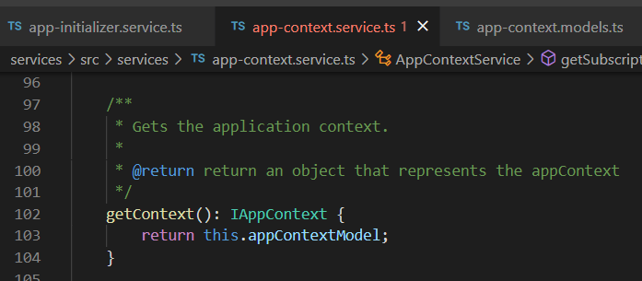



Z. template
new project
ExecuteAsync
square post-it
download
exe
download
exe
why
A slash
followed
by
two consecutive asterisks
D:\A1_research\C2_c0dice\B1_jmeter\A1_install
functionalities
introduction
build-exe
entity framework plus
zig help
⊂
4
every key-frame
defines the operation
success

