Slide 1

1. packages
structure
python

Slide 2


1.1 sources
main_vs_init.pdf
Intermediate Python Tutorial: How to Use the __init__.py File (youtube.com)
The initialization of the sys.path module search path — Python 3.12.4 documentation

Slide 3
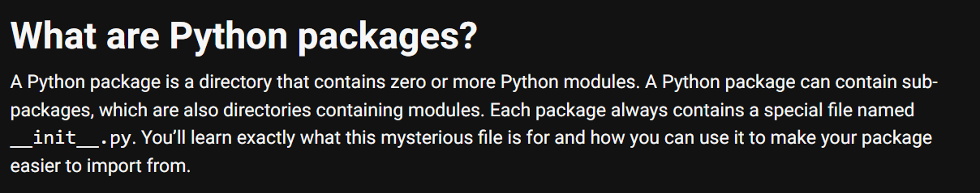

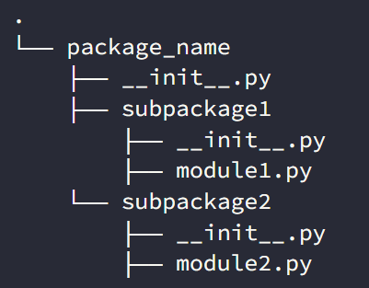
2. what
what
python-packages

Slide 4
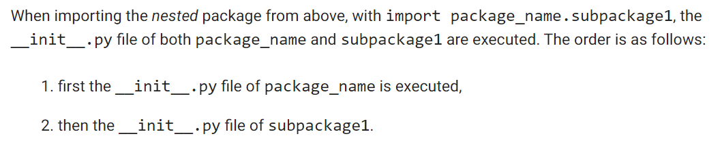
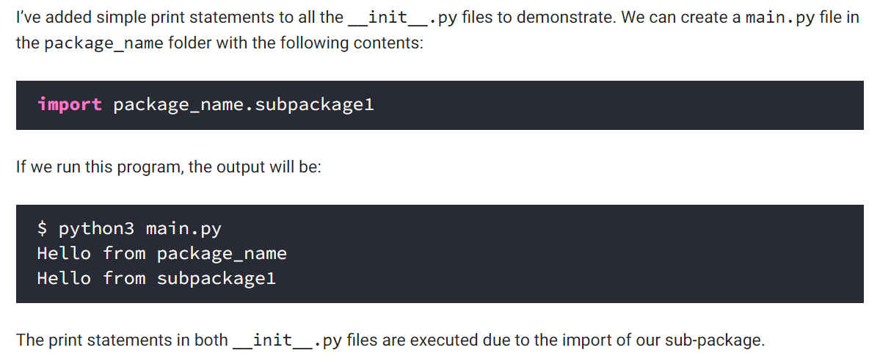
3. __init__
what
used when
import
init
example

Slide 5
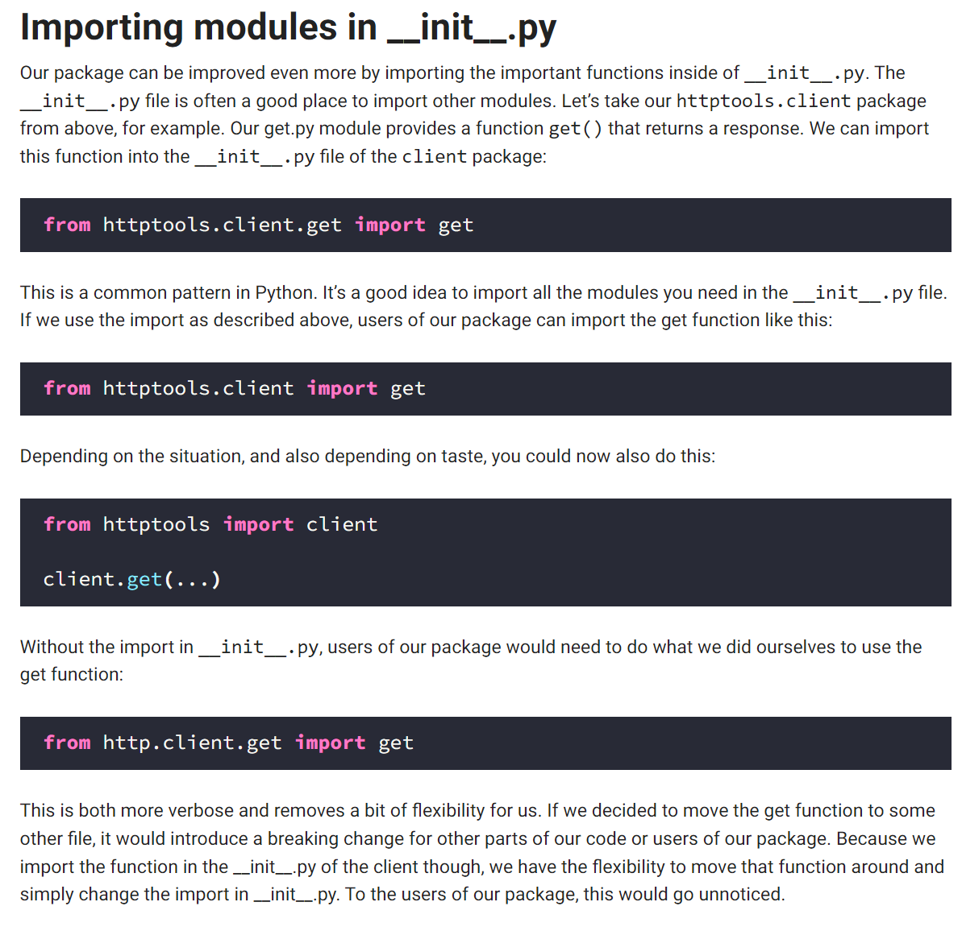
3.1 importing
what
Importing modules in __init__.py

Slide 6
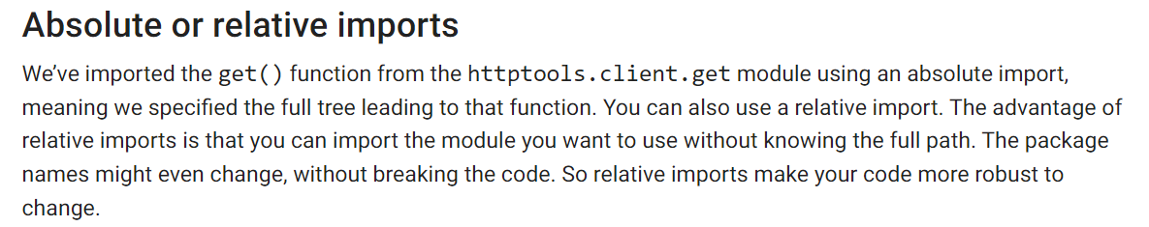
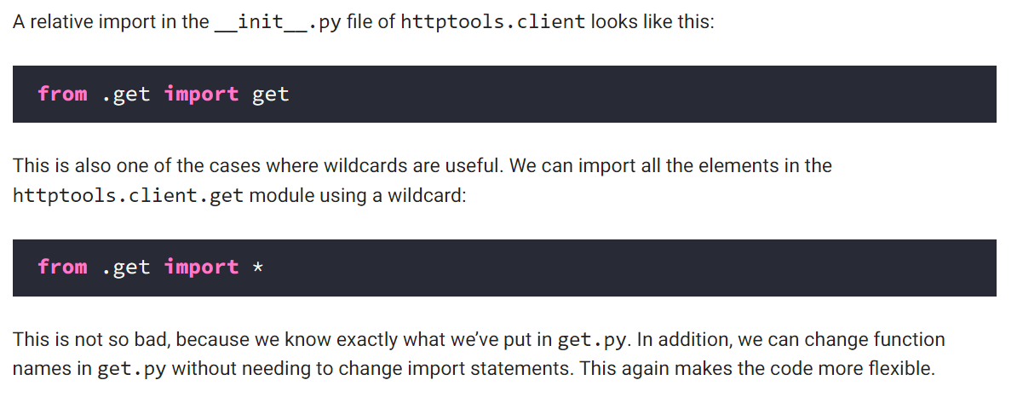
3.2 path
what
absolute and relative paths
relative

Slide 7
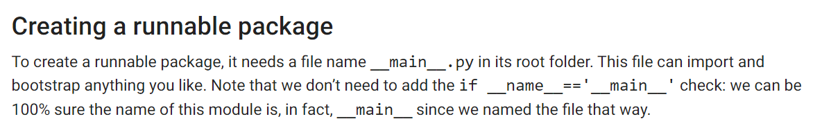
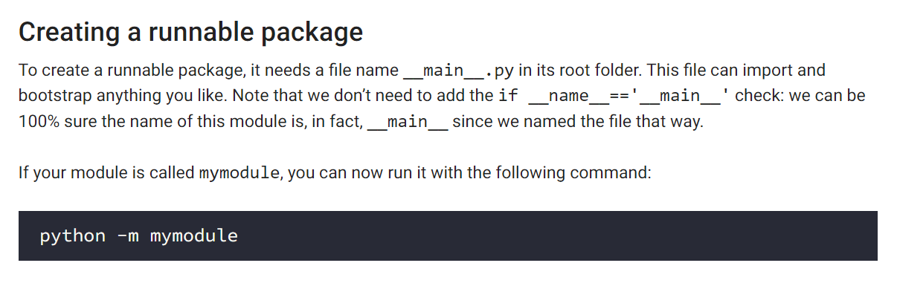
4. __main__
what
main
used when
execute
relative

Slide 8
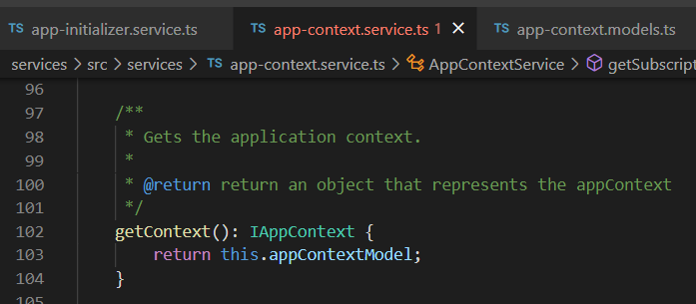

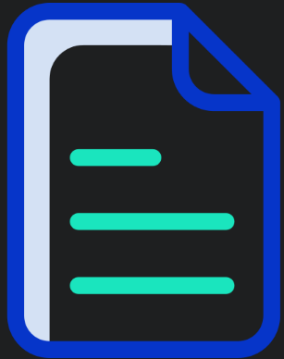

Z. template
new project
ExecuteAsync
square post-it
download
exe
download
exe
why
A slash
followed
by
two consecutive asterisks
D:\A1_research\C2_c0dice\B1_jmeter\A1_install
functionalities
introduction
build-exe
entity framework plus
zig help
⊂
4
every key-frame
defines the operation
success

