Slide 1

1. pyenv
python
environment

Slide 2

2. what
what
can manage
which Python
to use
in
current session,
globally,
per-project basis
pyenv
will make
the python command
point to
whichever
Python
is specified
none of these
overrides
the
default system Python
for
other applications
is safe to use
them
however
they work best
within
a Python
environment
tutorial: pyenv
video: environments

Slide 3
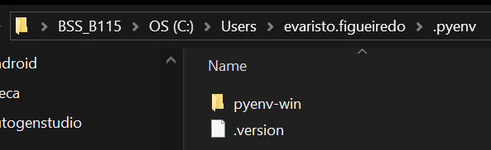
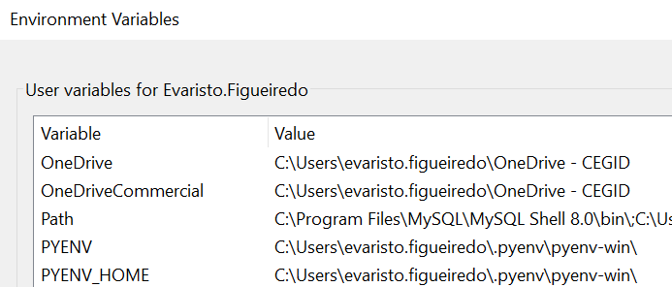


3. download
what
path
C:\Users\evaristo.figueiredo\.pyenv
site: tutorial
github/pyenv-win
video: install

Slide 4
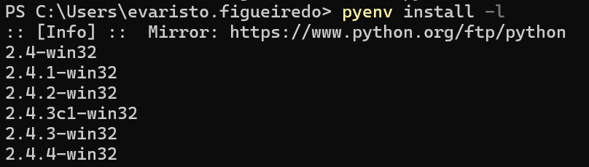

4. available
what
pyenv install -l
list
all available
python versions
to install
video: list available

Slide 5
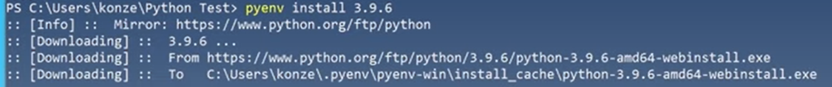
5. install
what
pyenv install 3.12.3
video: install

Slide 6
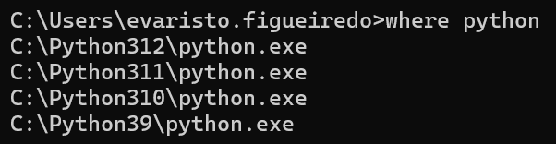

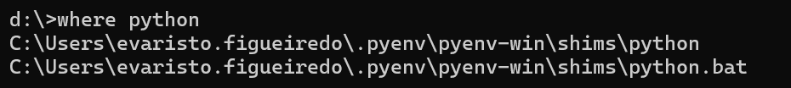
6. installed
what
pyenv versions
video: list installed
I remove all

Slide 7
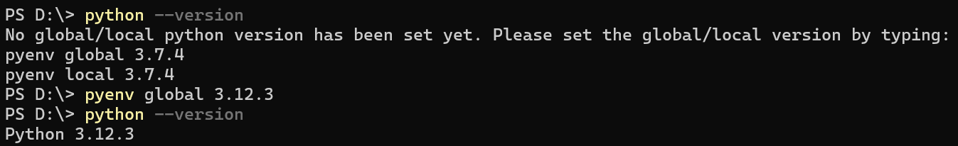
7. shell
what
pyenv global 3.12.3
video: shell

Slide 8
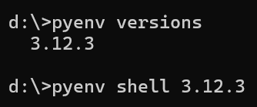
8. global
what
pyenv global 3.12.3
video: global

Slide 9
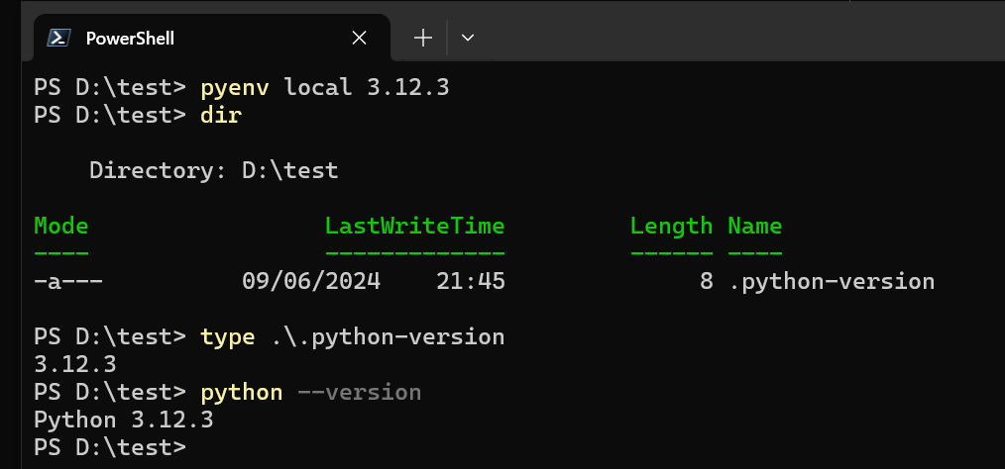
8. local
what
pyenv local 3.12.3
video: local

Slide 10
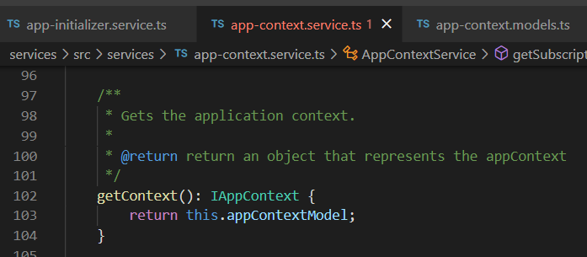



Z. template
new project
ExecuteAsync
square post-it
download
exe
download
exe
why
A slash
followed
by
two consecutive asterisks
D:\A1_research\C2_c0dice\B1_jmeter\A1_install
functionalities
introduction
build-exe
entity framework plus
zig help
⊂
4
every key-frame
defines the operation
success

