Slide 1

1. scopes
python
structure

Slide 2

1.1 sources
video
python scopes

Slide 3
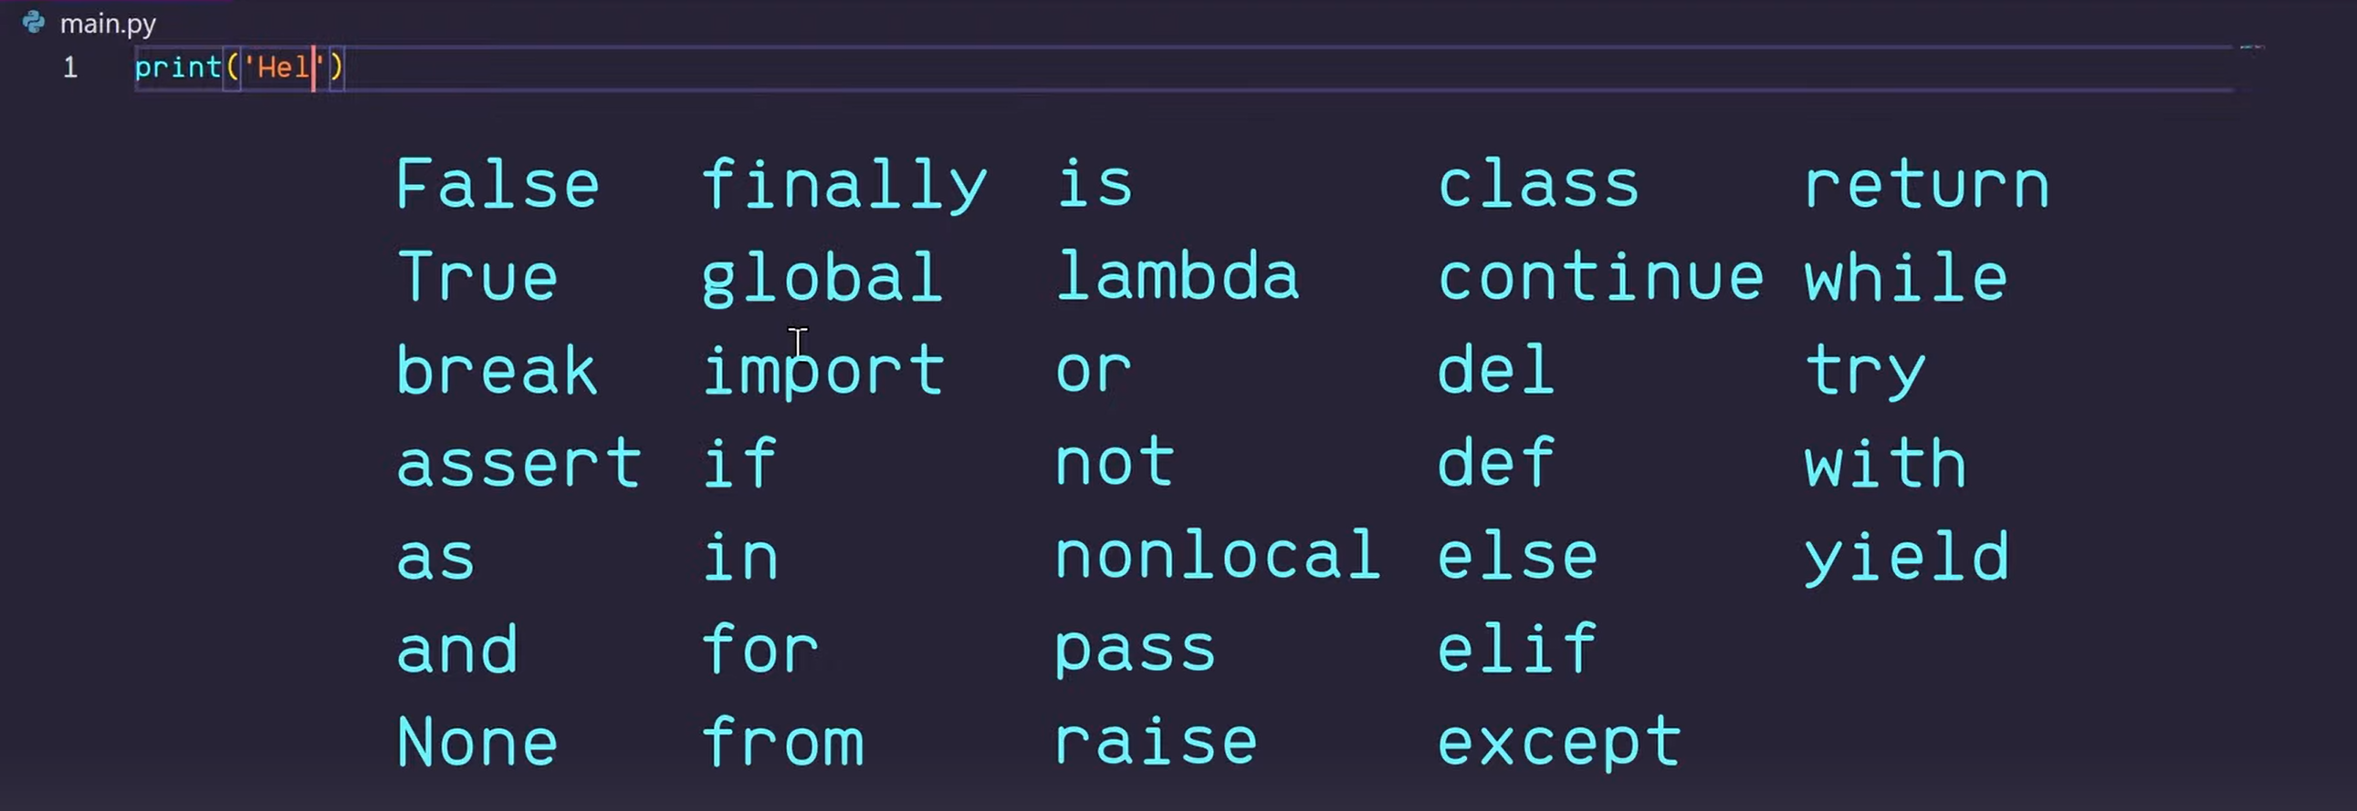
2. build in
what
build in

Slide 4
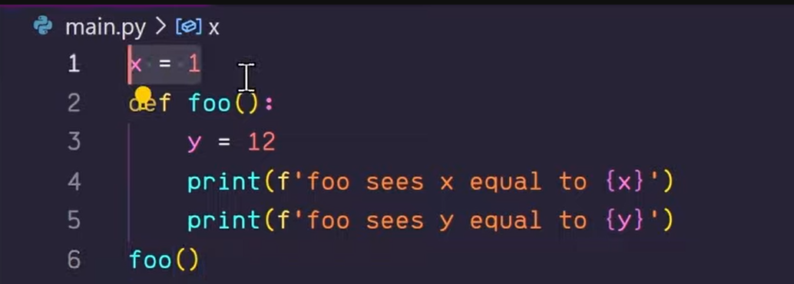
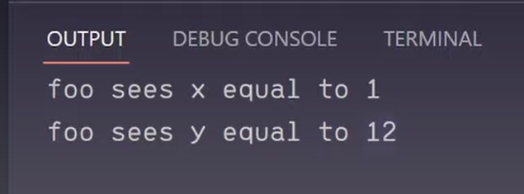
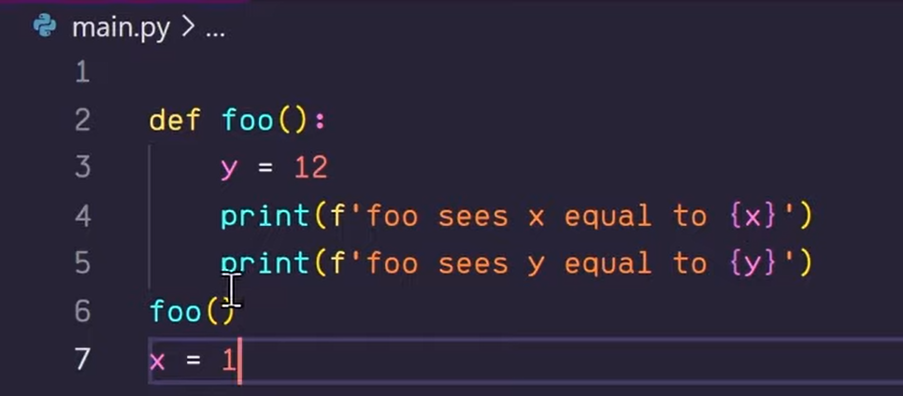
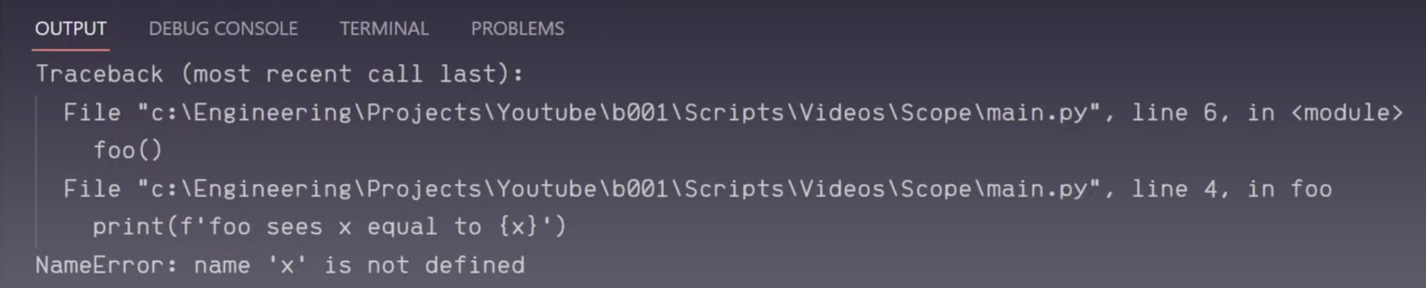
3. global
what
global
time dimension

Slide 5
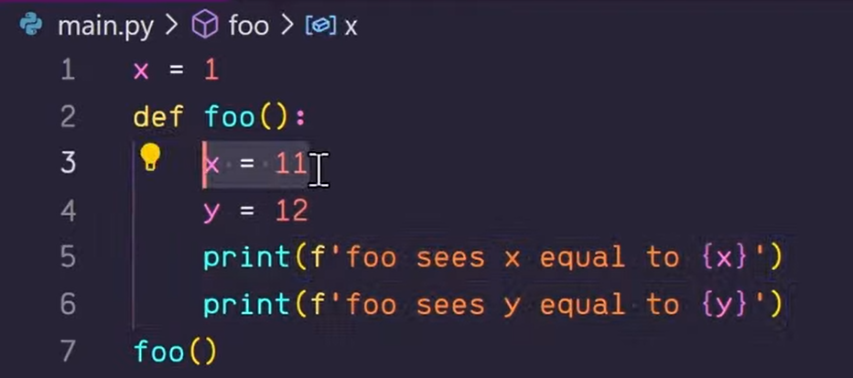
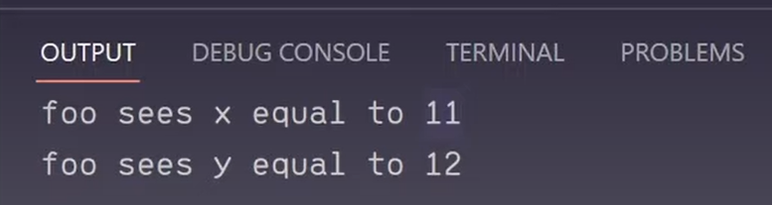
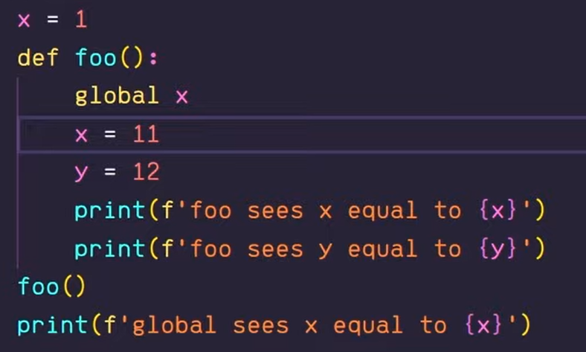
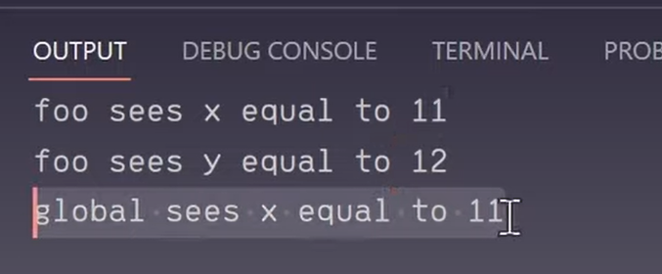
4. local
what
local
local to global

Slide 6
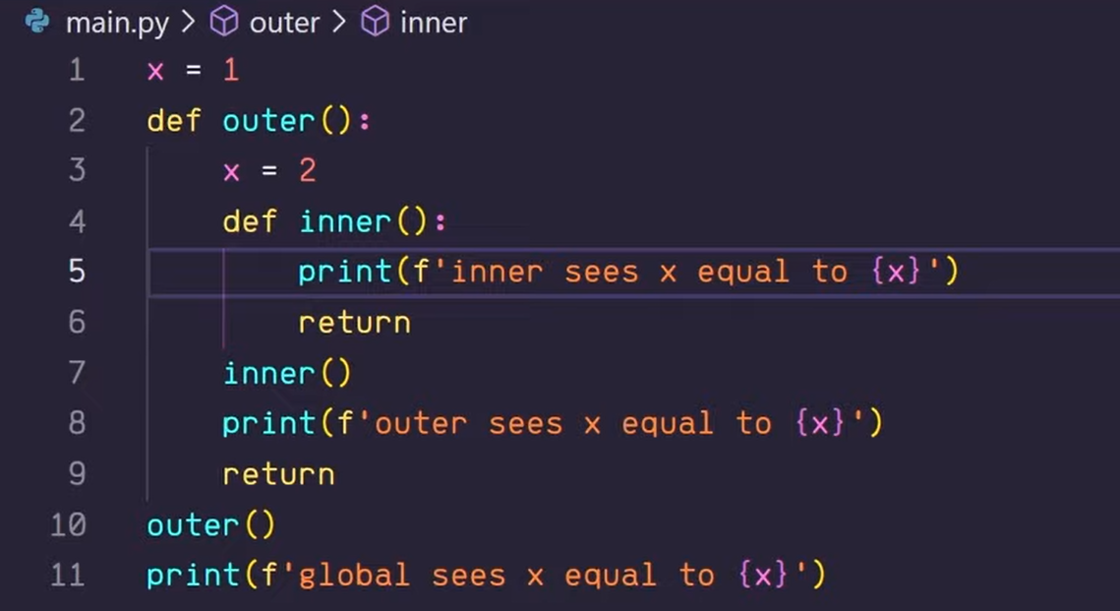
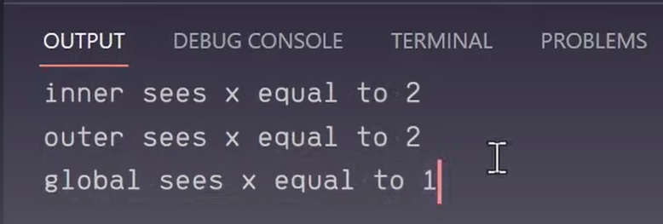
4.1 hierarchy
what
hierarchy

Slide 7
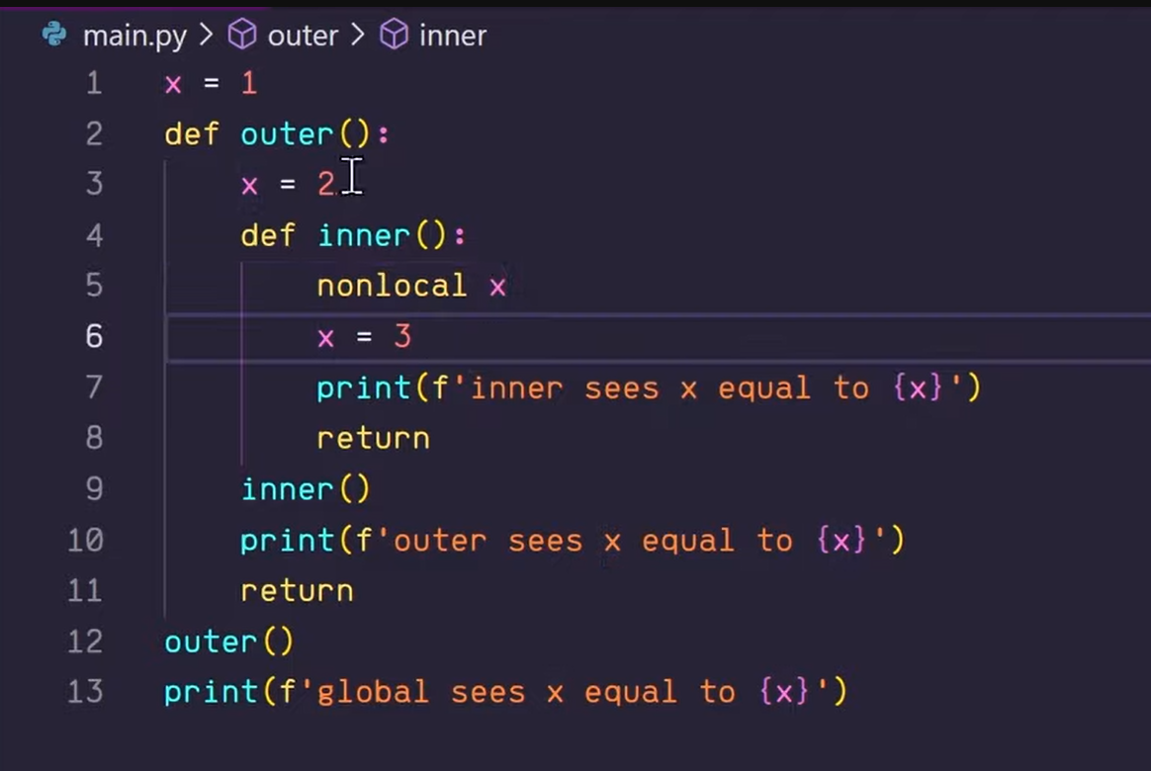
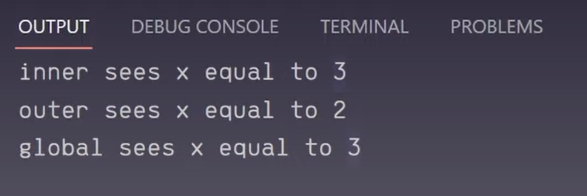
4.1.1 non local
what
non local

Slide 8
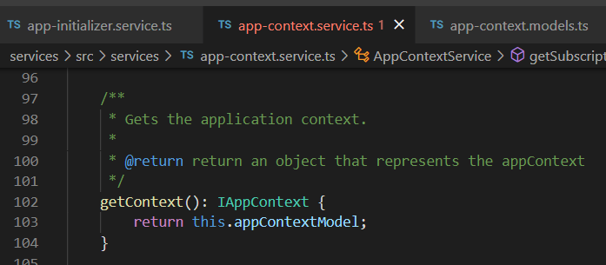




Z. template
new project
ExecuteAsync
square post-it
download
exe
download
exe
why
A slash
followed
by
two consecutive asterisks
D:\A1_research\C2_c0dice\B1_jmeter\A1_install
functionalities
introduction
build-exe
entity framework plus
zig help
⊂
4
every key-frame
defines the operation
success

